Slide 1
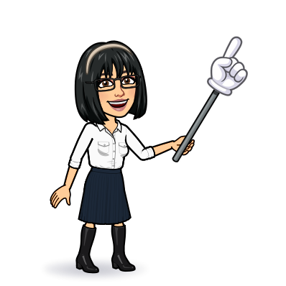
4 listening 5 pronunciation 6 conversation 7 about you
Today:
Date:
- -1445
Page 37-38
By: Dalal Al-Juaid

Slide 2
answer questions after a listening task
answer questions from the conversation
Warm up
ask different questions about family
practice the conversation about family with a partner

Slide 3
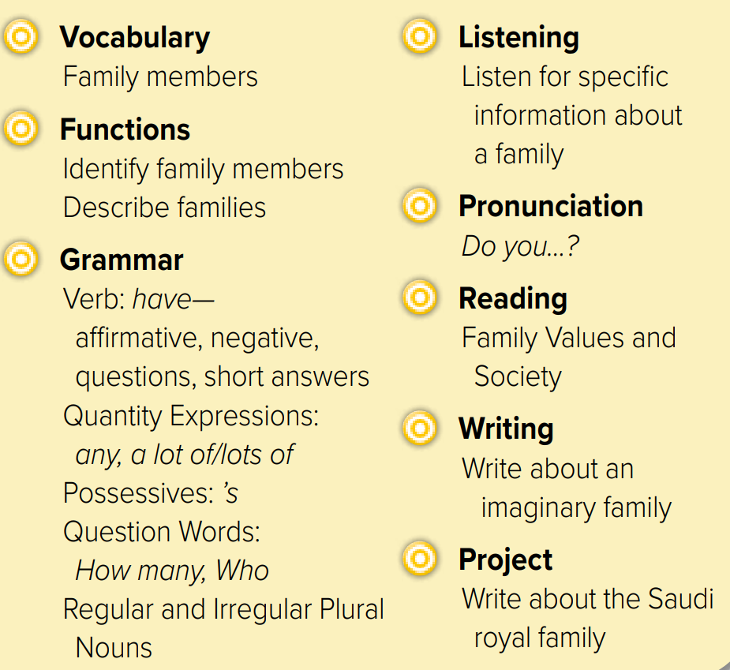

Slide 4
Revision
half & half
husband
#
#
aunt

Slide 5
I don’t have a lot of sisters
Do you have any cousins?
She is Dalals’ sister
Who brothers do you have?
He has 3 uncles
You has an aunt
How many aunts do you have?
Hams don’t have sisters.

Slide 6
Page 37
She has ………..
three
two
Warm up
seven
seven
Twenty-one

Slide 7
Do you …………?
Warm up

Slide 8
Who comes from a big family?
Page 38
scanning
Warm up
What is the opposite of married?
What is the son of your sister called?

Slide 9
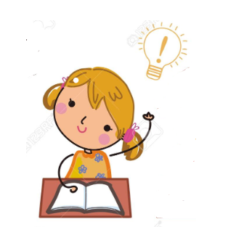
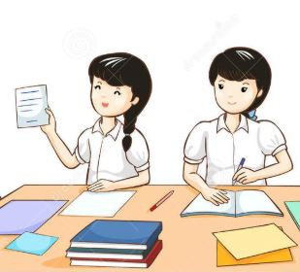
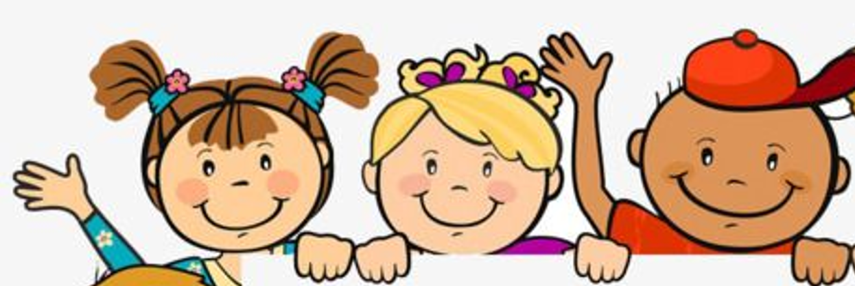
Think pair share
4 sisters – no brothers
3 of her sisters are single
Yes , she is
She is an only child
No, she doesn’t

Slide 10
Find them
Warm up

Slide 11
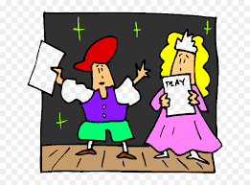
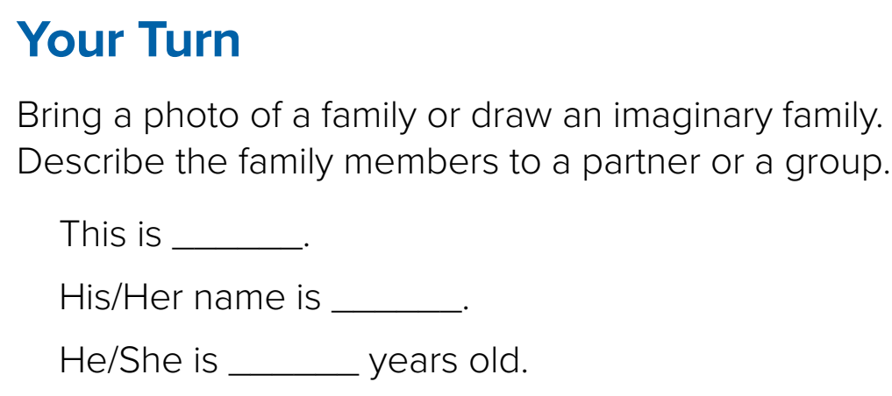
Role paly
Warm up
1-Listen
New words
Quick check

Slide 12
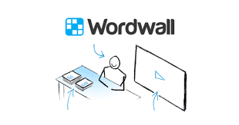
Lets play
Warm up

Slide 13
Warm up

Slide 14
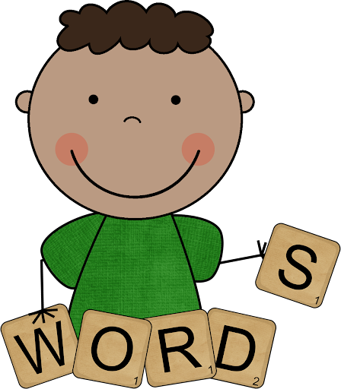
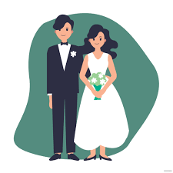
Big family
New Words
A lot of sisters and brothers
Only child
No sisters or brothers
married
#
single
Not married
nephew
#
niece
Sister’s son
Sister’s daughter
Brother’s son
Brother’s daughter

Slide 15
page 204 Ex(G)
for practice grammar
Warm up

Slide 16
p.204
How many sisters does he have
Who is Khaled’s mother
Warm up
Who is Khaled’s aunt
How many children do they have
Who are Khaled’s grandparents

