Slide 1






8 reading
Today:
Date:
- -1445
Page 39
By: Dalal Al-Juaid

Slide 2


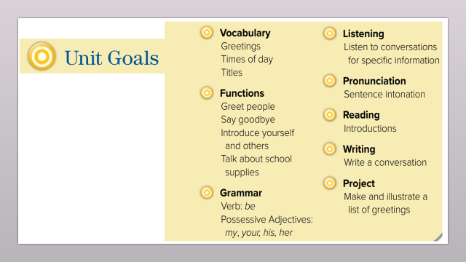
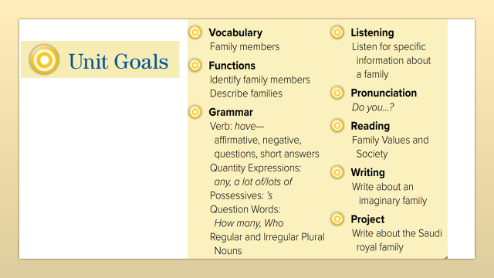
read about royal families
answer questions from the reading passage
Warm up
find the meaning of the new words

Slide 3
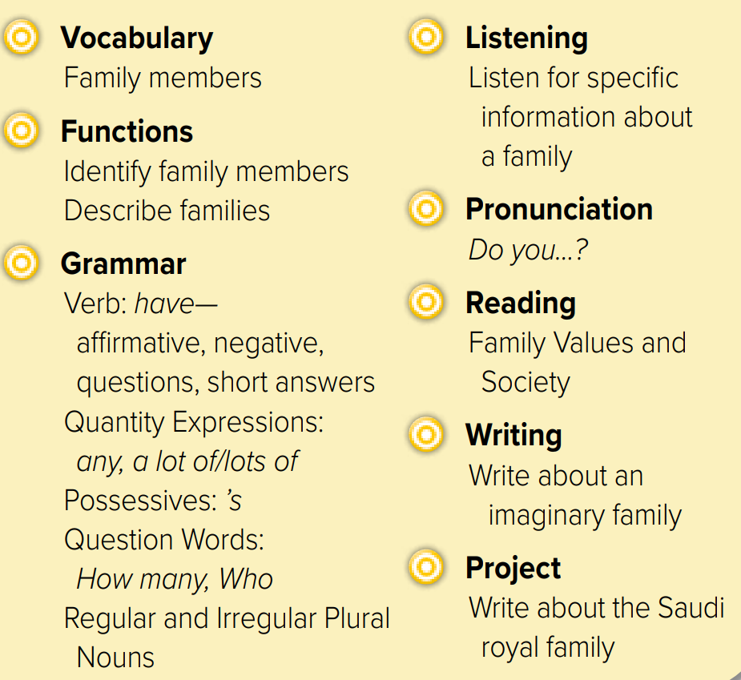
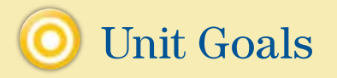

Slide 4

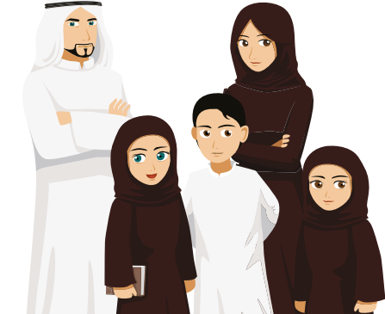





Revision
half & half
nephew
#
#
aunt

Slide 5




Slide 6



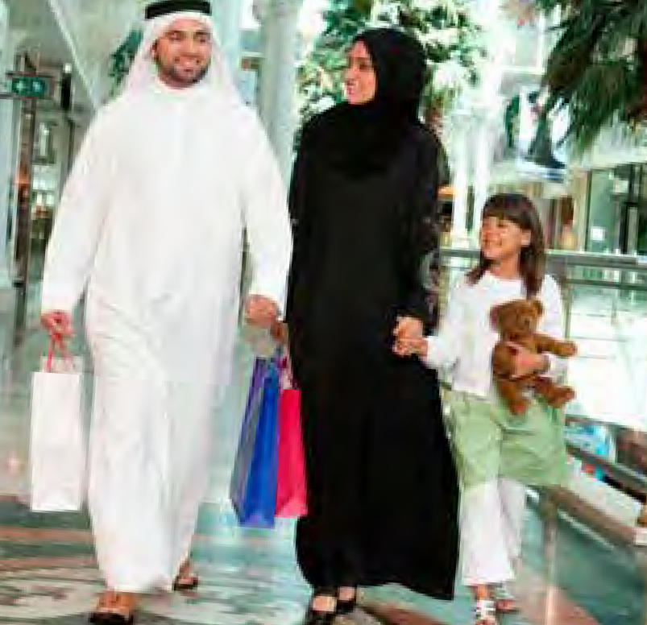
Why family is important in Saudi vision 2030?
Warm up

Slide 7

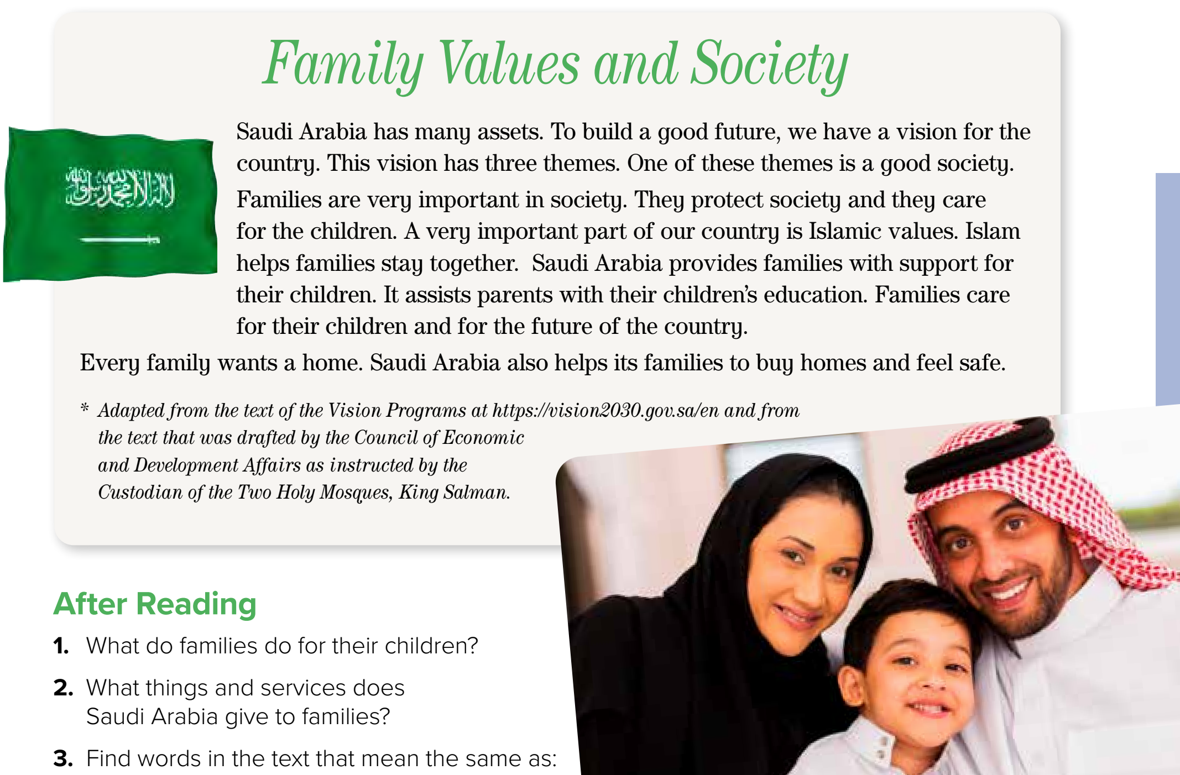






Listen
How many themes does the vision have?
Page 39
scanning
Warm up
What does every family want?

Slide 8

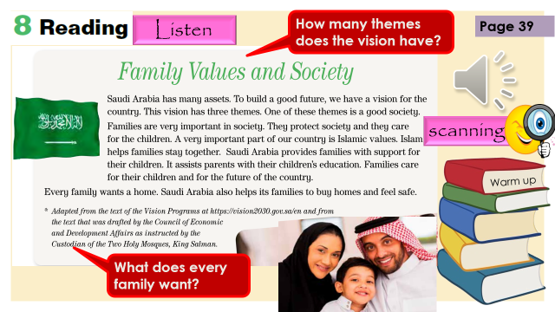
New Words
Work with a friend
Find them in the text
Warm up

Slide 9

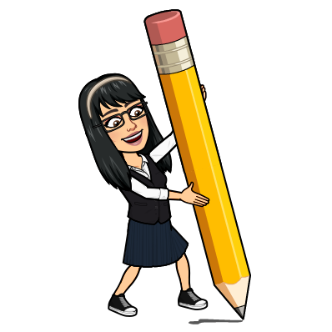
assets
New Words
Advantages – good things
themes
Topics – main ideas
vision
Dream - goal
support
help
society
People - families
education
school
قيم
values
Good manners

Slide 10

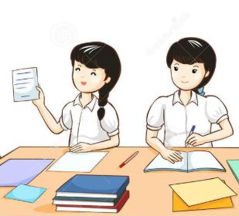
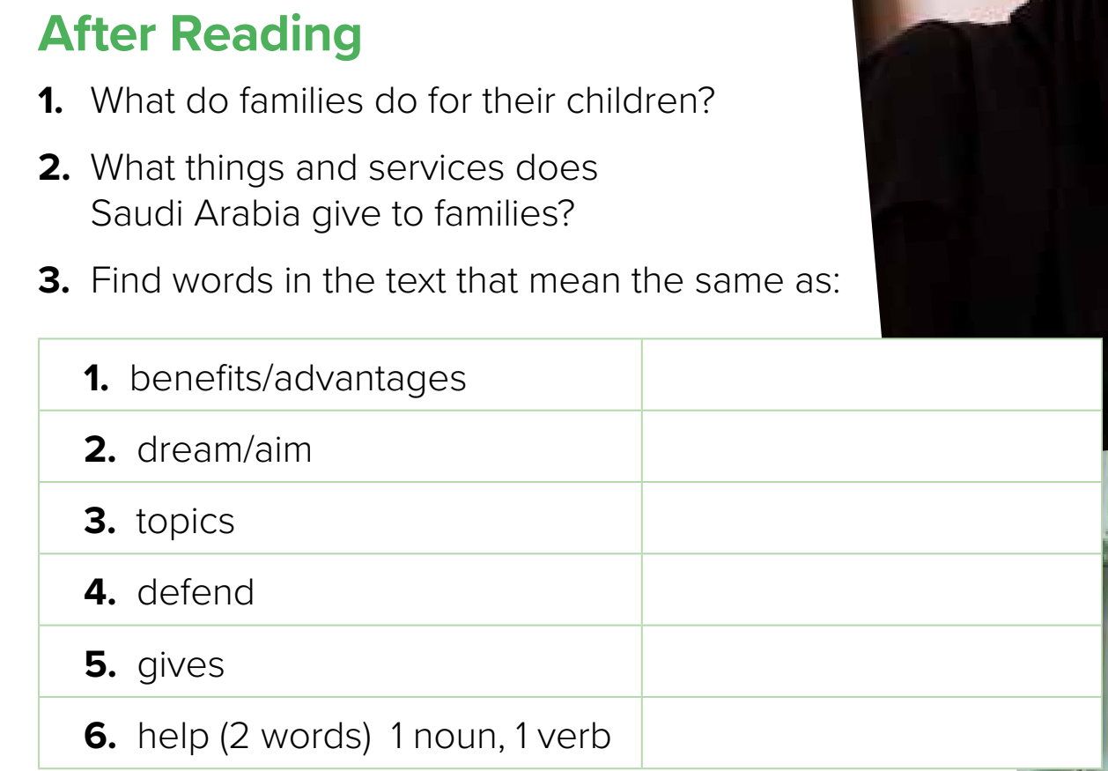


Families care for their children and for the future of the country
Think pair share
support for their children; assistance for their children’s education; help to buy homes; help to feel safe.
Good things
assets
Want to make
vision
Main ideas to talk about
themes
Make safe
protect
provide
Give something
support (n)
assist (v)

Slide 11



Lets play
Warm up

Slide 12




Warm up
Do you love your country? Why?

Slide 13





page 205 Ex(H)
for practice reading
Warm up

Slide 14
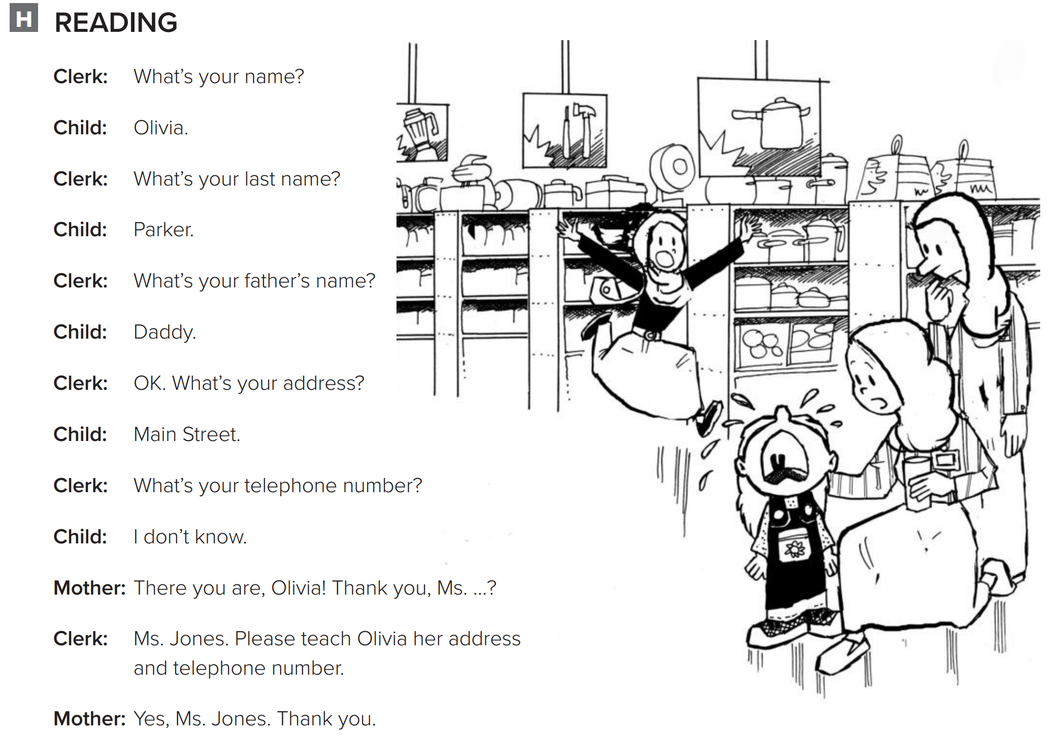
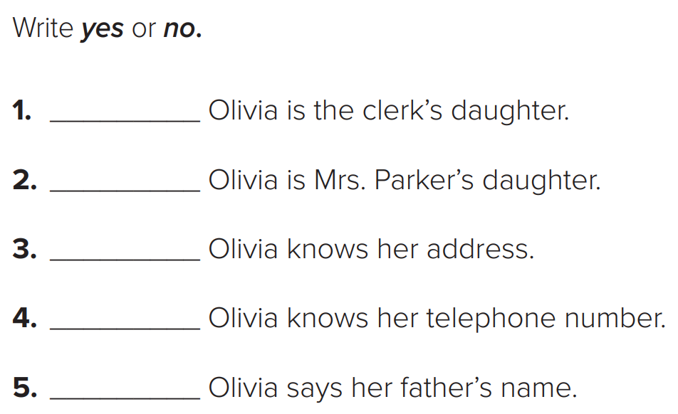
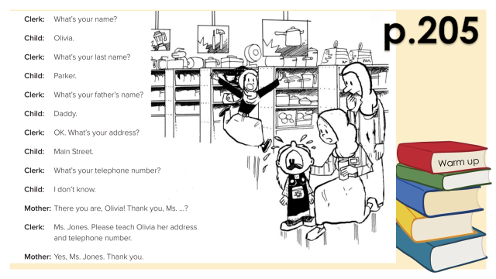
p.205
No
Yes
Warm up
No
No
Yes

Slide 15
p.205
Warm up

