Slide 1
Families, Families
Reading

Slide 2
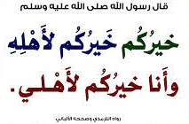

Slide 3
Read the passage correctly.
Answer the questions from the reading passage.

Slide 5
What do you do, to be a good member of your family?

Slide 6
@ page 39

Slide 8
READING STRATEGY
Paired reading
Put students in pairs.
read through the text together, taking turns to read out loud and help each other with pronunciation.
Ask each student to underline any unknown words and then compare these with their partner.

Slide 9
What does every family want?
Listen
How many themes does the vision have?

Slide 11
Families care for their children and for the future of the country.
2. Saudi Arabia gives families: support for their children; assistance for their children’s education; help to buy homes; help to feel safe.

Slide 12
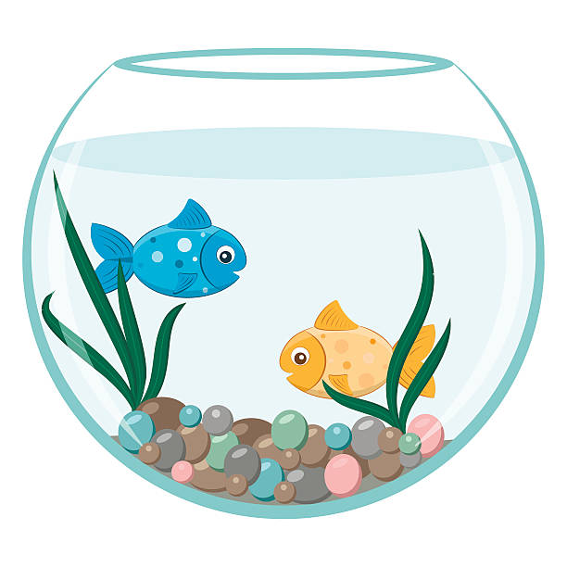
Aim means ……………
protect
Vision

Slide 13
Topics means …………..
themes
assets

Slide 14
Defend means ………..
support
Protect

Slide 15
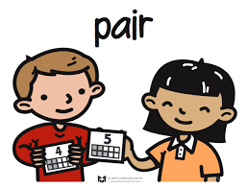
assets
vision
themes
Project
provides
support / assists

Slide 17
Family has no values on society
true
false

Slide 18
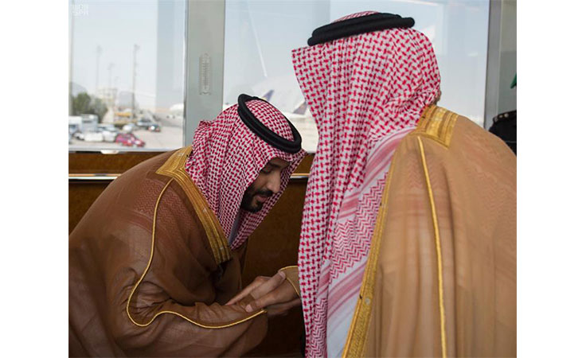
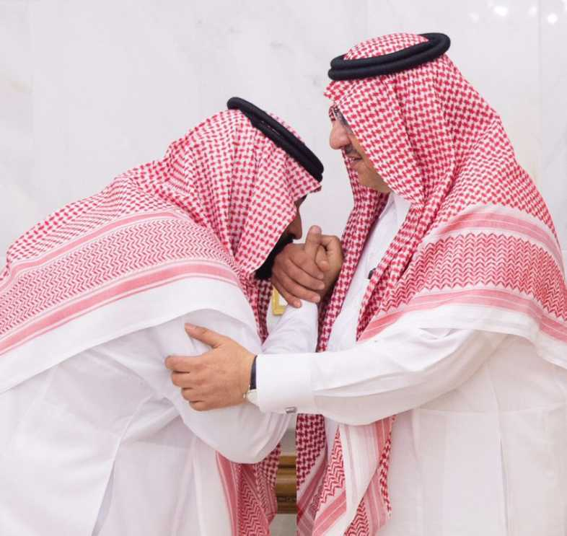
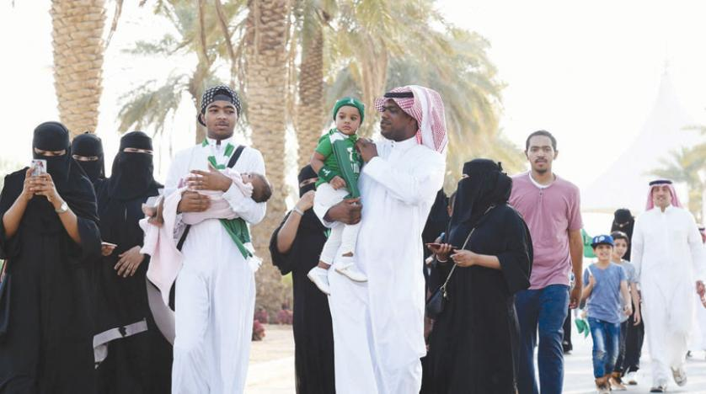
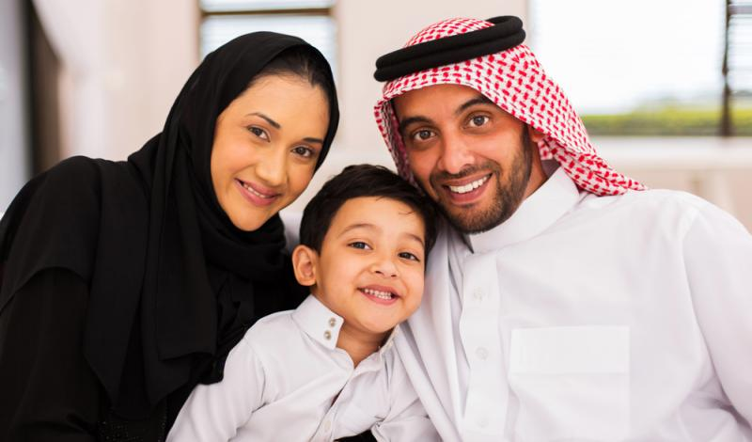
Saudi families are Muslim

Slide 20
Work
book

Slide 22
No
yes
No
No
No

Slide 23
