Slide 1

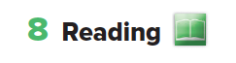
Unit 5
Page 45

Slide 2
Use the white board to write any value you think is very important to be in families.

Slide 3
What makes a good family?!
Love
Respect
Support
Sharing
Honesty
Trust

Slide 4

The Saudi Arabia vision has 3 themes
Topics

Slide 5


What are the 3 vision themes?

Slide 6
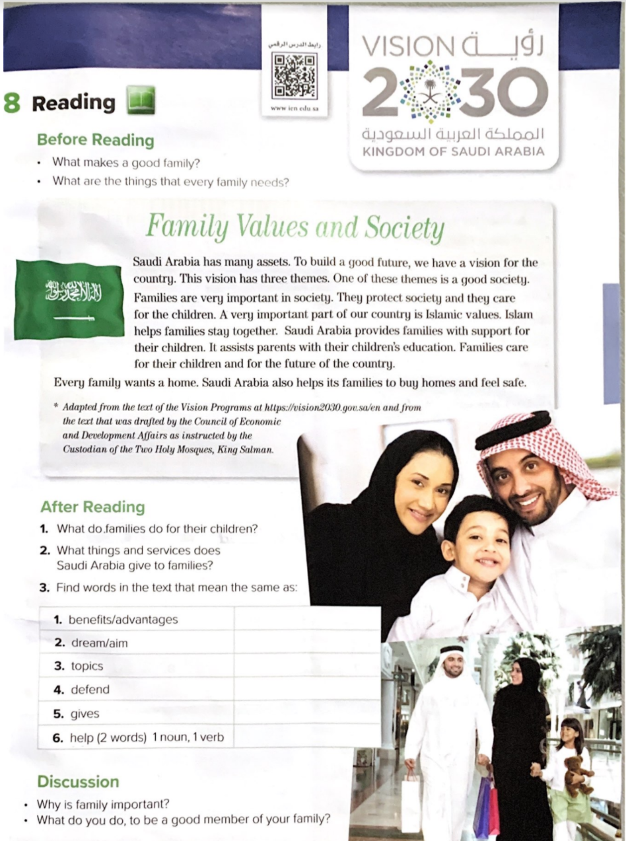
Vision
2030
Page 45

Slide 7
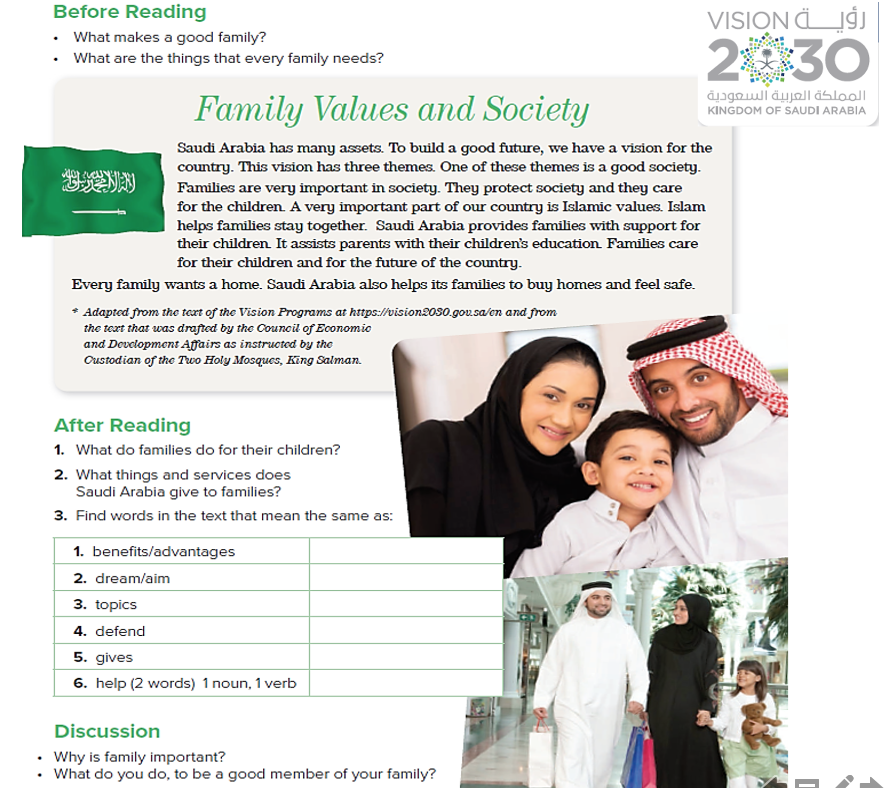
What are the lesson’s objectives?
Page 45

Slide 8
Objectives
At the end of the lesson you will be able to:
Read a passage about family values and society.
Recognize the new words.
Practice listening for specific information.
Answer questions about the passage.

Slide 9
Strategies
  Brainstorming
  Picture Reading
  Pre-While-Post
  One minute.

Slide 10
What is the title?
Page 45

Slide 11
What do you see?
Page 45

Slide 12
Page 45

Slide 13
What are the things that every family needs?
Food
Shelter
Clothes
Education
Health
services
Security

Slide 14
Do you have all these needs in Saudi Arabia?

Slide 15
What is your job toward all these blessings?
يتمتّع العبد الشكور بزيادة الرزق والنِعم عليه، فالشكر سبب لزيادة النعم.

Slide 16

It’s time to read

Slide 17
Read the passage
Page 45

Slide 18
Difficult words:

Slide 19

3 themes.
Read the text and answer the following questions:
How many themes does Saudi Arabia vision have?
Which vision theme does the passage talk about?
What is the most important part of our country?
How does Islam help families?
A good society.
Islamic values.
Islam helps families stay together.

Slide 20
1- Families care for their children.
2- Saudi Arabia provides families with support for their children and their education.
Page 45

Slide 21
Assits
Vision
Themes
Protect
Provides
Assist(n) support(v)
Page 45

Slide 22

Page 45

Slide 23
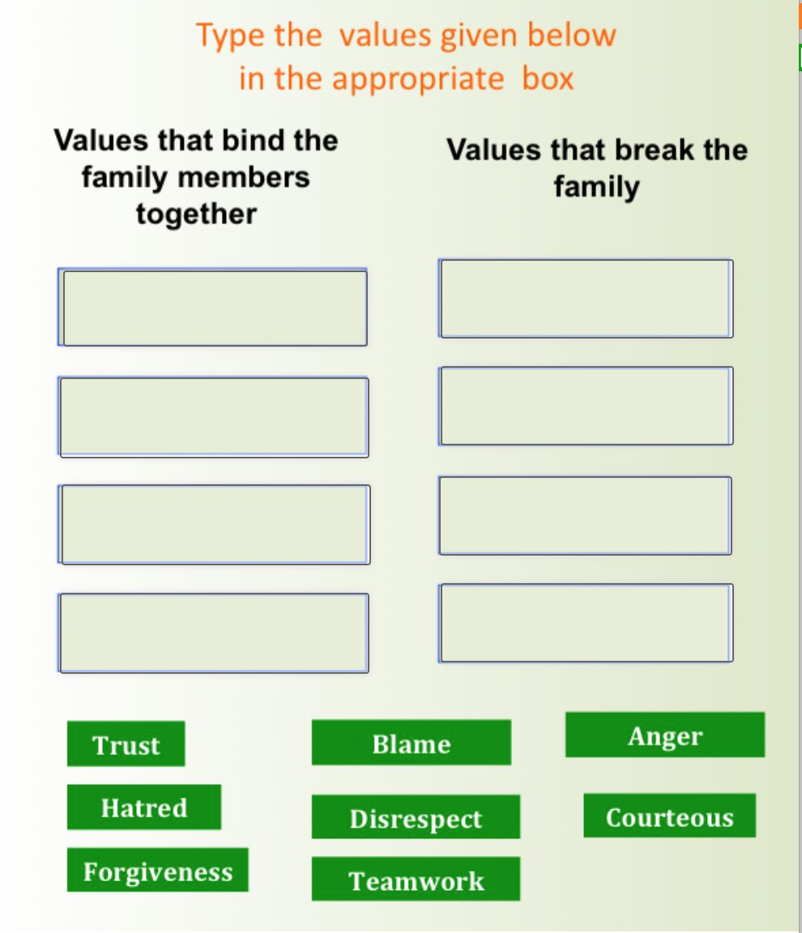
Interactive worksheet

Slide 24
Ways of Encouraging Learner Autonomy
Make a list of things that Saudi Arabia has given us as citizens.

Slide 25
THANKS!
T. Noha Aaljammaz

