Slide 1
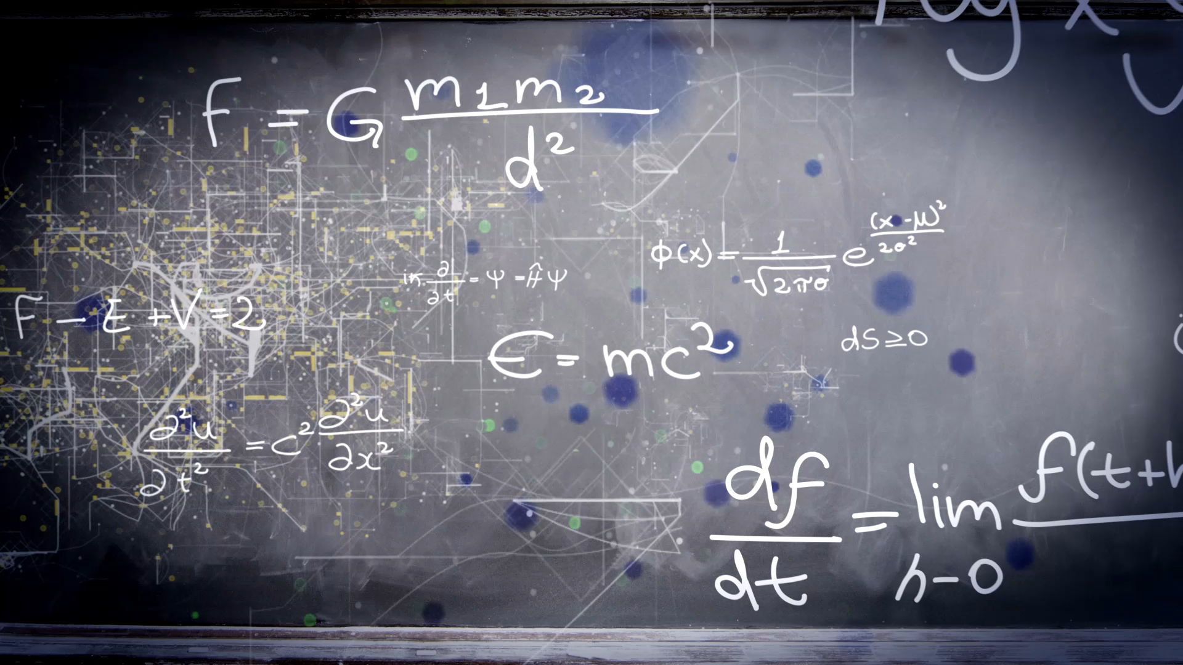
Unit 5
Families, Families
Workbook pages (203 – 206)

Slide 2
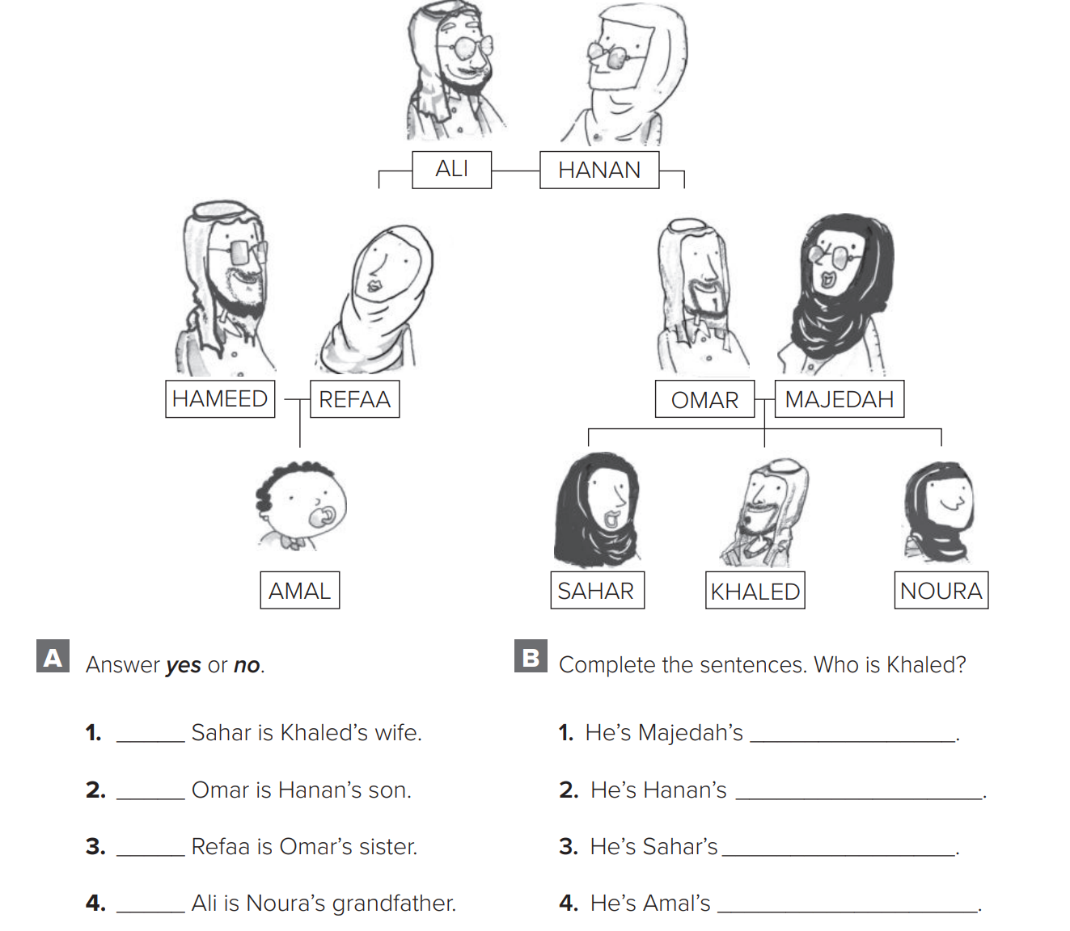

p.203
no
yes
yes
yes

Slide 3

p.203
son
grandson
brother
cousin

Slide 4
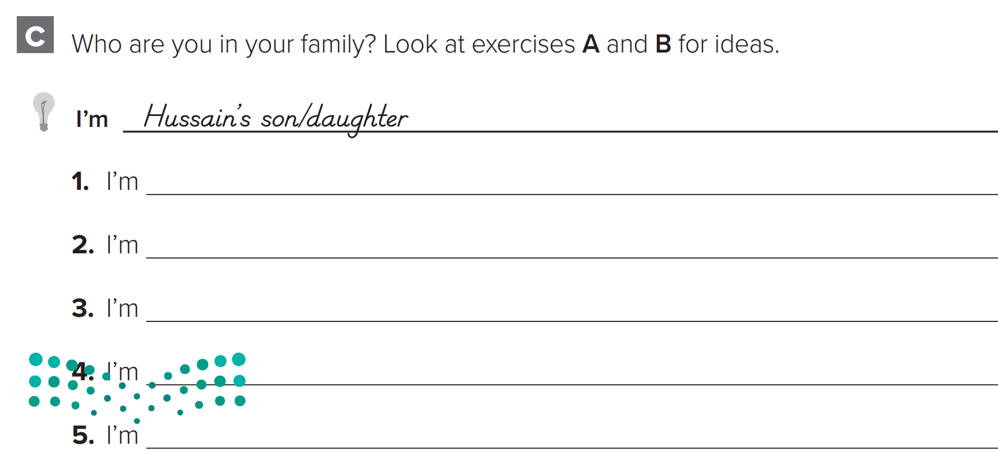

p.203
Omar’s daughter

Slide 5

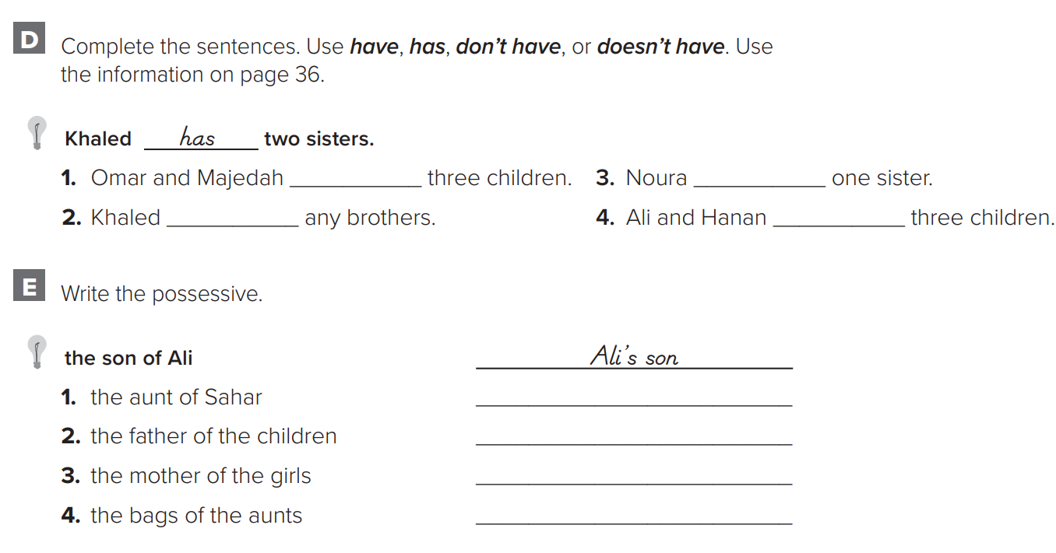
p.204
have
has
doesn’t have
don’t have
Sahar’s aunt
children’s father
girls’ father
aunts’ bags

Slide 6
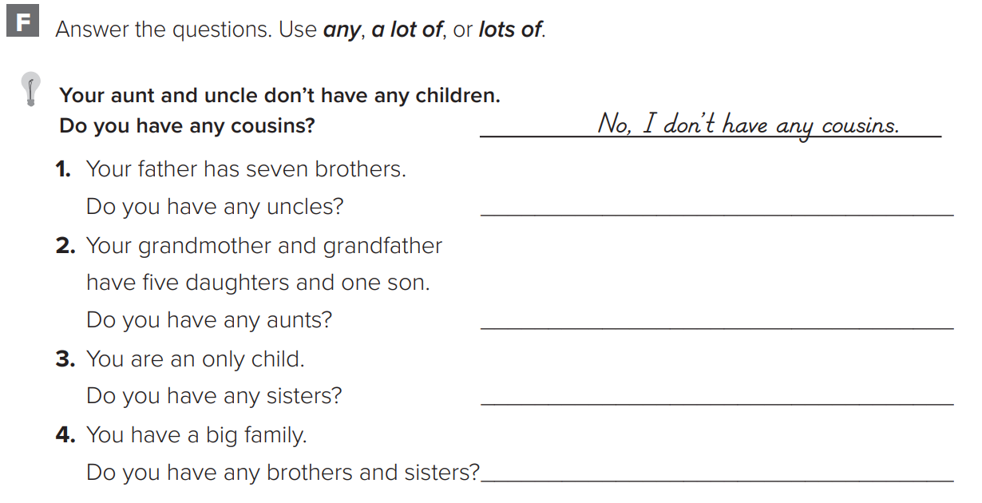

p.204
Yes, I have 7 uncles.
Yes, I have one aunt.
No, I don’t have any sisters.
Yes, I have a lot of Sisters and brothers.

Slide 7
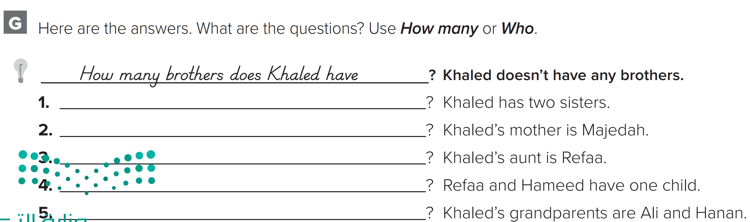
p.204
How many sisters does he have
Who is Khaled’s mother
Who is Khaled’s aunt
How many children do they have
Who are Khaled’s grandparents

Slide 8
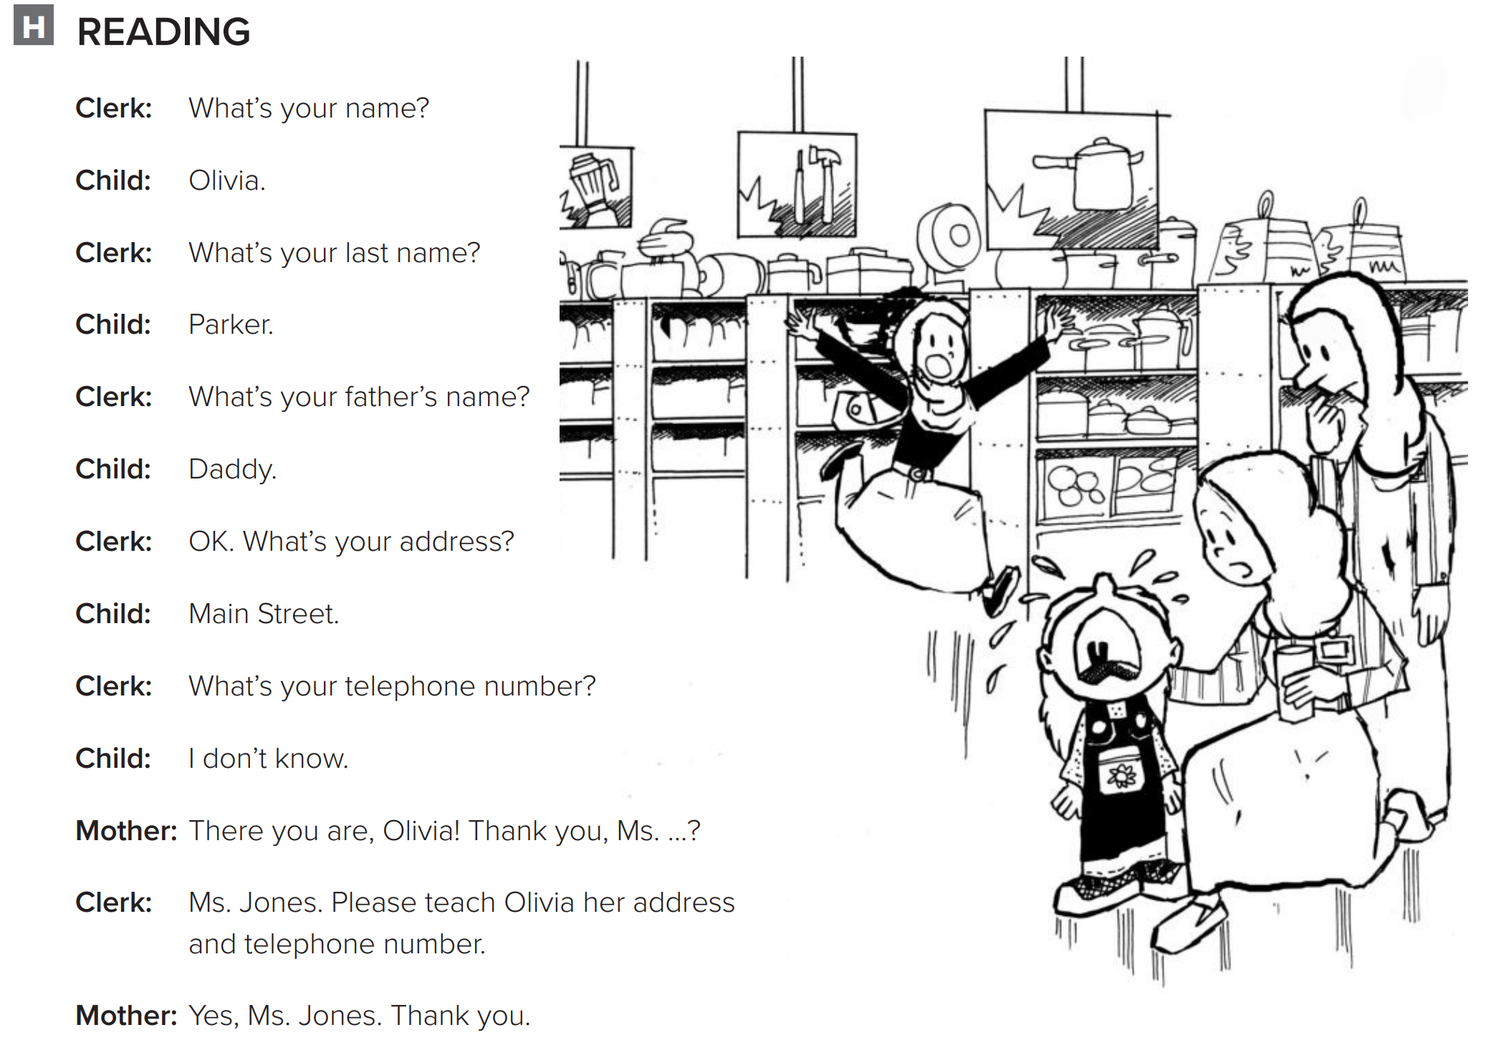

Slide 9
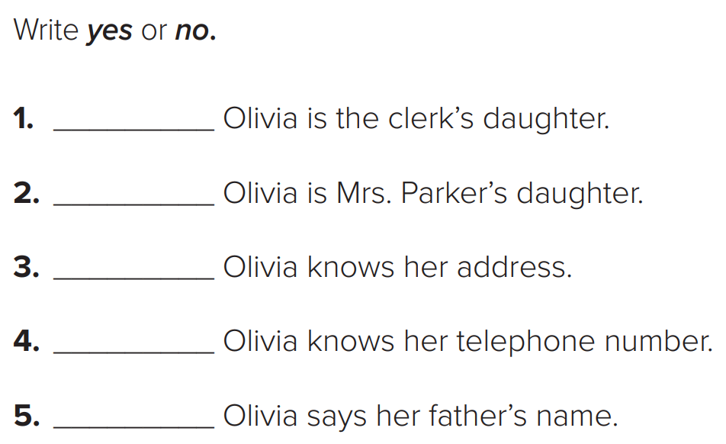

p.205
No
Yes
No
No
Yes

Slide 10
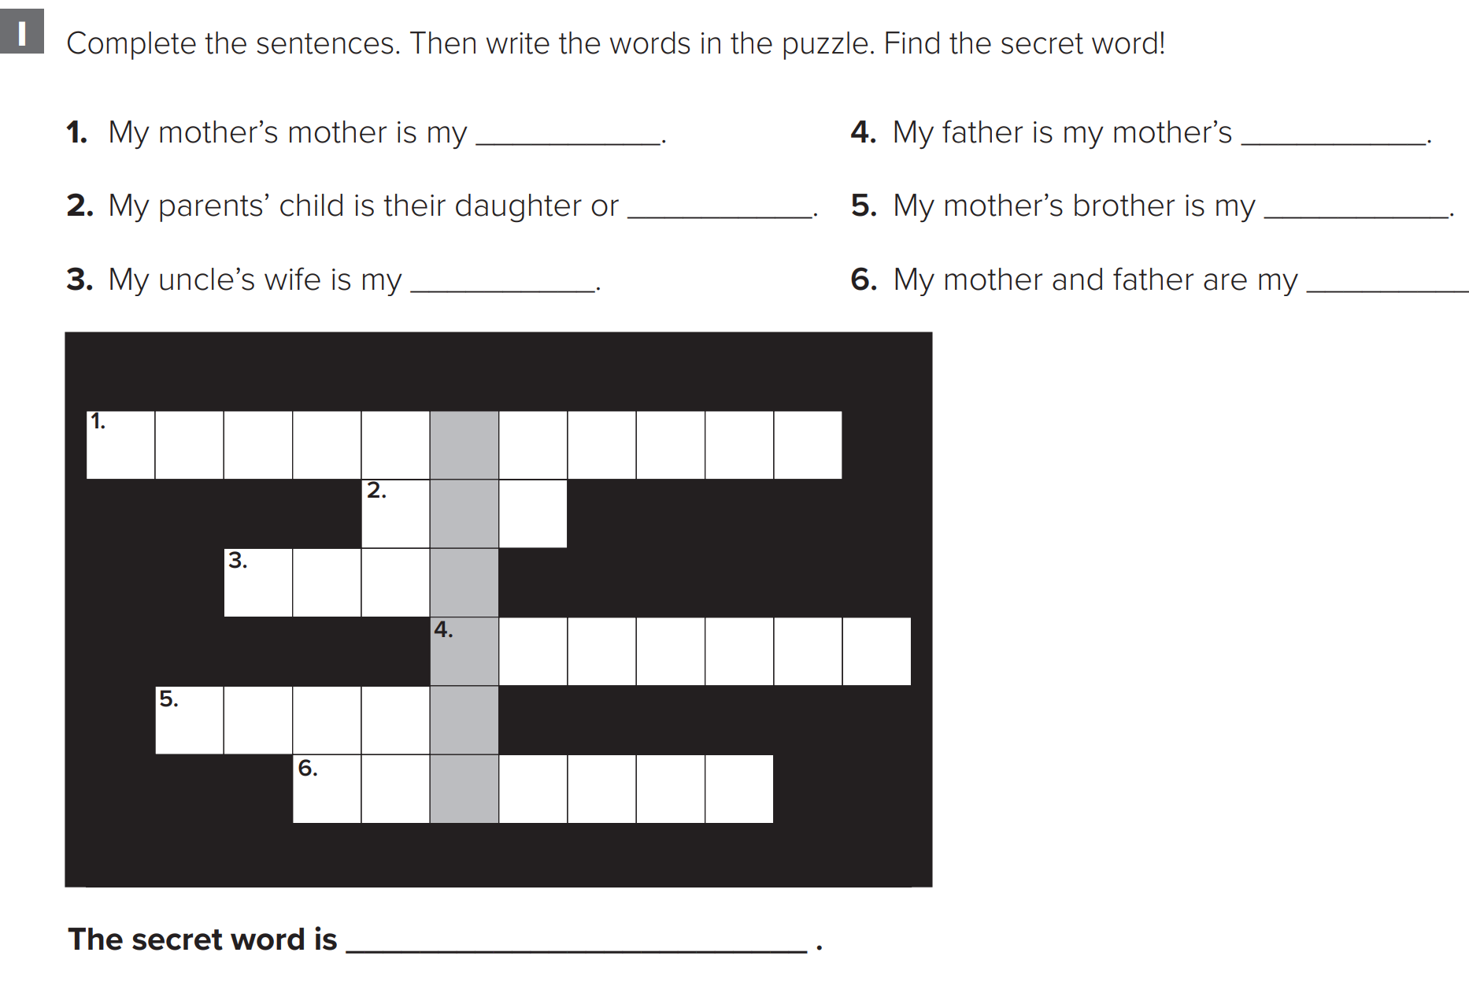
p.206
grandmother
husband
son
uncle
aunt
parents
mother

Slide 11
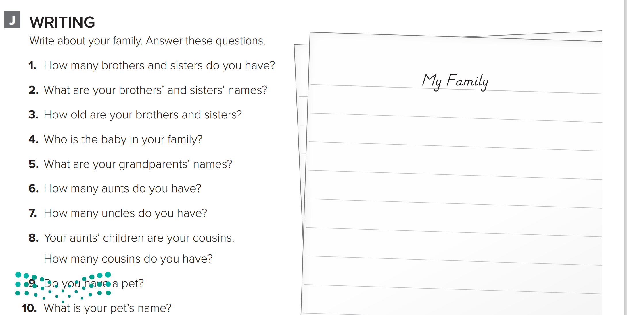
p.206
My family is big. I have one brother and two sisters. My brother’s name is Faisal. My sisters’ names are Wa’ad and Maha. Faisal is eight years old. Asma is twelve years old, and Maha is seventeen years old. Faisal is the baby in my family. My grandfathers’ names are Ali and Abdullah. My grandmothers’ names are Aisha and Noura. I have three aunts and four uncles. I have twelve cousins. I have a pet. It’s a cat. My cat’s name is Lulu.

