Slide 1
Choose
1. The robber ( arrest – arrested – was arrested – is arrested) by the police last night.
2. The criminal ( will be brought – will brought – will be bring – will bring) to the justice soon.
3. The suspect (have – were – was – will) pursued by a helicopter.
4. The child ( has be– has being– have been– has been) kidnapped.
5. The thief had escaped before the police ( had arrived – has arrived – arrived – arrive)
6. Adnan (use to watch – used to watch – used to watched – use watched ) TV every night.
7. We (were play – were playing – was playing – are playing ) when the robbery took place.
8. I was watching the football match while I ( eat – eating – ate - was eating).
2) Write (P) for passive sentences or (A) for Active sentences
• ( ) Ali broke the window.  ( ) The driver has been murdered.
• ( ) The suspect was found guilty.  ( ) They stole the car.
A
P
P
A

Slide 2
Put the verbs in the correct past forms.
1. I _______________ (buy) a new phone before my brother ___________ (buy) one.
2. While I _________________ (drive) my brother ___________________ (call) his friend.
4) Correct the underlined mistakes
1. I install an alarm before the robbery take place.-
2. He playing PS5 when his father arrive home
3. Ali would be a slim. He didn't used to ate junk food.
4. I didn't used to try new things but now I liked to do.
had bought
bought
was driving
was calling
had installed
took place
was playing
arrived
used to
use to eat
didn't use to
like

Slide 3
Rearrange (Unscramble) the sentences
1. caught / be / The burglar/ by / will / the police.
2. home / when Jinan / been / I had / came / sleeping
The burglar will be caught by the police
I had been sleeping when Jinan came home

Slide 4
) Fill in the spaces
(valuables / prison / suspect / sentenced / misdemeanor / arrested / charged / burglar / hijacked )
It was not a (1) _________ . A (2) _______ broke into a store and stole (3) _______ then (4) _______ a van. After the owner had called the police, the (5) _______ was (6) _______ and (7) _______ with 5 burglaries. He was (8) _______ to 10 years in (9) _______
misdemeanor
burglar
valuables
hijacked
suspect
arrested
charged
sentenced
prison

Slide 5
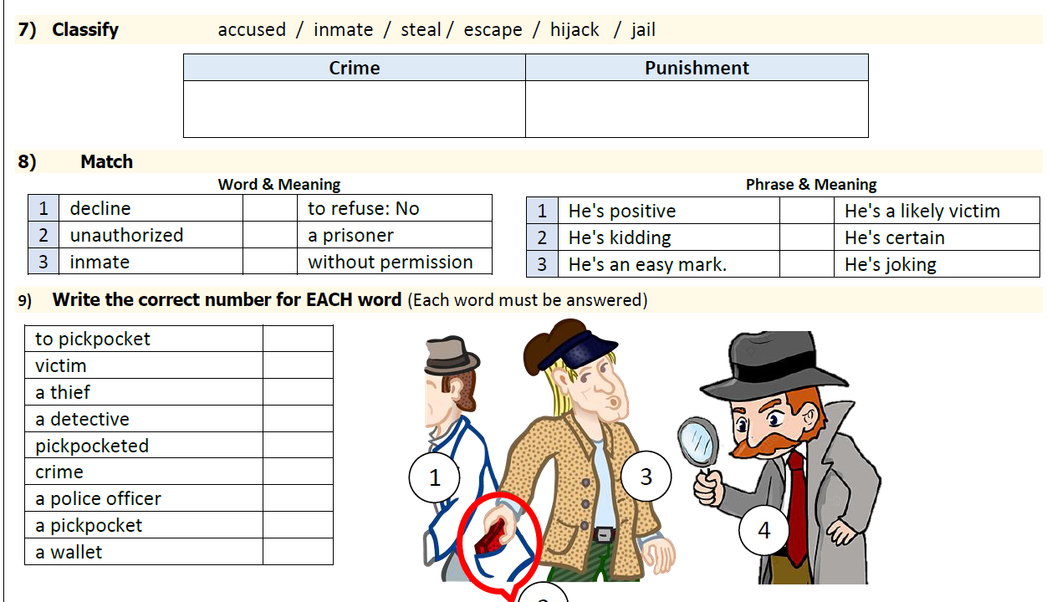
steal / escape / hijack
accused / inmate / jail
1
3
3
1
2
2

