Slide 1

Unit 5
Since when?
Reading

Slide 2
بسم الله الرحمن الرحيم
Day:
Date:
Inventions

Slide 3
Learning Objectives
1
Identify the main idea of reading
2
Identify specific information
3
Give meaning of the new words
4
Answer questions about the reading
5
Design a presentation about the most important invention.

Slide 4
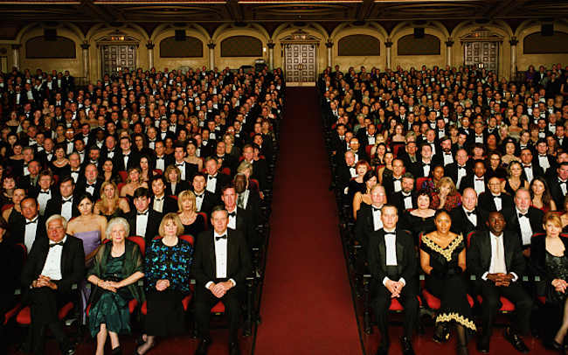
Vocabulary
Audience

Slide 5
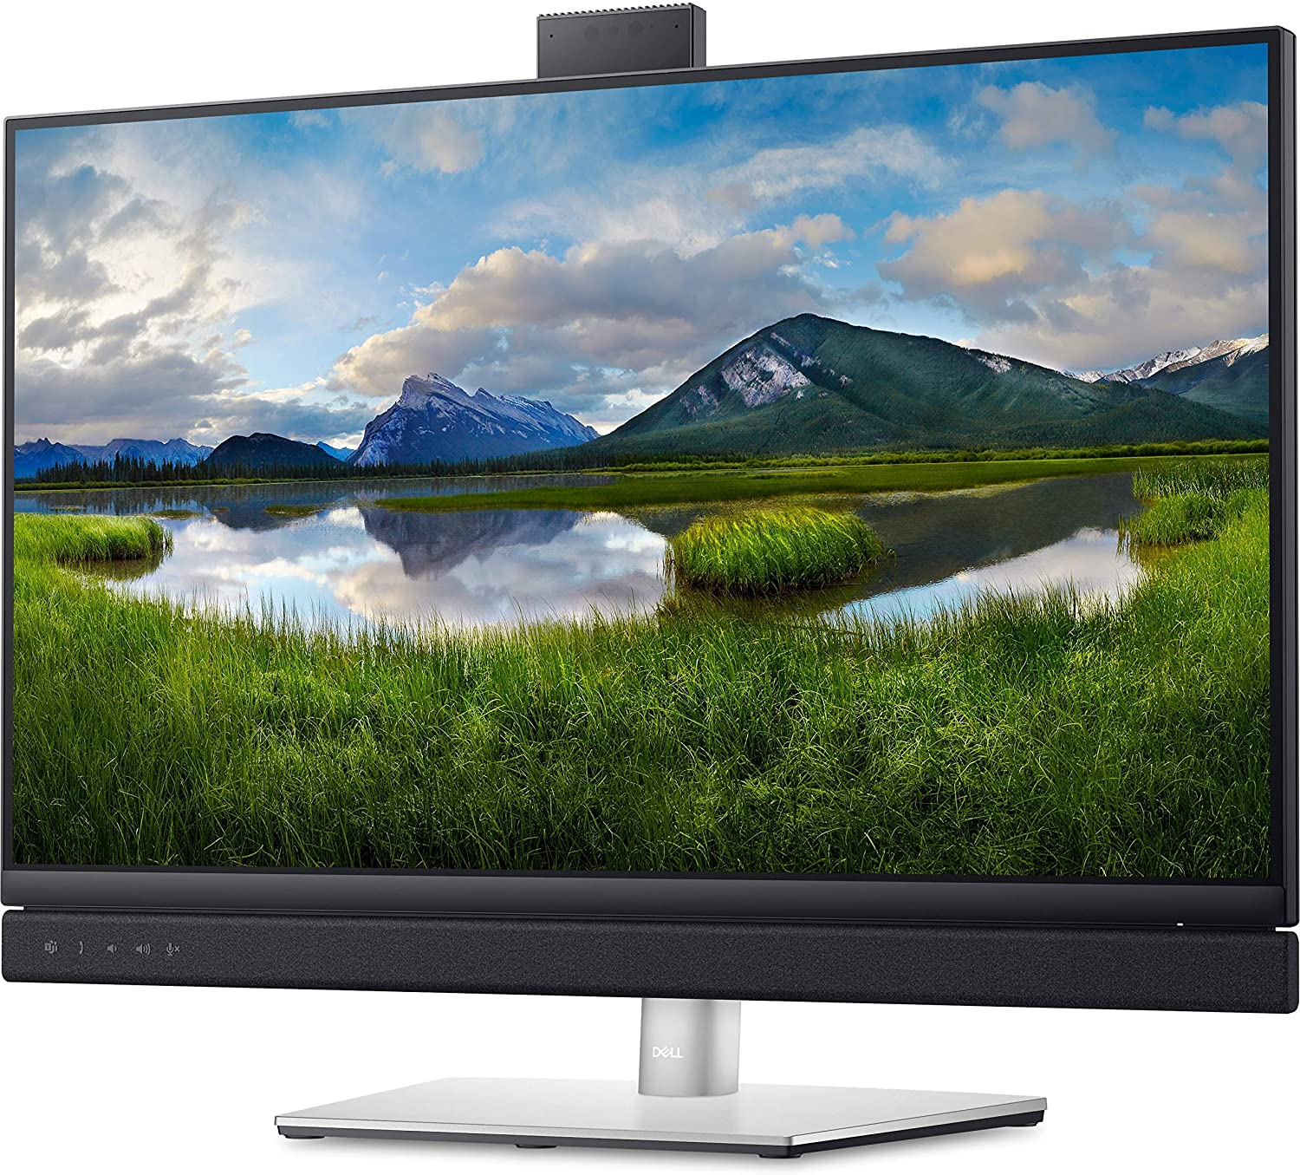
Vocabulary
Screen

Slide 6

Vocabulary
Special Effects

Slide 7
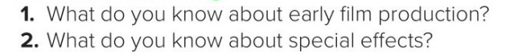

Reading
Pages 54 & 55
Before reading

Slide 8

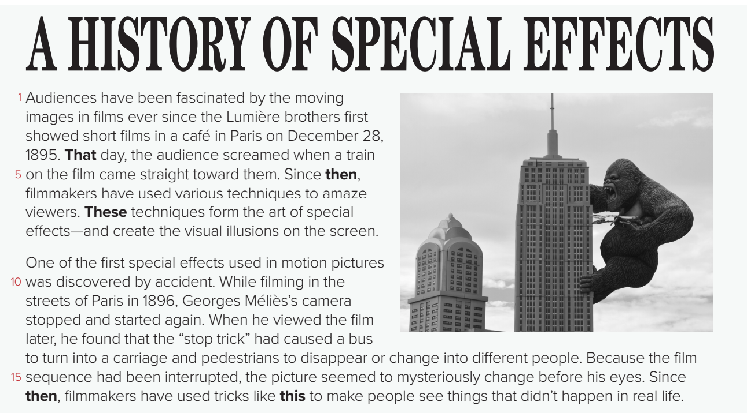
Reading
Page: 54

Slide 9
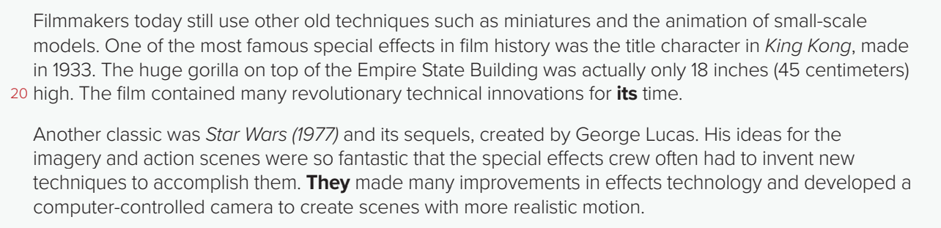
Reading
Page: 54

Slide 10
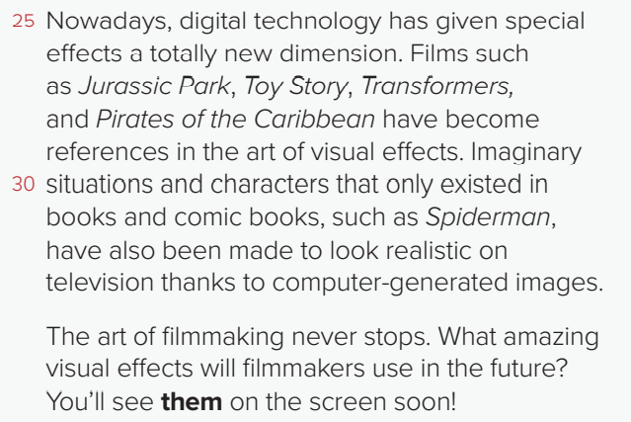
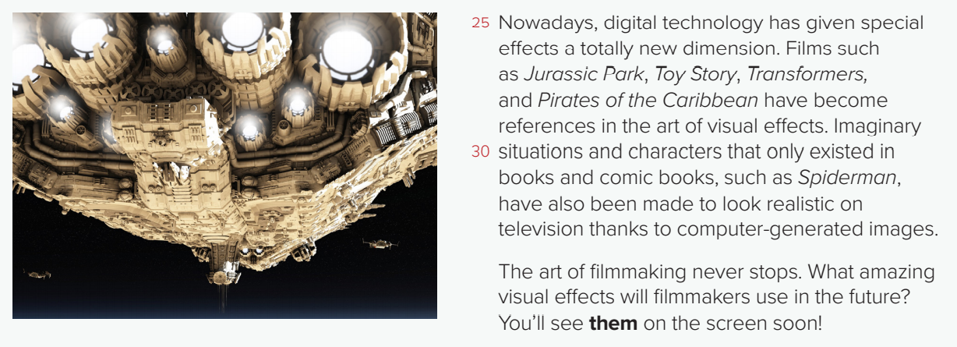
Reading
Page: 54

Slide 11
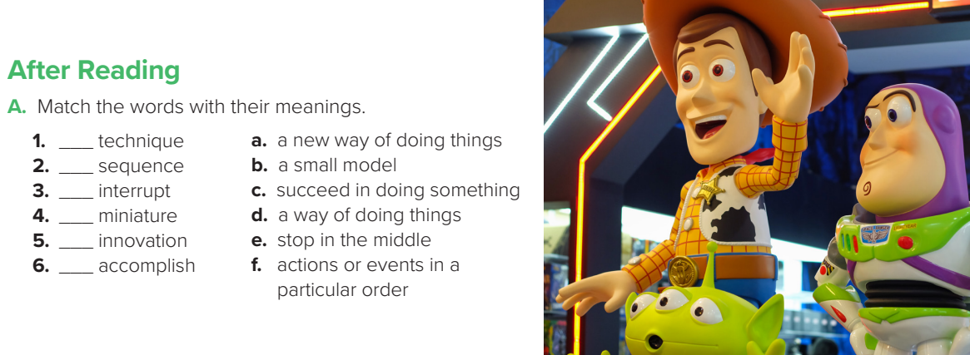
Reading
After reading
d
f
e
b
a
c
Page: 55

Slide 12
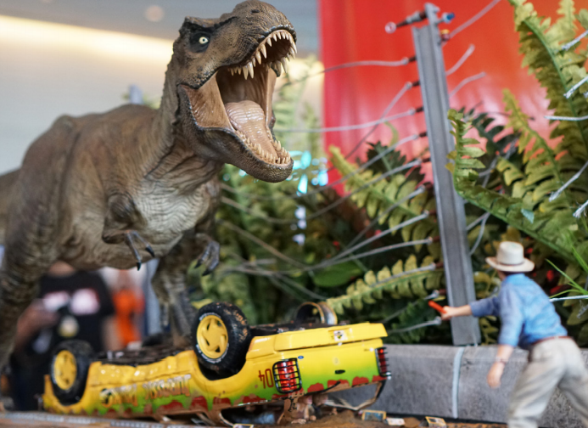
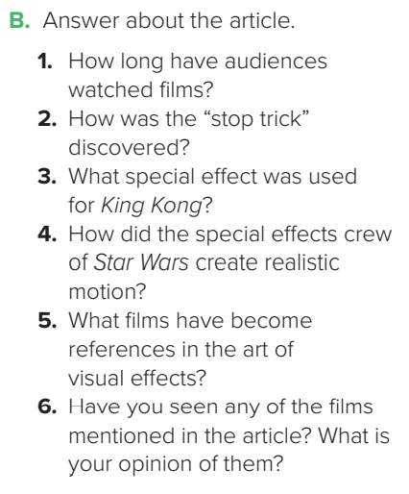
Reading
After reading
Answers
Audiences have watched movies since 1895/for more than 115 years.
2. The “stop trick” was discovered by accident.
3. A small model of a gorilla was used, but in the film it looked large.
4. They used a computer-controlled camera to create scenes with more realistic motion.
5. Jurassic Park,, Toy Story, Transformers, and Pirates of the Caribbean.
6. Answers will vary.
Page: 55

Slide 13
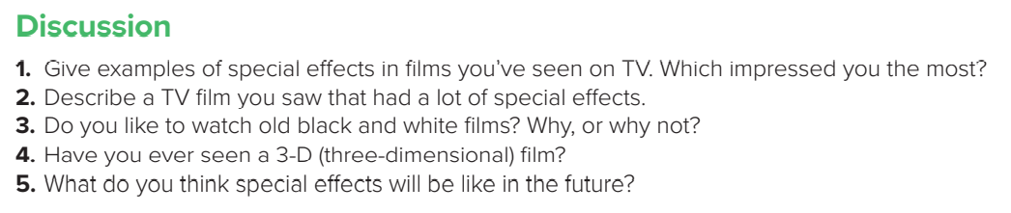
Reading
Discussion
Page: 55

Slide 14
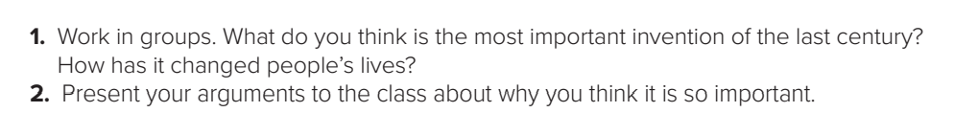

Project
Page: 55

Slide 15

Homework
Page 201

Slide 16

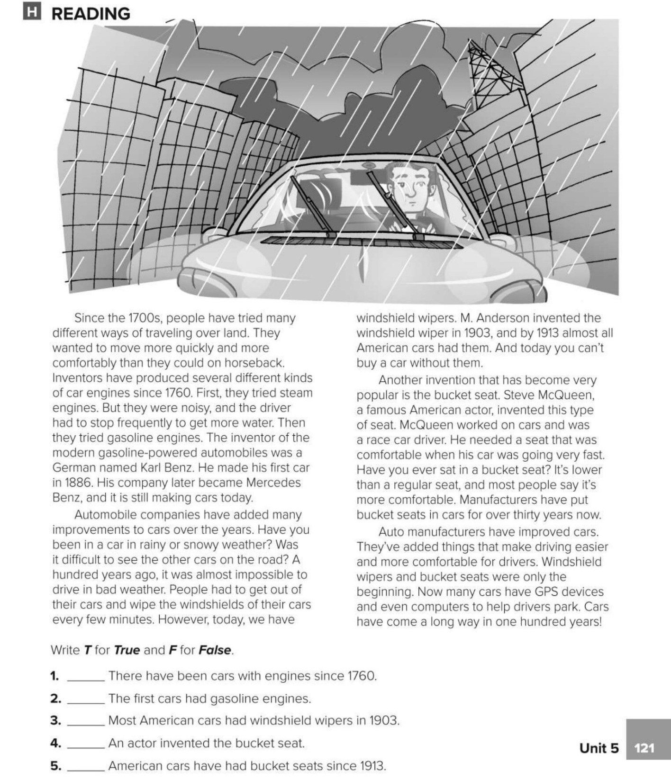
T
F
F
T
F

