Slide 1

Unit 5
Since when?
Writing

Slide 2
بسم الله الرحمن الرحيم
Day:
Date:
Inventions

Slide 3
Learning Objectives
1
Discuss the topic based on Ss’ information
2
Write about most important possessions
3
Use possessive pronouns or possessive adjectives correctly
4
Use demonstrative pronouns and adverbs correctly
5
Use relative pronouns correctly

Slide 4
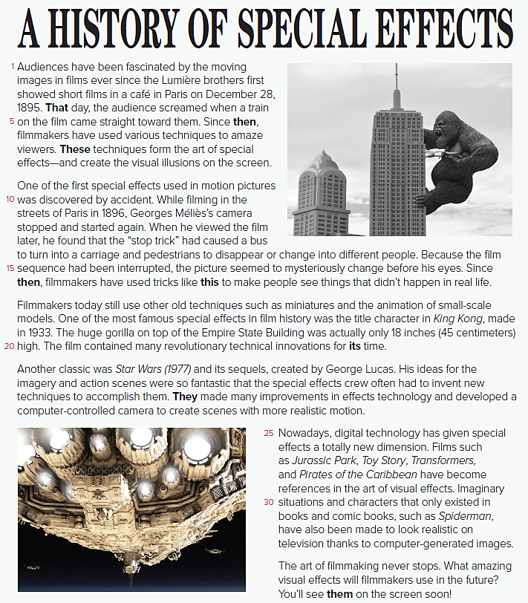
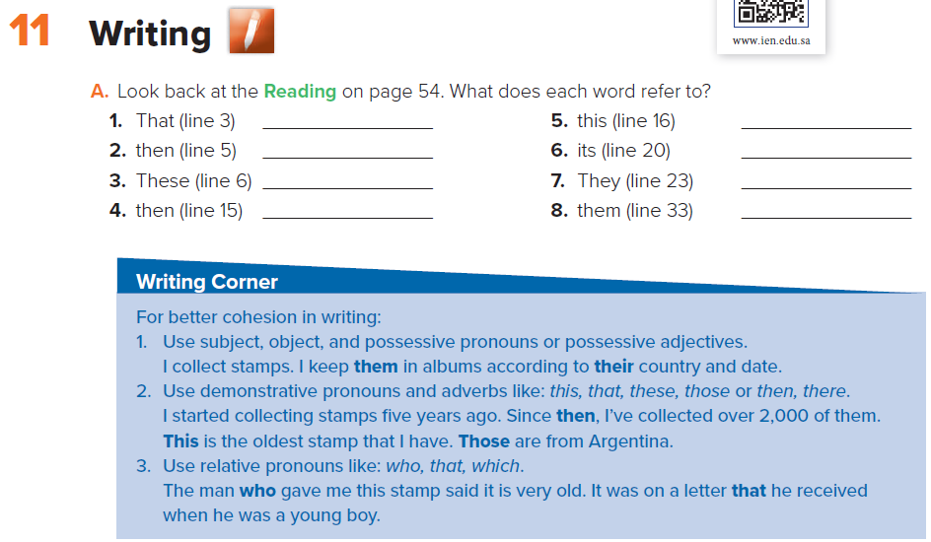
Page 56
Writing
December 28, 1895
December 28, 1895
Techniques filmmakers use
1896
The “stop trick”
The film king kong
The special effects crew
Amazing visual effects

Slide 5

Writing
Page: 56

Slide 6
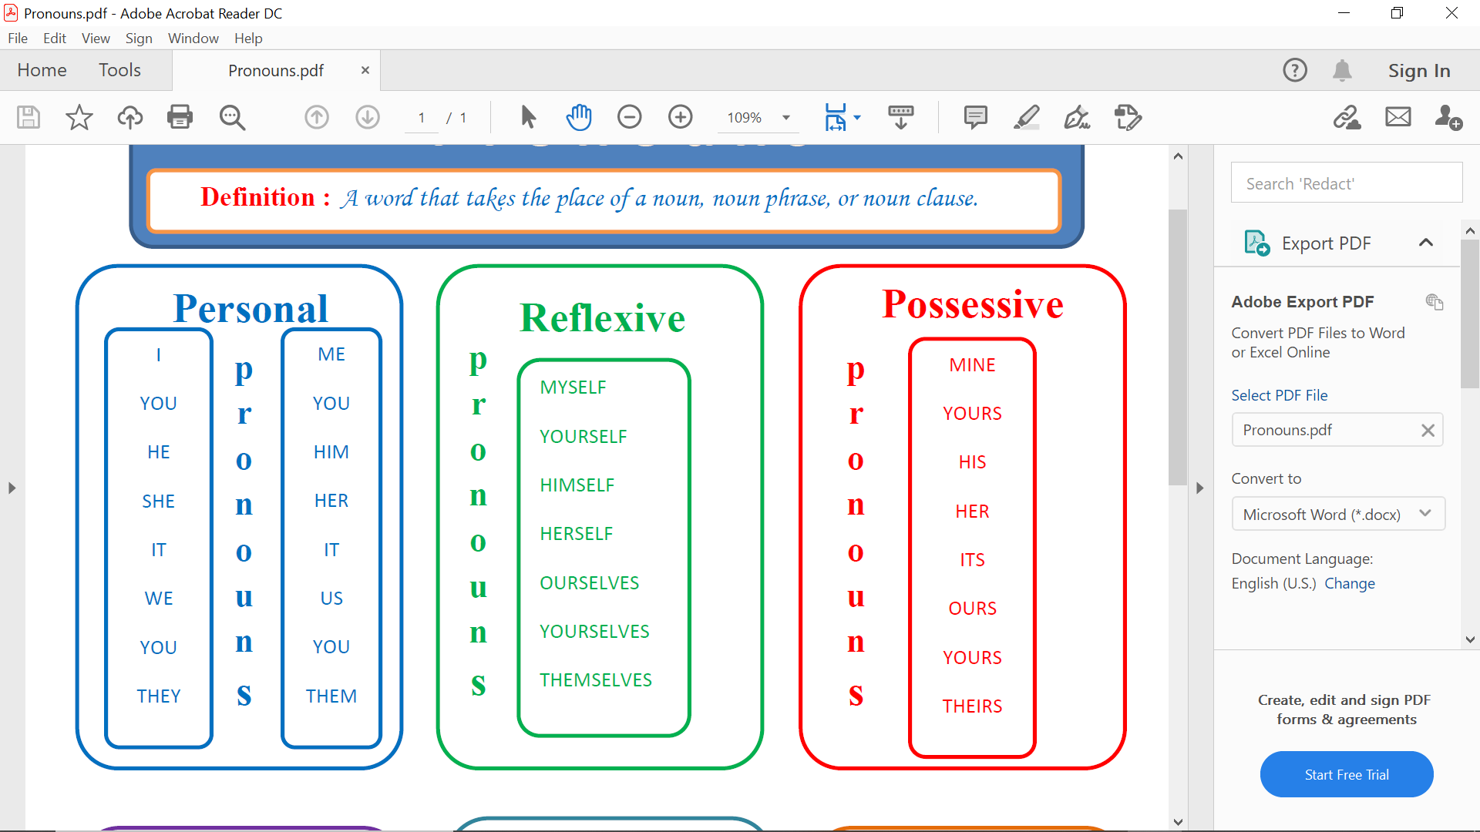
Pronouns
Definition: A word that takes the place of a noun, noun phrase, or noun clause

Slide 7
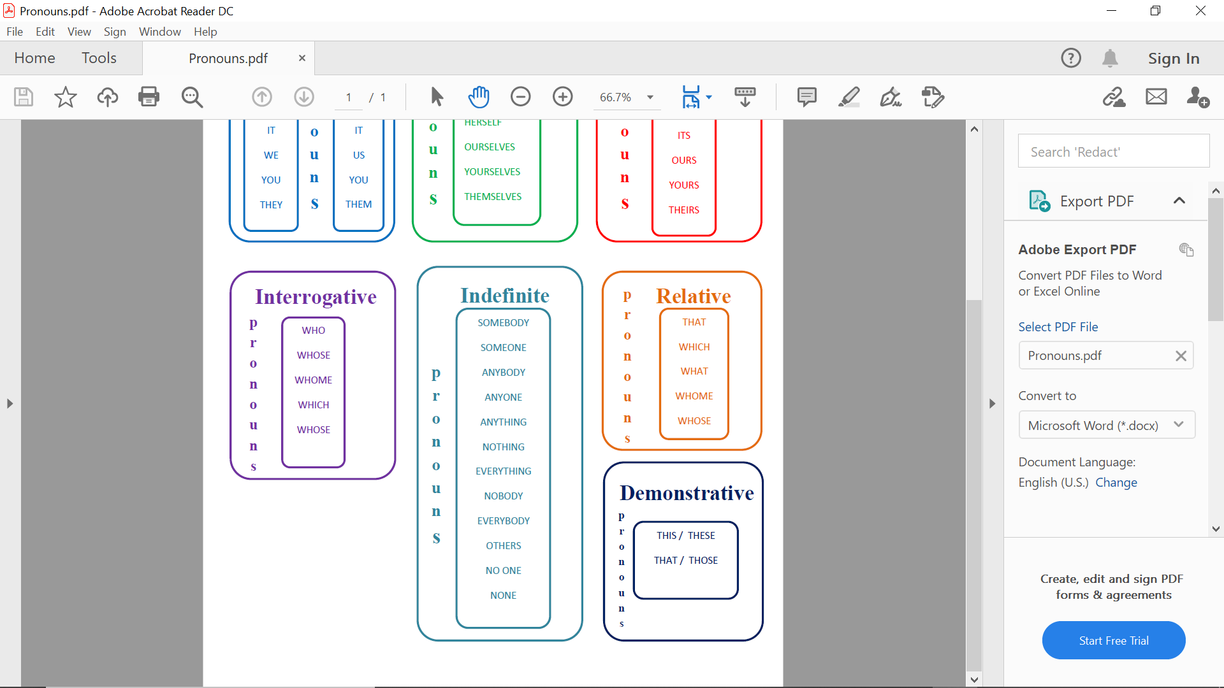
Pronouns
Definition: A word that takes the place of a noun, noun phrase, or noun clause

Slide 8
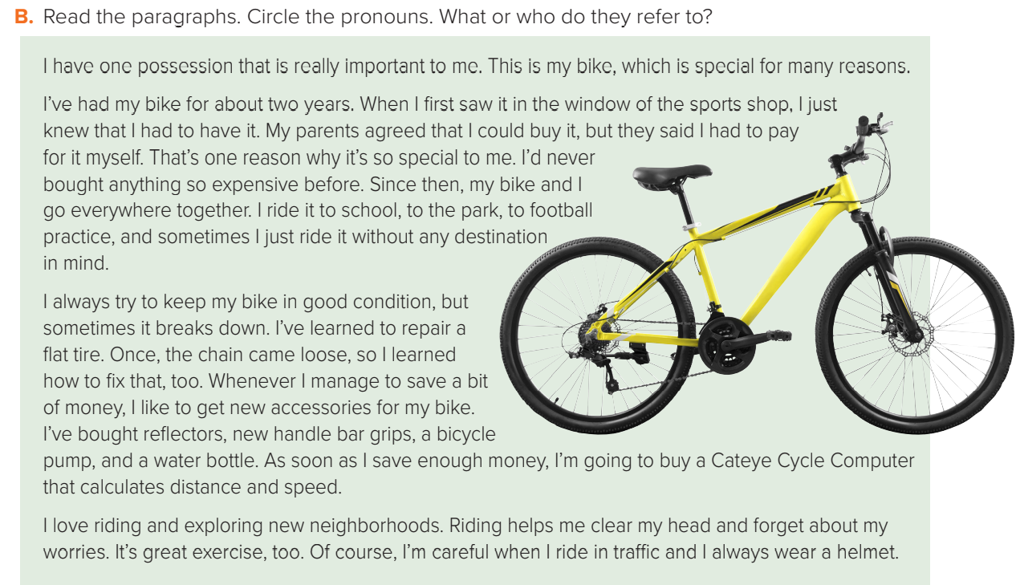

Paragraph 1 I/me = the owner of the bike that = one possession This = the important possession
which = my bike
Paragraph 2 I/myself/me = the owner of the bike it = the bike they = my parents That = having to pay for it
myself then = buying the bike
Paragraph 3 I = the owner of the bike it = the bike (fix) that = a loose chain that = Cateye Cycle Computer
Paragraph 4 I/me = the owner of the bike It = riding
Page:56

Slide 9
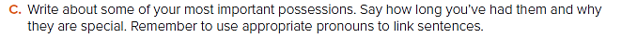

Slide 10

Homework
Page 202(I)

Slide 11

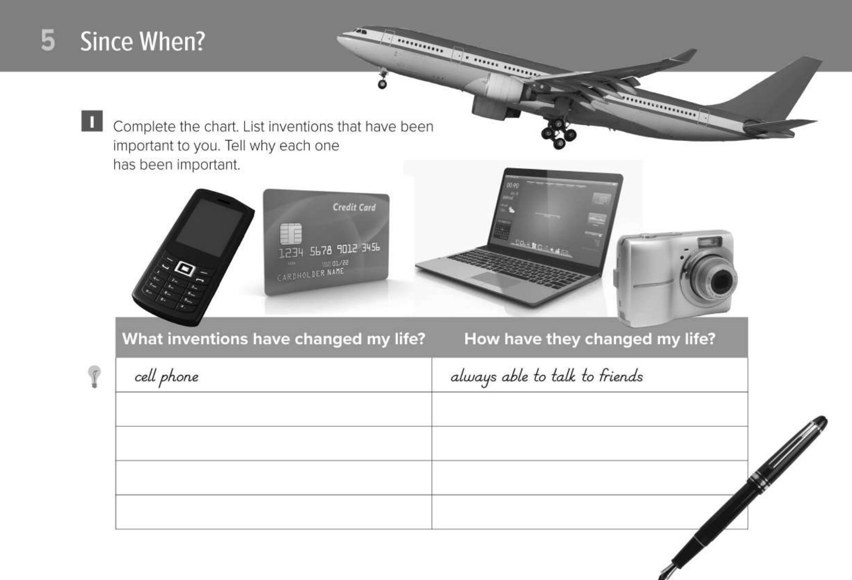
credit card
can shop without cash
plane
can travel quickly around the world
laptop
can use the Internet
digital camera
can take photos on vacation

