Slide 1

Unit 5
Since when?
Form, Meaning & Functions

Slide 2
بسم الله الرحمن الرحيم
Day:
Date:
Inventions

Slide 3
Learning Objectives
1
Use passive voice for simple present tense correctly
2
Use passive voice for present perfect tense correctly
3
Use passive voice for past tense correctly
4
Transform active sentences into passive
5
Transform passive sentences into active

Slide 4
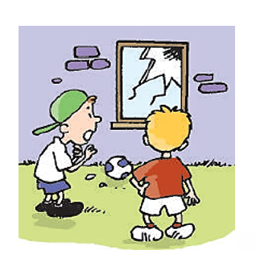
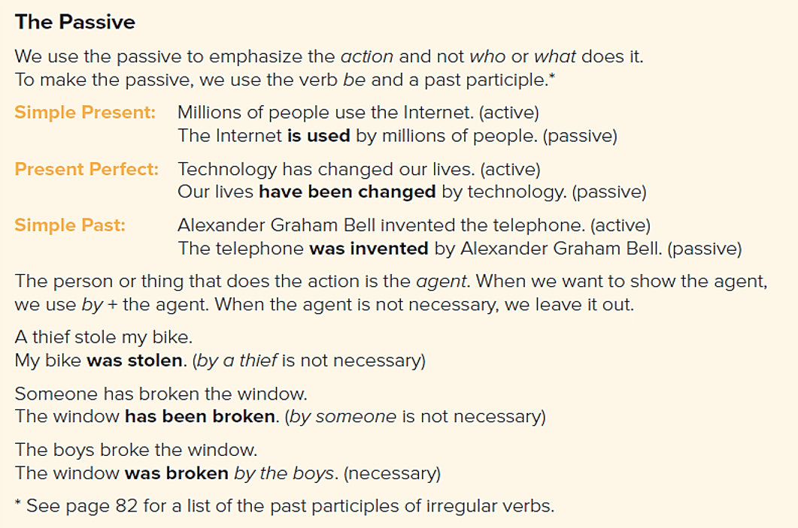
Form, Meaning & Functions
Page 57

Slide 5

May I ask you a question ?
active OR passive ?
Ali opened the door.
Sara is reading the book now.
Bader will meet his teacher at the library.
The dinner is cooked.

Slide 6

When we use Passive…
Use the passive when …
1- we are interested in the action rather than the people who do the action (agent / doer).
2- we don’t know exactly the agent (doer)
3- it is understood who did the action
Examples:
1- The school was built in 1981.
2- His car has been stolen.
3- Talking is not permitted.

Slide 7

The Passive
active passive
Ali writes the story.
… tense?
… subject ?
… verb?
… object?
Present simple
Ali
write
The story

Slide 8
The Passive
active passive
S V O write-wrote - written
Ali writes the story.
The story is written by Ali.

Slide 9


The Passive
active passive
take -took-taken
People take lots of photos on holidays.
Lots of photos are taken (by people) on holidays.
S V ________O________
by
be

Slide 10
The Passive
Present Perfect
Ali has opened the door.
Form:
o + have been + v3 ( + by + agent)
The door has been opened (by Ali).
… tense?
… subject?
… verb?
… object?
have - has

Slide 11

The Passive
Present Perfect
The police has caught the thief.
The thief has been caught (by the police).
have
… tense?
… S ?
… verb?
… object?
have
has

Slide 12
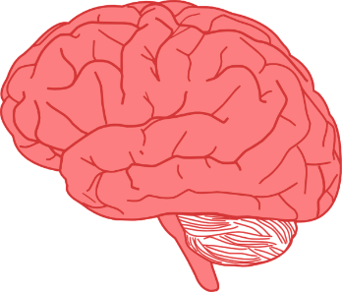
Refresh your memory
Notes should be considered
when changing into passive
1- keep on the tense of the active sentence
2- use correct verb to be / has / have
3- use past participle
4- by is used to introduce the agent
5- by is not used if it is not important who does the action

Slide 13

Change into passive!
Let’s Practice
Sami receives a letter .
A letter is received by Sami.

Slide 14
The Passive
active passive
Amal made the cake.
The cake was made by Amal.
S V ____O____
by
be

Slide 15
The Passive
active passive
The newspaper has published my essay.
My essay has been published by the newspaper.
S V ____O____

Slide 16
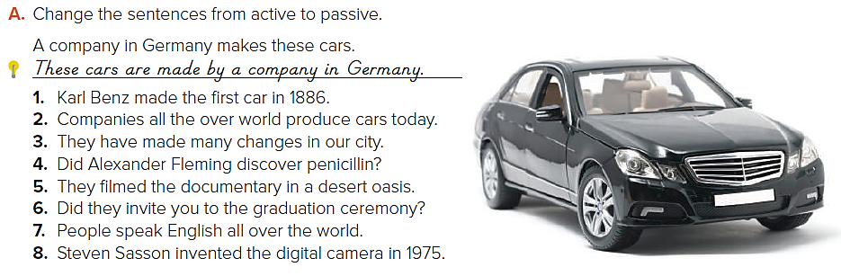
Page 57
Answers
1. The first car was made by Karl Benz in 1886.
2. Cars are produced all over the world today.
3. Many changes have been made in our city.
4. Was penicillin discovered by Alexander Fleming?
5. The documentary was filmed in a desert oasis.
6. Were you invited to the graduation ceremony?
7. English is spoken all over the world.
8. The digital camera was invented by Steven Sassoon in 1975.

Slide 17
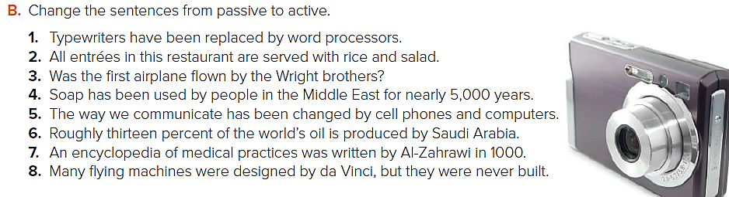
Page 57
Answers
1. Word processors have replaced typewriters.
2. This restaurant serves all entrees with rice and salad.
3. Did the Wright brothers fly the first airplane?
4. People in the Middle East have used soap for nearly 5,000 years.
5. Cell phones and computers have changed the way we communicate.
6. Saudi Arabia produces roughly thirteen percent of the world’s oil.
7. Al-Zahrawi wrote an encyclopedia of medical practices in 1000.
8. Da Vinci designed many flying machines, but he never built them.

Slide 18

Practice

Slide 19

Homework
Page 202(J)

Slide 20

