Slide 1

Unit 5
Since when?
Listen & Discuss

Slide 2
بسم الله الرحمن الرحيم
Day:
Date:
Inventions

Slide 3
Learning Objectives
1
Talk about inventions
2
Match inventions to their definition
3
Express actions that began in the past and continue into the present.
4
Value the blessing of having inventions and technology that make their lives easier.
5
Answer questions about inventions correctly.

Slide 4
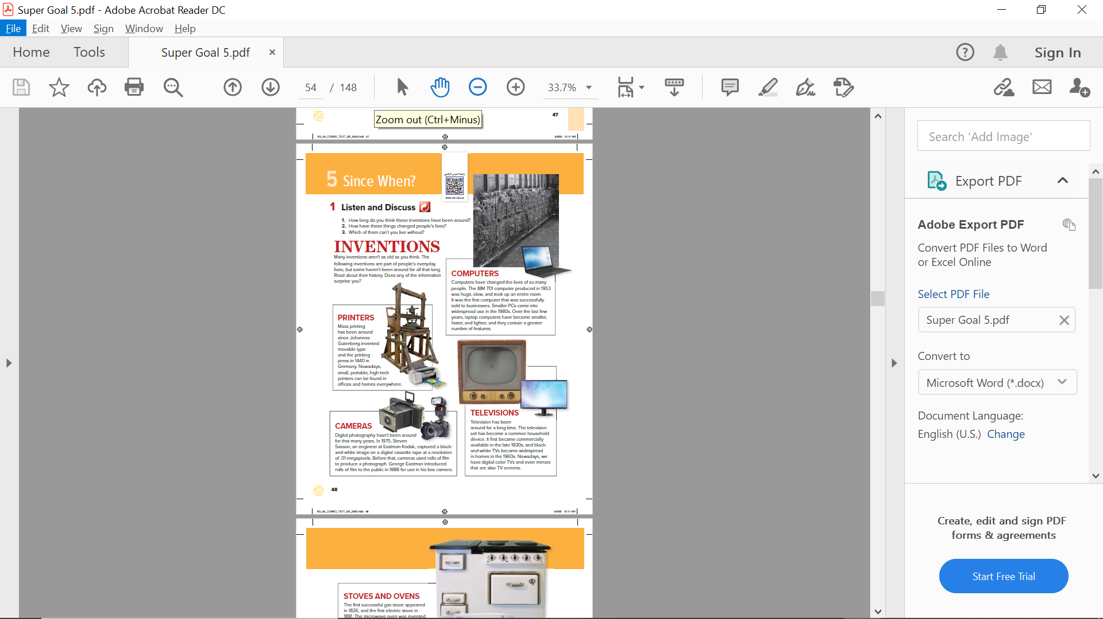
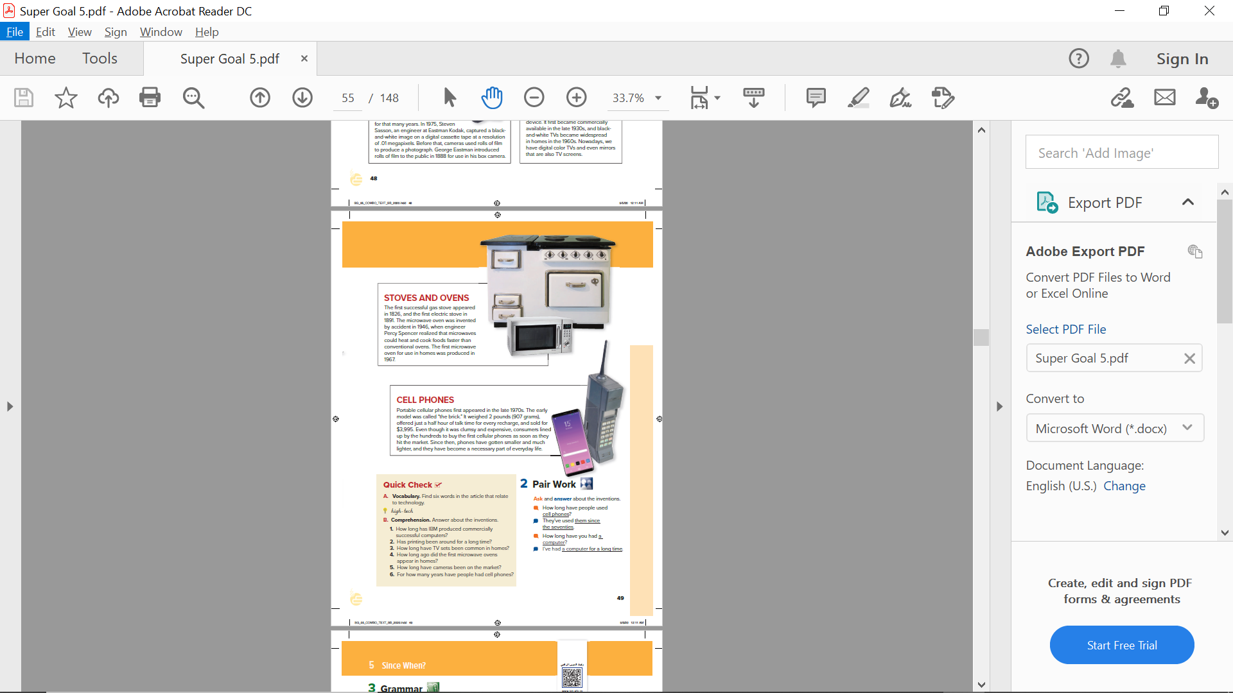
KWL Learning Chart
 | KWL
What I Know | What I Want to Know | What I learned

Slide 5
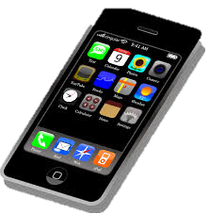
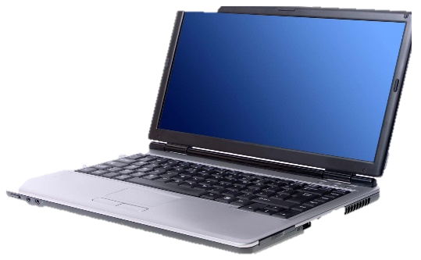
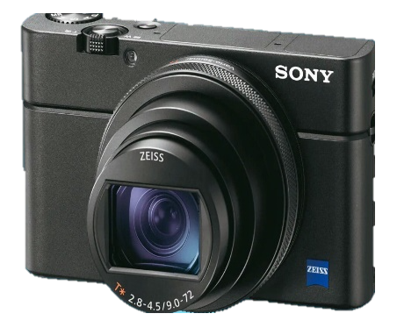
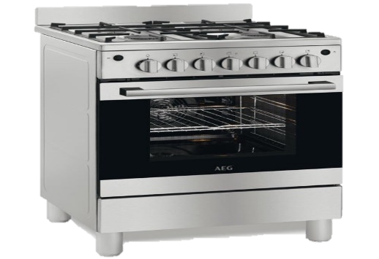
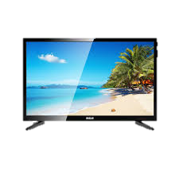
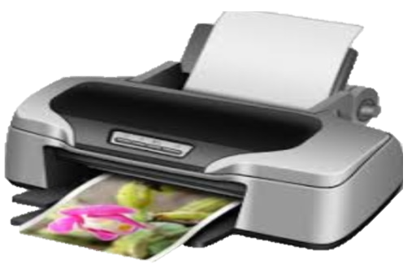
Can you name these inventions?

Slide 6
Instructions
Listen carefully.
Underline words related to technology.
Find for dates in which the inventions was found.
Find names of inventors.
Answer the question (How long has the invention been invented?)

Slide 7
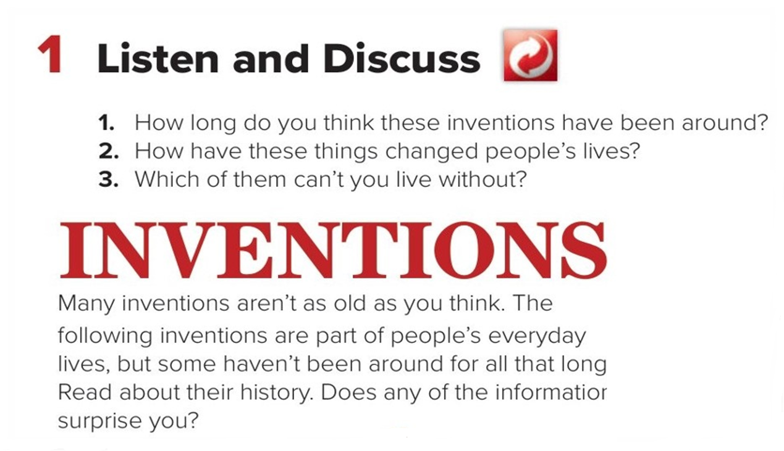

Pages 48- 49

Slide 8

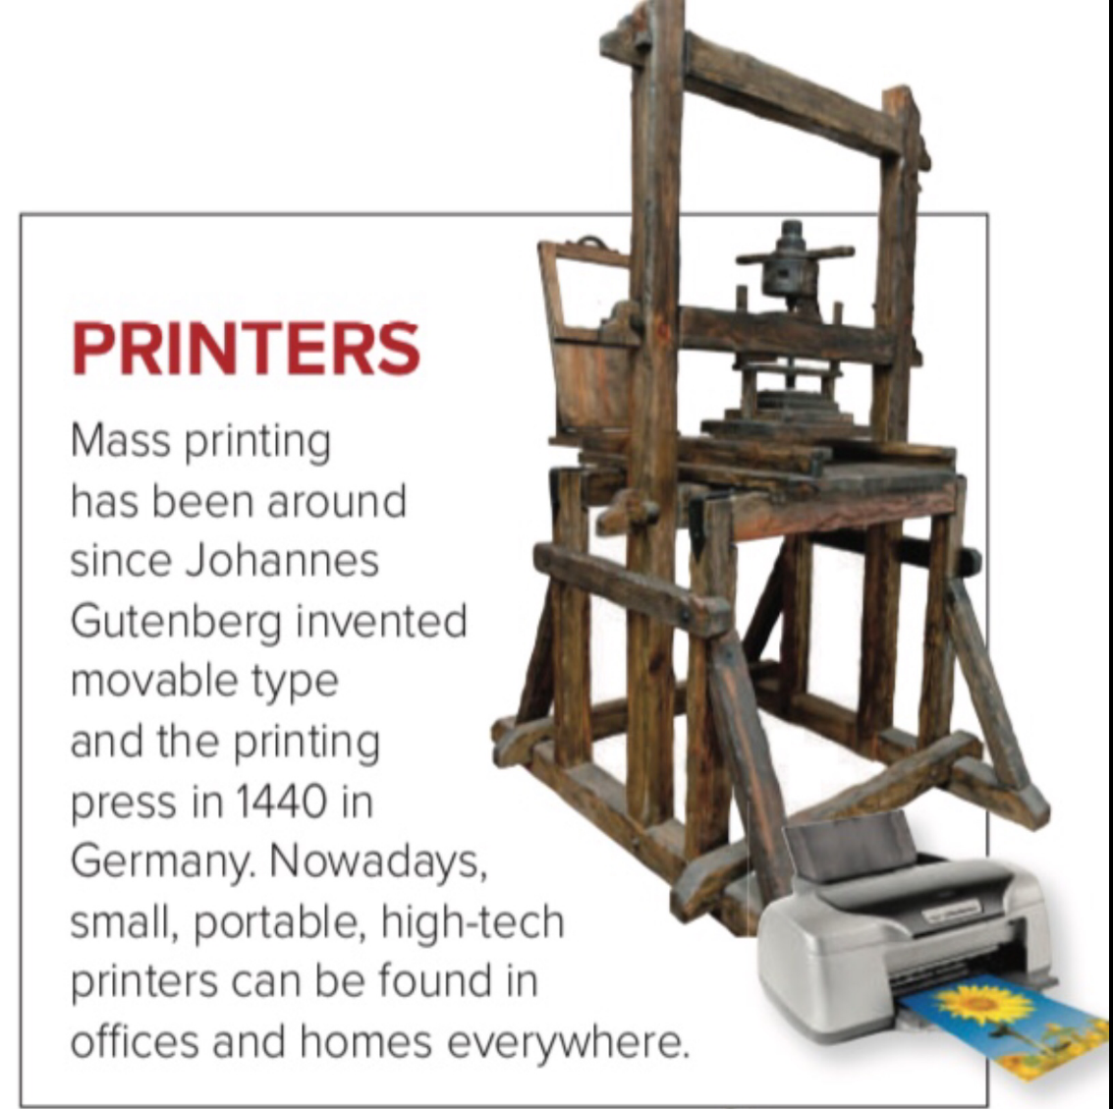
Who invented movable and printing press?
How is the printers nowadays?
Pages 48- 49

Slide 9
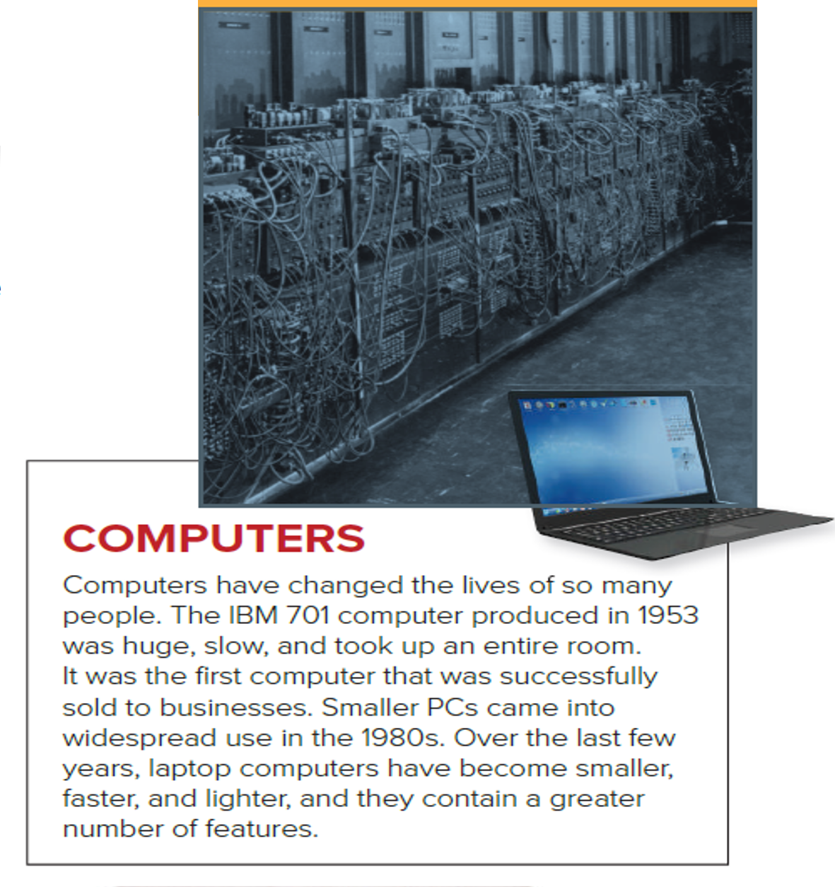
How was the computers that produced in 1953?
When was smaller PCs came into widespread?
Pages 48- 49

Slide 10
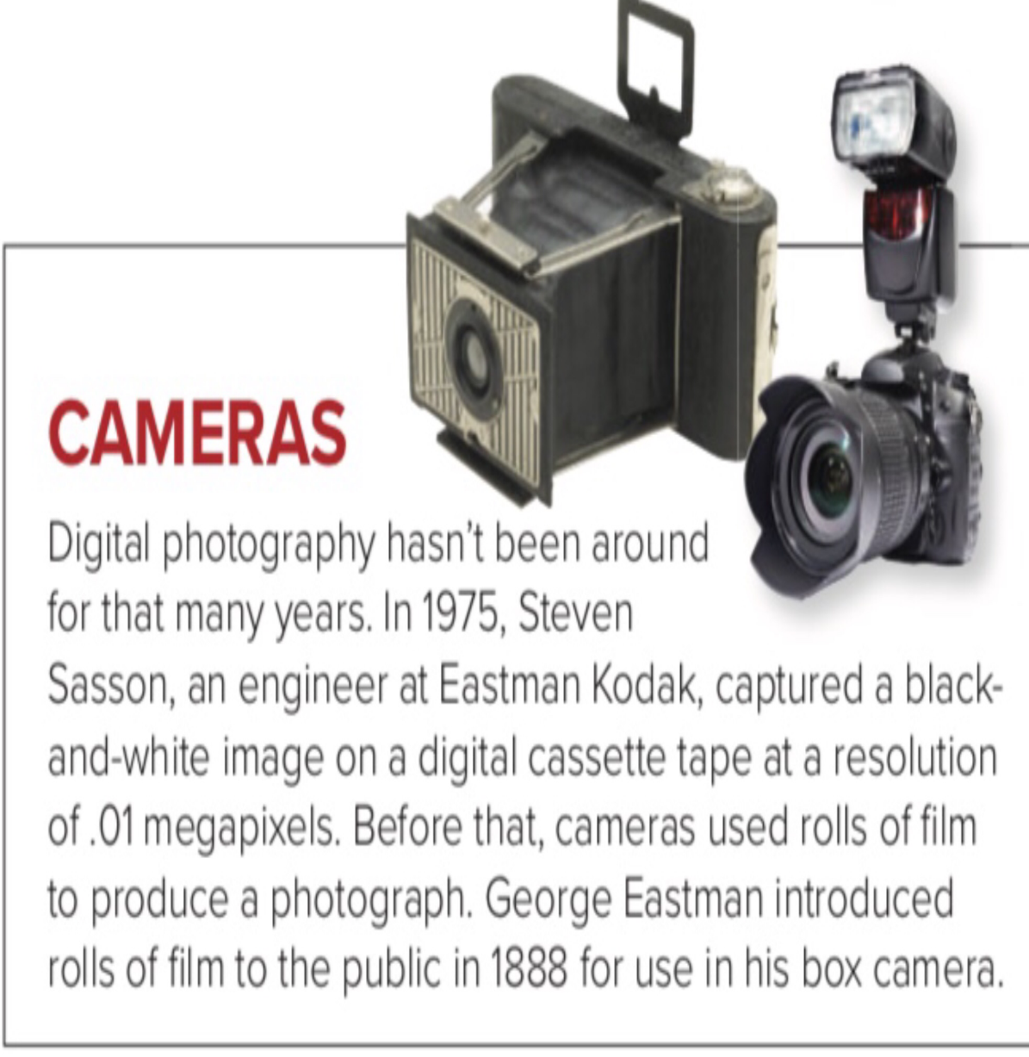
When was the digital photography started?
Who introduced rolls of film in 1888?
Pages 48- 49

Slide 11
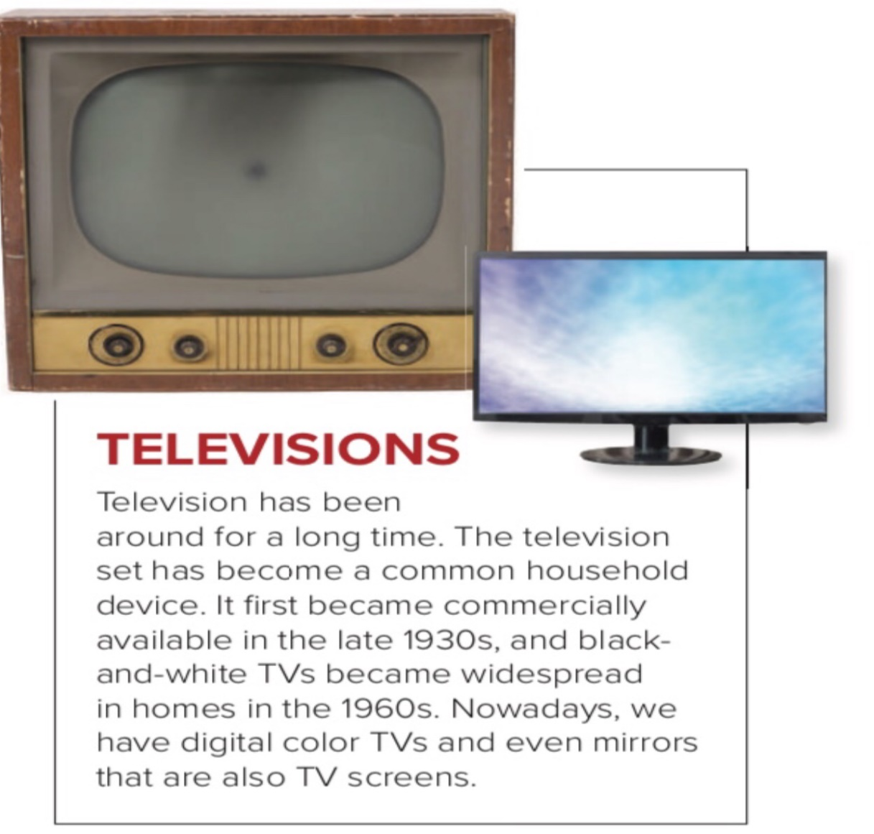
How was the TVs in 1960?
How is the TVs nowadays?
Pages 48- 49

Slide 12

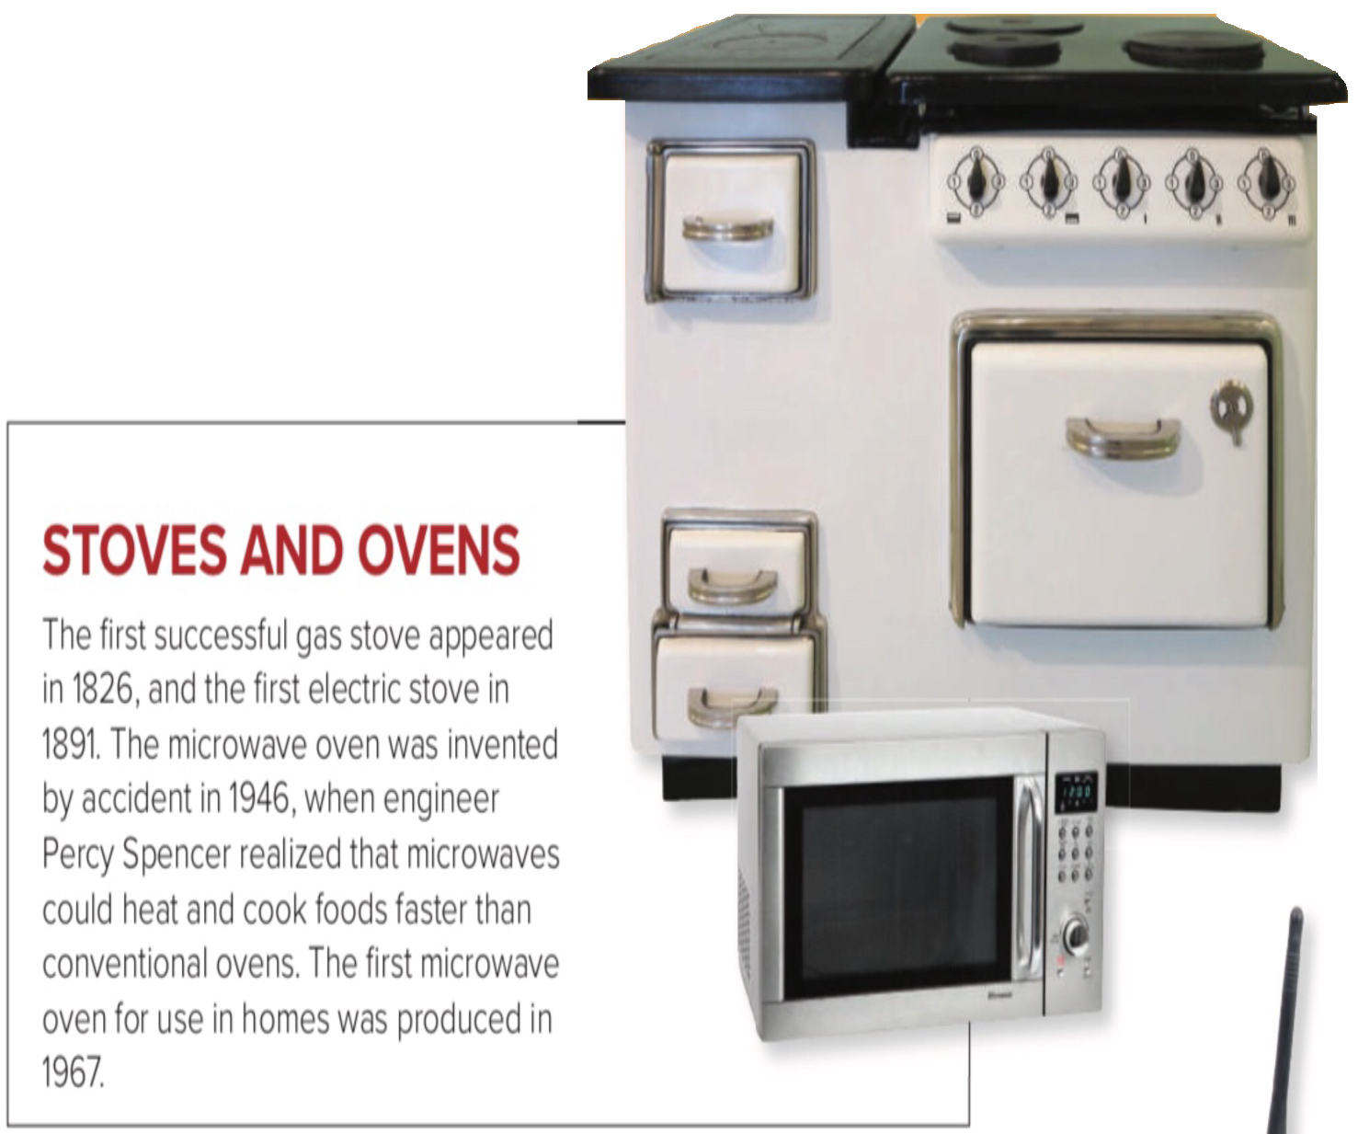
When was the first gas stove appeared?
How was the microwave oven invented?
Pages 48- 49

Slide 13
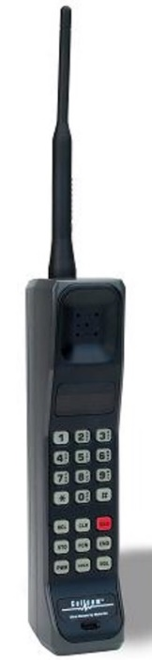
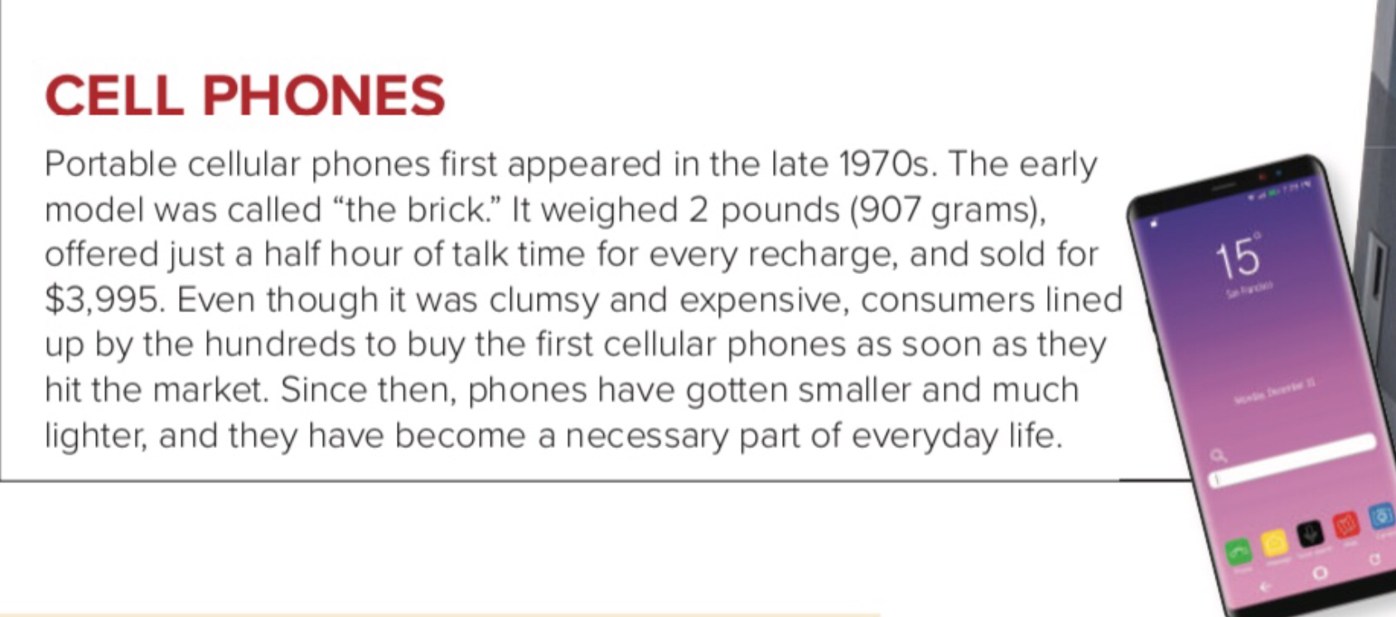
What was the early model called?
How is the phones since then?
Pages 48- 49

Slide 14
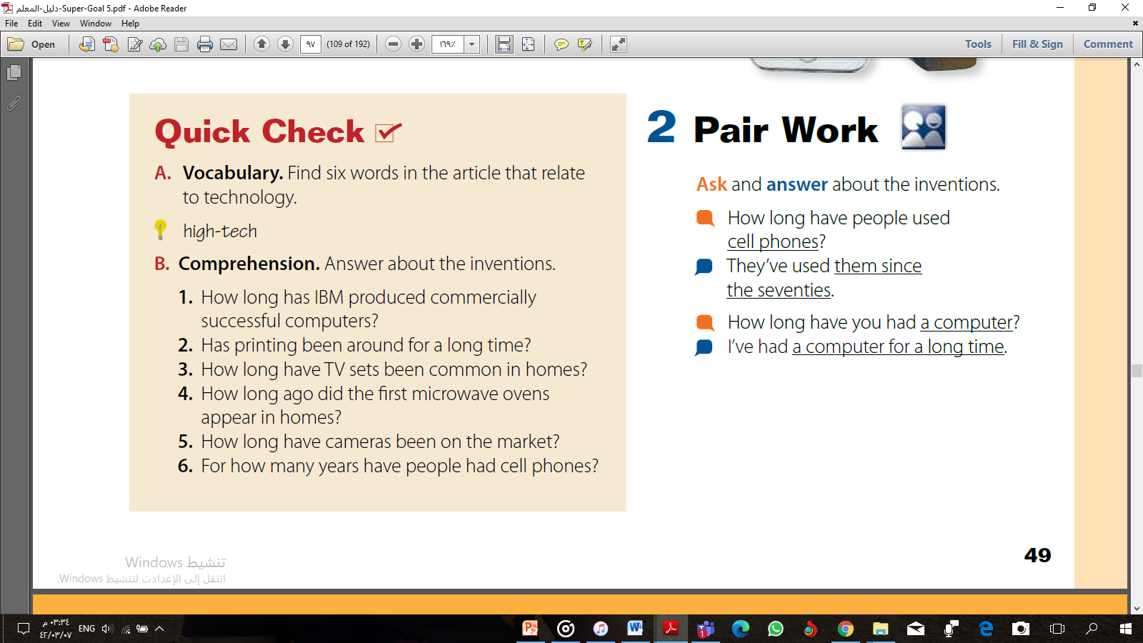
Pages 48- 49
Answers
A. There are more than six words:
invention, computer , PCs, screens , laptop , printer , device , television, digital , cassette tape , recharging , megapixels.

Slide 15
Pages 48- 49
Answers
1. IBM has produced commercially successful printers since 1953/for about 60 years.
2. Printing has been around since 1440/for almost six hundred years.
3. TV sets have been common in houses since the 1960s/for more than 50 years.
4. The first microwave oven appeared in homes about 45 years ago.
5. Cameras have been on the market for more than 120 years/since 1888.
6. People have had cell phones for about 35 years.

Slide 16
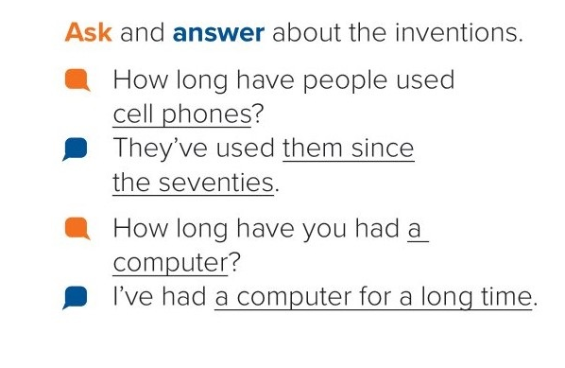
Pair Work

Slide 17

Final Assessment

Slide 18
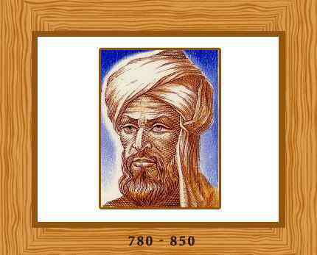
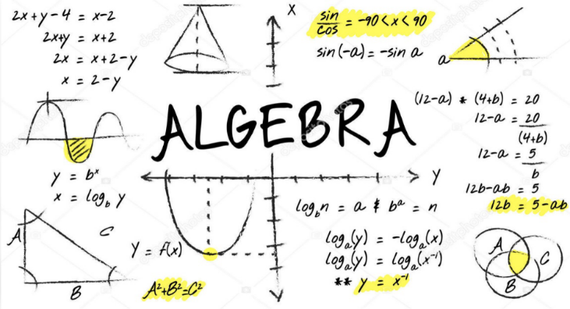
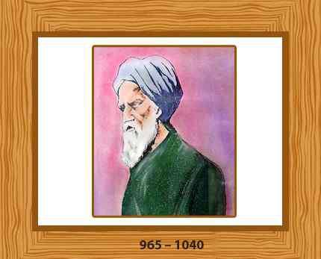
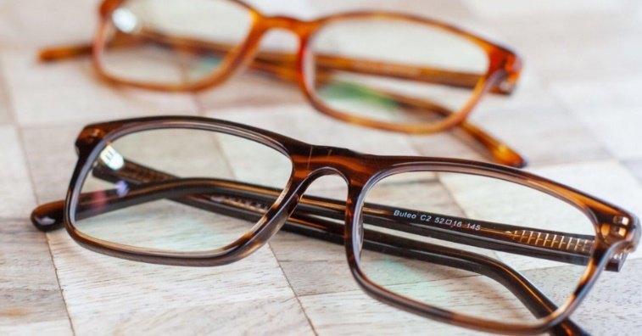
Famous Muslim Scientists
Muhammad ibn Musa Al-Khwarizmi
Ibn Al-Haytham

Slide 19

Task
Invention | Date of invention | Inventor

Slide 20
Summary
Invention | Date of invention | Inventor
Computer | 1953
Printer | 1440 | Johannes Gutenberg
Television | 1960
Stove/Microwave | 1826/1946 | Percy Spencer
Camera | 1974 1888 | Steven Sasson George Eastman
Cell phone | 1970

Slide 21

Homework
Page 197

Slide 22

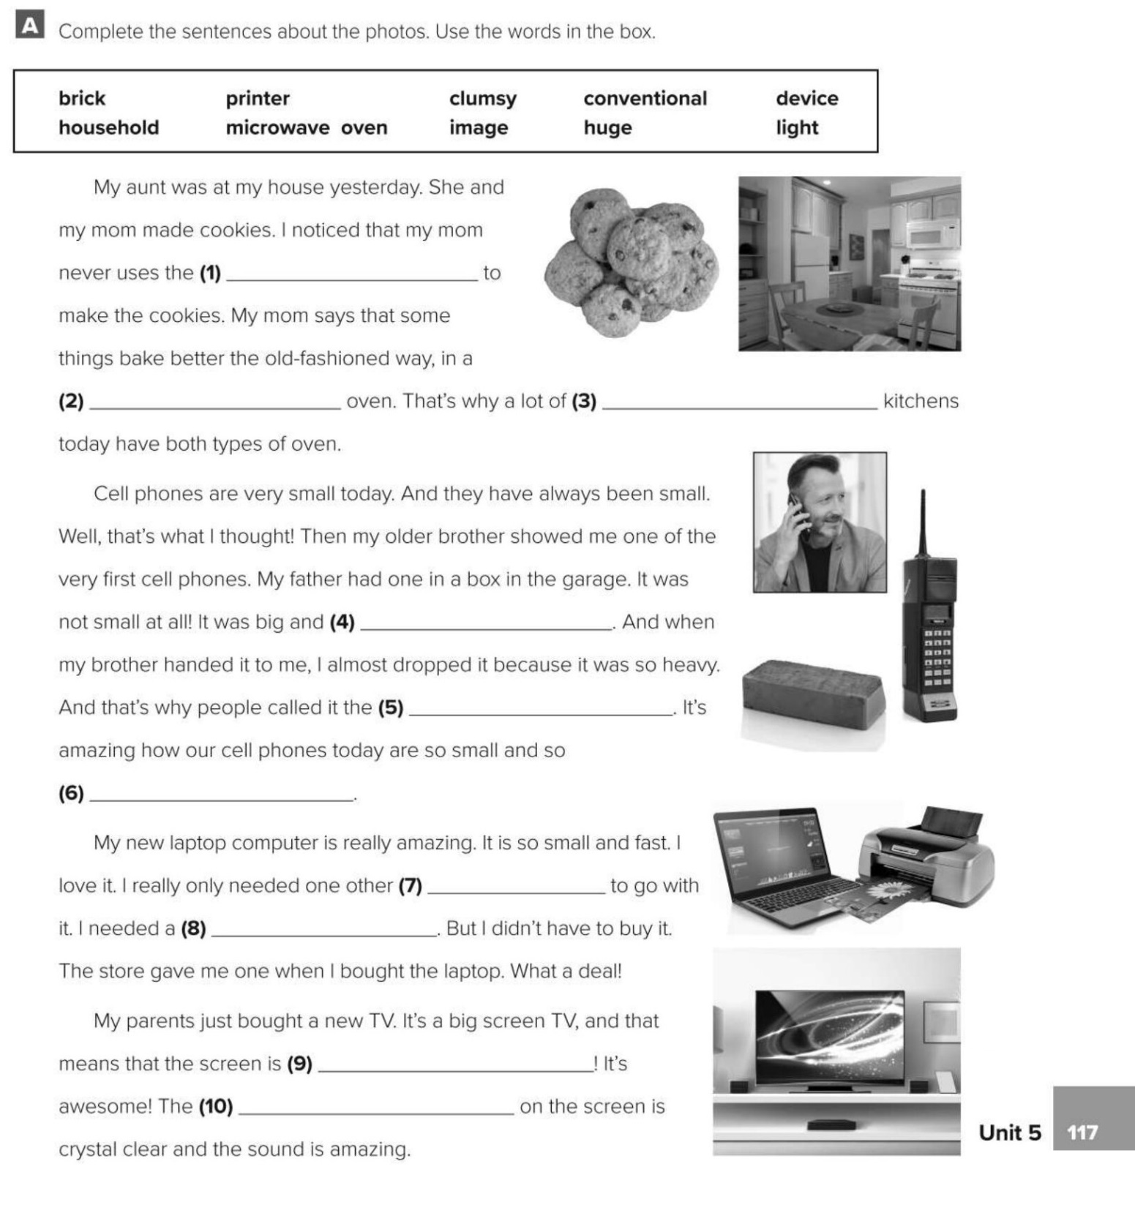
microwave oven
conventional
household
clumsy
brick
light
device
printer
huge
image

