Slide 1
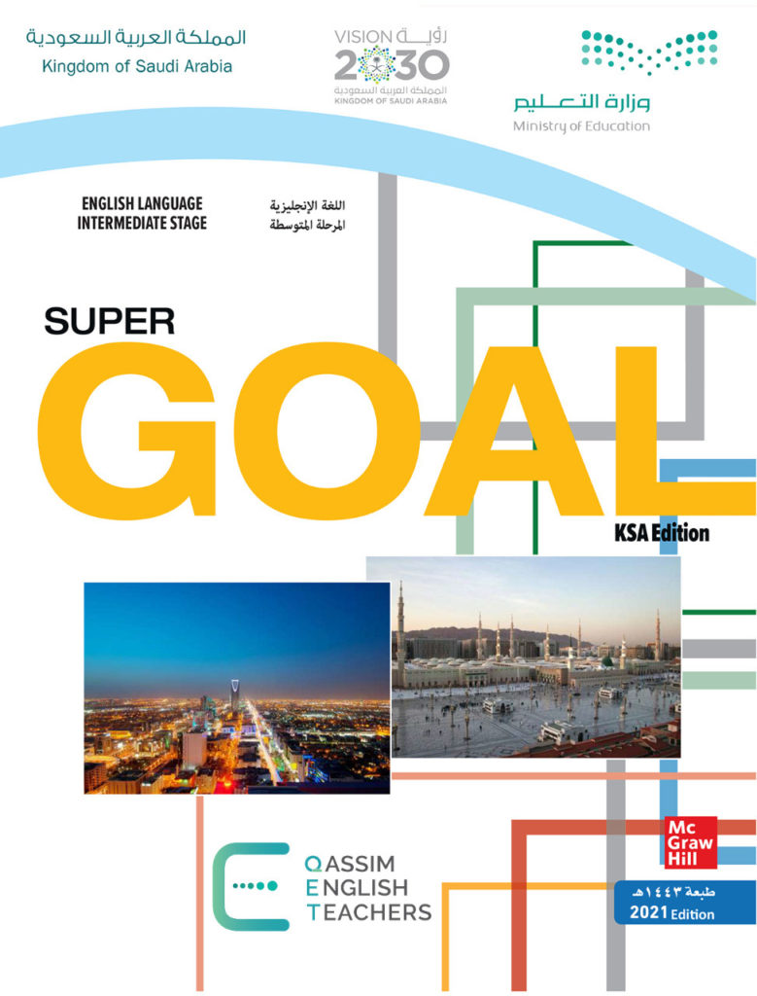
Unit 6
Do you Know Where It Is?
Writing

Slide 2
بسم الله الرحمن الرحيم
Day:
Date:

Slide 3
Learning Objectives
02
04
write about Saudi Arabia
write well-organized paragraphs.
01
03
discuss the topic based on Ss' information
recognize the rules of writing a paragraph.

Slide 4

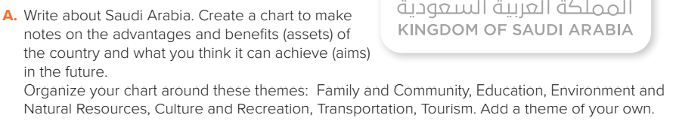
Page:66

Slide 5

Sample answers
Topics | the advantages and benefits of Saudi Arabia | What can be achieved in the future.
Family and Community | Family has strong relationship and live according to Islamic religion values and laws | Government will support families to rise their children in many ways
Education | many modern schools and universities have been built all over the country | Develop the learning system
Environment and Natural Resources | S.A is the largest oil producer in the world | to benefit from the other natural resources like gold and other minerals
Culture and Recreation | Local theaters and public libraries and summer camps | There will be large museums , galleries, sport facilities…..etc.
Transportation | There is a good transportation system many international airports modern roads ,trains…..etc. | Subways in the big cities & public buses
Tourism | S.A has a lot of historical & natural places across the country | Reform the historical places and make entertainment events in the places to attract tourists

Slide 6

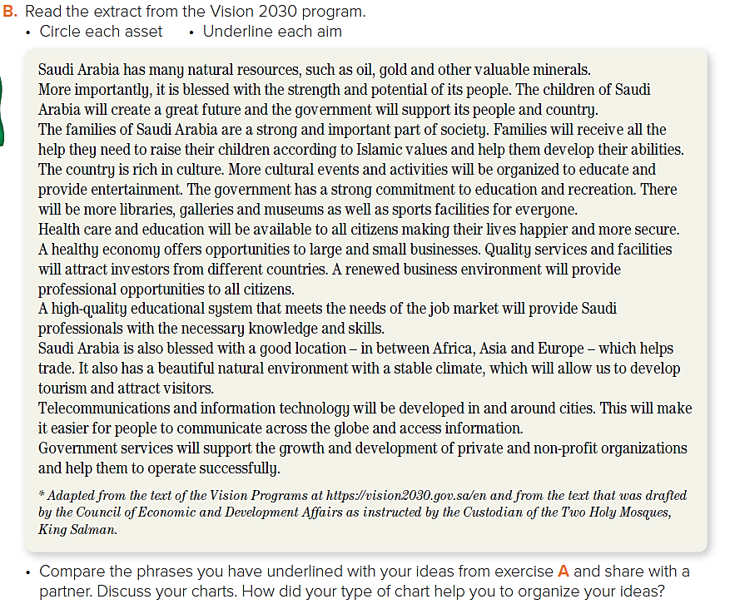
Page:66

Slide 7
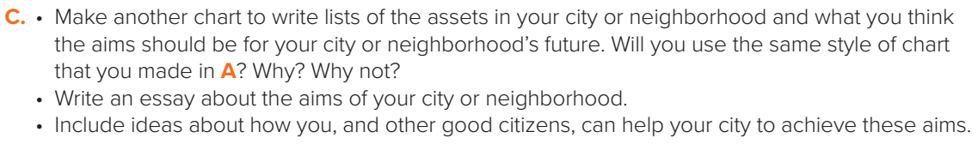
I live in a great city in a wonderful country.
Jeddah is a city with a lot of assets and also a lot of things we can aim towards.
Page:66

Slide 8
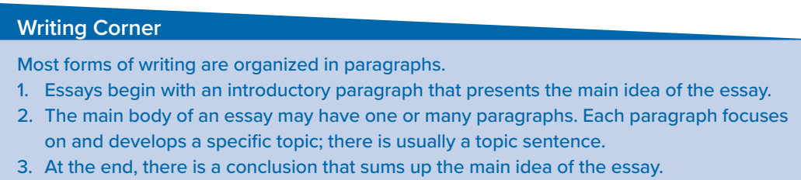
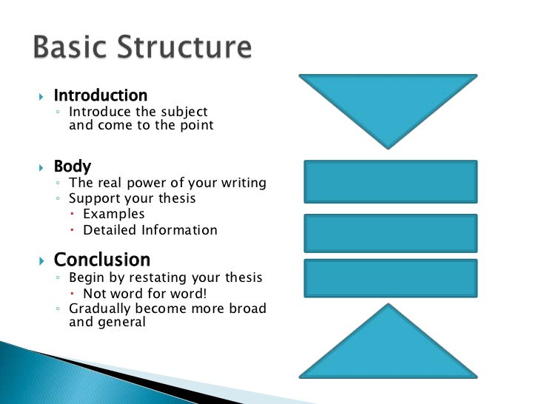
Page:66

Slide 9
Homework!
Page 208 (J)

Slide 10
