Slide 1

Unit 6
Do you Know Where It Is?
Revision

Slide 2
بسم الله الرحمن الرحيم
Day:
Date:

Slide 3
Choose the correct answer:
  1. Abha is [ less modern - more modern - modern ] than Jeddah.
  2. My dress is [ longer - long - longest ].
  3. Nada is as [ tall - taller - tallest ] as Huda.
  4. Makkah is [ the least crowded - crowded - more crowded ] than Abha.
  Talal is [ heavy - heavier - heavier than ] Ali.
  Ameera is [ tall – taller – the tallest ] girl in the class.

Slide 4
Choose the correct answer:
  7. Nora is [ smart – smarter – the smartest ] than Batoul.
  8. That is [ the most – more – most ] expensive watch I've ever seen.
  The Mona Lisa is the most [ tall – famous – good ] painting in the world.
  Salma’s mark is the [ bad –worse –worst ] in class.
  She lives in [ a – an –the ] United States.
  Planes are [ a – an –the ] fastest means of transport.

Slide 5
Write the correct form of the adjectives:
Sami is ( fat ) Adel.
Sami is fatter than Adel.
2. Nasser's mark is ( good ) Ryan's .
Nasser's mark is better than Ryan’s
The Holy Quran is ( great ) book in the world.
The Holy Quran is the greatest book in the world.

Slide 6
Write the correct form of the adjectives:
Fatima is 150 cm tall. Nora is 150 cm tall.
[ Use as ………… as ]
Fatima is as tall as Nora.
Maha's mark is 29. Fatima's mark is 18.
[ Use not as ………… as ]
Maha's mark is not as bad as Fatima's mark.

Slide 7
Make indirect questions:
1- What is the name of the street?
(use Do you know )
Do you know what the name of the street is?
2- What time does the bank open?
(use Can you tell me)
Can you tell me what time the bank opens?

Slide 8
Write the word in its correct place:
Diversity –pilgrim –renovate –commute -gateway
renovate
I'm going to …………………………………… the house.
Jeddah is the ……………………… to the to the holy mosque in Makkah.
We will recognize our differences and appreciate the ………………………… .
The Saudi government works very hard to facilitate Hajj for each ……………………
gateway
diversity
pilgrim.

Slide 9
Match words with meanings:
1- a bit |  | a- an unbroken series
2- run down |  | b- not looked after
3- aspects |  | c- strong agreement
4- combination |  | d- a little
5- consecutive |  | e- mixture
6- definitely |  | f- features
5
2
6
1
4
3

Slide 10
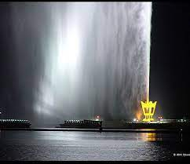
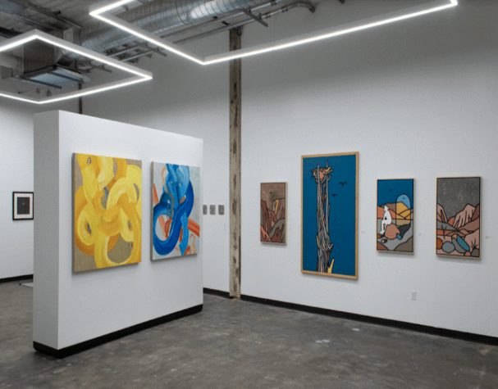
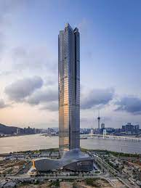
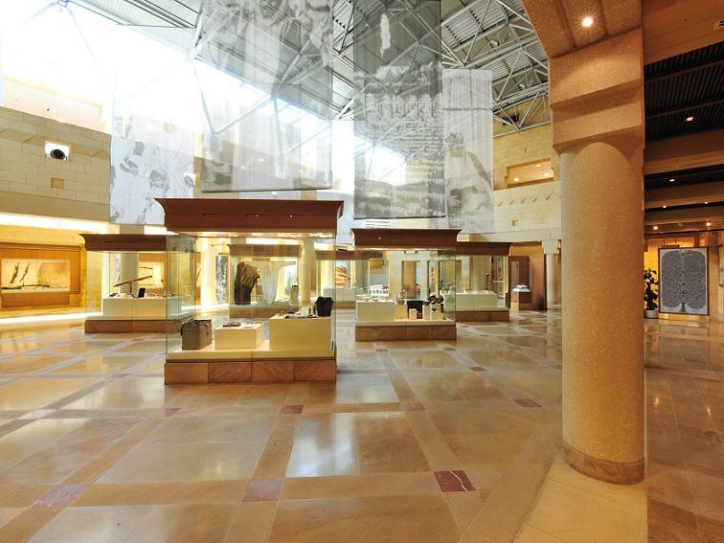
Identify the following objects:
museum –sculpture –gallery –skyscraper –fountain
fountain
gallery
museum
skyscraper

