Slide 1

Unit 6
Do you Know Where It Is?
Form, meaning & Function

Slide 2
بسم الله الرحمن الرحيم
Day:
Date:

Slide 3
Learning Objectives
02
04
differentiate between the articles
write the correct article.
01
03
Use articles correctly
use the definite article correctly.

Slide 4
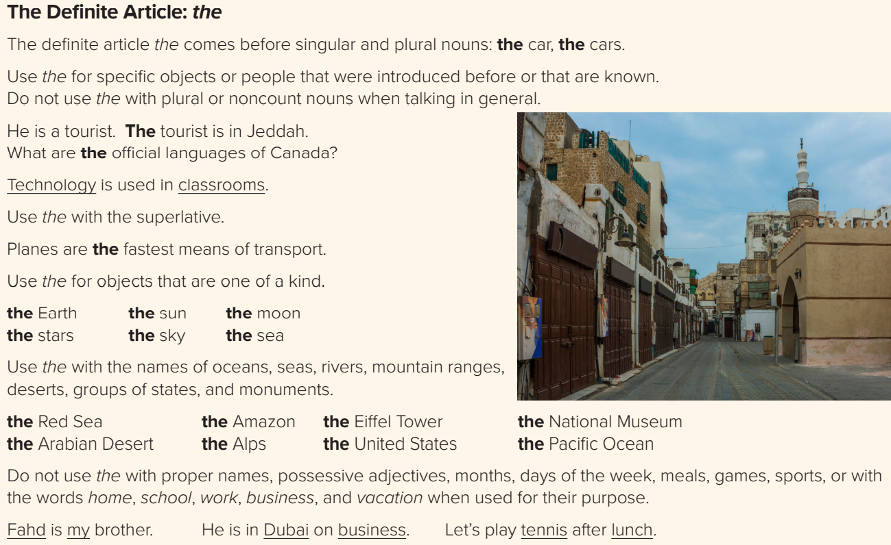
Page:67

Slide 5
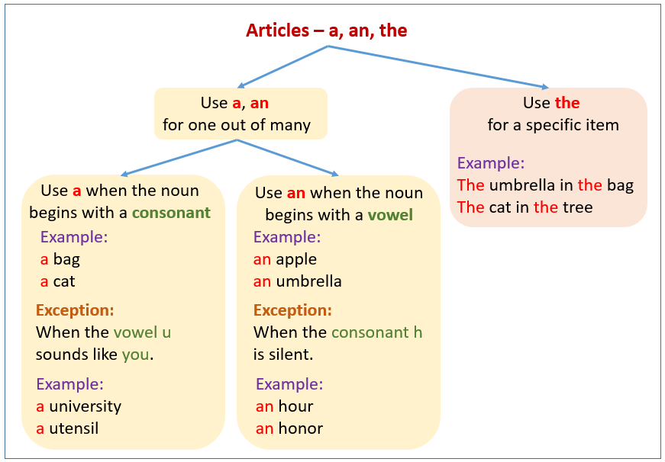

Slide 6
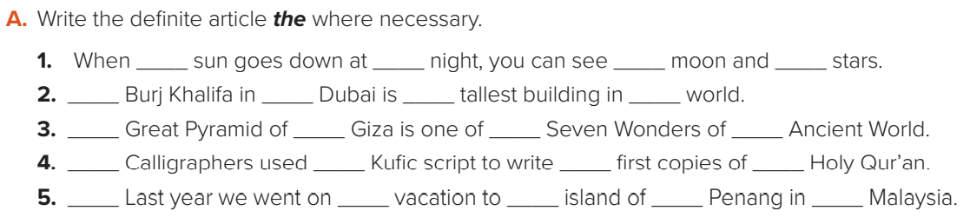
the
the
the
The
the
the
The
the
the
the
the
the
Page:67

Slide 7
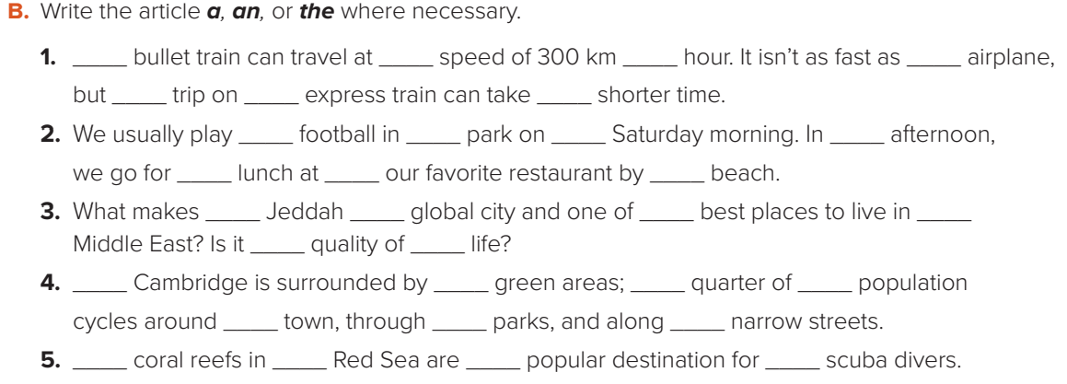
The
a
an
an
a
the
a
the
the
the
a
the
the
the
a
the
the
the
the
The
the
a
Page:67

Slide 8



Slide 9
Homework!
Page 208 (h)

Slide 10
