Slide 1
Unit :6
Do You
Know
Where It Is?
Listen and discuses
By : Asma Almjlad

Slide 3
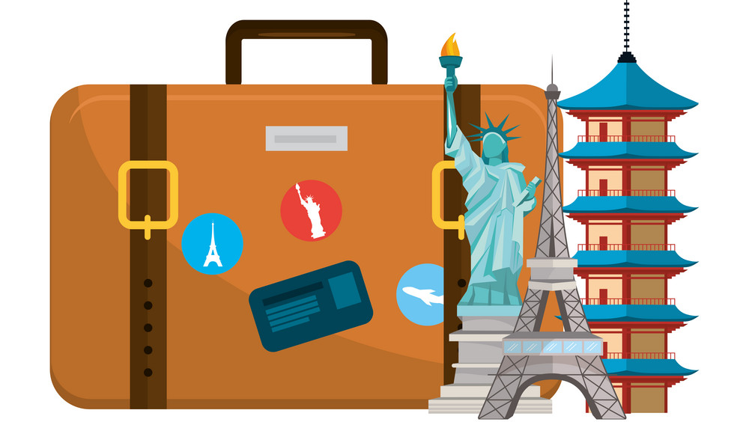
Recognize the comparative and superlative e forms
Describe features of places
Talk about quality of life

Slide 4
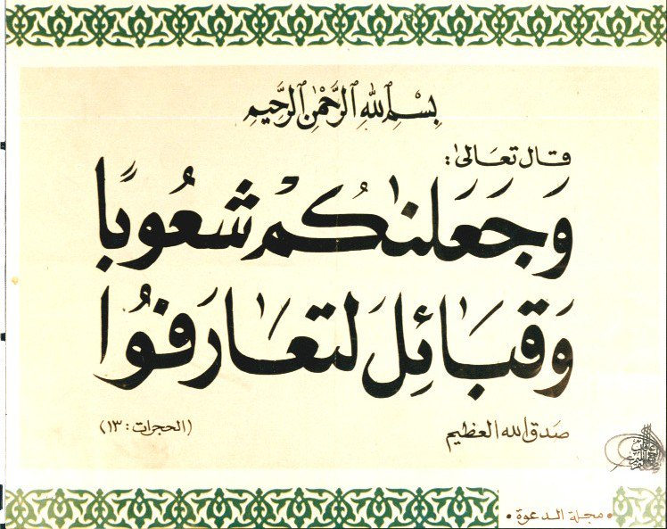

Slide 5
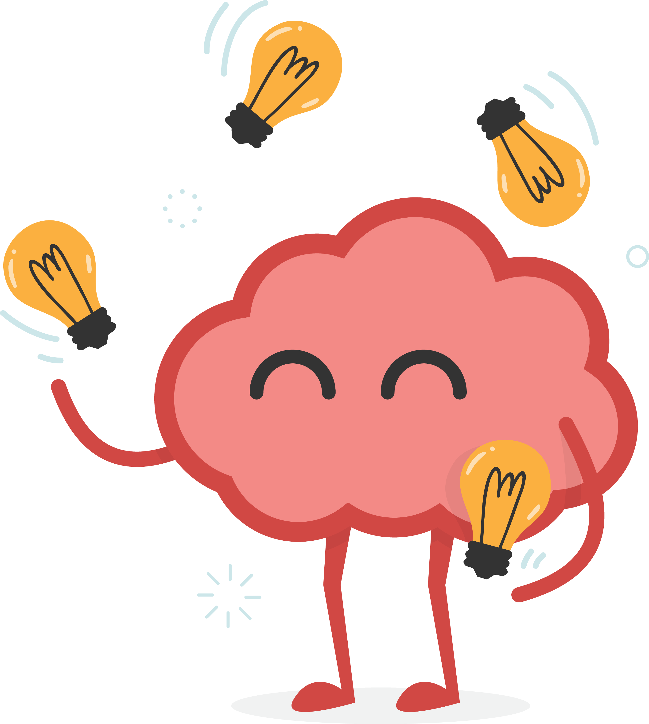
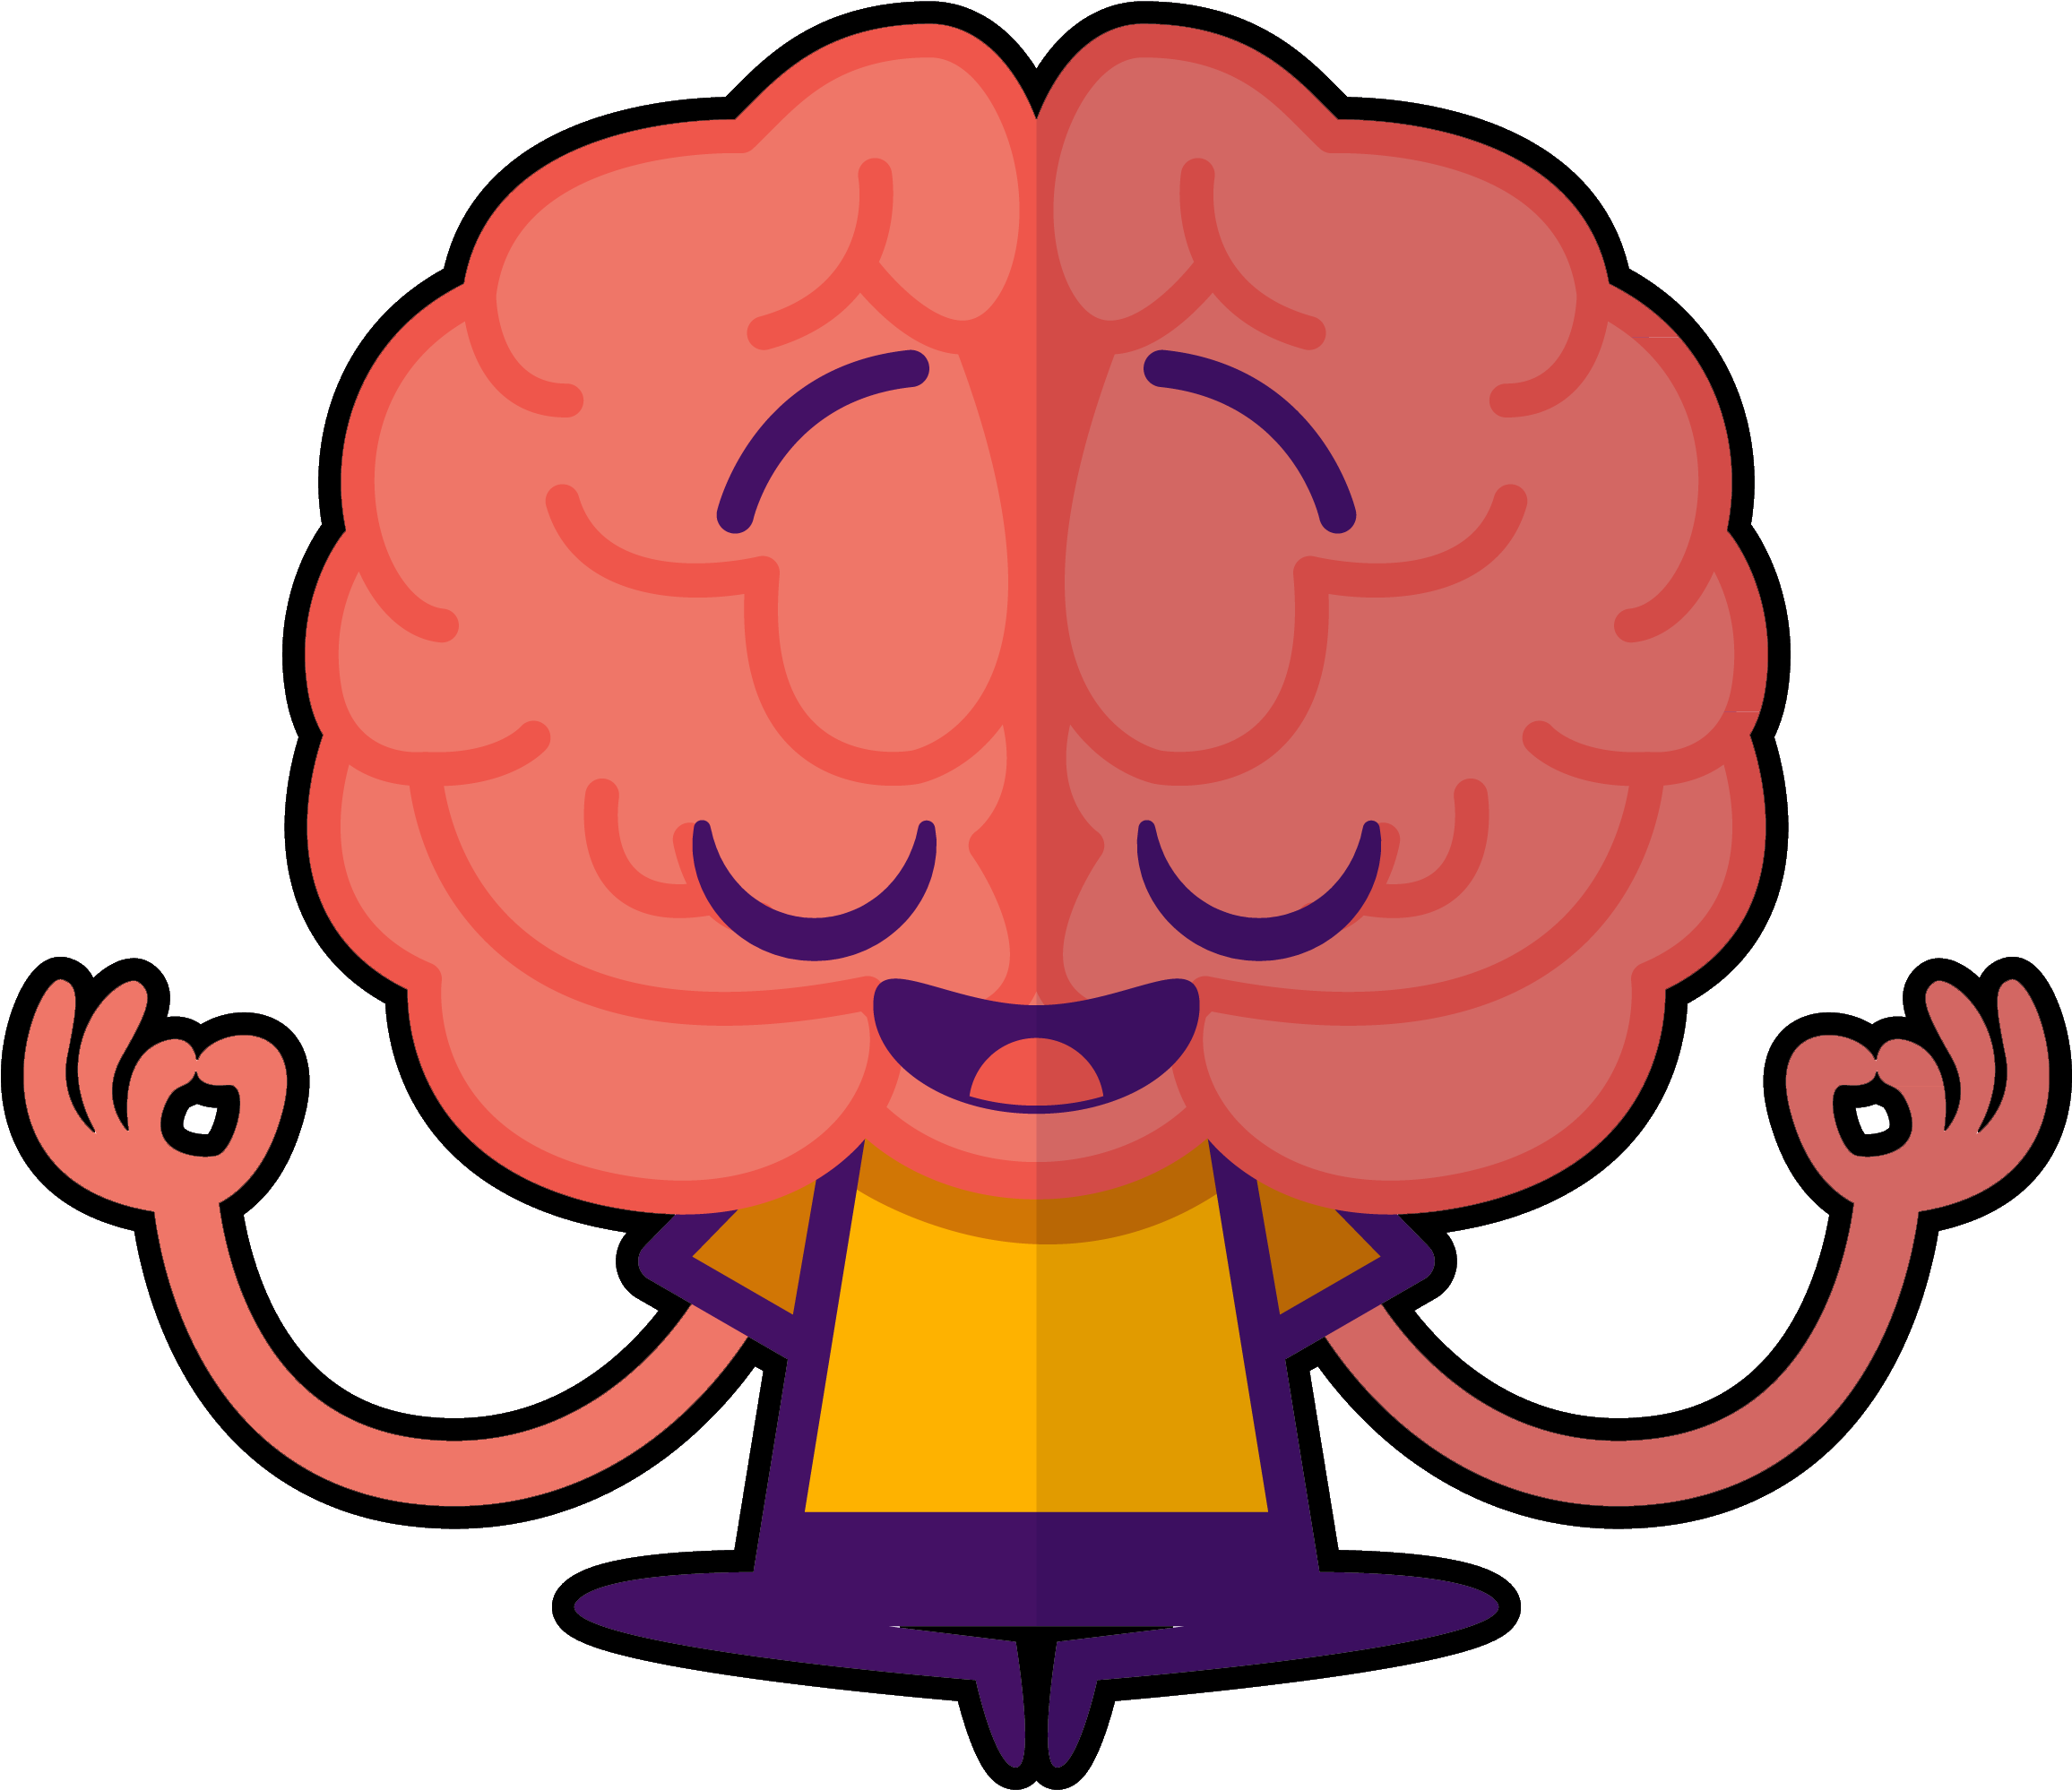

Slide 6
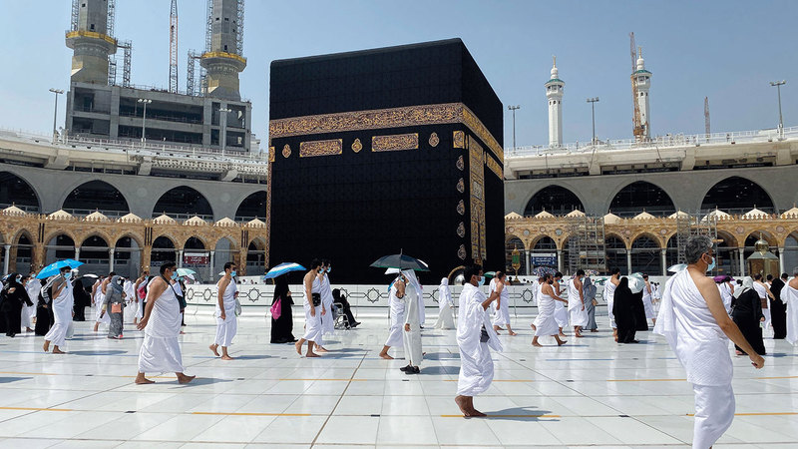
Guess the name of the city
This city is holiest city in Islam

Slide 7
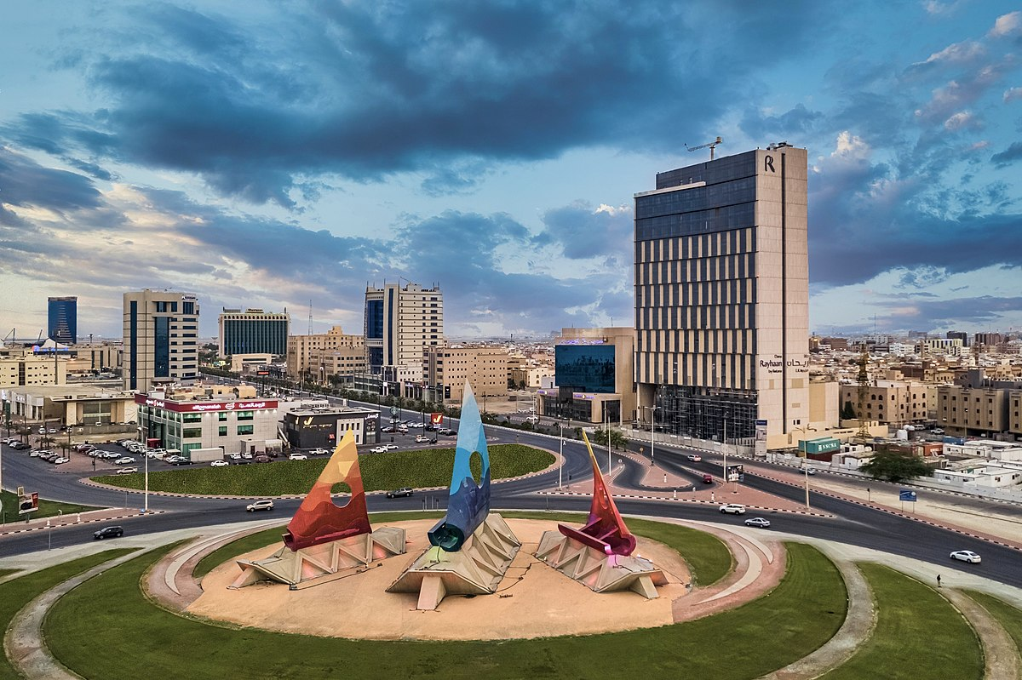
Guess the name of the city
It is known for being a major administrative center for the Saudi oil industry.

Slide 8
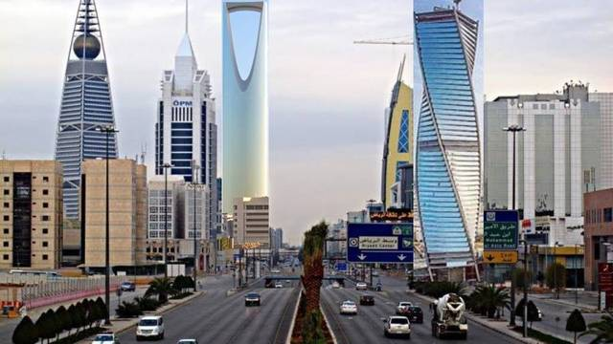
Guess the name of the city
It is the capital of Saudi Arabia and the largest city

Slide 9
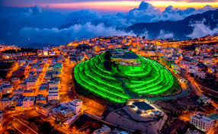
Guess the name of the city
is the capital of 'Asir Region
It has a nice weather in summer

Slide 10
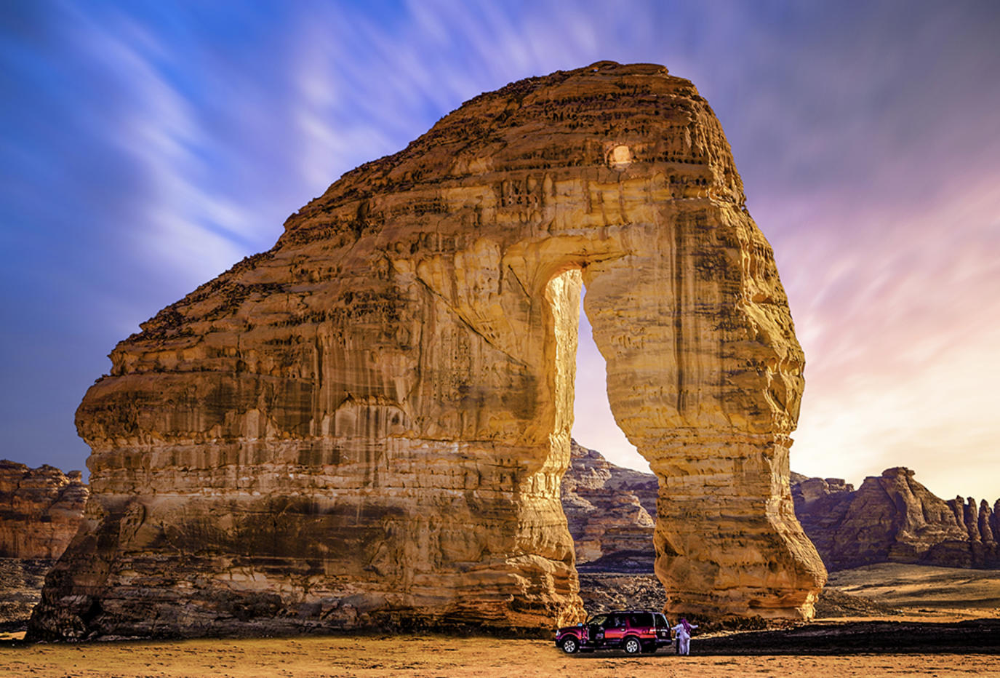
Guess the name of the city
It (also known as Al-Hijr, or Mada'in Saleh )
Winter at Tantora was a traditional celebration in it

Slide 11
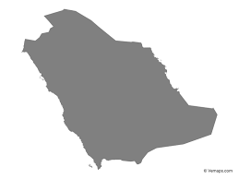
Where do You Live?
Do you think (city) is (boring/exciting), too?
Do you think town is (boring/exciting), too?
Is it city or town ?
Are there good restaurants?
Are there good hospitals?
Are there good cultural events ?
Are there good schools in the town?
Is there good transportation?

Slide 12
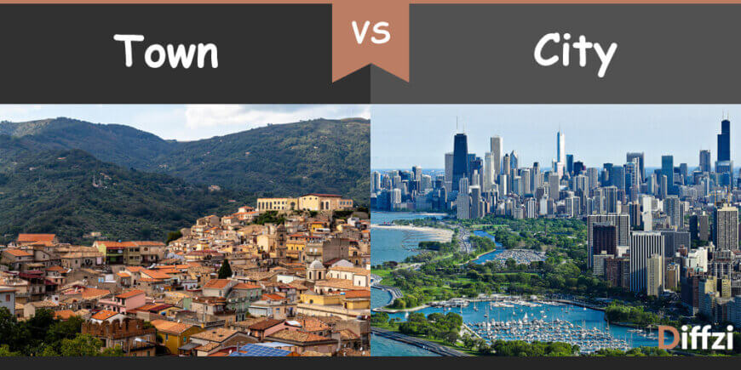
What’s the Difference between
city and town ?
town
city
An area that is smaller than a city and larger than a village
a large human settlement of greater size, population, or importance than a town or village.

Slide 13
The Population of a City Is Generally Bigger
Cities cover a wider area than towns
Towns generally do not have advanced facilities as cities.

Slide 14
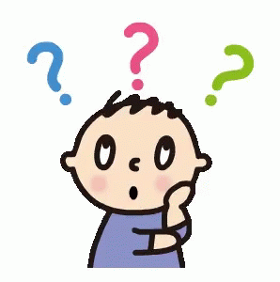
@ page 58+59
How many pictures are there ?
What can you see in these pictures ?

Slide 15
listen
Are the cities in the pictures small, medium-size, or large?
How is the town in picture C different from the city in picture B?
What are the largest cities in the world?

Slide 16
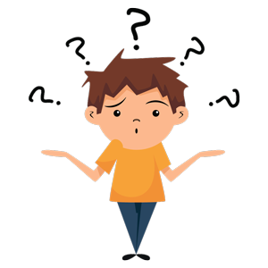
Japan
How fast do you think the train goes?
How do people probably describe the train service in this country?

Slide 17
Hong Kong

Slide 18
Cambridge (England)

Slide 19
Mexico City

Slide 20
This place does not have a lot of crime.
Hong Kong
It takes a long time to get to school or work in this place.
Mexico city
It’s easy to travel between cities in this place.
Japan

Slide 21
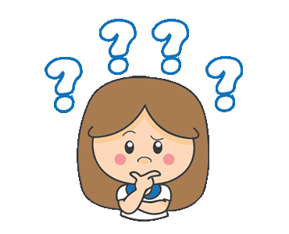
What do you think people want in the town or city they live in?
Do people want hospitals in their town?

Slide 22
Complete
_____ is bigger than _____. (comparative)
_____ is the biggest city in the country. (superlative)
A: the most efficient; as expensive as; shorter
B: the safest; lower
C: the oldest; the largest; as quiet as
D: the worst; worse

Slide 23
false
false
true
false
true

Slide 24
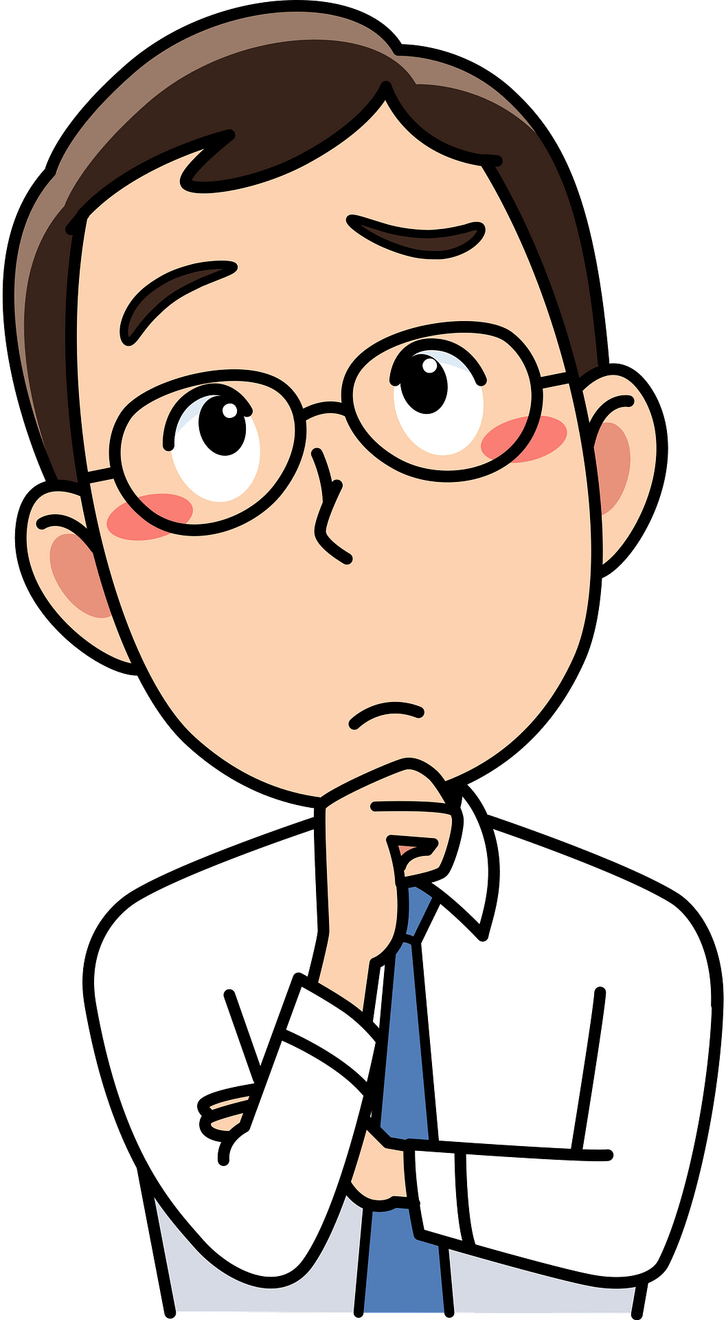

Slide 25
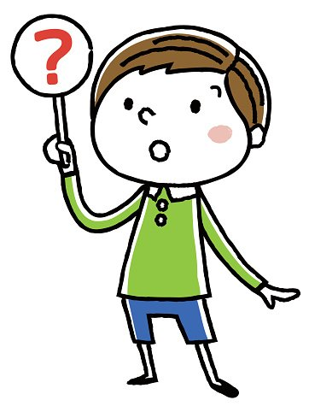
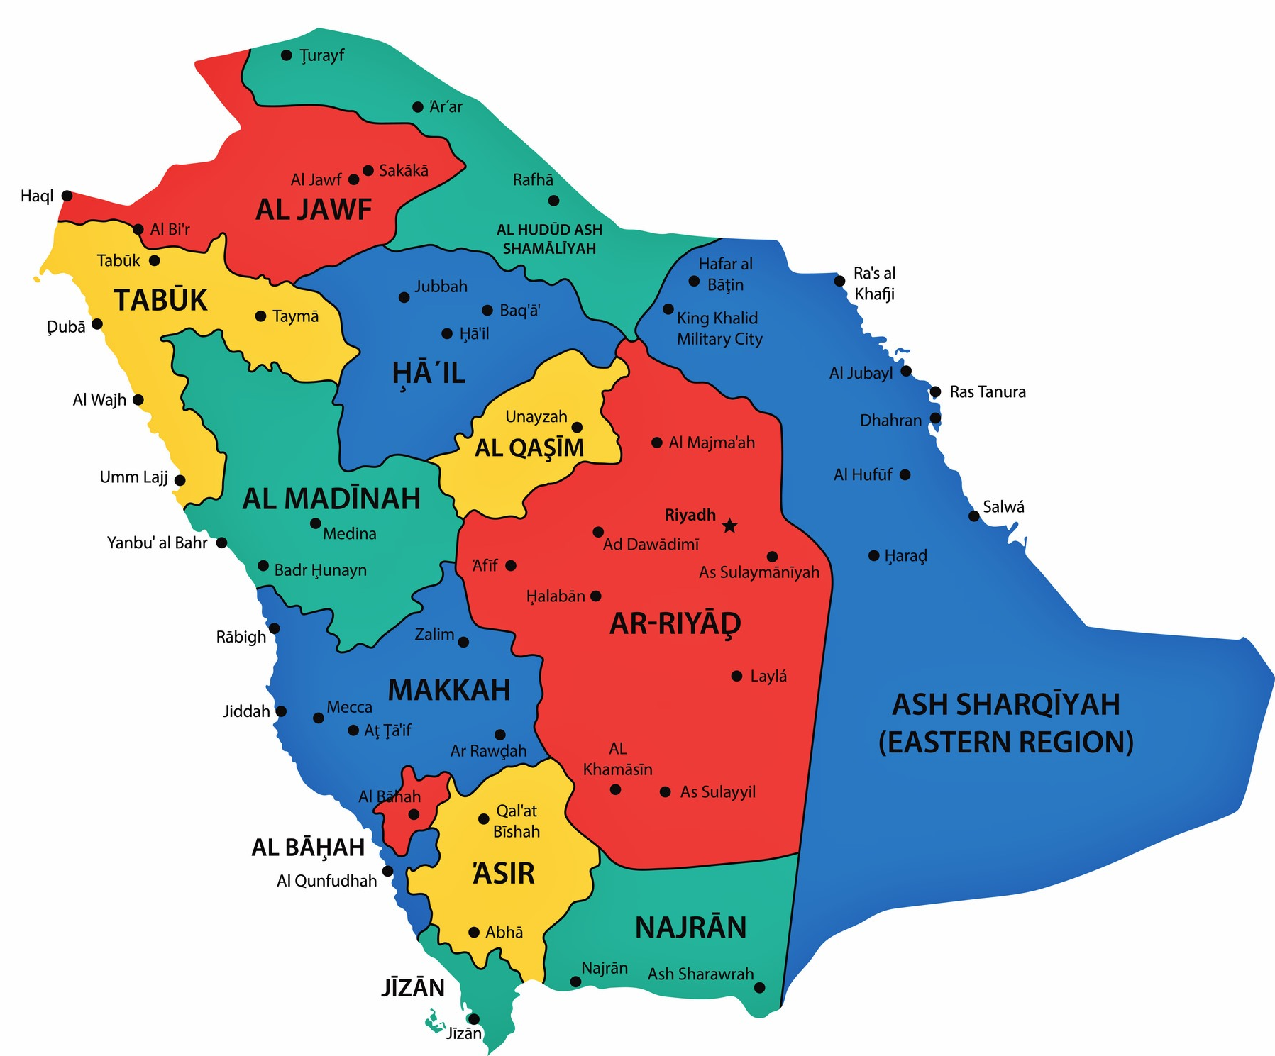
Give examples
Some cities ?
Some towns ?
Some villages ?

Slide 27
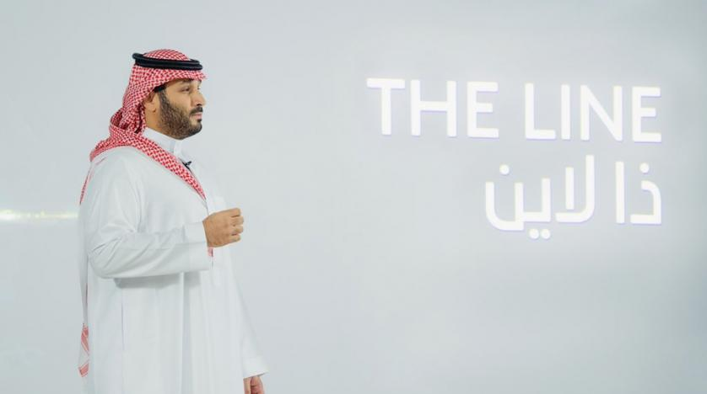
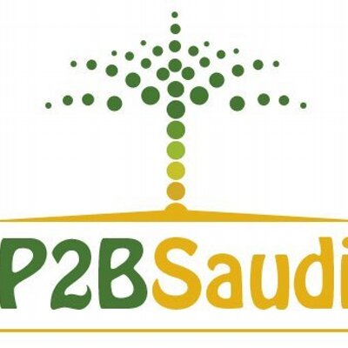
What do you know about crown prince Mohammed bin Salman city

Slide 28
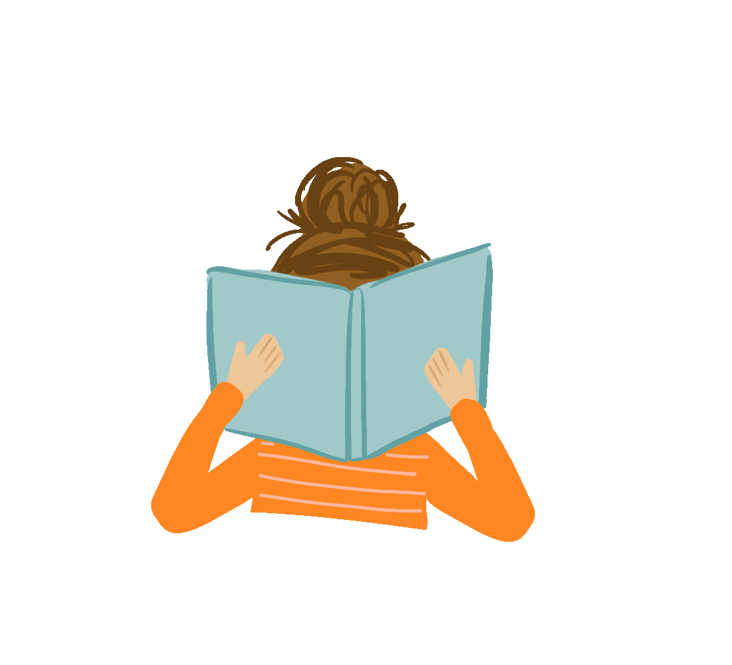
Work
book

Slide 30
cost of living
public transportation system
punctual
efficient
housing
cozy
green spaces
quality of life
crime rate

