Slide 1
NOV 2020
Unit:6
Do you know where it is?
Tr.Ghaliah Alqurashi

Slide 2
L: 1
Listen and discuss

Slide 3
Objectives
02
04
Describe features of places
Find the meaning of new words
01
03
Recognize the comparative and superlative e forms
Talk about quality of life

Slide 4
Click here
Enjoy
https://quizizz.com/join/quiz/5fa5a407277e8f001c0074a8/start

Slide 5
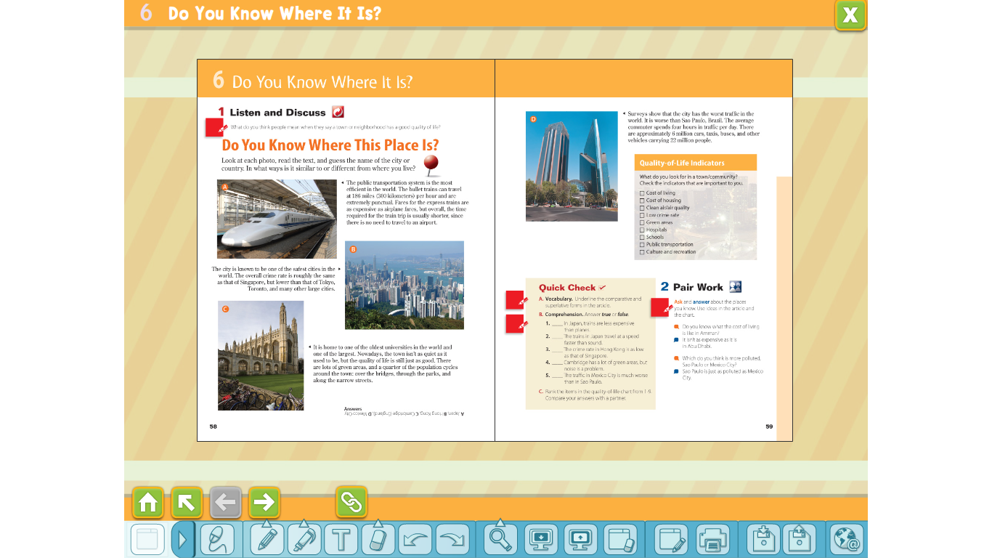
Warm up
1.What’s your hometown like?
2. Do you agree with?
3. what do you think live in Riyadh look like?
4. Make video for granny

Slide 6
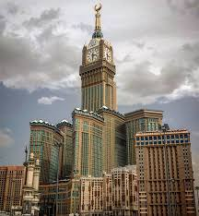
what kinds of services your town or city offers?
Are there good restaurants/hospitals/ cultural events/schools in the town? Is there good transportation/housing?

Slide 7
Open books to page 58

Slide 8
BEFORE READING
01
02
03
04
05
06
How fast do you think the train goes?
How do people probably describe the train service in this country?
Are the cities in the pictures small, medium-size, or large?
07
What are the largest cities in the world?
How is the town in picture C different from the city In picture B?
What is the population of the largest cities?
What problems do large cities have?

Slide 9

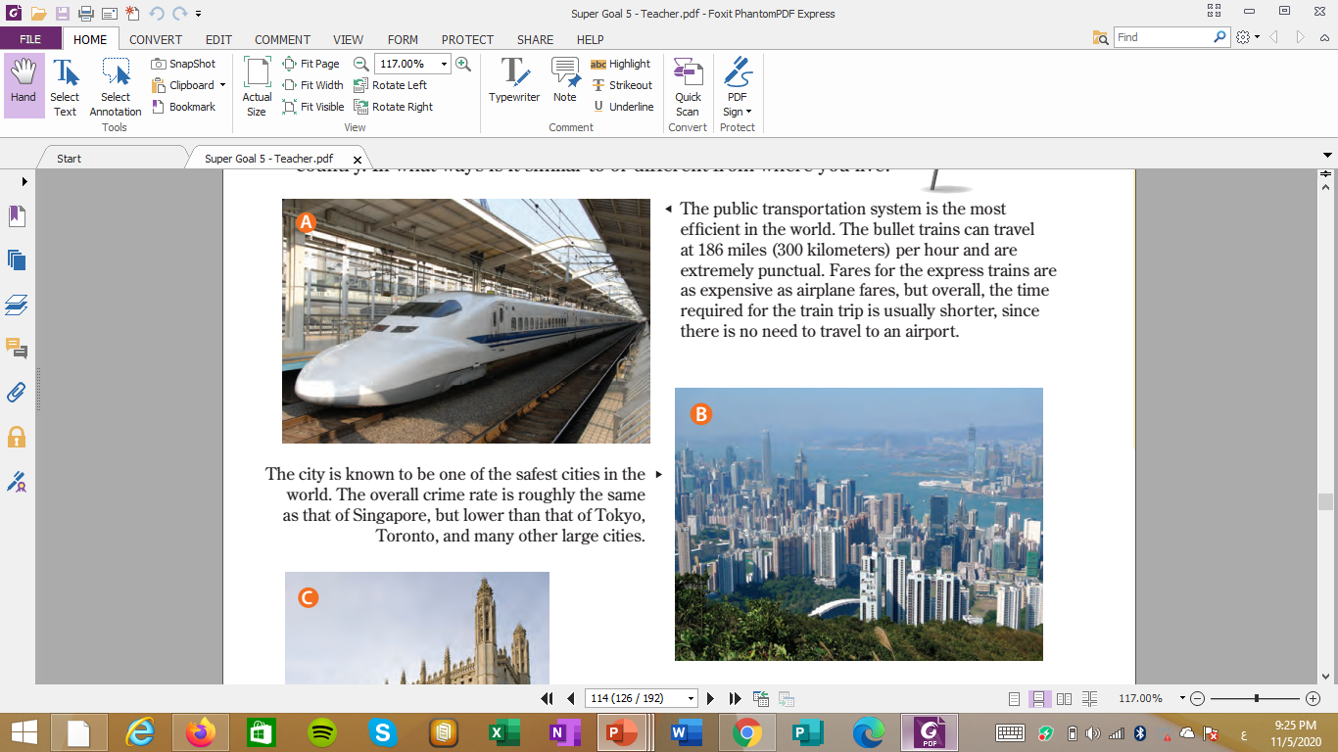
NOV 2020
Japan
The public transportation system is the most efficient in the world. The bullet trains can travel at 186 miles (300 kilometers) per hour and are extremely punctual. Fares for the express trains are as expensive as airplane fares, but overall, the time required for the train trip is usually shorter, since there is no need to travel to an airport.

Slide 10
NOV 2020
Hong Kong
The city is known to be one of the safest cities in the world. The overall crime rate is roughly the same as that of Singapore, but lower than that of Tokyo,
Toronto, and many other large cities.

Slide 11
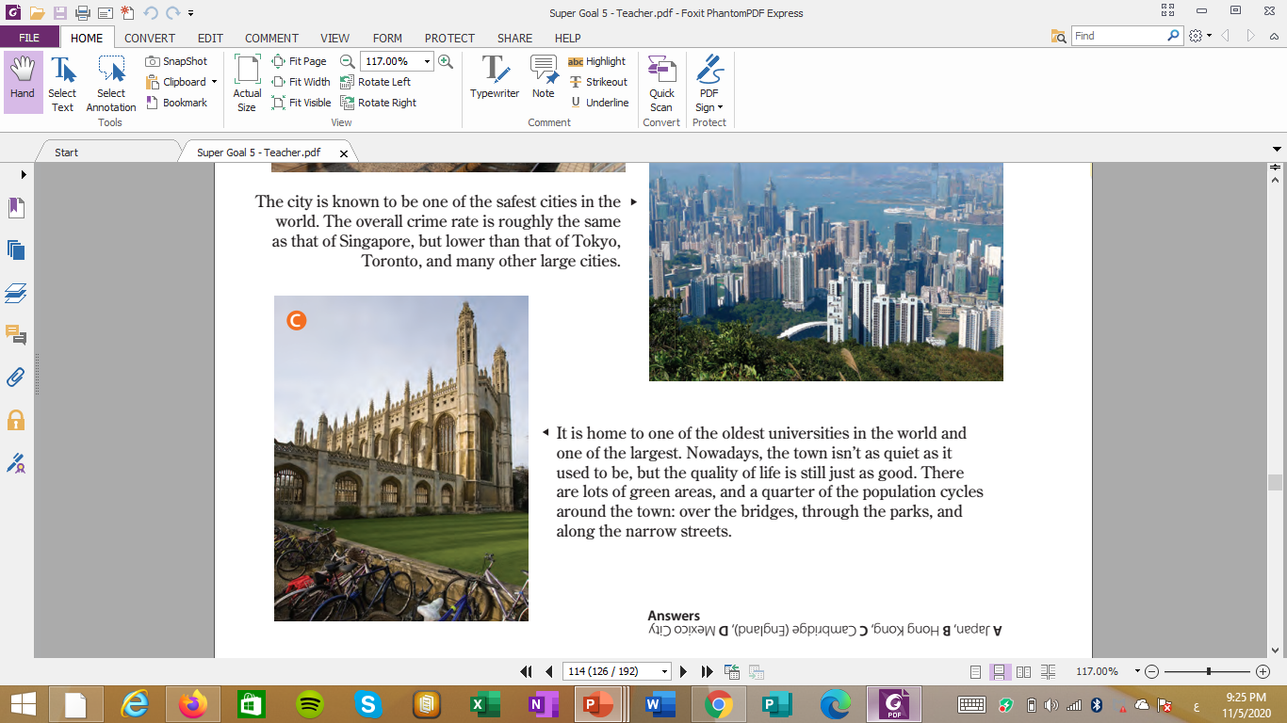
NOV 2020
Cambridge(England)
It is home to one of the oldest universities in the world and one of the largest. Nowadays, the town isn’t as quiet as it used to be, but the quality of life is still just as good. There are lots of green areas, and a quarter of the population cycles around the town: over the bridges, through the parks, and along the narrow streets.

Slide 12
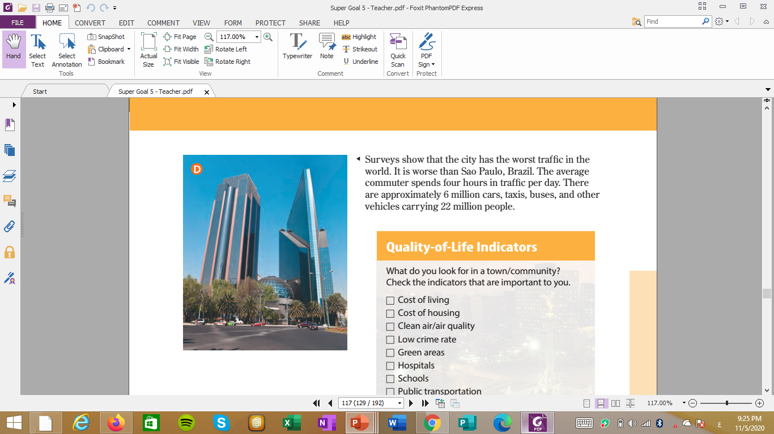
NOV 2020
Mexico City
Surveys show that the city has the worst traffic in the world. It is worse than Sao Paulo, Brazil. The average commuter spends four hours in traffic per day. There are approximately 6 million cars, taxis, buses, and other vehicles carrying 22 million people.

Slide 13
It takes a long time to get to school or work in this place.
This place does not have a lot of crime.
It’s easy to travel between cities in this place.
MEXICO CITY
HONG KONG
JAPAN

Slide 14
1
2
What do you think people want in the town or city they live in?
Do people want hospitals in their town?

Slide 15
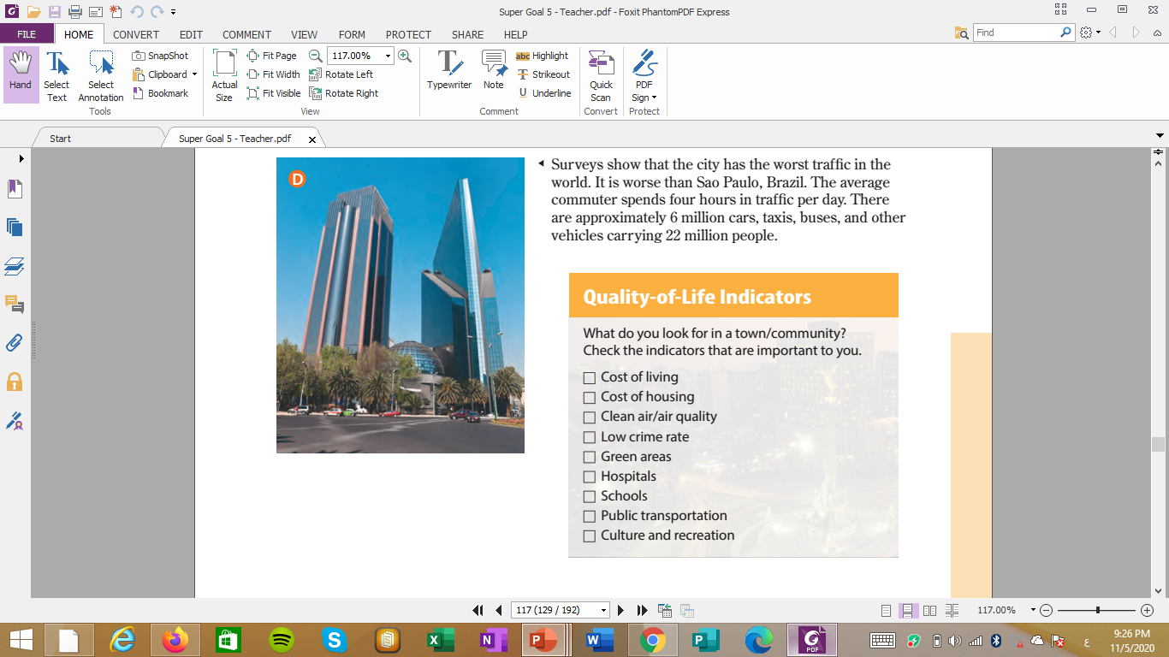

Slide 16
1
2
Did anybody mention prices for things like food, rent, and telephone service?
Did anybody talk about the cost of buying a home or renting an apartment?
That’s the cost of living
That’s the cost of housing.

Slide 17
Practice
Complete:
1. .………….…………. Is begger than …………….…
2. ……………………… is the begest city in the country.

Slide 18
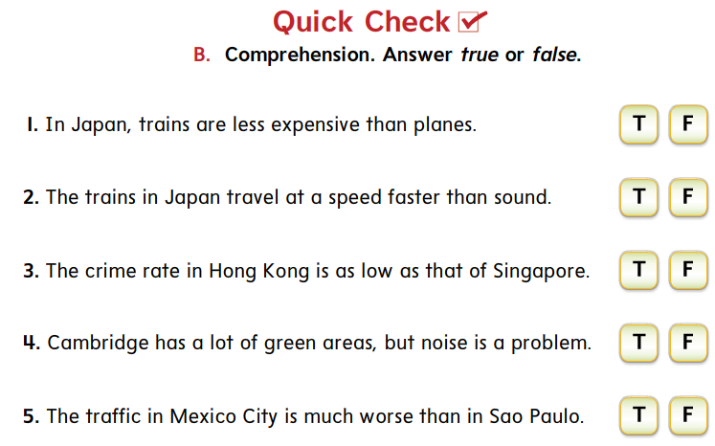

Slide 19
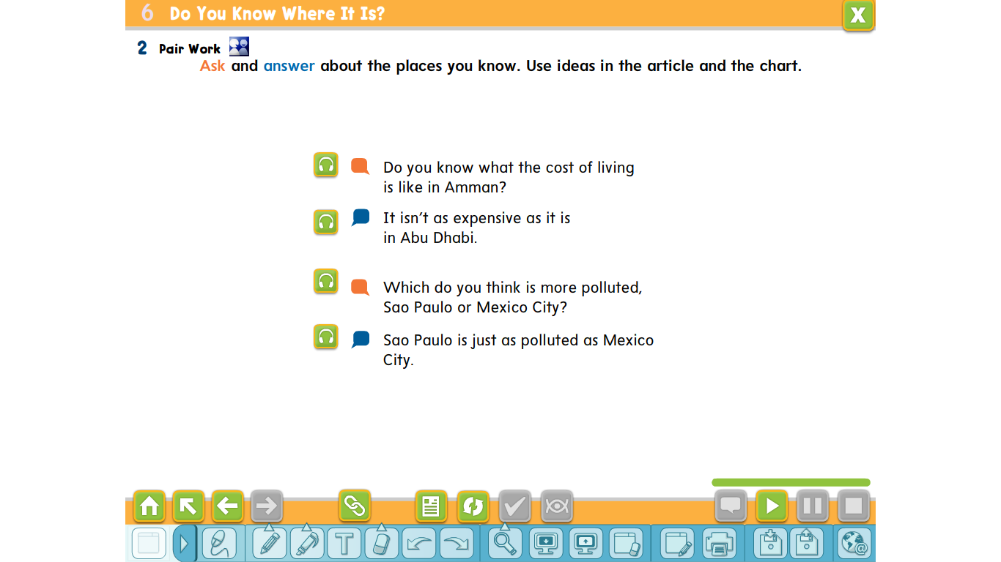

Slide 20
Is it better to live in a house or an apartment?

Slide 21
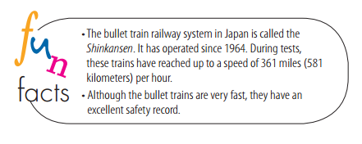

Slide 22
THANKS!

Slide 23
Grammar

Slide 24
Examples :
Ali is taller than Ahmad
Ali is the tallest in the school
Comparative
superlative

Slide 25
#Rule 1: in (adjectives ) Comparative :
- one or two syllabus we use with it ( ..ER at the end of the adjective).
- we use THAN before the object .
- three or more syllabus we use ( MORE before the adjective) .

Slide 26
#Rule 2: in (adjectives ) Superrlative:
- one or two syllabus we use with it ( ..EST at the end of the (adjective).
- we use THE before (adjective).
- three or more syllabus we use ( THE MOST before the (adjective) .

Slide 27
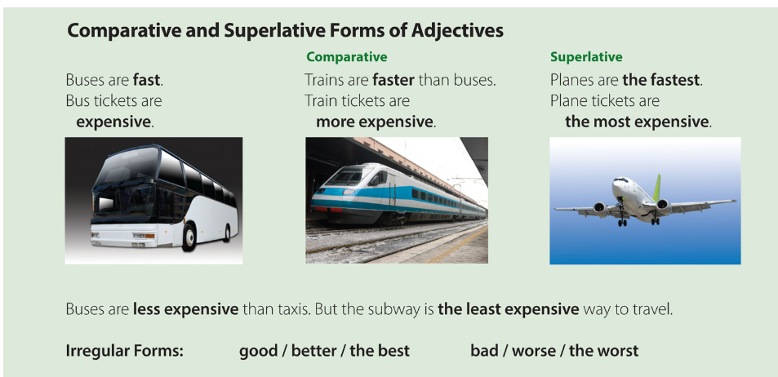

Slide 28
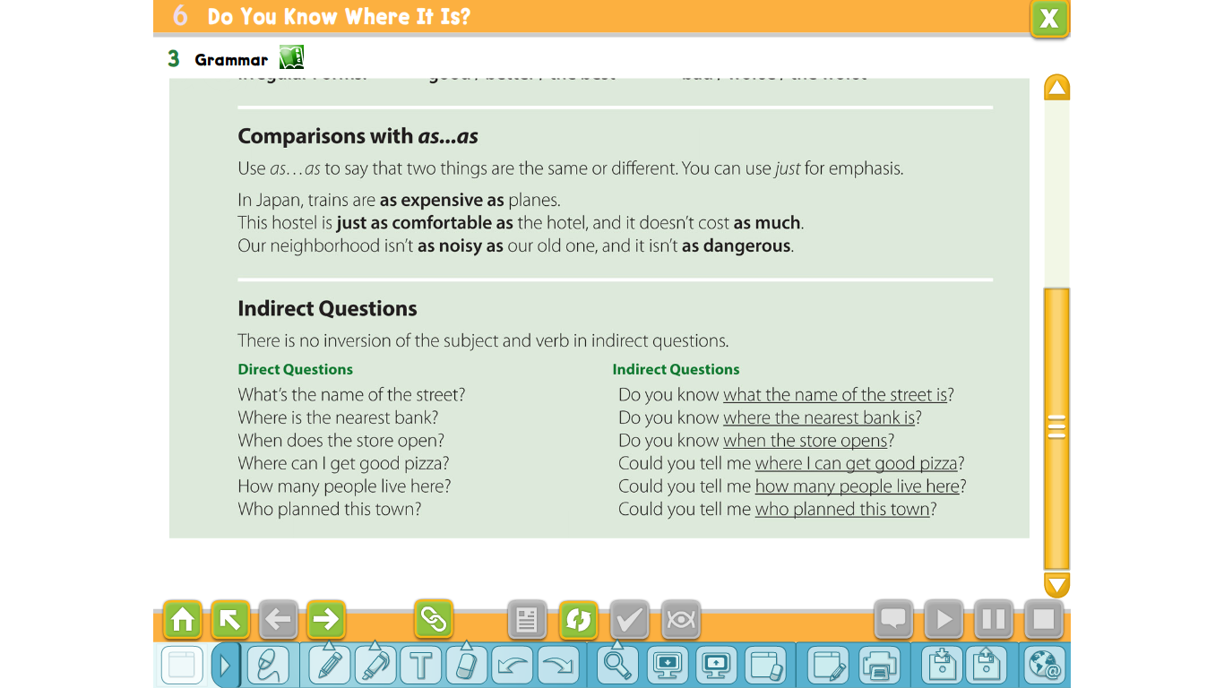

Slide 30
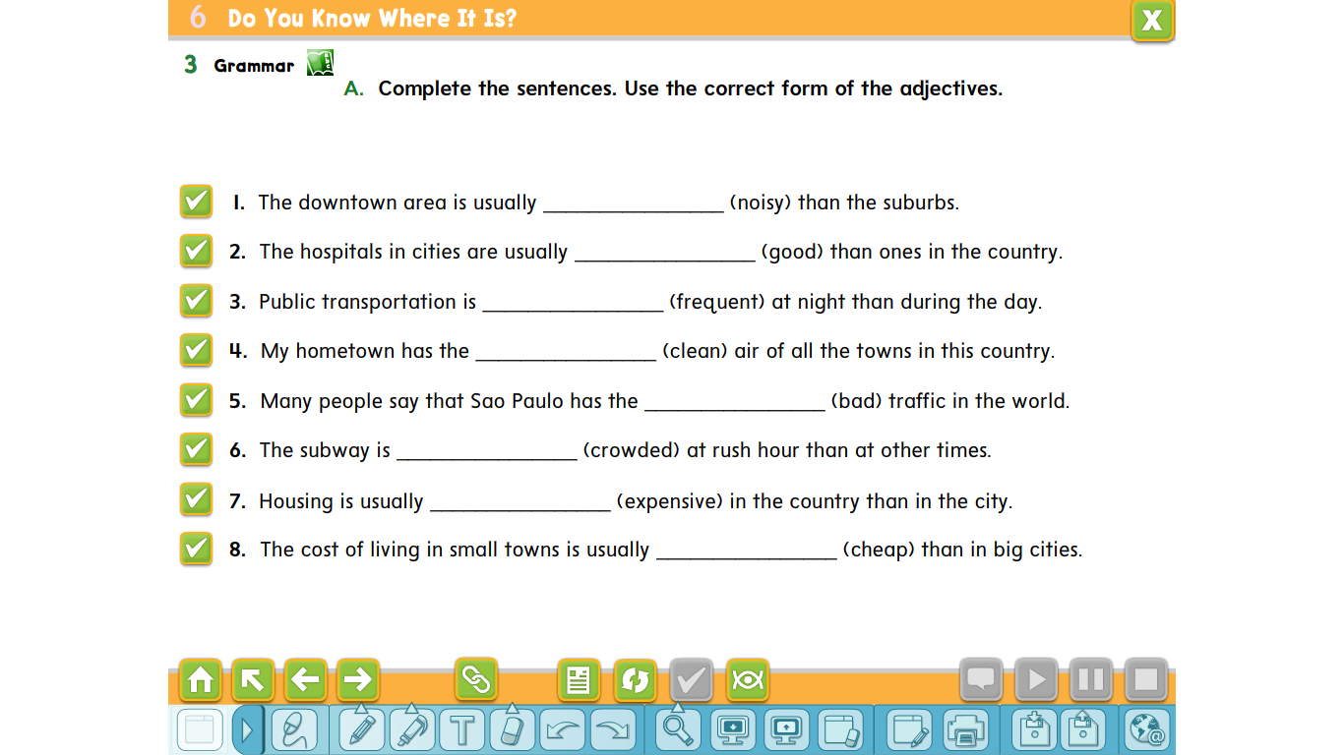
noisier
better
less frequent
cleanest
worst
more crowded
less expensive
cheaper

Slide 31
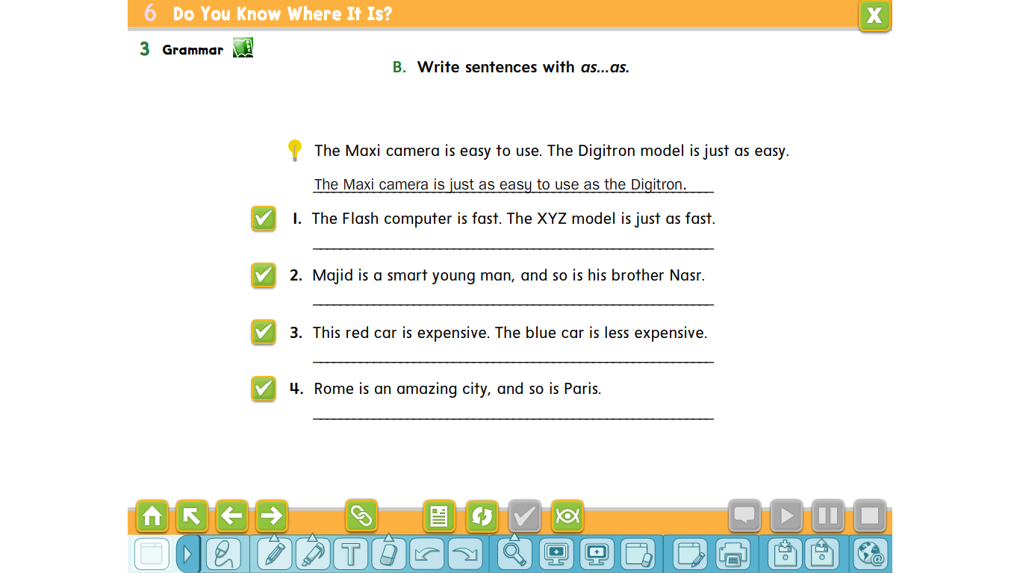
The XYZ model is as fast as the Flash computer.
Majid is as smart as his brother Nasr.
The blue car isn’t as expensive as the red car.
Paris is as amazing as Rome

Slide 32
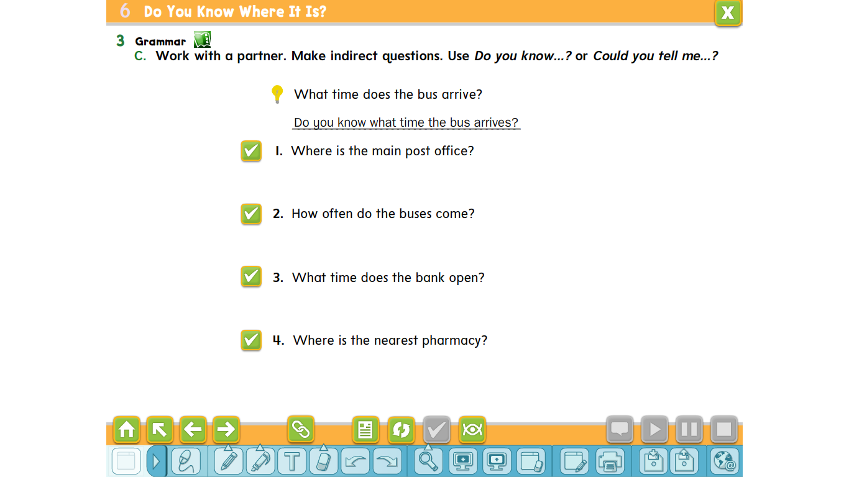
Do you know where the main post office is?
Could you tell me where the main post office is?
Do you know how often the buses come?
Could you tell me how often the buses come?
Do you know what time the bank opens?
Could you tell me what time the bank opens?
Do you know where the nearest pharmacy is?
Could you tell me where the nearest pharmacy is?

Slide 33
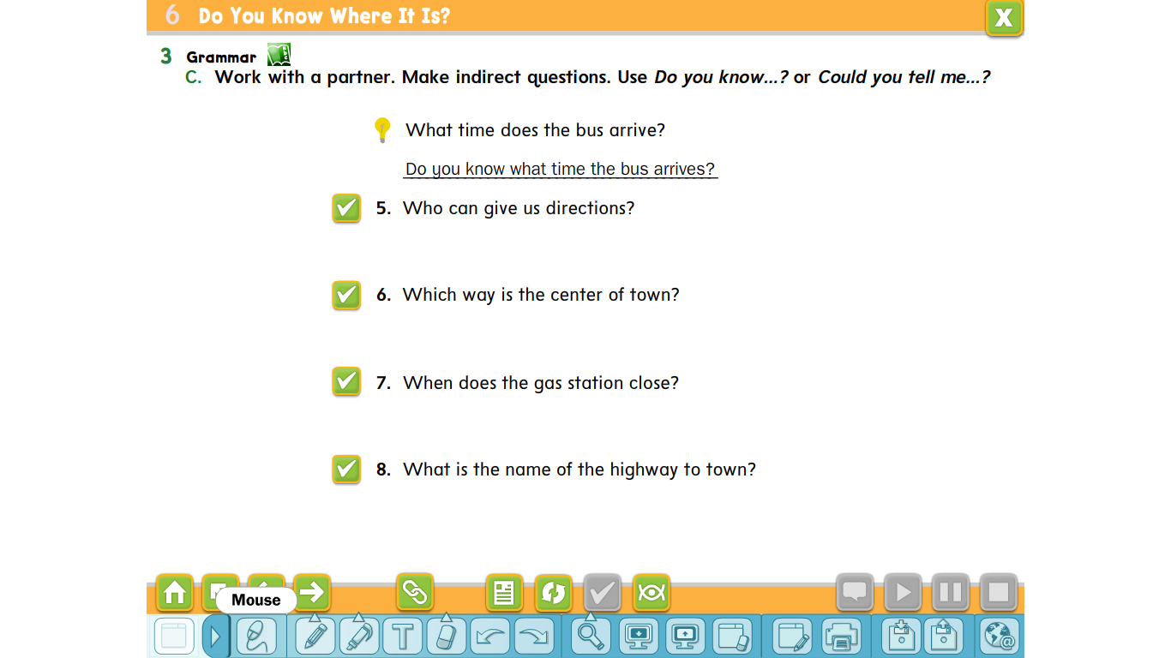
Do you know who can give us directions?
Could you tell me who can give us directions?
Do you know which way the center of town is?
Could you tell me which way the center of town is?
Do you know when the gas station closes?
Could you tell me when the gas station closes?
Do you know what the name of the highway to town is?
Could you tell me what the name of the highway to town is?

Slide 34
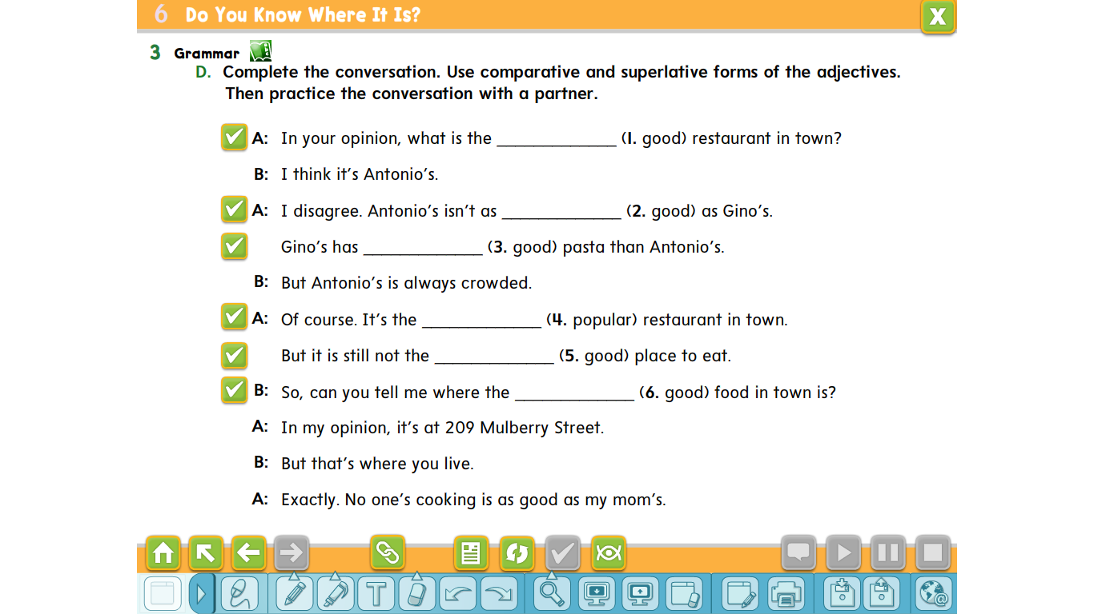
best
good
better
most popular
best
best

Slide 35
Language and context + listening + pronunciation + conversation

Slide 36
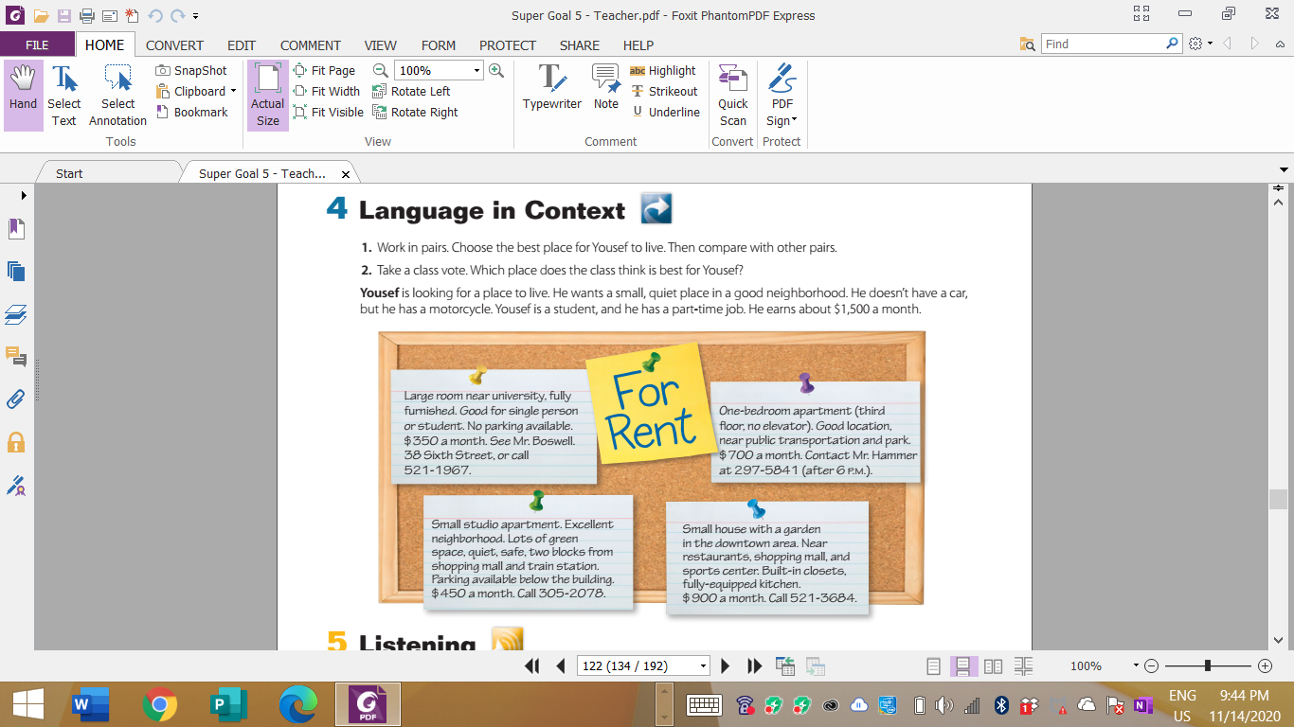

Slide 37
-Which place is the most/least expensive?
-Is the house more expensive than the apartment?
-Which place is the most convenient for transportation?
-Which neighborhood is the best? Why?

Slide 38
- What happens to the garbage we throw away every year?
-How many kilos of trash do you think you throw away every day?
-How careful are you about recycling?
-What kinds of things can people recycle?

Slide 39
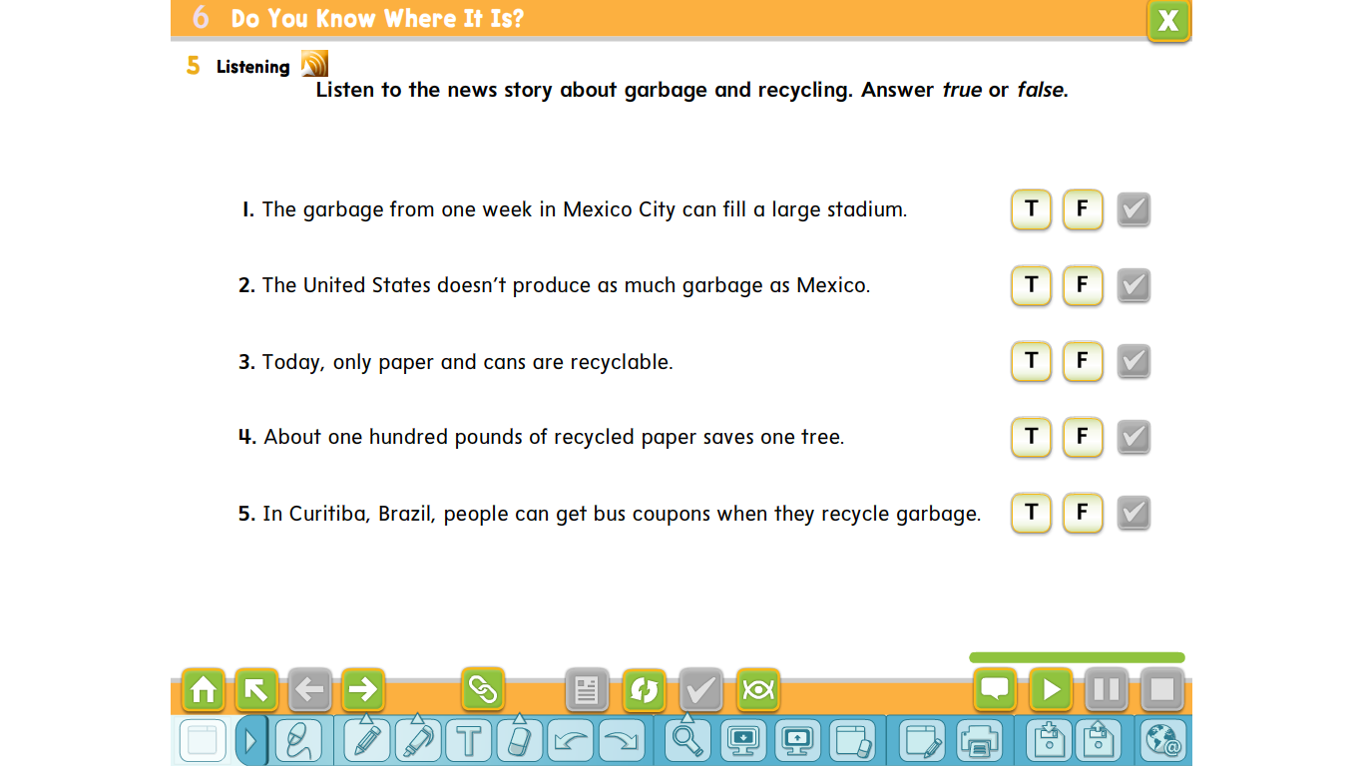

Slide 40
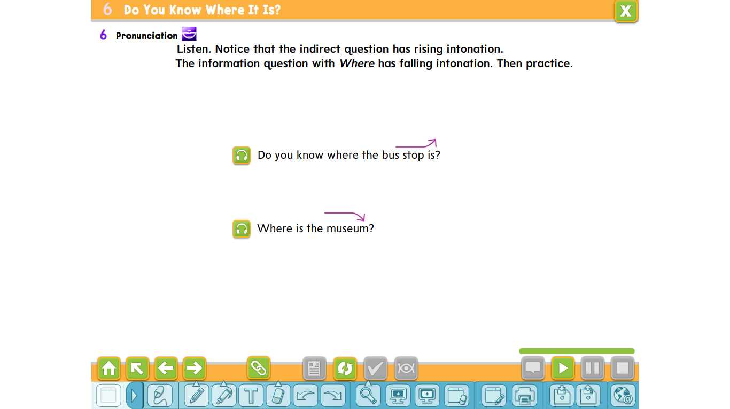

Slide 41
What are the advantages/disadvantages of living in the suburbs/ city?

Slide 42
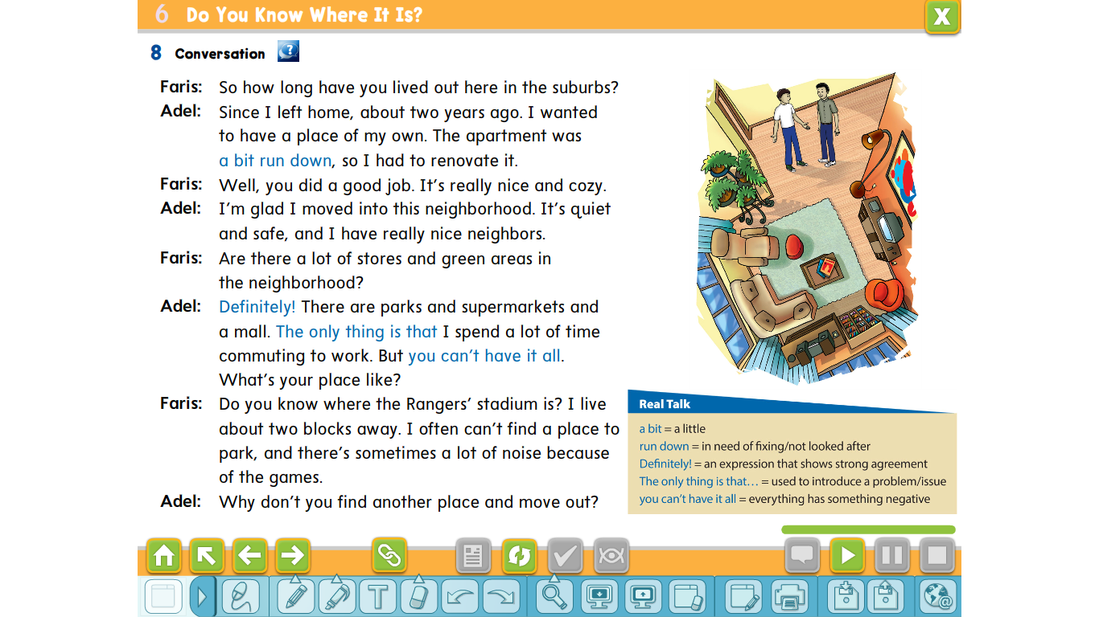

Slide 43
Think – pair – share
Was it very run down or a little run down?
Who says a bit?
Adel’s apartment was a bit what?
Why isn’t it run down now?
Are there any buildings in our town that are run down?
What does Adel say was run down?
( Adel)
(run down)
( a little)
(his new apartment)
(He renovated it.)

Slide 44
Think – pair – share
Will you be happy if you have no homework tonight?
Who says Definitely?
Why does he say it?
What does he say next?
Is this a good thing or bad thing?
Who says The only thing is that…?
( Adel)
(He is very certain about his answer to the question.)
(Adel)
(He spends a lot of time
commuting.)
(bad)

Slide 45
Who says You can’t have it all?
Why does he say it?
(He likes everything about where he lives except for one thing, the commute.)
Adel

Slide 47
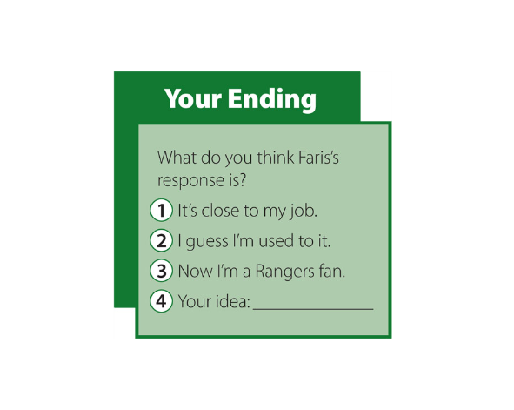

Slide 48
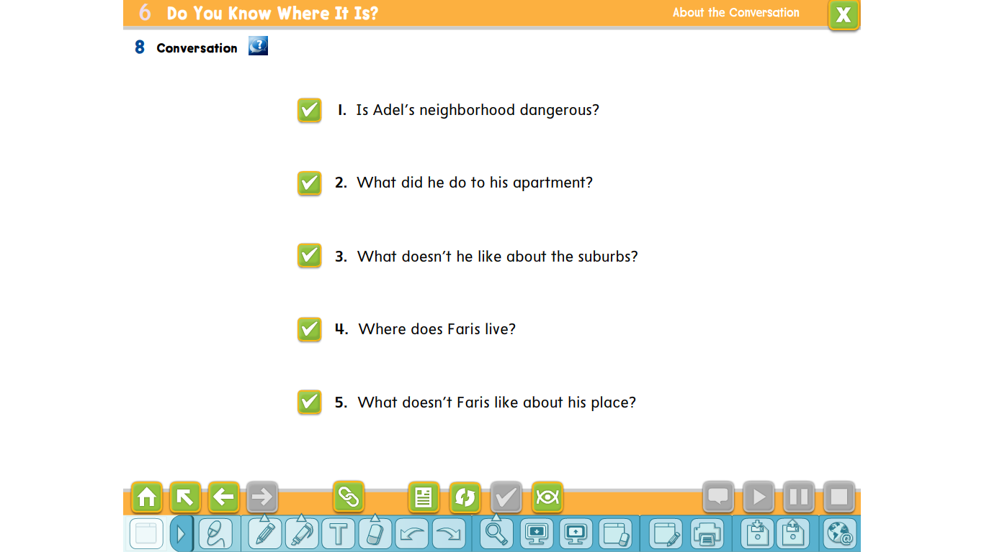
No, it isn’t. It’s safe.
Adel renovated his apartment.
He spends a lot of time commuting to work.
Faris lives near Rangers Stadium.
He often can’t fid a place to park, and sometimes there is a lot of noise.

Slide 49
Reading

Slide 50
Before Reading
1. Which cities in the Middle East do you think have the best quality of life?
2. What do you base your opinions on?
Give reasons.

Slide 51
What do you think Jeddah is famous for?
What do you see? How would you describe the city? Why do you think people go there
Describe this building. Would you like to visit it?
Why do you think people go there?
How old do you think the building is? What do you think people use this building for today?
What aspects do you think make Jeddah a great place to live?

Slide 52
Finding the main idea and supporting details

Slide 53
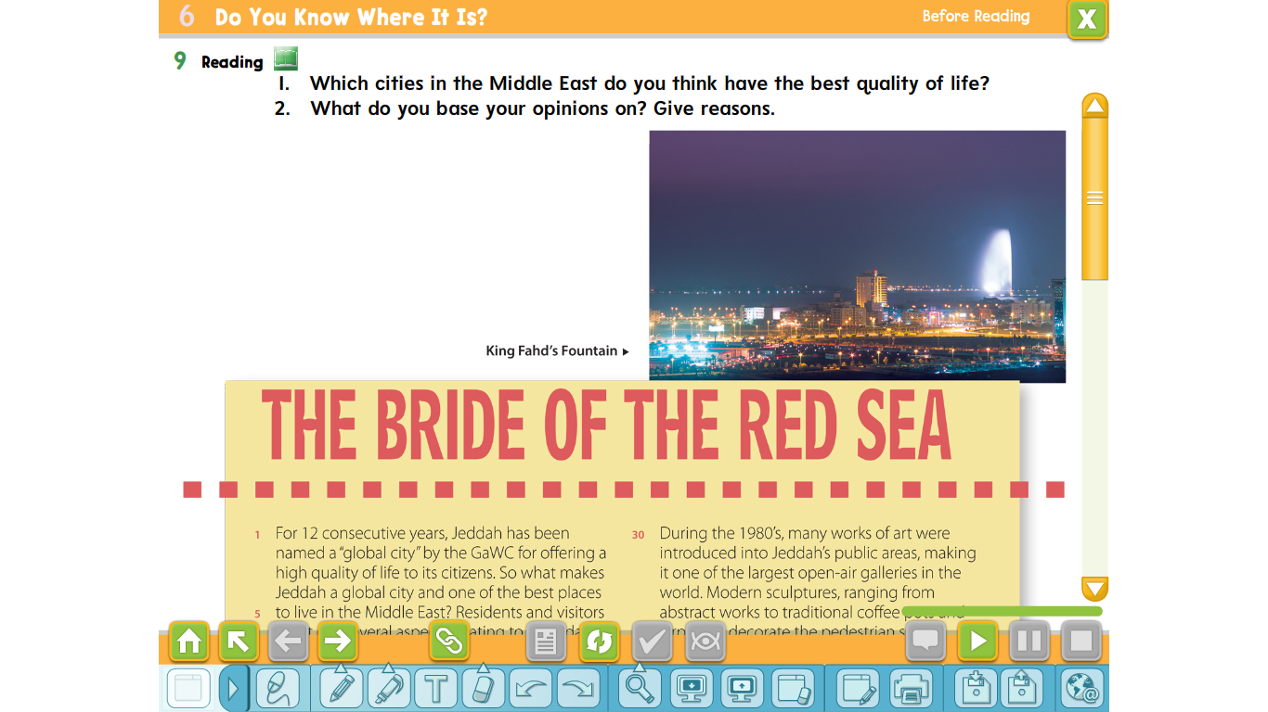
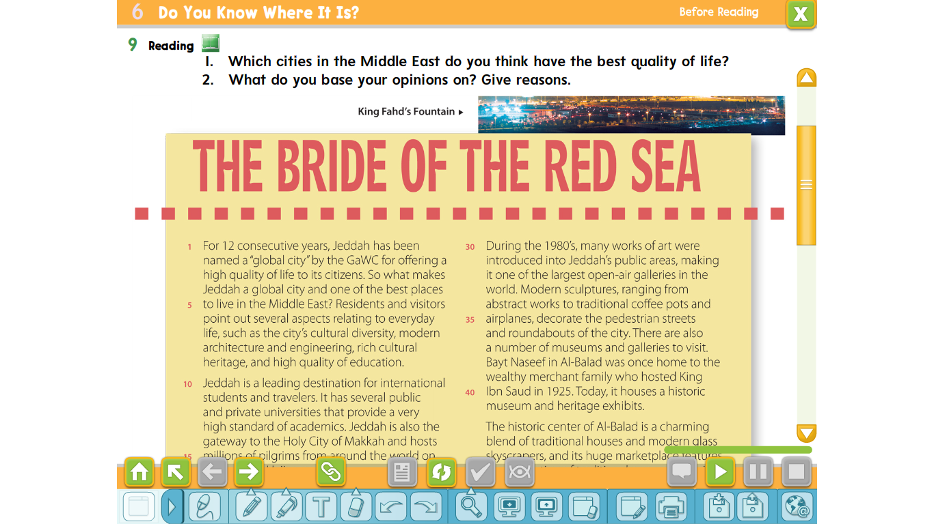
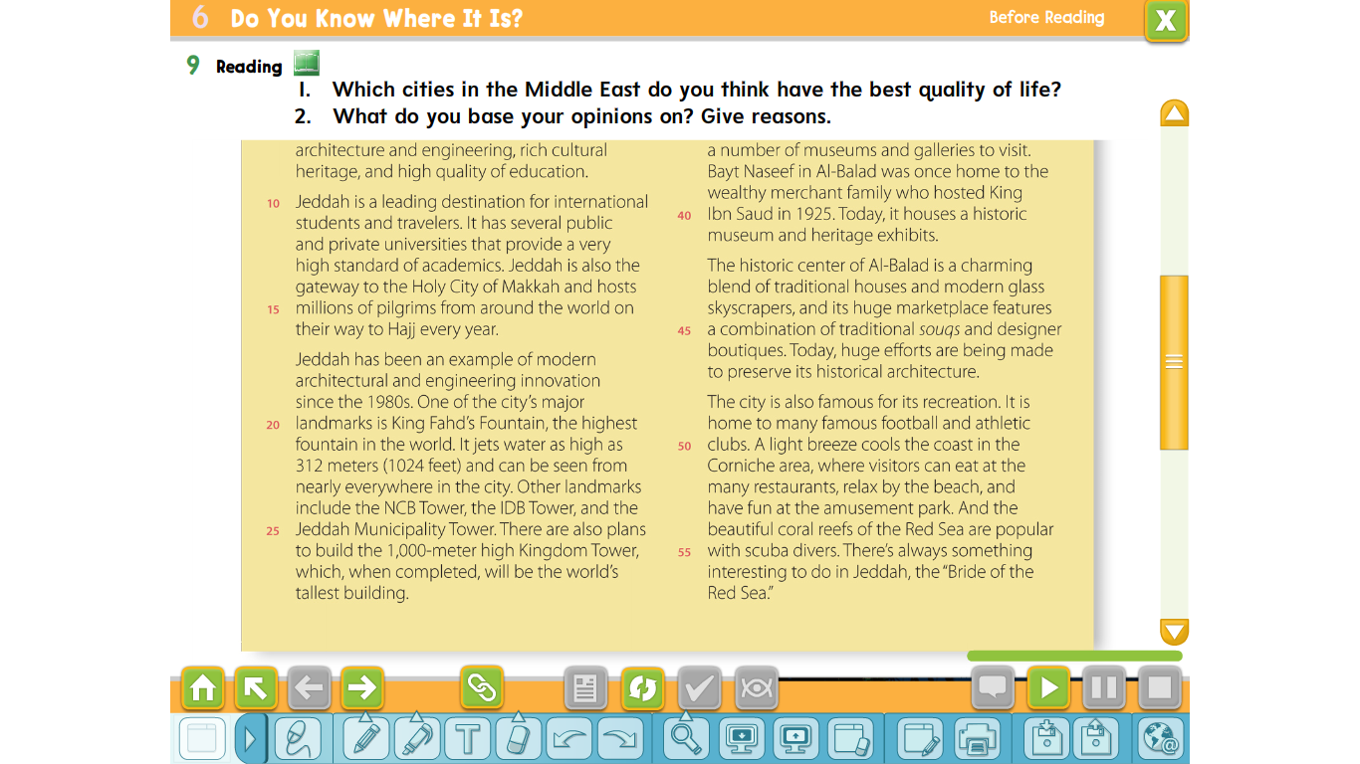

Slide 56
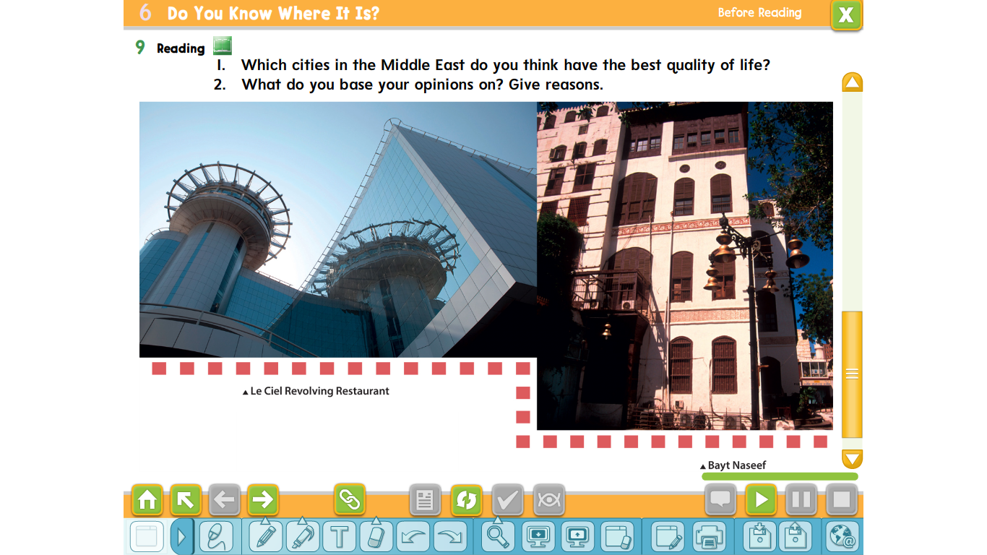

Slide 57
Words and their meaning
point out =
rich =
cultural heritage =
diversity =
gateway =
pilgrim =
tell someone information you think they do not know
containing a lot of something good
the buildings, customs, languages, etc., that have existed for a long time and continue to be important to a society
the state of having a lot of different cultures
an entrance or an important means of access
a person who travels to a holy place

Slide 58
Words and their meaning
abstract =
charming =
expressing ideas by using colors, lines, and shapes without a realistic picture
very attractive or pleasing

Slide 59
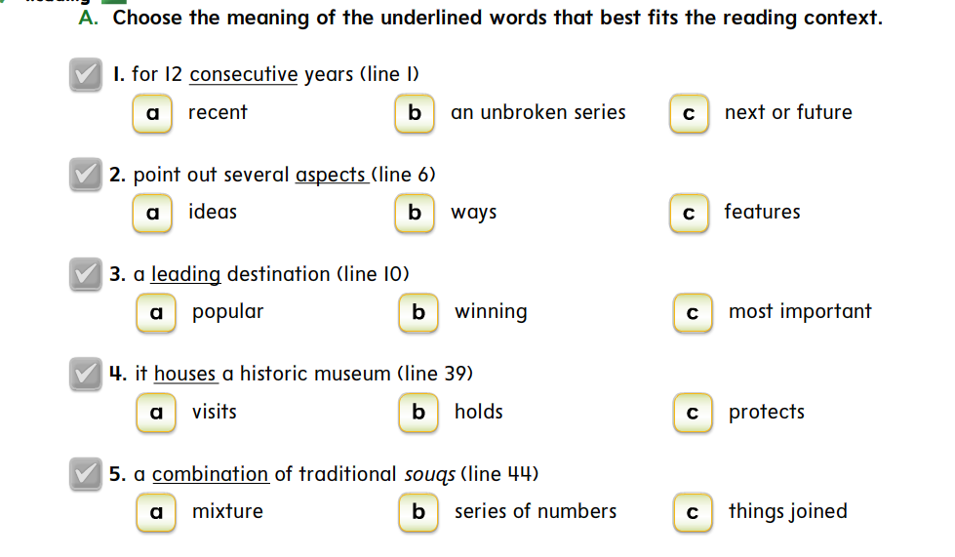

Slide 60
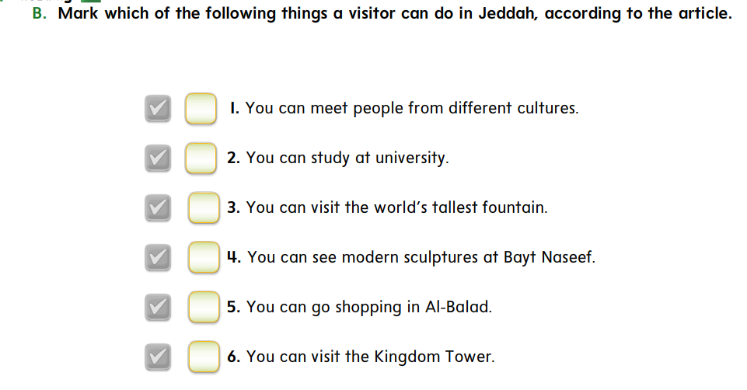

Slide 61
Tr. Ghaliah alqurshi
Thanks

