Slide 1
Unit 5
Conversation
Page 53

Slide 2
Lesson Goals & Outcomes
Listen and practice a conversation
Answer general question about the conversation
use the "real talk" phrases in a conversation

Slide 3
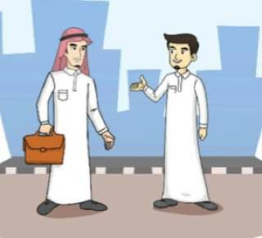
Describe what do you see on this picture??

Slide 4
Brainstorming strategy
What are they
talking about?
What are they
wearing?

Slide 5

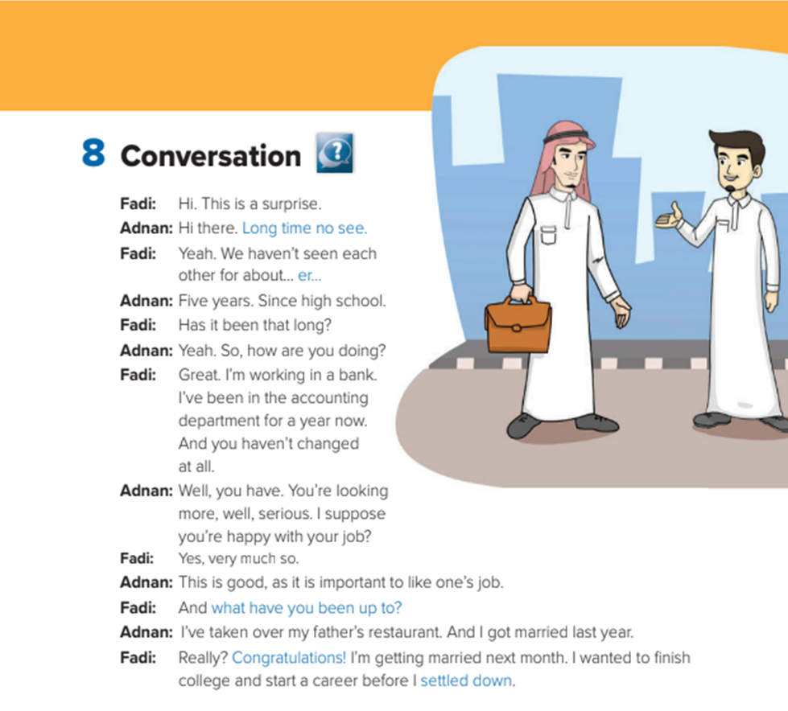
Listen to the audio

Slide 6
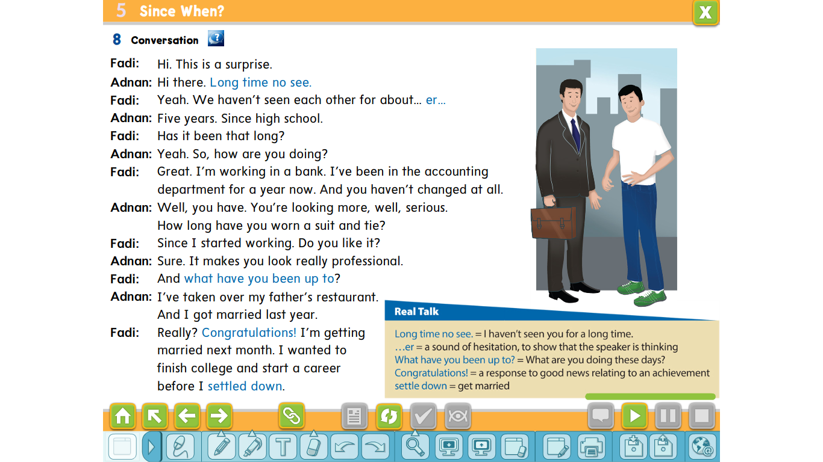

Slide 7

Who says ? ,, why?
Fadi
Adnan
Long time no see

Slide 8
Who says ? ,, why?
Fadi
Adnan
Long time no see
Because he didn’t see fadi for a long time

Slide 9

Who says ? ,, why?
Fadi
Adnan
..er
Because he is thinking

Slide 10
Who says ? ,, why?
Fadi
Adnan
What have you been up to?
What has Adnan been up to?
He took over his father restaurant

Slide 11
Who says ? ,, why?
Fadi
Adnan
Congratulations
Why he say that?
Because Adnan got married

Slide 12
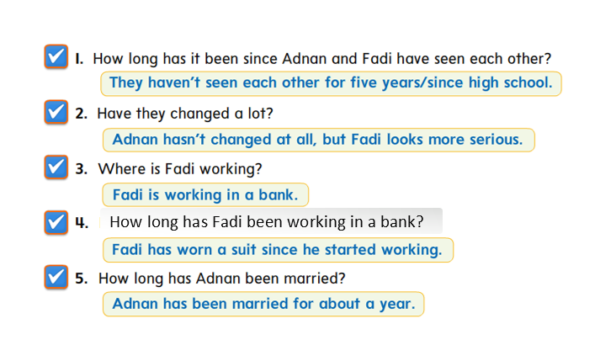
About the conversation

Slide 13
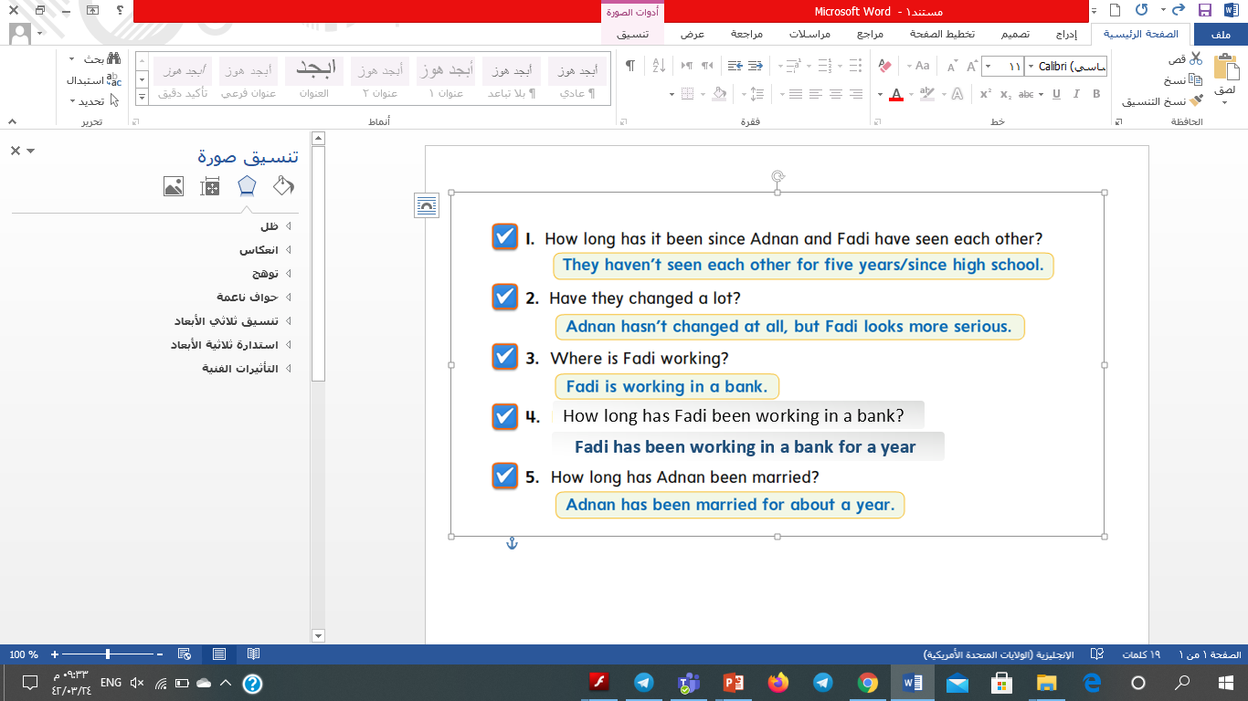
About the conversation

Slide 14

Homework
Make a conversation between you and an old friend you haven’t seen for a long time

Slide 15


