Slide 1
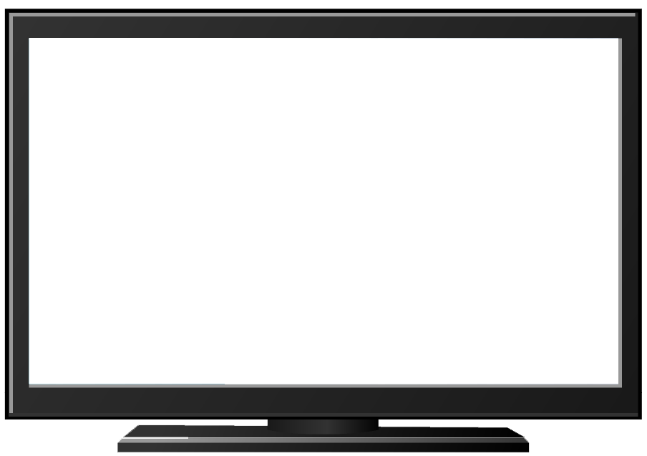

Super Goal 5
U5
Listen & Discuss

Slide 2
Lesson Goals & Outcomes
actions that
began in the past
and continue into
the present
the invention with its definition.
meaning of new words
actions that
have happened
recently
Match
Express
Find
4
about inventions
Express
3
5
2
Talk
1

Slide 3

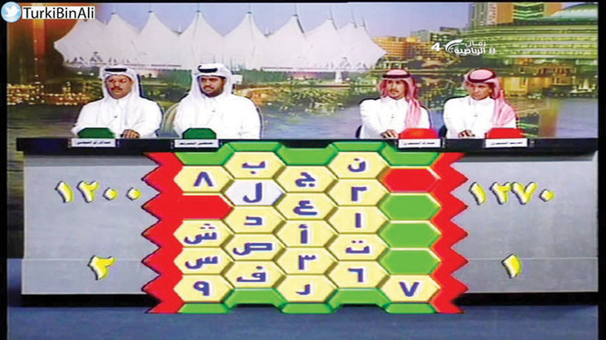
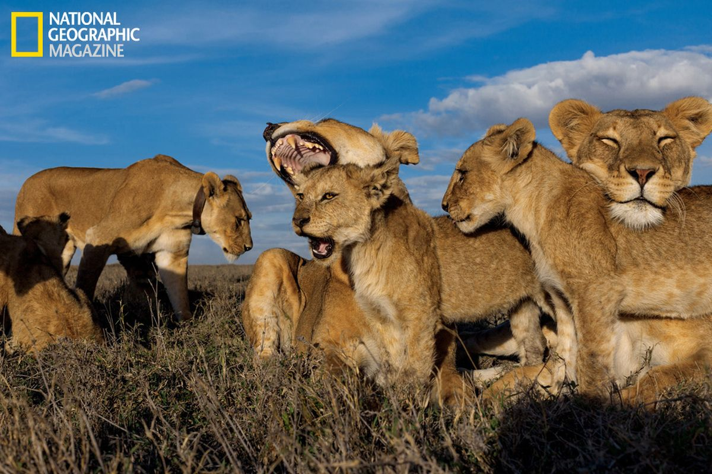
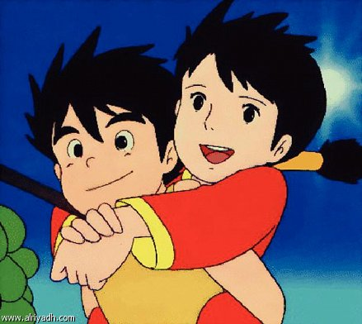
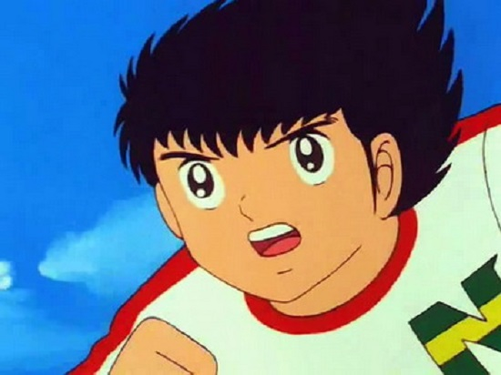
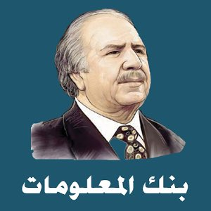
Once upon time ..
I liked watching..

Slide 4
Books OPEN
Pages: 48 - 49

Slide 5
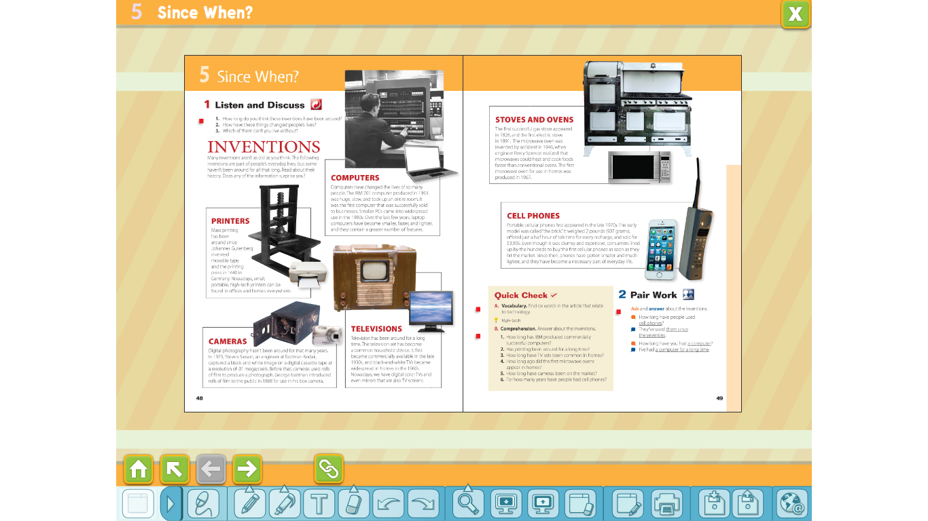

Read along
as you listen

Slide 6
How was what you did
today different from what people did one hundred
years ago?
What appliances did you use this
morning
When were they invented?
Can you live
without them?

Slide 7
Which computer is a PC?
When did PCs become popular?
When did people
use computers like the one in the black-and-white picture?
How is the laptop computer different from the older
computer?
What adjectives do you think describe that computer?

Slide 8
Johannes Gutenberg
Who is Johannes Gutenberg?
Where was he from?
When did he live?
he invented the printing press
How are printers different nowadays?

Slide 9
When did people first buy TV sets?
How
are TVs different nowadays?
When did they become common in homes?

Slide 10
Does the stove
have an oven? Where is it?
What heats and cooks food the fastest?
Which came first, the gas stove or the electric stove?

Slide 11
What did people need to buy
for their cameras before digital cameras?
What makes one digital camera different from another?

Slide 12
When did cell phones
first appear?
How much do you think the older cell
phone weighed?
How much do you think it cost?
How long can you talk on your cell phone before
you have to recharge it?
How long do you think you
could talk on the older cell phone before you had to
recharge it?

Slide 13
technology

Slide 14
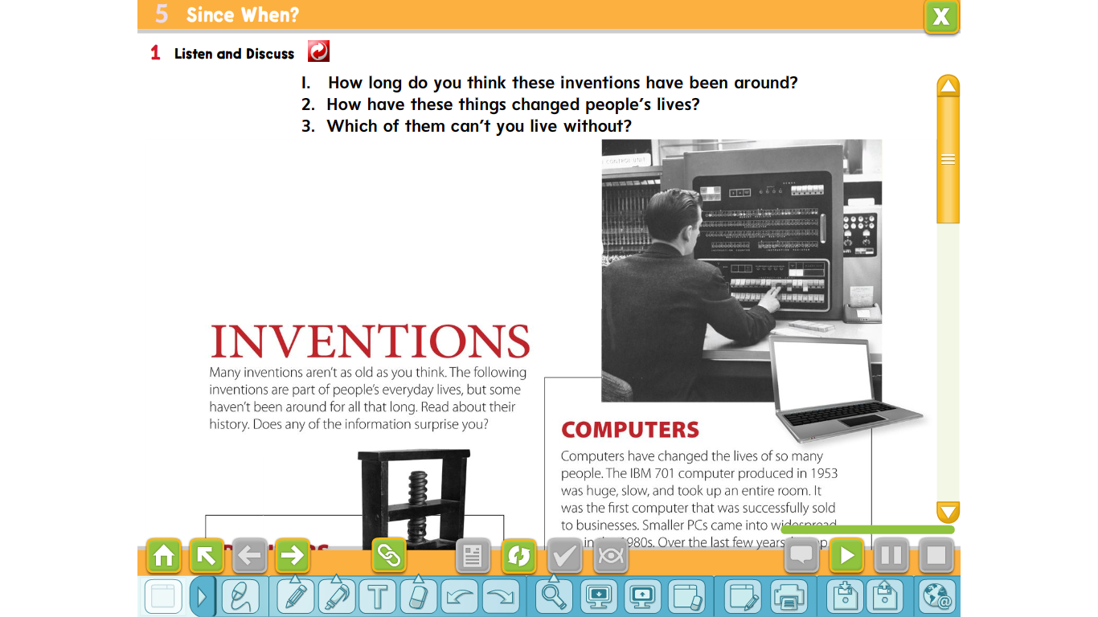

Slide 15
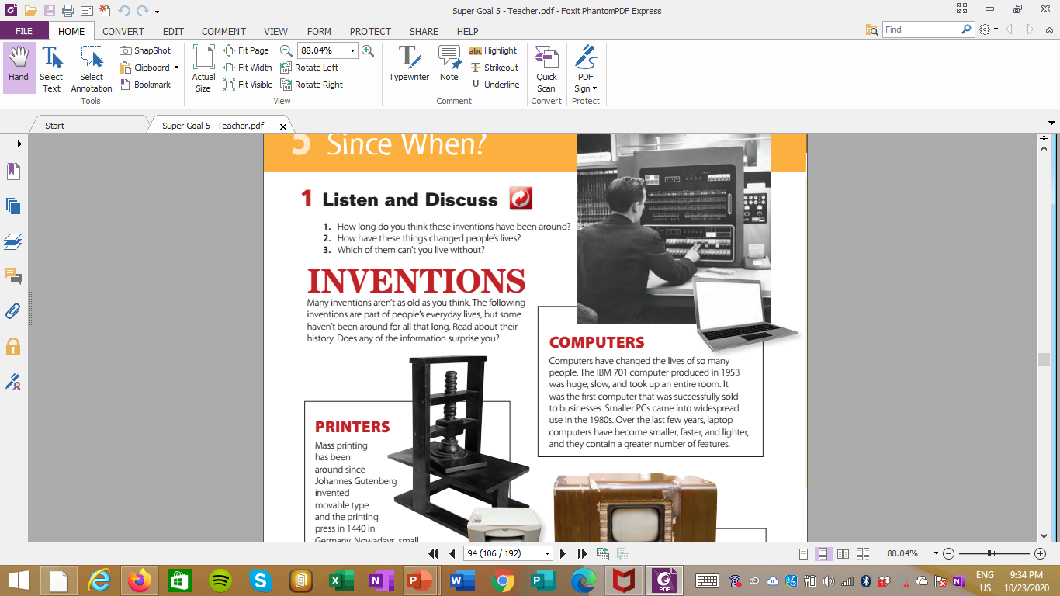
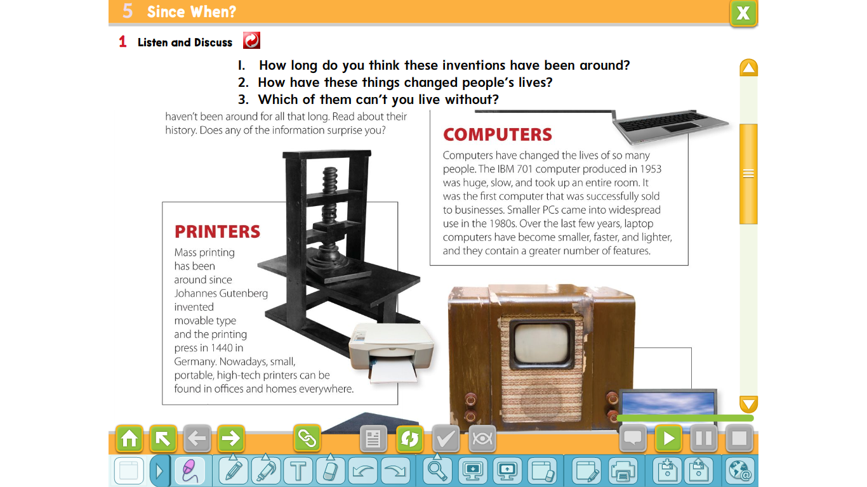


Slide 16
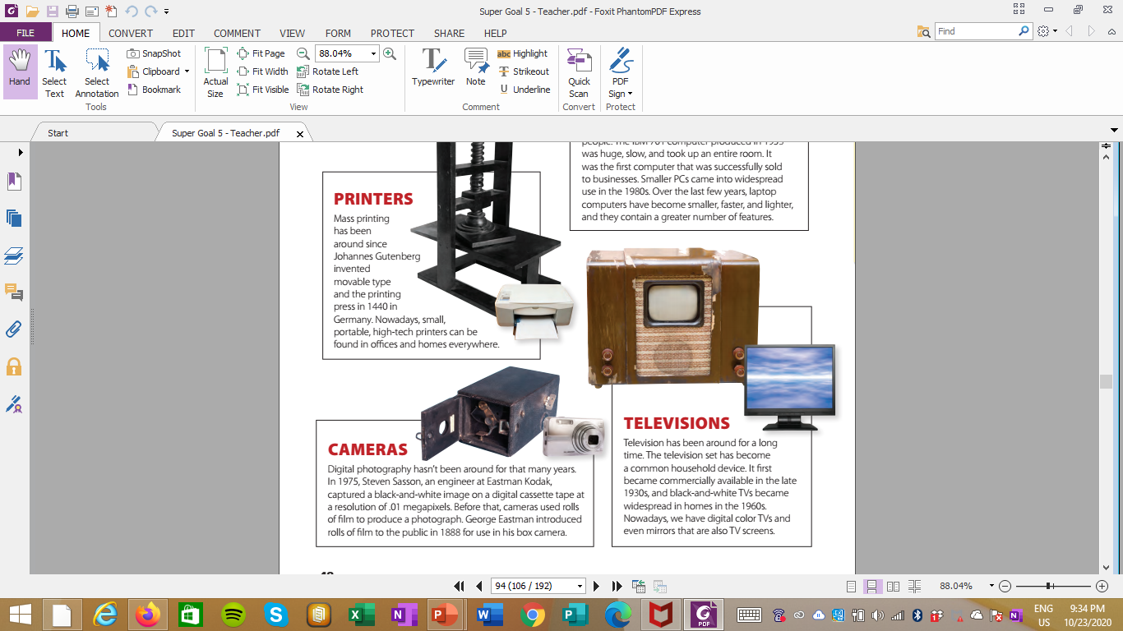
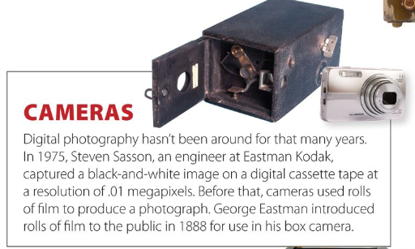

Slide 17
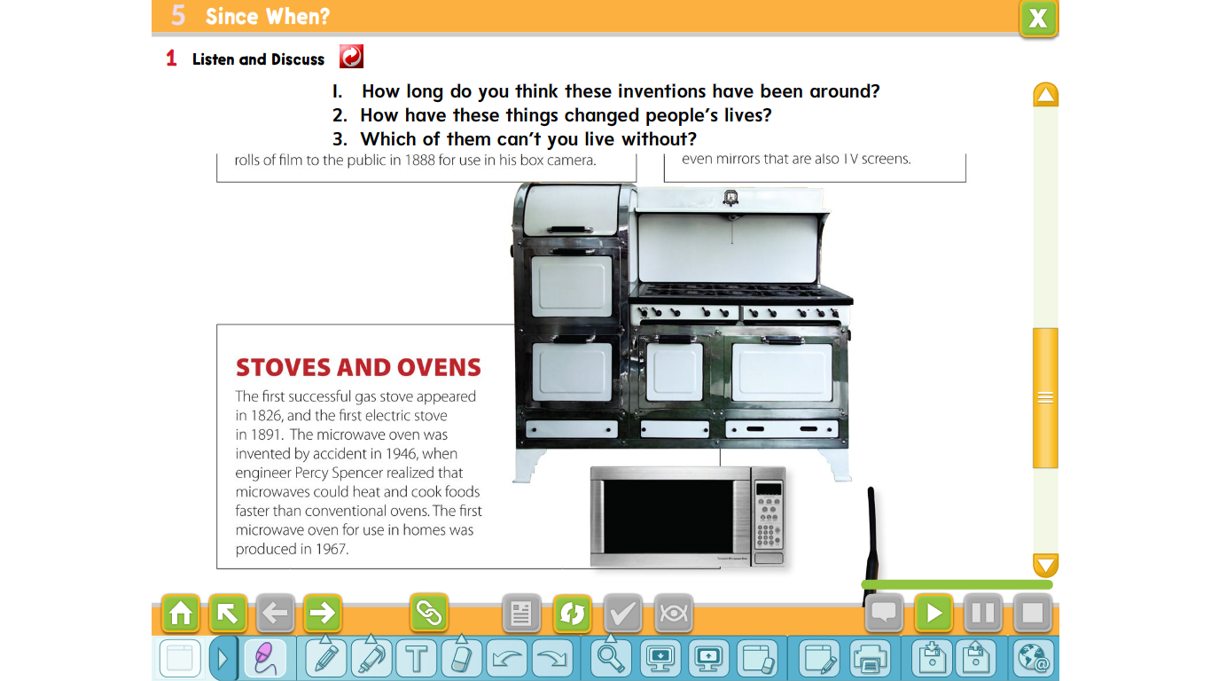
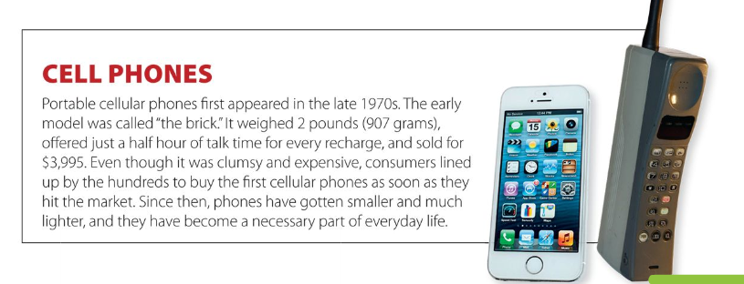

Slide 18
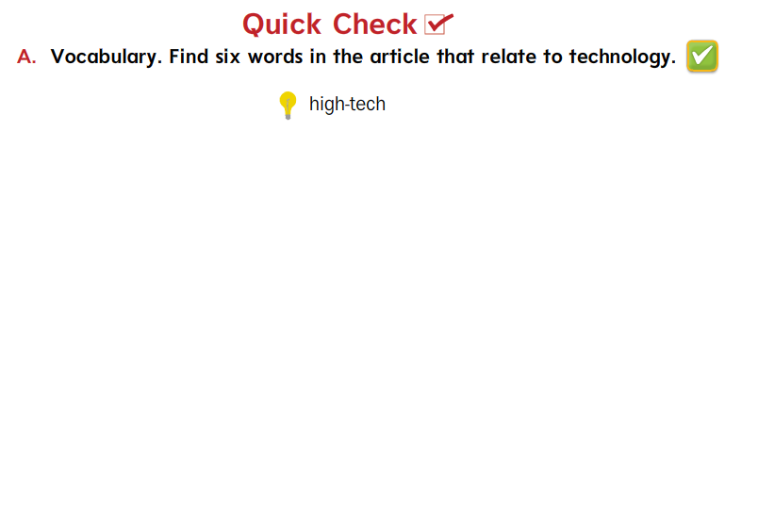
invention, computer, PCs, screens, laptop, printer, device, television,
digital, cassette tape, recharging, megapixels

Slide 19
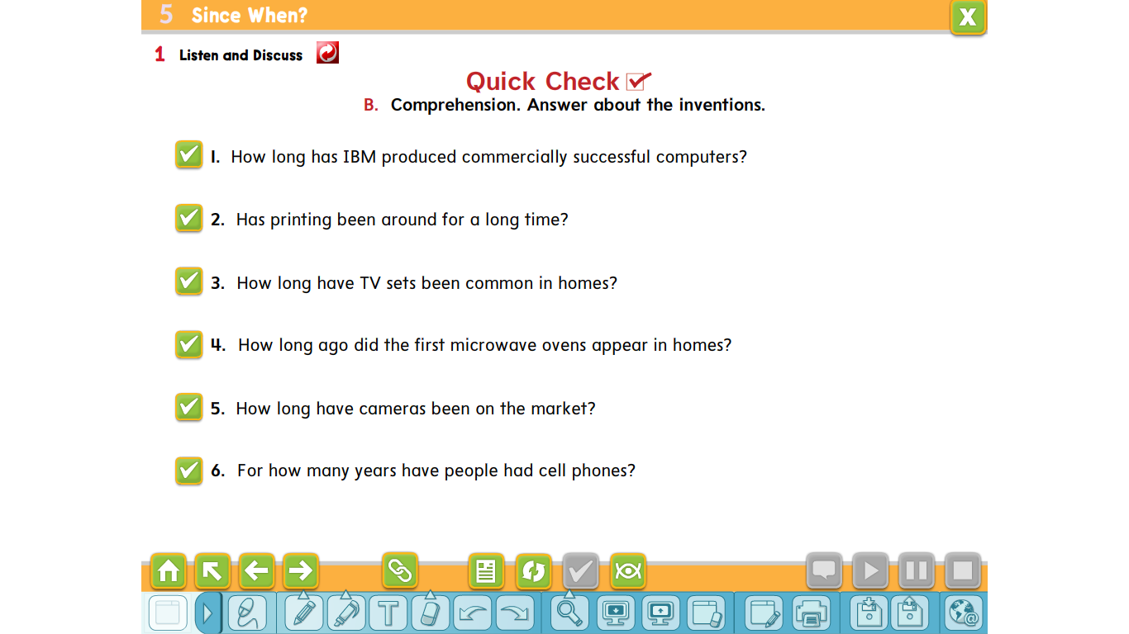
Printing has been around since 1440/for almost
six hundred years
IBM has produced commercially successful printers since 1953/for about 60 years.
Printing has been around since 1440/for almost six hundred years
TV sets have been common in houses since the 1960s/for more than 50 years.
The first microwave oven appeared in homes about 45 years ago.
Cameras have been on the market for more than 120 years/since 1888
People have had cell phones for about 35 years.

Slide 20
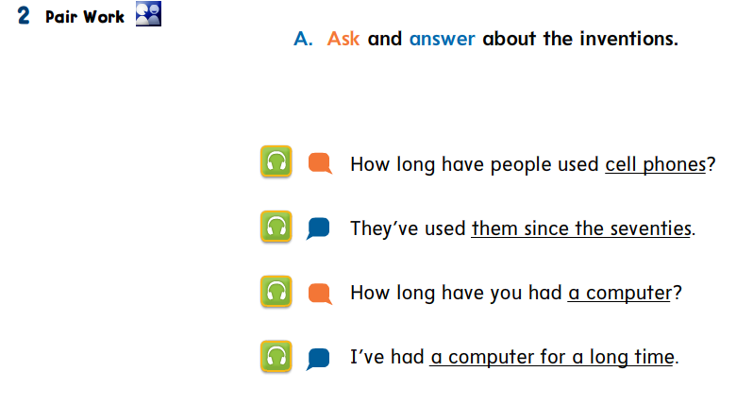

Slide 21
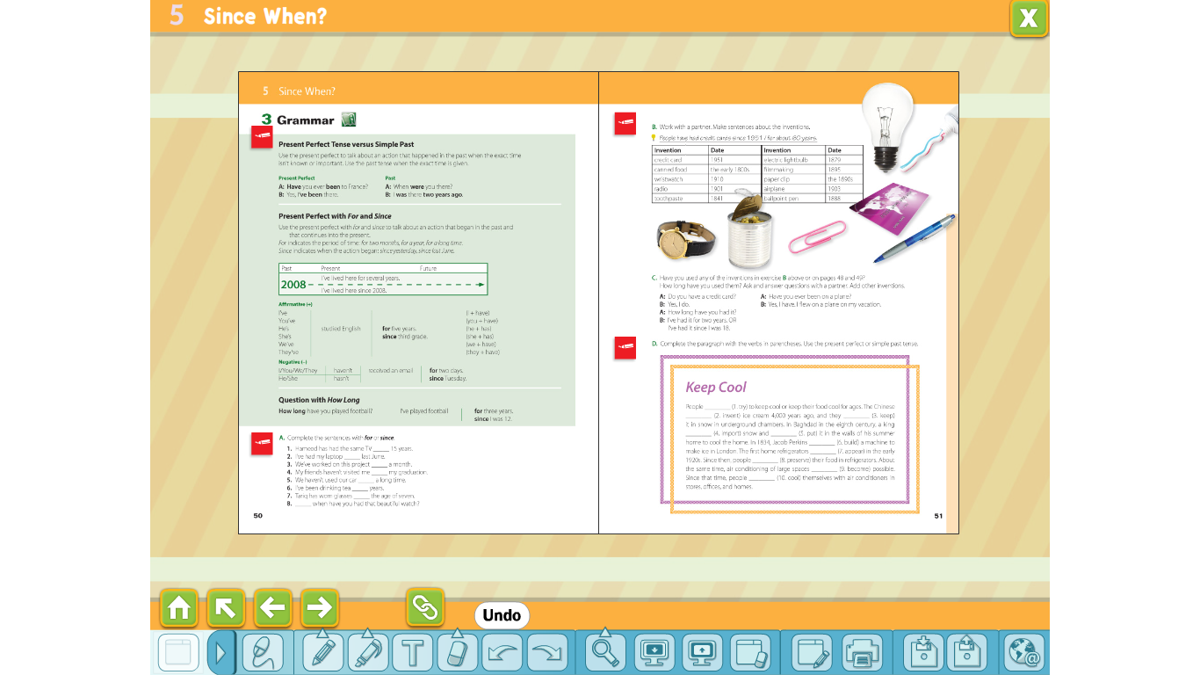
Grammar

Slide 22
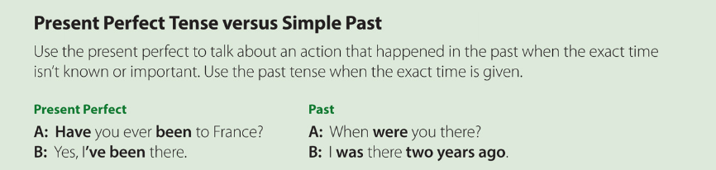
Have you seen the TV show (title)?
Did you see the TV show (title) yesterday?

Slide 23
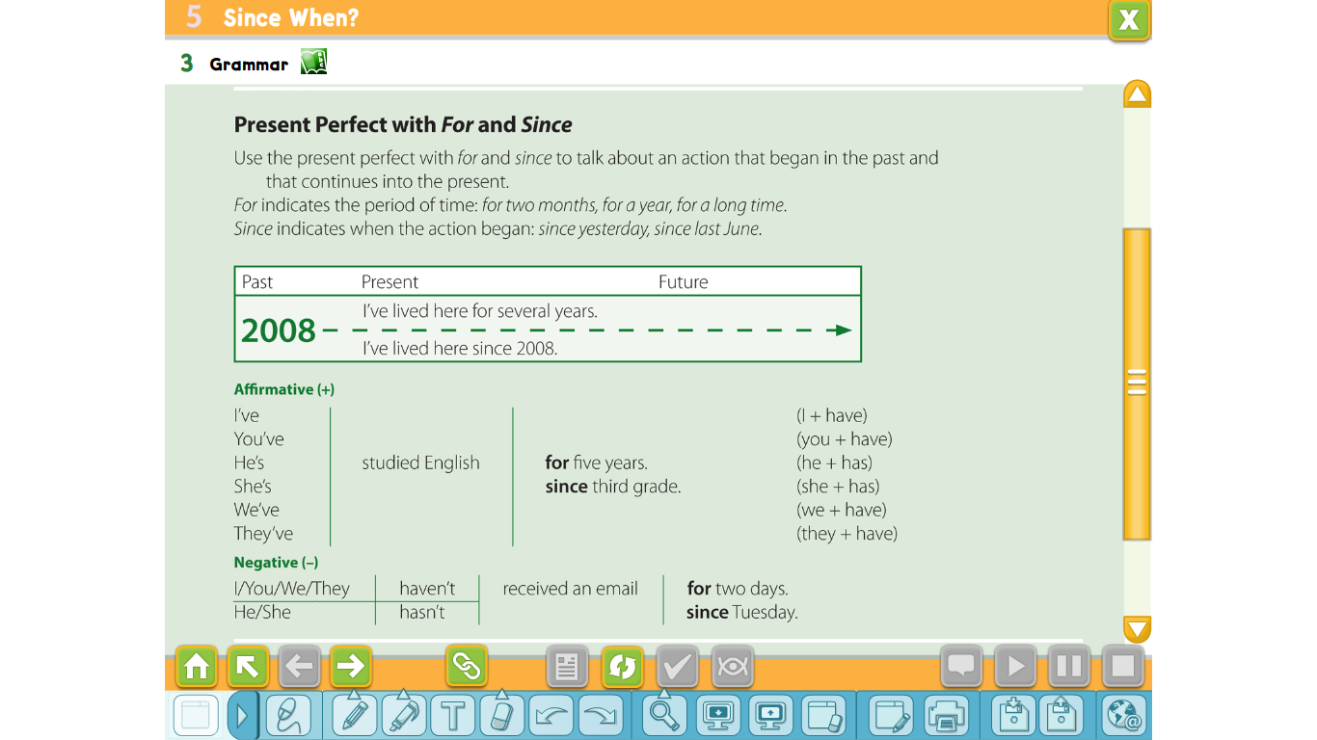

Slide 24
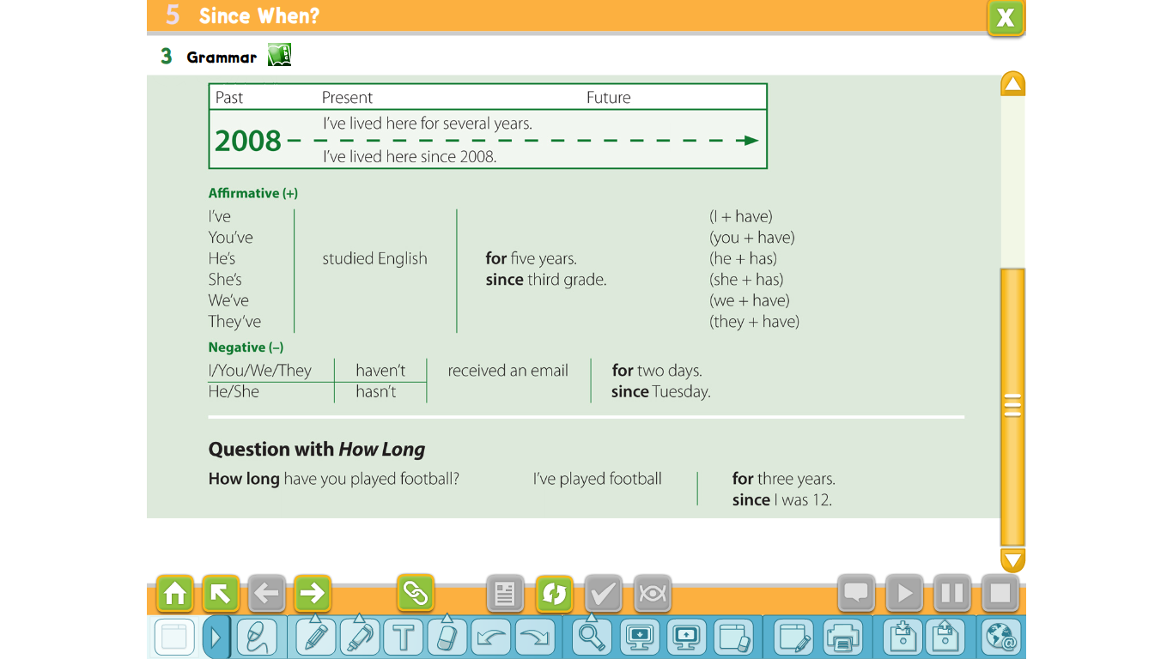

Slide 25
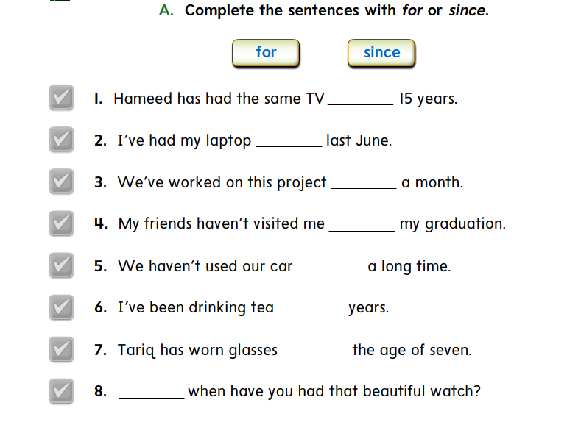
for
since
for
since
for
for
since
since

Slide 26
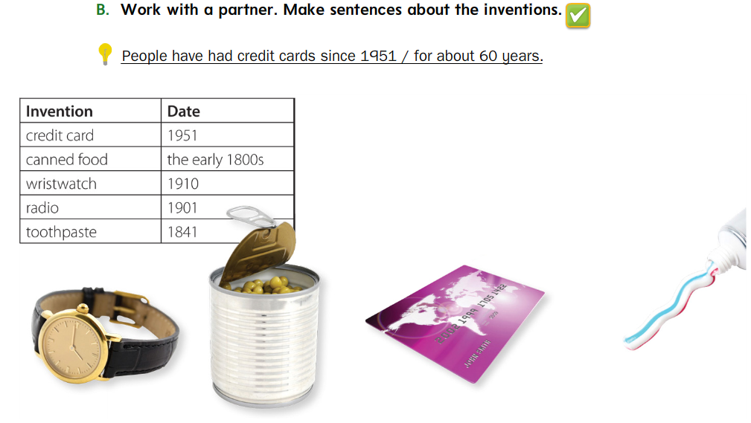
People have eaten canned food since the early 1800s.
People have worn wristwatches for over 100 years.
People have had radios since 1901.
People have used toothpaste for over 170 years.

Slide 27
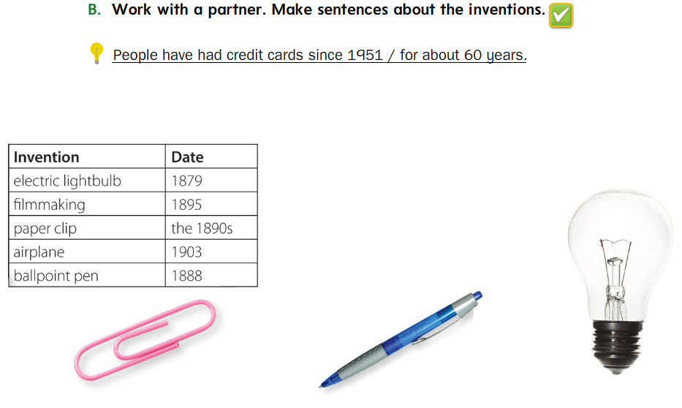
People have used electric lightbulbs since 1879.
People have made films since 1895.
People have used paper clips since the 1890s.
People have flown airplanes since 1903.
People have used ballpoint pens for a long time.

Slide 28
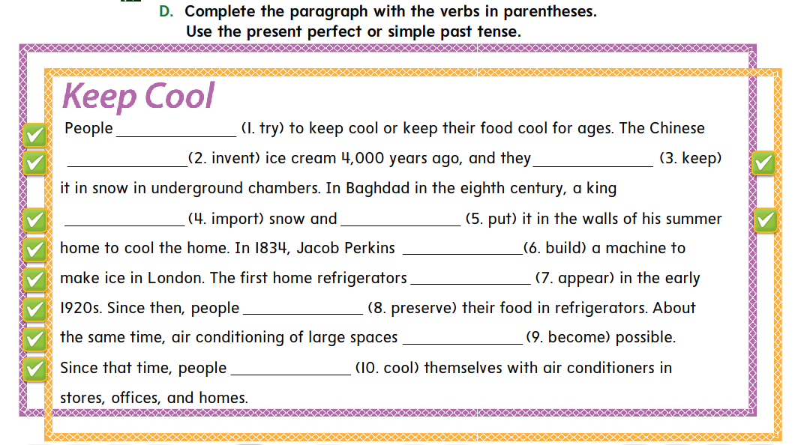
have tried
invented
kept
imported
put
built
appeared
have preserved
became
have cooled

Slide 29
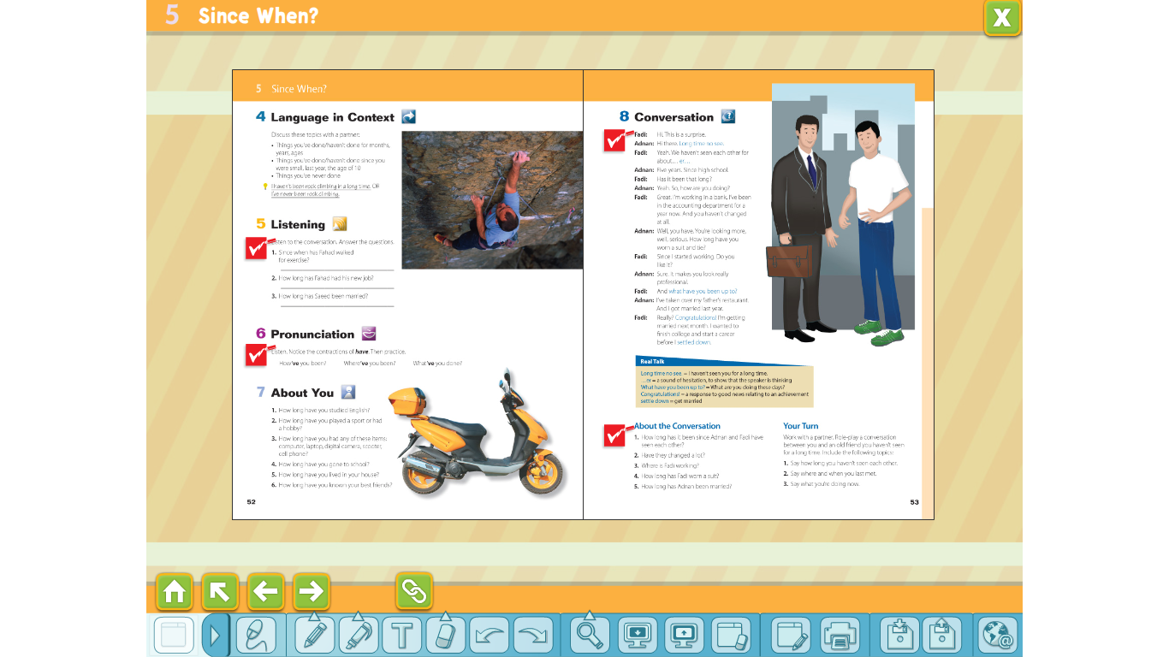
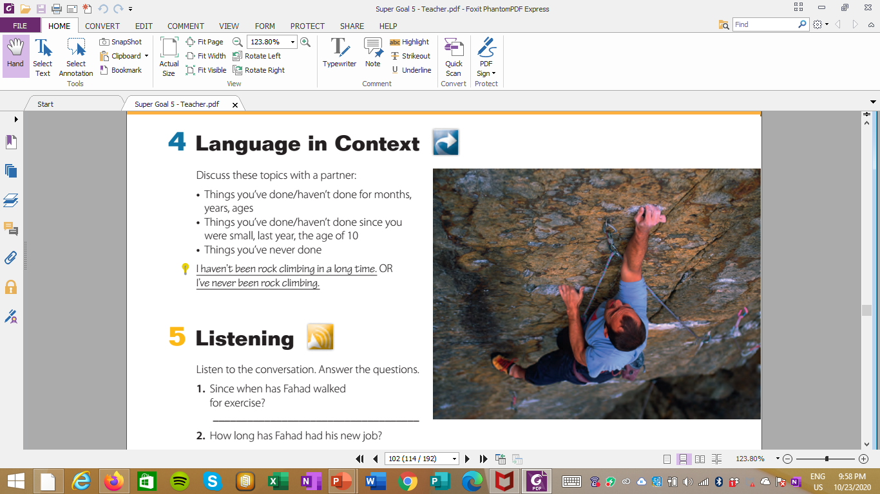

Slide 30
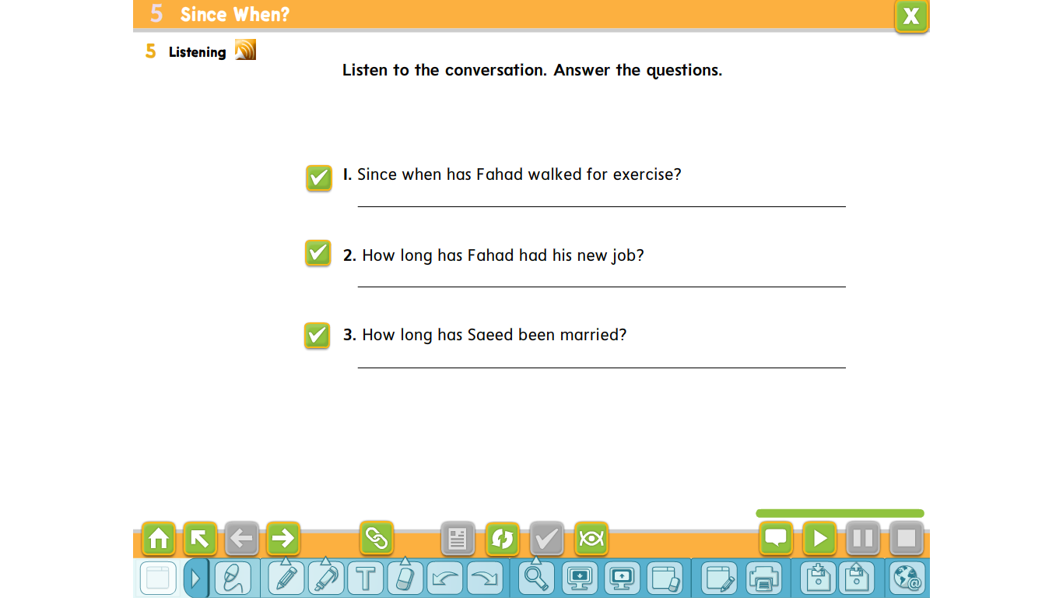
Fahad has walked for exercise since he had his heart problem.
Fahad has had his new job for six months.
Saeed has been married for almost a year.

Slide 31
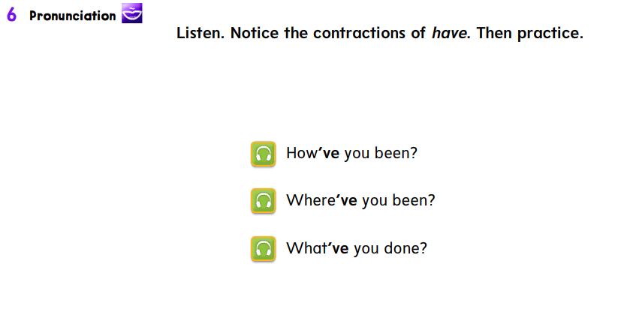

Slide 32
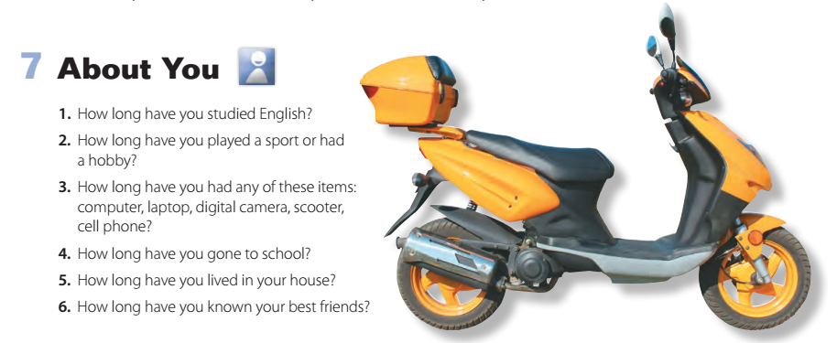

Slide 33
Super Goal 5
U5
Conversation

Slide 34
Lesson Goals & Outcomes
meaning of new words
Use the "real talk" in new sentences
Interview partner about Internet use
Find
Express
3
2
Talk
1

Slide 35
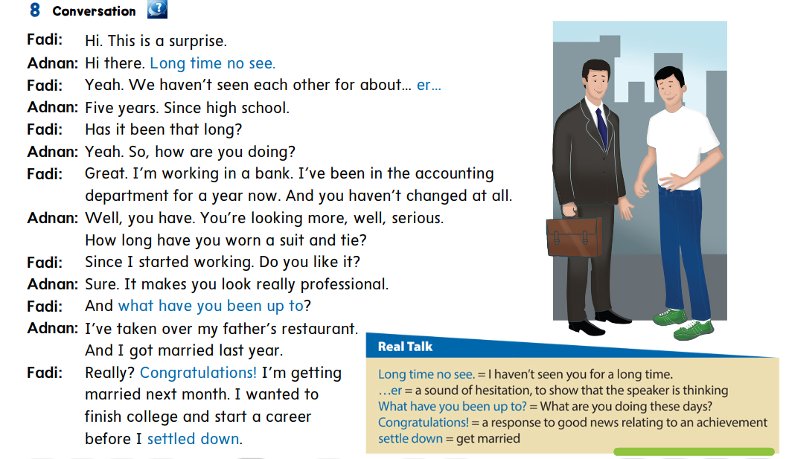

Slide 36

What are they going to talk about?
Whose look do you like more?
How is their style different?
How old are the men?

Slide 37

Think, Pair, Share
Real talk

Slide 38
Who says Long time no see?
(Adnan)

Slide 39
When do we say this?
(when we haven’t seen someone for a long time)

Slide 40
Who says …er?
(Fadi)

Slide 41
Why does he say this?
(to show he’s thinking)

Slide 42
Who says What have you been up to?
(Fadi)

Slide 43
What has Adnan been up to?
(He took over his father’s restaurant and he got married.)

Slide 44
Who says Congratulations?
(Fadi)

Slide 45
Why does he say it?
(Adnan got married.)

Slide 46
What other times do people say Congratulations?
(Some examples include when a baby is born, when students graduate, and when people get promoted.)

Slide 47
Who says he wanted to start a career before
he settled down?
(Fadi)

Slide 48
Who has settled down?
(Adnan)

Slide 49
Is Fadi ready to settle down now?
(Yes, he’s getting married next month.)

Slide 50
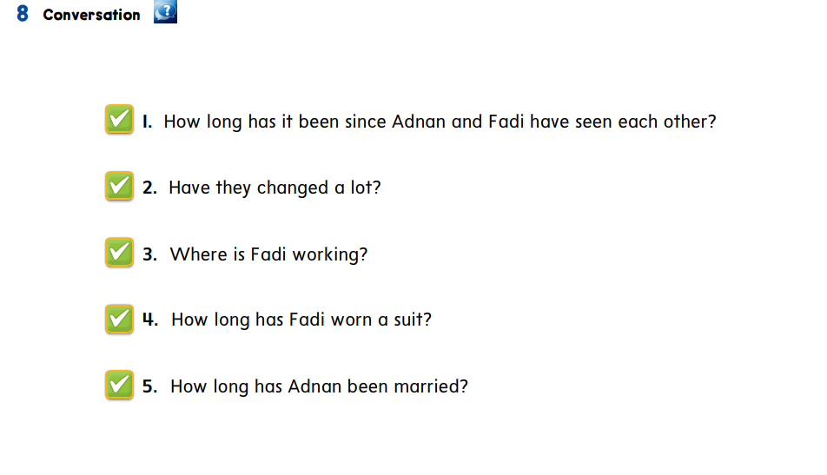
They haven’t seen each other for fie years/since high school.
Adnan hasn’t changed at all, but Fadi looks more serious.
Fadi is working in a bank.
Fadi has worn a suit since he started working.
Adnan has been married for about a year.

Slide 51
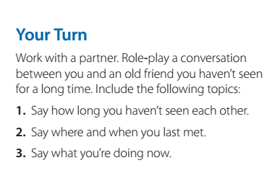

Slide 52
Reading
Before Reading
1. What do you know about early film production?
2. What do you know about special effects?
Which films today have lots of special effects?
What special effects did they use for the films in the pictures?
Why do films have special effects?
Notes:
in readings often have
vocabulary related to a special topic. The writer
frequently gives clues to the meaning of these words
or gives definitions. For example, point out the word
screamed in the fist paragraph. If students don’t know
the meaning, have them read the whole sentence
which shows that the audience (the people watching
the film) was afraid. Ask: What does an audience
do when they are afraid? Elicit: They scream. Have
students look at interrupted in the second paragraph.
Have them read the entire sentence and the two
sentences before it. Have them guess the meaning of
interrupted. (stopped in the middle)

Slide 53
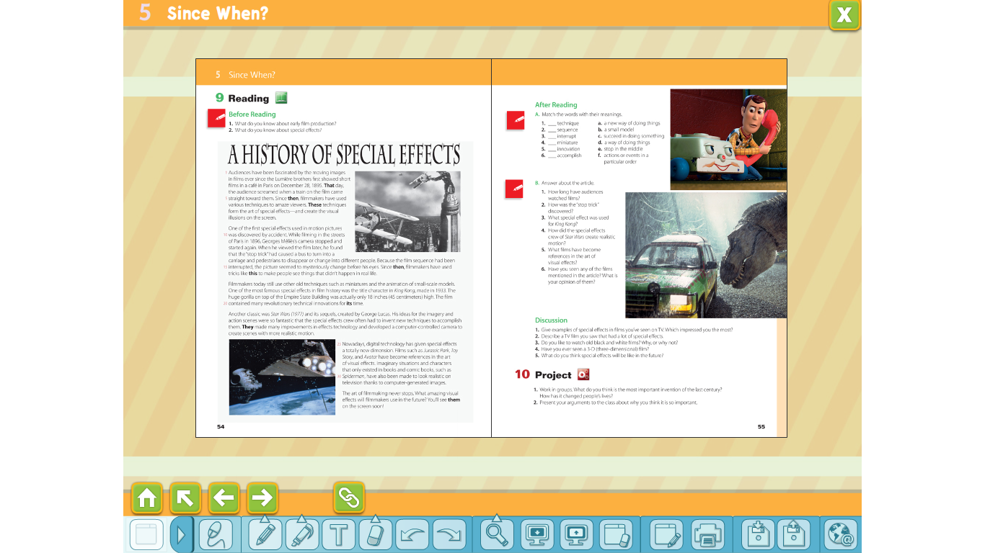
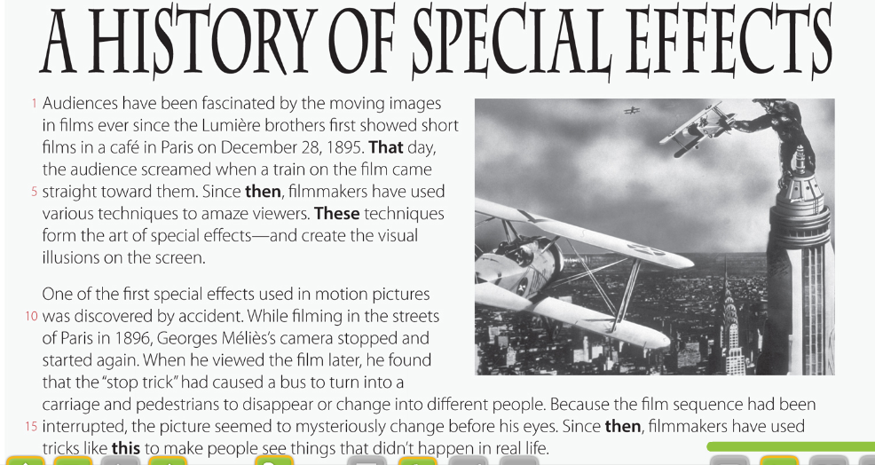
(paragraph 2)
(paragraph 1)
The Lumière brothers made the fist film.
George Méliès discovered the “stop trick” by
accident.
The first film had no special effects
The “stop trick” made it look like people and things
in the film changed into someone or something else.
Other filmmakers were not interested in the “stop
trick” technique.
Notes:
(paragraph 1)
The Lumière brothers made the fist film. (true)
The fist film had no special effects. (false—Special
effects were used to make people think a train was
coming straight toward them.)
(paragraph 2)
George Méliès discovered the “stop trick” by
accident. (true)
The “stop trick” made it look like people and things
in the film changed into someone or something else.
(true)
Other filmmakers were not interested in the “stop
trick” technique. (false—Filmmakers have used tricks
like this since then.)

Slide 54
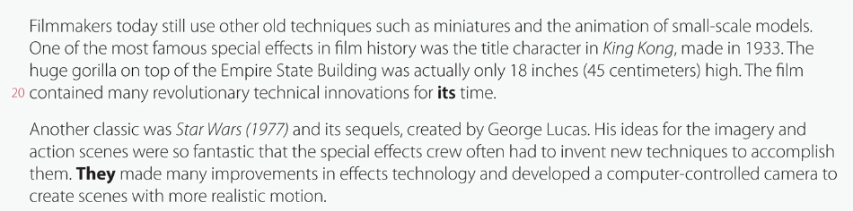
Paragraph 3
Paragraph 3
King Kong was the name of an animal.
George Lucas was a very innovative filmmaker with new ideas.
A computer-controlled camera was used in the Star Wars film to create scenes with realistic motion.
The special effects crew of Star Wars used old techniques and technology.
The gorilla looked big in the film but was really very small.
Notes:
(paragraph 3)
King Kong was the name of an animal. (true)
The gorilla looked big in the film but was really very
small. (true)
(paragraph 4)
George Lucas was a very innovative filmmaker with
new ideas. (true)
The special effects crew of Star Wars used old
techniques and technology. (false—They invented
new techniques and made improvements in effects
technology.)
A computer-controlled camera was used in the Star
Wars film to create scenes with realistic motion.
(true)

Slide 55
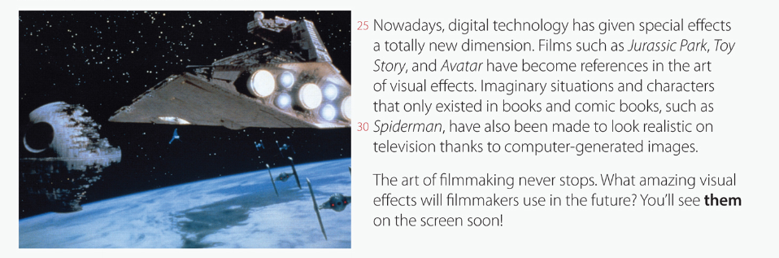
(paragraph 5)
Special effects nowadays are different because of computers.
The comic book Spiderman comes from the film of the same name.
Special effects nowadays are different because of computers.
Notes:
(paragraph 5)
Special effects nowadays are different because of
computers. (true)
People study Toy Story and Avatar because of their
special effects. (true)
The comic book Spiderman comes from the film
of the same name. (false—The film comes from the
comic book of the same name.)

Slide 56
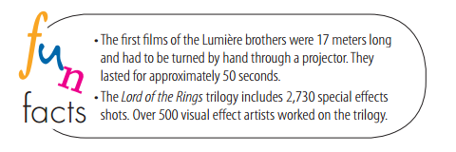

Slide 57
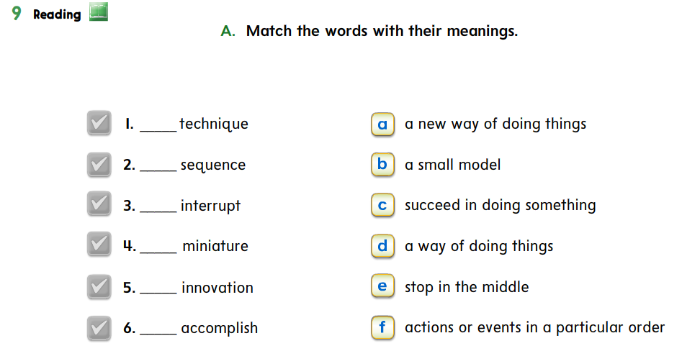
d
f
e
b
a
c

Slide 58
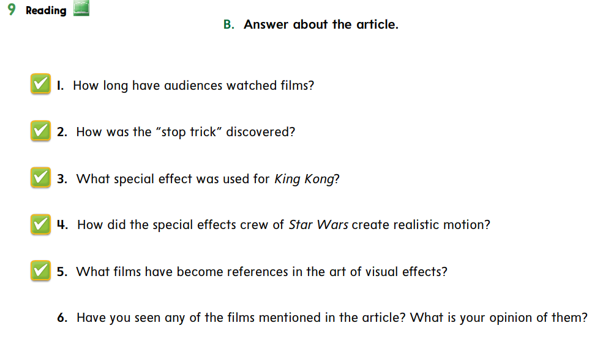
Audiences have watched movies since 1895/for more than 115 years.
The “stop trick” was discovered by accident.
A small model of a gorilla was used, but in the film it looked large.
They used a computer-controlled camera to create scenes with more realistic motion.
Jurassic Park, Lord of the Rings, Toy Story, and Avatar.

Slide 59
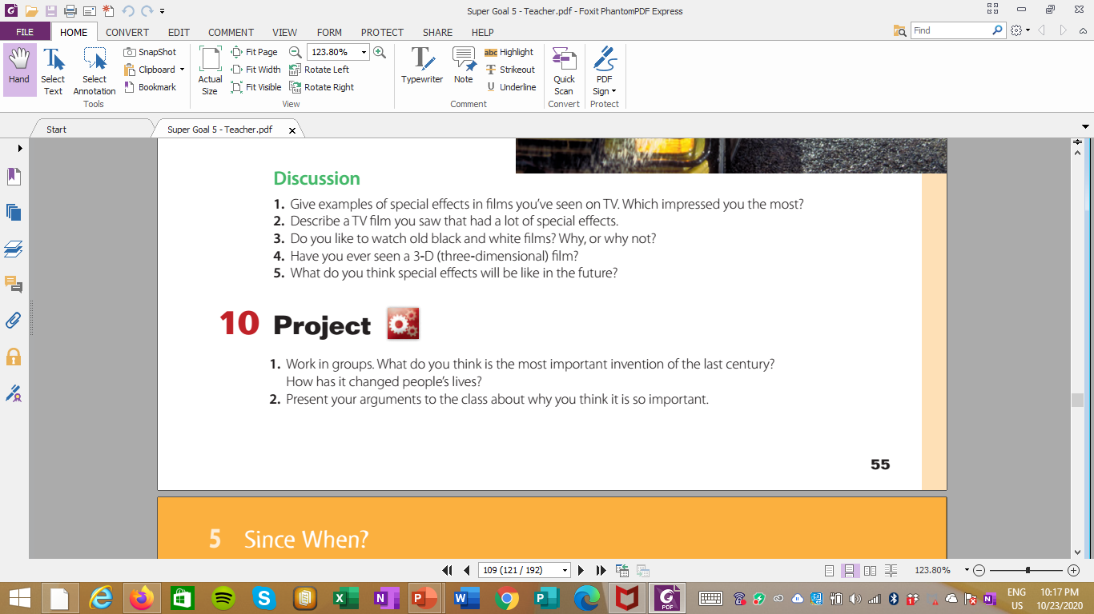

Slide 61
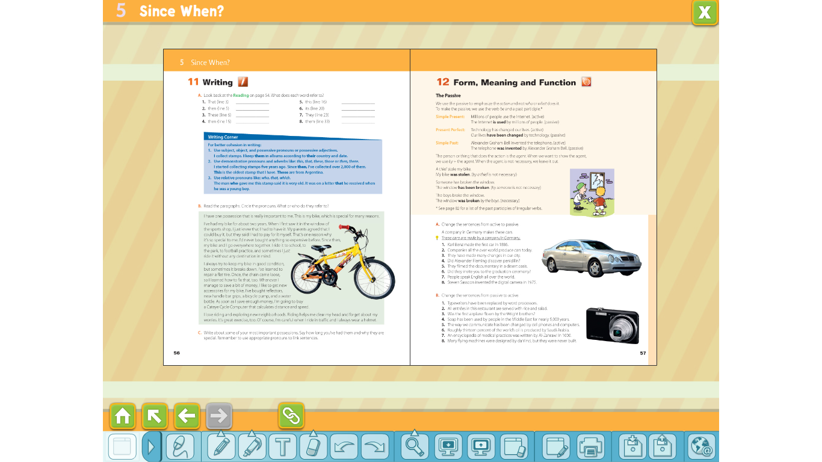
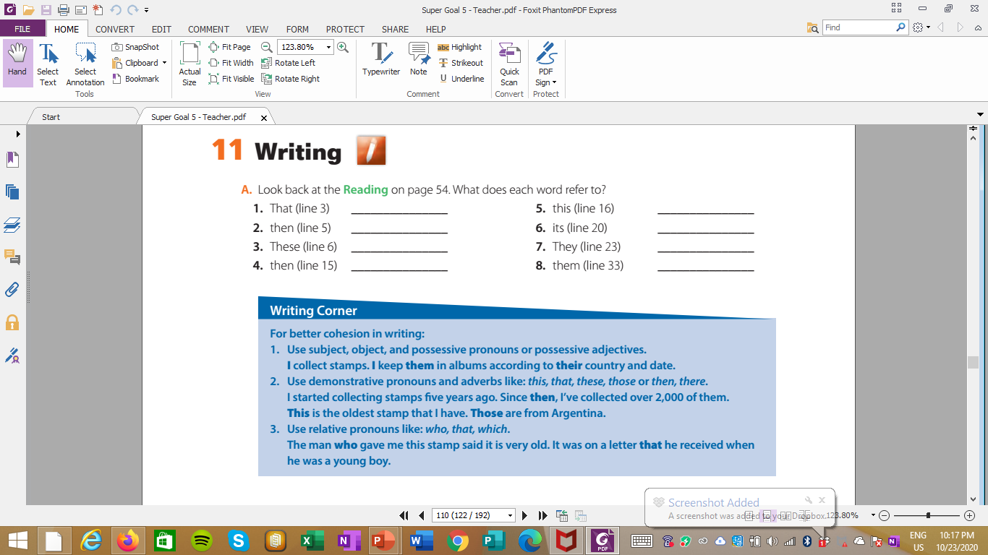
December 28, 1895
the “stop trick”
December 28, 1895
the film King Kong
techniques filmmakers use
the special effects crew
1896
amazing visual effects

Slide 63
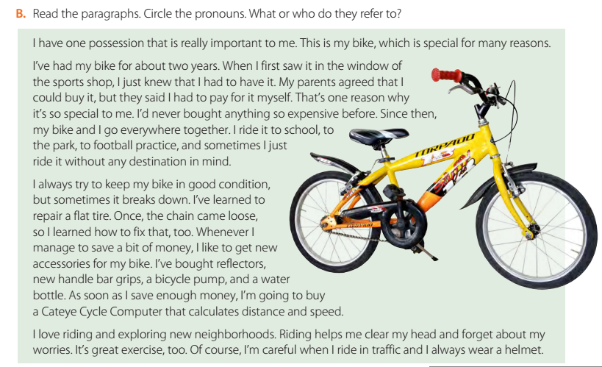

Slide 64
Who paid for the bike?
Why is the bike so special?
When did the person get the bike?
What did the person do when the chain came loose?
What does the Cateye Cycle Computer do?

Slide 66
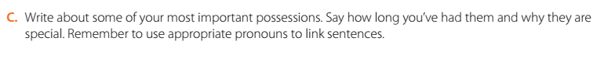

Slide 67
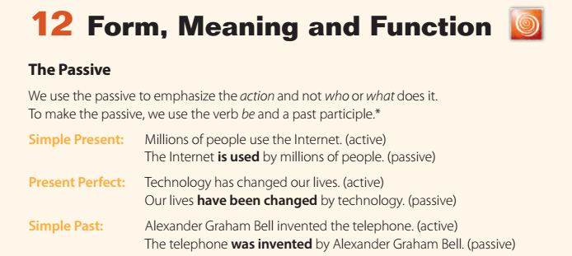

Slide 69
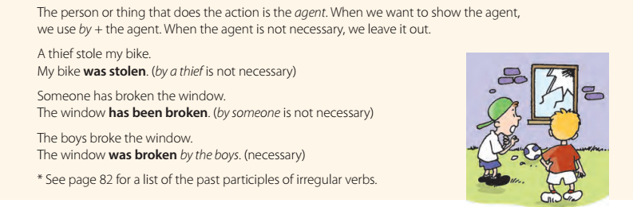

Slide 70
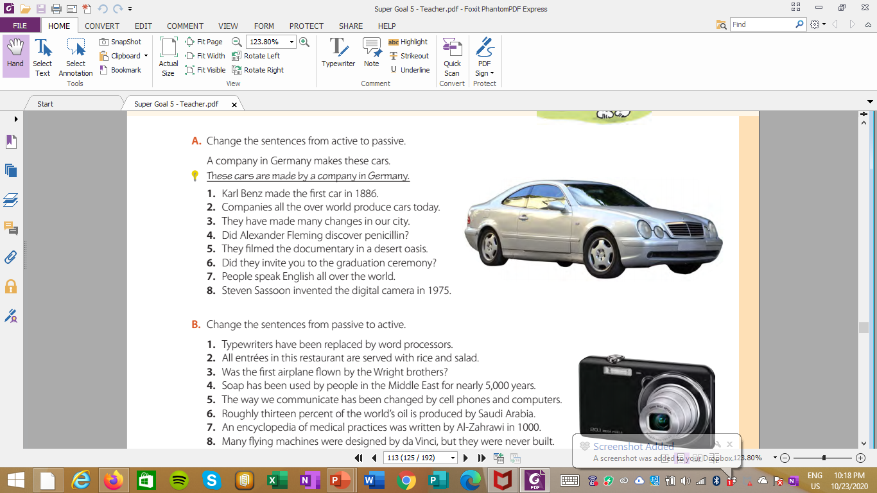
The digital camera was invented by Steven Sassoon in 1975.
1.The first car was made by Karl Benz in 1886.
2.Cars are produced all over the world today.
3.Many changes have been made in our city.
4.Was penicillin discovered by Alexander Fleming?
5.The documentary was filmed in a desert oasis.
6.Were you invited to the graduation ceremony?
7.English is spoken all over the world.
8.The digital camera was invented by Steven Sassoon in 1975.

Slide 71
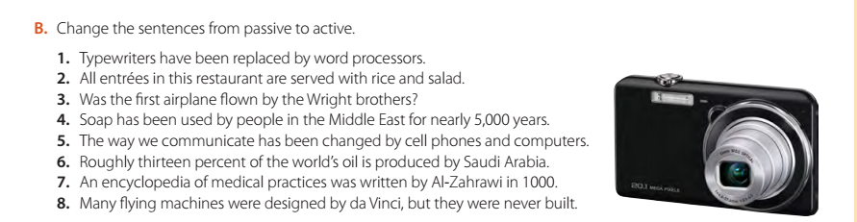
1.Word processors have replaced typewriters
2.This restaurant serves all entrées with rice and salad.
3.Did the Wright brothers fly the fist airplane?
4.People in the Middle East have used soap for nearly 5,000 years.
5.Cell phones and computers have changed the way we communicate.
6.Saudi Arabia produces roughly thirteen percent of the world’s oil.
7.Al-Zahrawi wrote an encyclopedia of medical practices in 1000.
8.Da Vinci designed many fling machines, but he never built them.

