Slide 1
It’s a Good Deal, Isn’t It?
Listen and discuss

Slide 2

Goals :
01
03
02
04
List
Listen
Confirm
Sort
A number of tools
Tools according to usage
To the conversation at the garage sale
Information
05
06
Talk
Listen
About common items at garage sale
To conversation between two man about misunderstanding

Slide 3

Do you have things in your home that you longer use?
What do you do with things that you don’t want or need anymore?

Slide 4
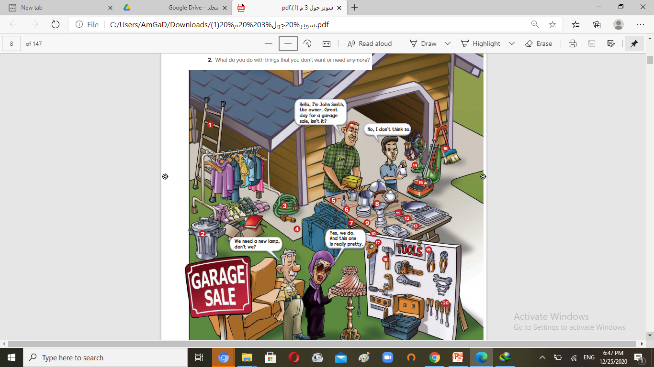
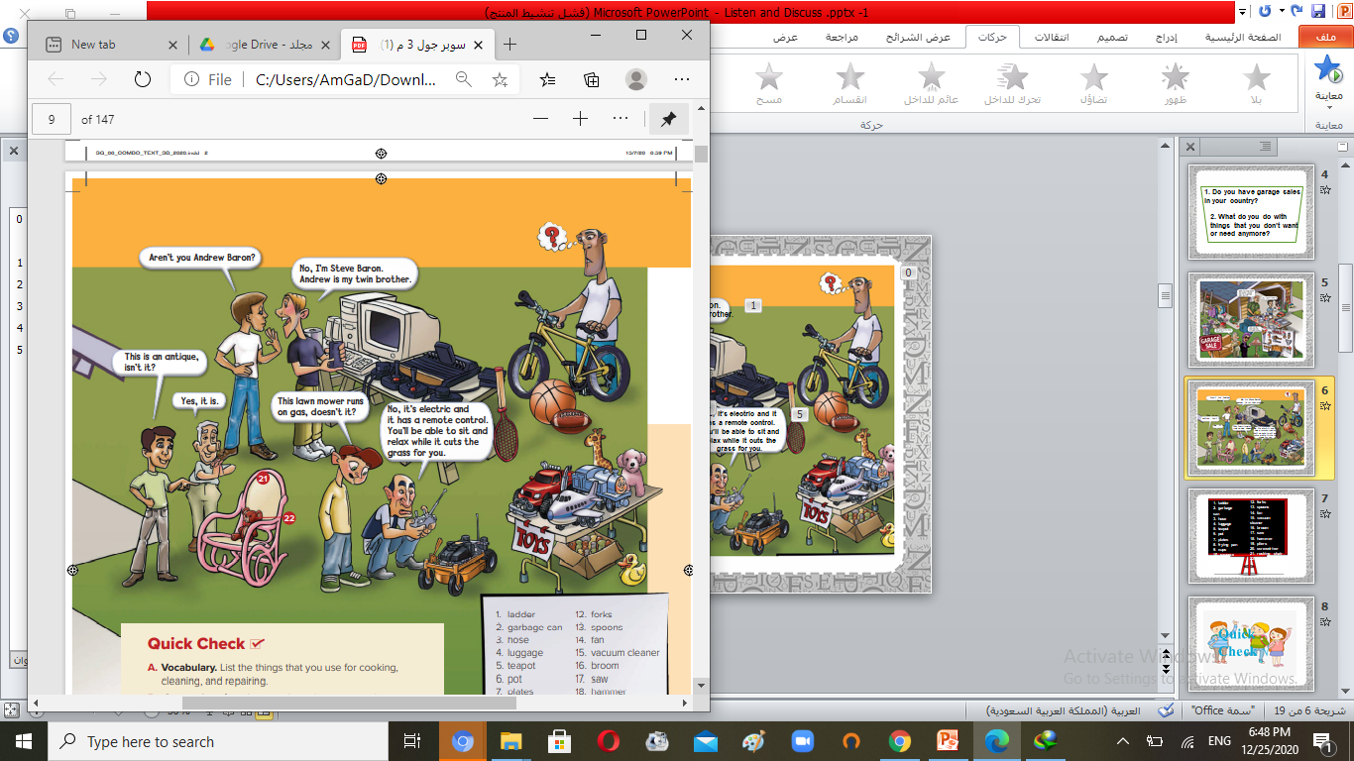
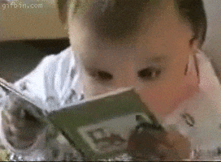
Open your book p. 68+ 69.

Slide 5

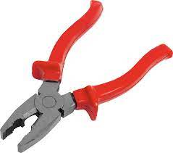
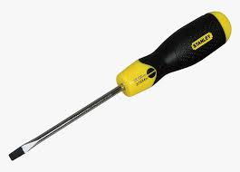
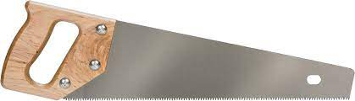
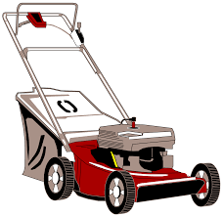
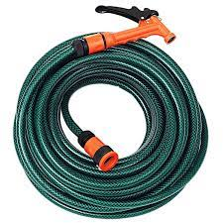

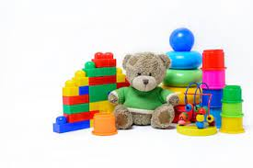

How many people are looking at the things for sale?
11
What kind of tools do you see?
Saw
hammer
plier
screw driver
What things do you see outside the house?
Ladder
Lawn mower
Hose
What things do you see for the child?
Teddy bear
Toys

Slide 6
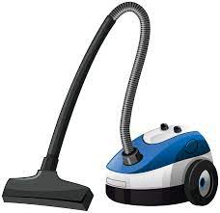
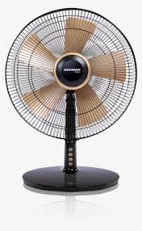
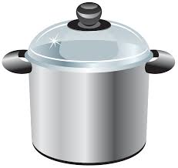
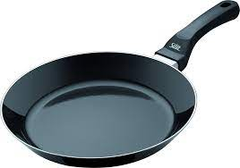
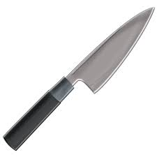

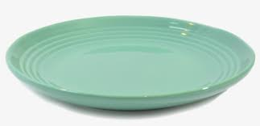
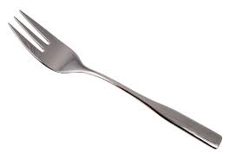
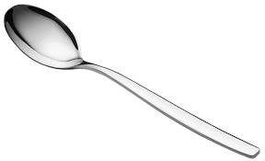
What appliances do you see?
What kitchen things do you see?
Vacuum cleaners
Fan
Pot
Frying pan
Knife
Tea pot
Fork
Spoon
Plate

Slide 7




What travel items do you see?
Luggage or suitcases
What sport equipment do you see?
Bicycle
Tennis racket
Balls

Slide 9
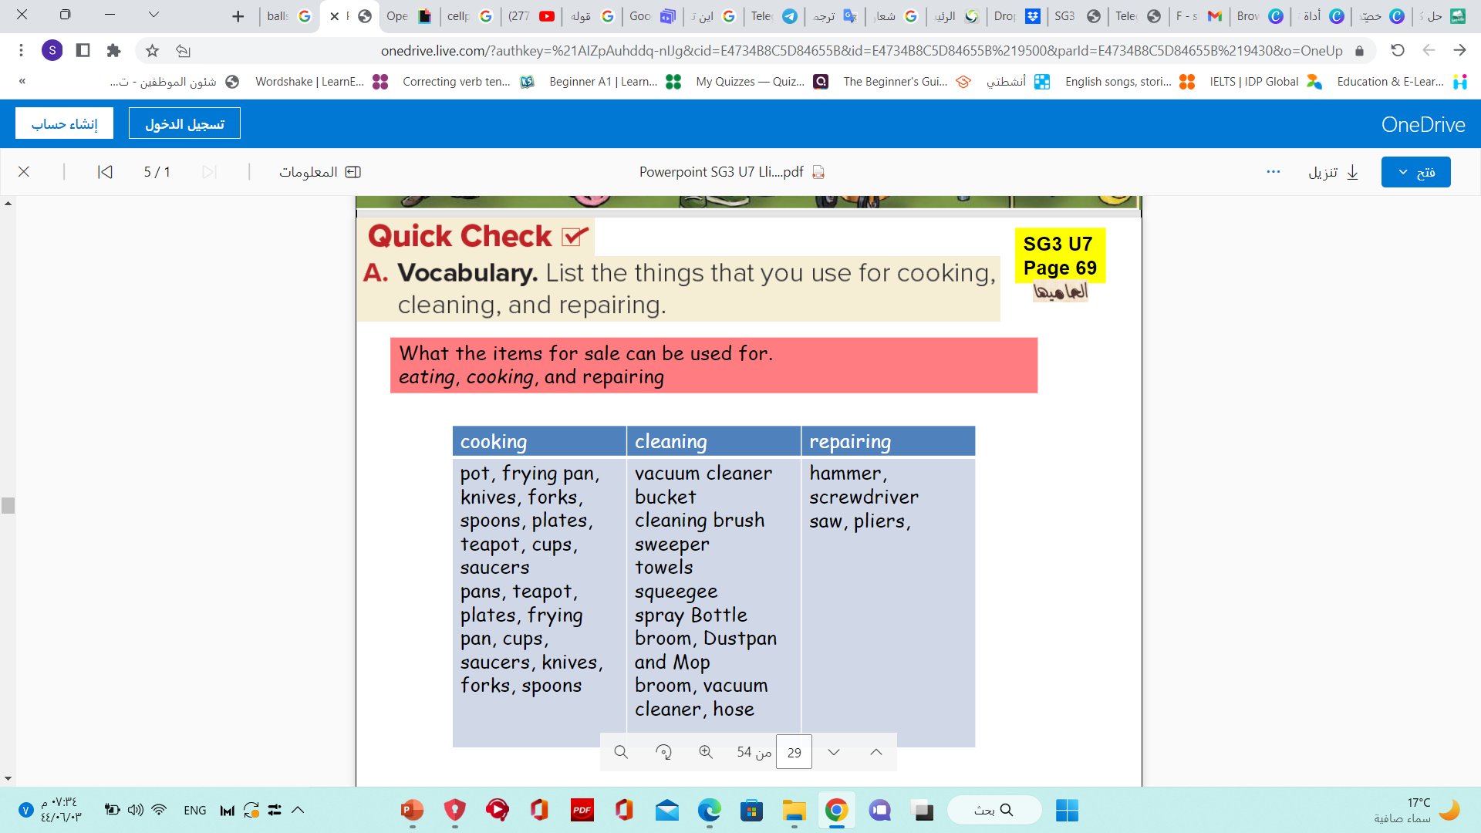
Repairing | Cleaning | Kitchen
Teapot
pot
plates
frying pan
cups
Forks
Spoons
saucers
Vacuum cleaner
Sweeper
Towels
Cleaning brush
Saw
Hammer
Screwdriver
Pliers

Slide 10
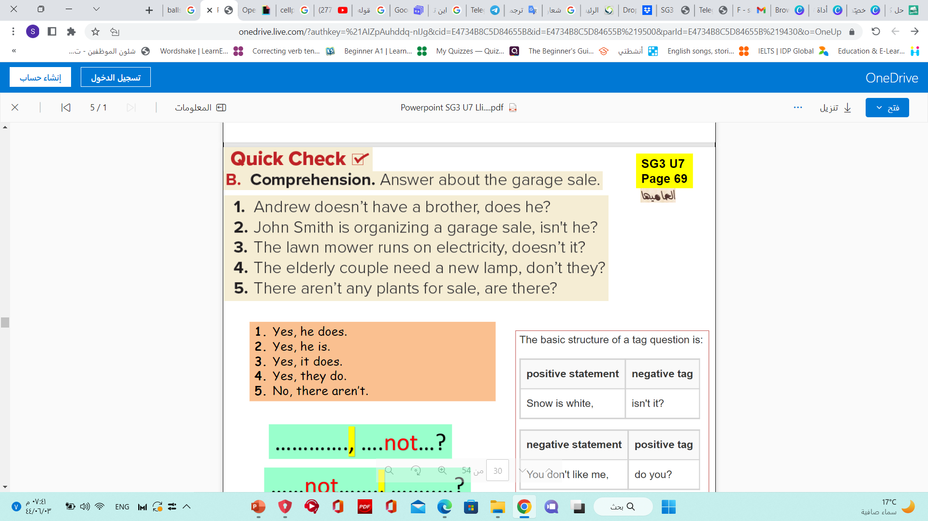
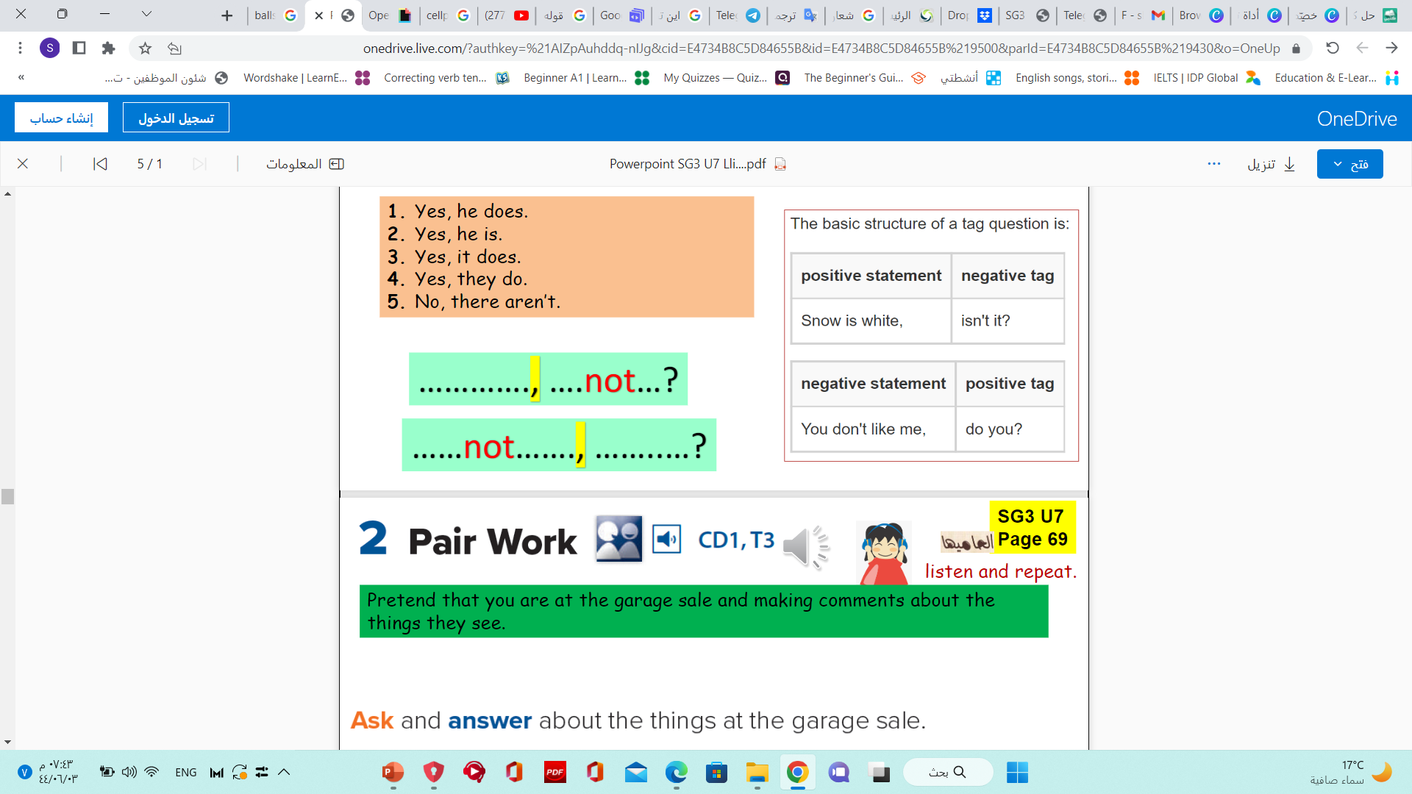
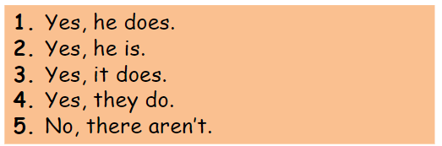

Slide 11
pretend that you are at the garage sale and making comments about the things they see.

Slide 12



Slide 13
قال رسول الله صلى الله عليه وسلم: " إن الصدقة لتطفئ غضب الرب وتدفع ميتة السوء"

Slide 14
Spelling
Saw
Plates
Sweeper
Cup
Forks

Slide 15

Goals :
01
03
02
04
List
Listen
Confirm
Sort
A number of tools
Tools according to usage
To the conversation at the garage sale
Information
05
06
Talk
Listen
About common items at garage sale
To conversation between two man about misunderstanding

Slide 16

Homework p.209

Slide 17
Have a nice day

