Slide 1

Unit 7
It’s a good deal, isn’t it?
Listen & Discuss

Slide 2
بسم الله الرحمن الرحيم
Day:
Date:

Slide 3
Learning Objectives
Name tools correctly
Classify tools into different categories
Answer Yes/No questions
Listen for specific information
Use new words correctly

Slide 4

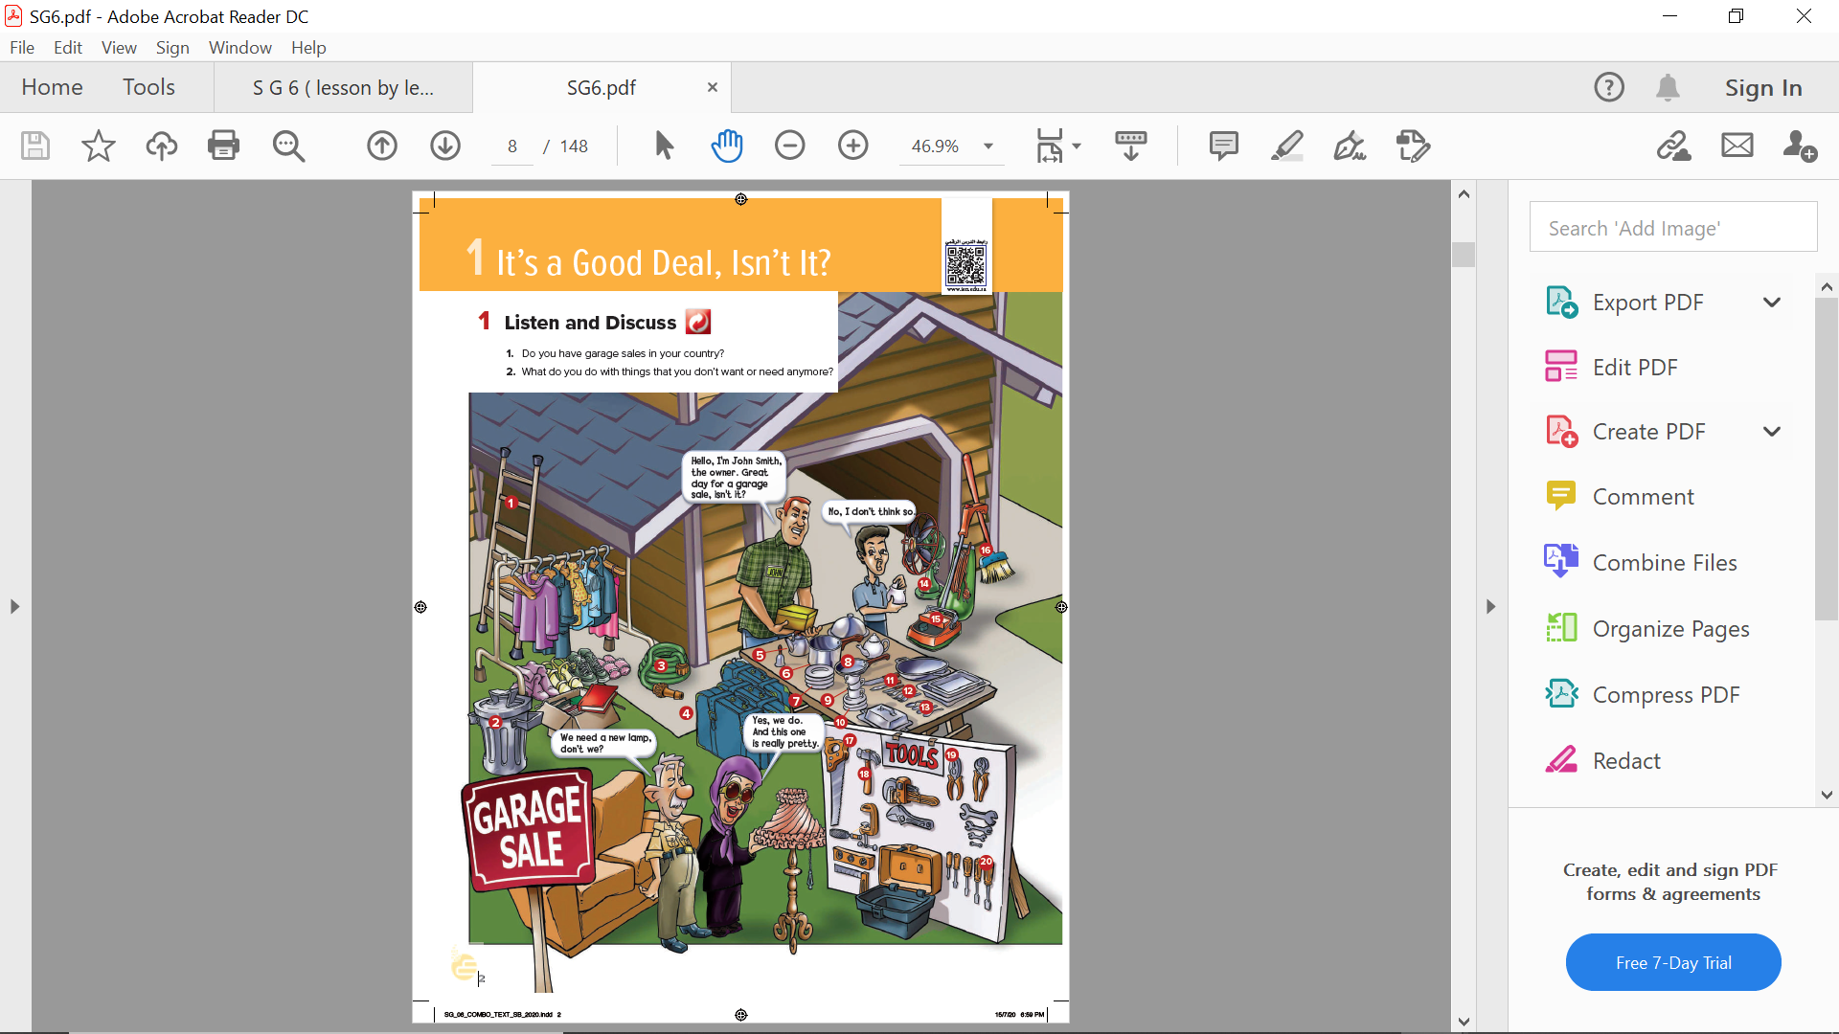
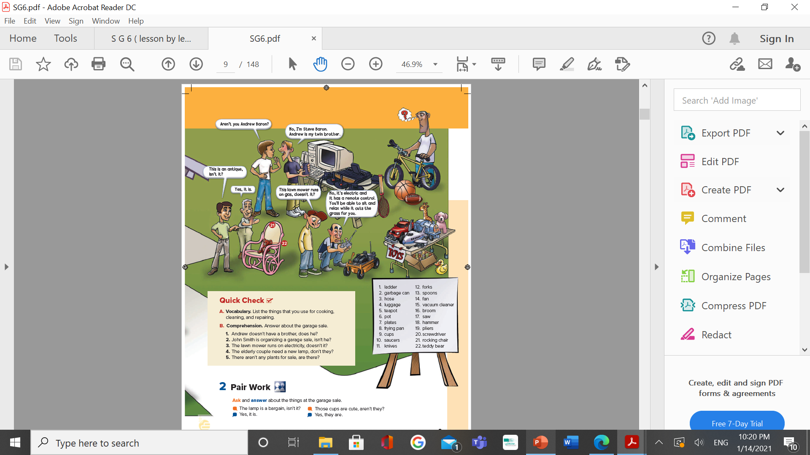
Pages 68 & 69

Slide 5
Pages 68 & 69

Slide 6
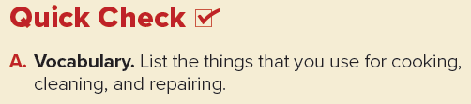
Answers
Cooking: pots (and pans), teapot, plates, frying pan, cups, saucers, knives, forks, spoons
Cleaning: broom, vacuum cleaner, hose
Repairing: saw, hammer, pliers, screwdriver
Page 69

Slide 7
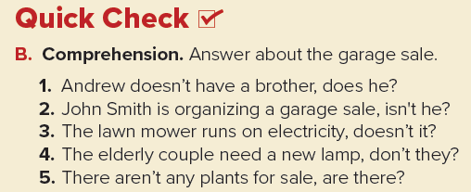
Answers
1. Yes, he does.
2. Yes, he is.
3. Yes, it does.
4. Yes, they do.
5. No, there aren’t.
Page 69

Slide 8
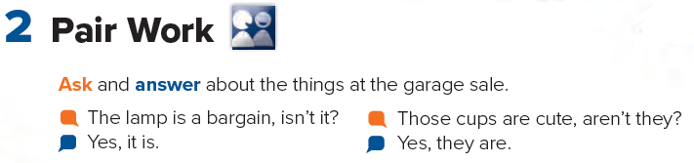
Page 69

Slide 9
Page 209
Homework

Slide 10
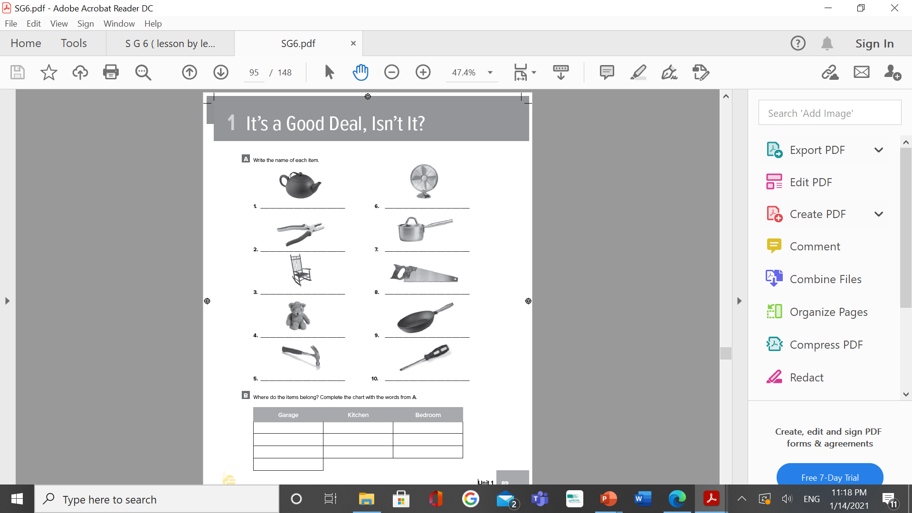
teapot
fan
pliers
pot
rocking chair
saw
teddy bear
frying pan
hammer
screwdriver

Slide 11
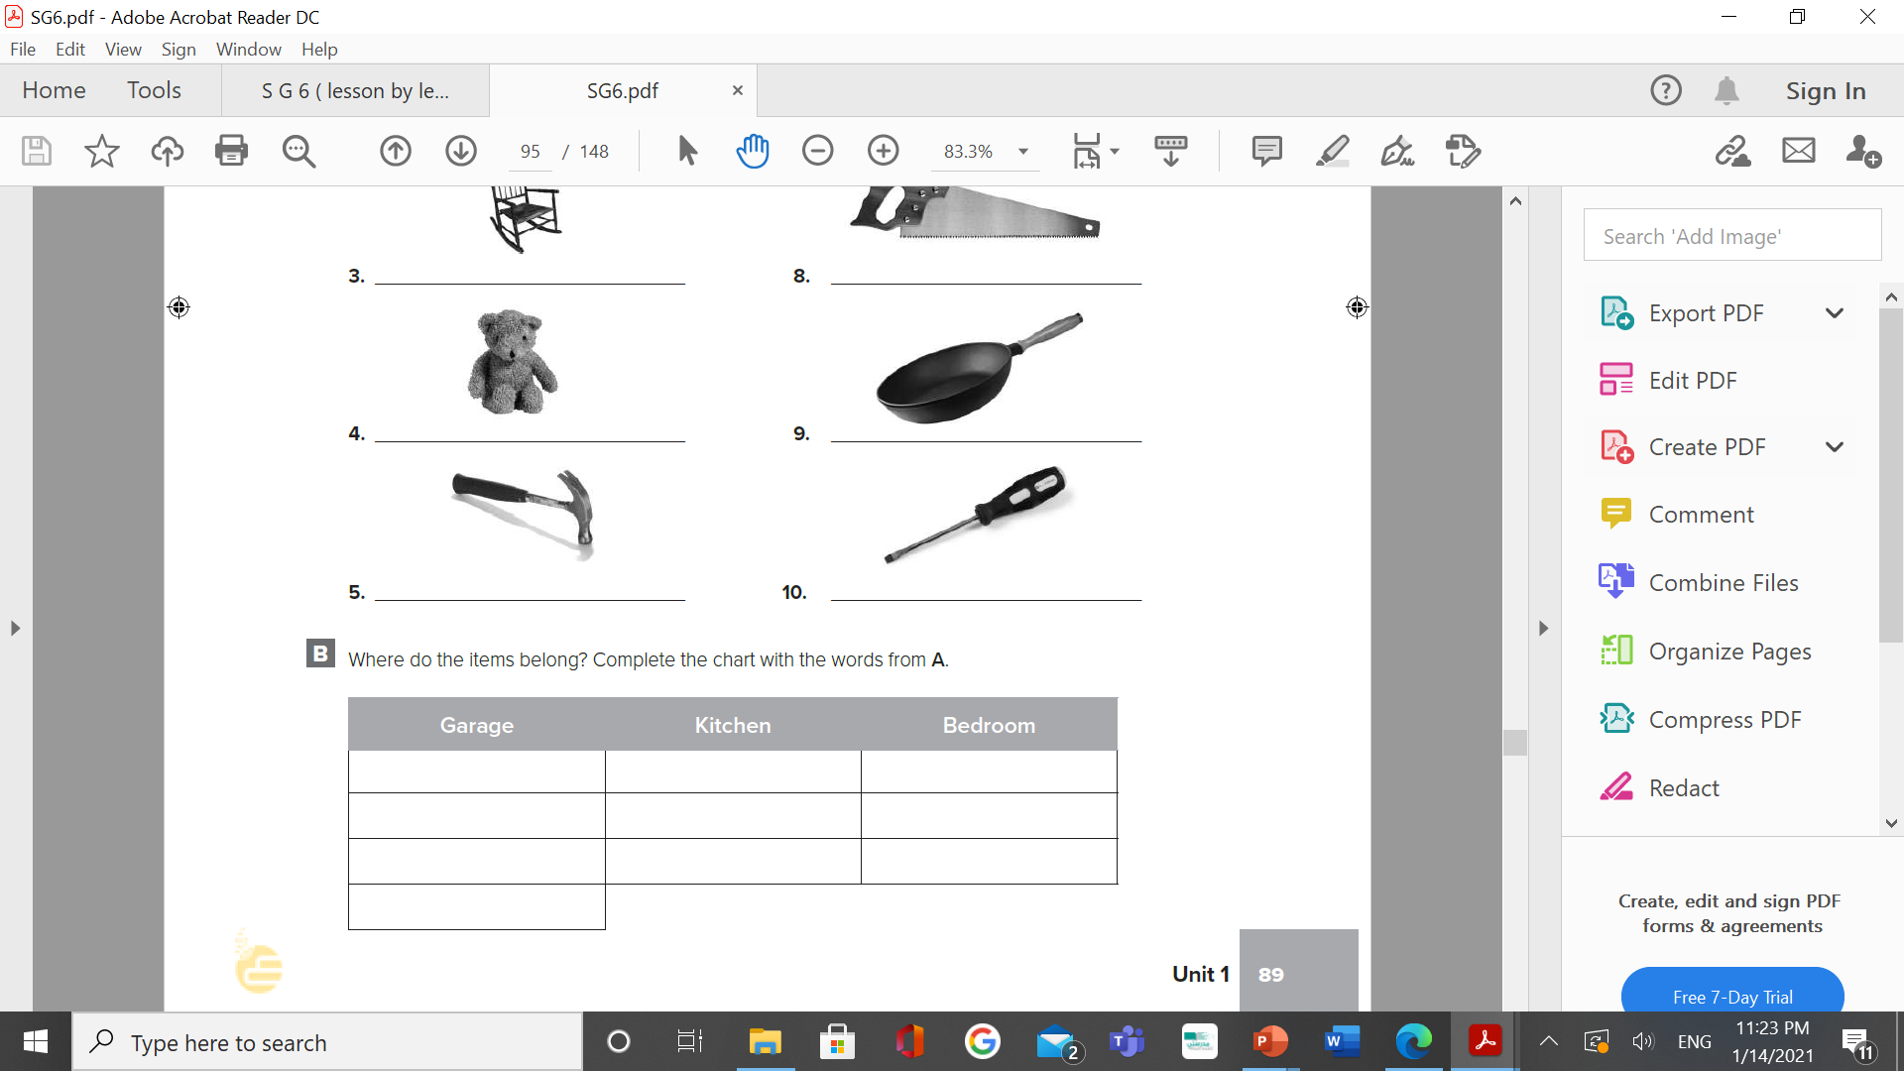
pliers
teapot
rocking chair
hammer
pot
teddy bear
saw
frying pan
fan
screwdriver

