Slide 1

Unit 7
It’s a good deal, isn’t it?
Form, meaning & Function

Slide 2
بسم الله الرحمن الرحيم
Day:
Date:

Slide 3
Learning Objectives
Make suggestions correctly
Accept a suggestion correctly
Refuse a suggestion correctly

Slide 4
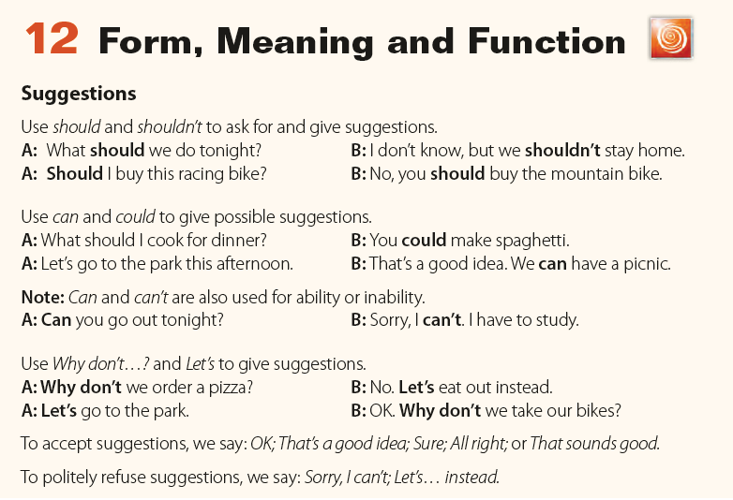
Page 77

Slide 5
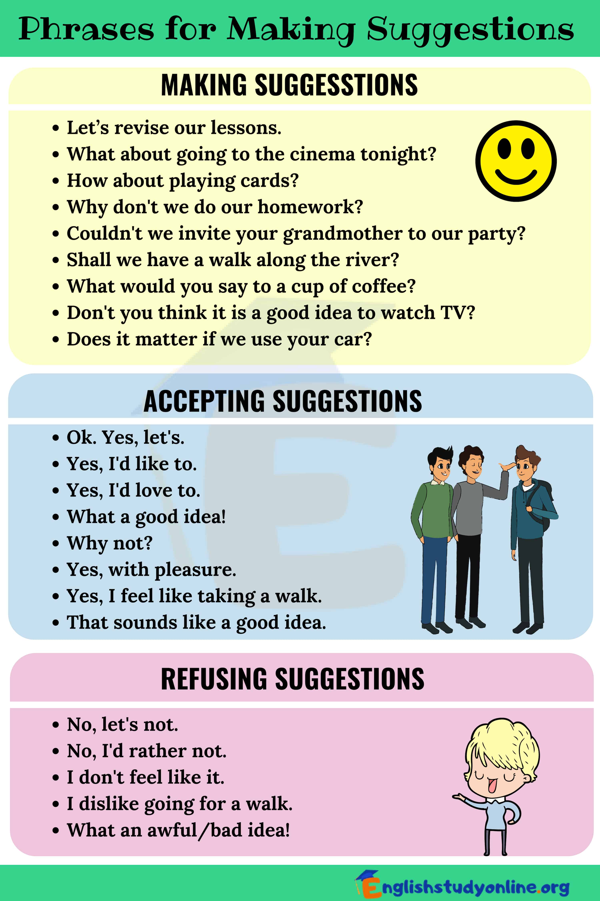

Slide 7

Practice

Slide 8
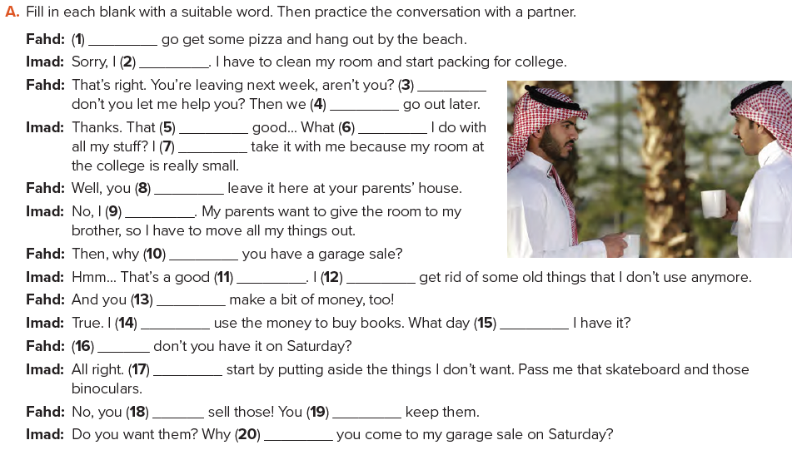
Let’s
can’t
Why
could
sounds
should
can’t
should
can’t
don’t
idea
could
can
can
should
Why
Let’s
shouldn’t
should
Page 77
don’t

Slide 9
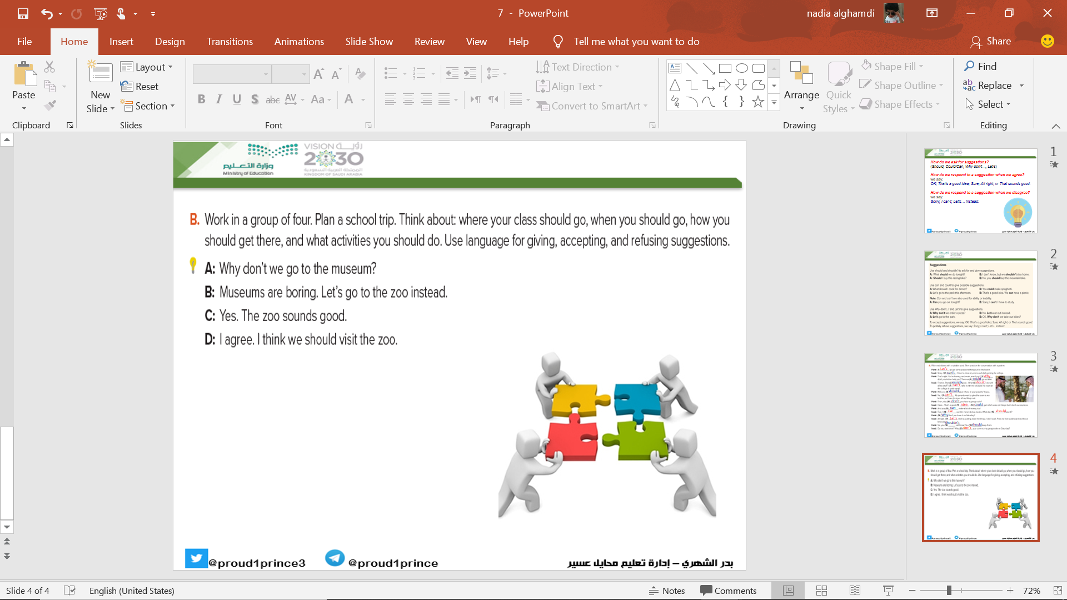
Page 77

Slide 10
Page 214 (J)
Homework

Slide 11
