Slide 1
It’s A good Deal, Isn’t it?

Slide 2
The objectives of the lesson :
At the end of this session, the students will be able to :
Rephrase a text
Produce the rising intonation

Slide 3
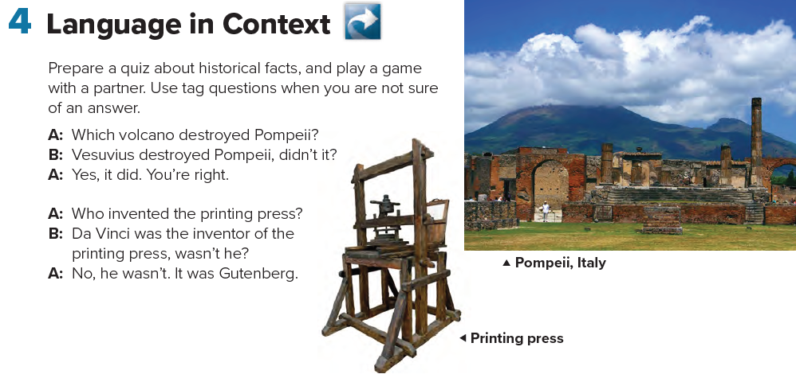

Slide 4

Can you think of more !
important people, places, and events in history

Slide 5

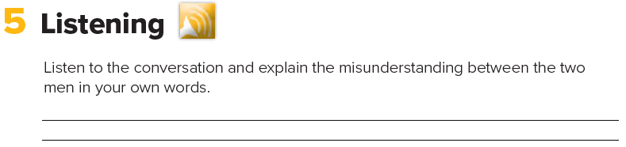
George Scott thinks the man is a famous author named Melvin Dupont.
Is the man happy or annoyed when the stranger talks to him?

Slide 6
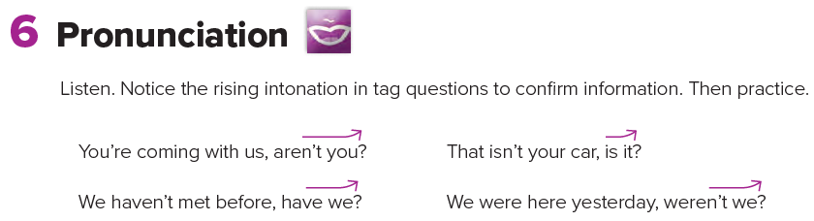

Slide 7



