Slide 1
It’s A Good Deal, Isn’t It?

Slide 2

The objectives of the lesson :
At the end of this session, the students will be able to :
Read a text to answer questions
Design a garage sale ad
Answer questions about the text

Slide 3

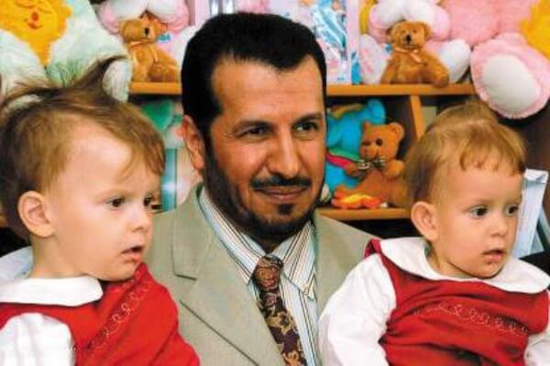

Slide 4
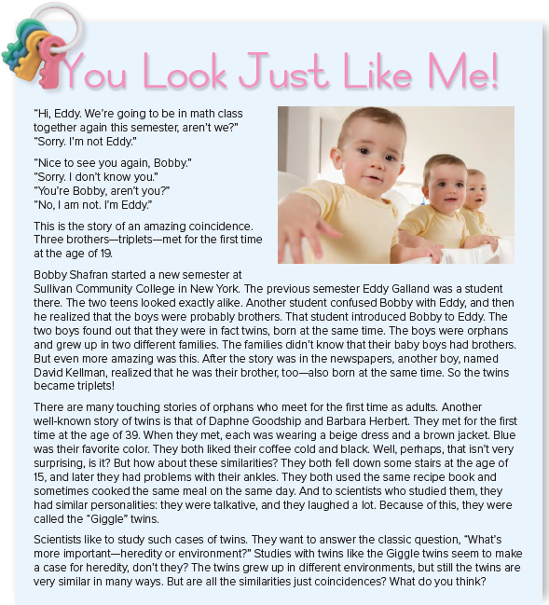


Slide 5
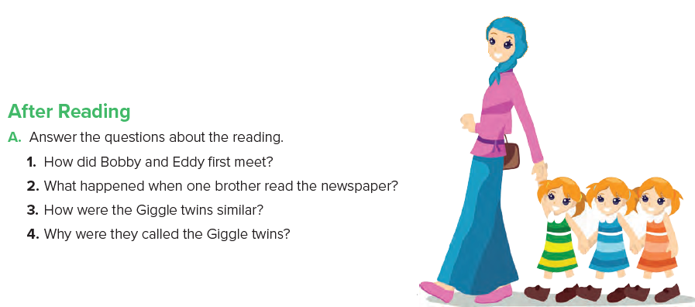
1. They met when another student introduced them.
2. One brother read the story about Bobby and Eddy and realized that he was their brother, too.
3. They wore similar clothes, had the same favorite color, and liked coffee the same way.
4. They laughed a lot.

Slide 6
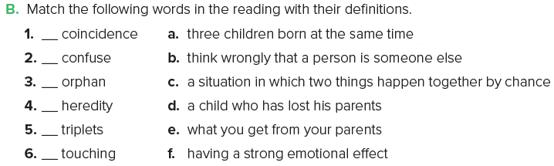
c
b
d
e
a
f

Slide 7


Slide 8
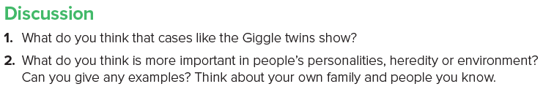


Slide 9
