Slide 1

Drive Slowly
Unit 8
Grammar

Slide 2
بسم الله الرحمن الرحيم
Day:
Date:

Slide 3


use modal auxiliaries correctly
must/mustn’t/must not
Learning Objectives
Should/ shouldn’t
use adverbs of manner correctly.

Slide 4
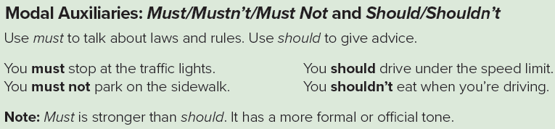
Page 80

Slide 5

Practice

Slide 6
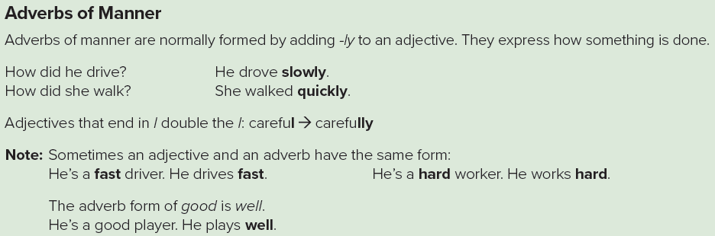
Page 80

Slide 7
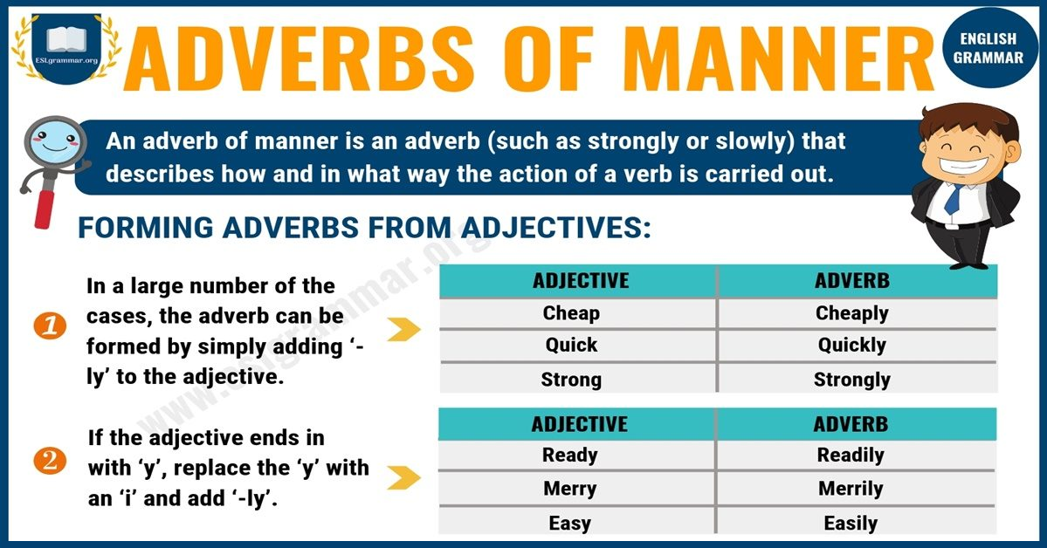

Slide 8

Practice

Slide 9
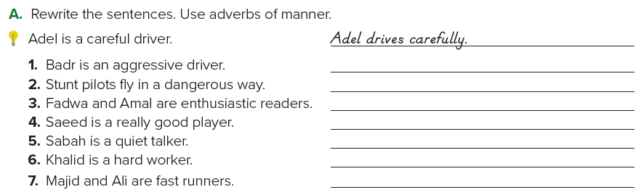
Page 80
Badr drives aggressively.
Stunt pilots fly dangerously.
Fadwa and Amal read enthusiastically.
Saeed plays really well.
Sabah talks quietly.
Khalid works hard.
Majid and Ali run fast.

Slide 10
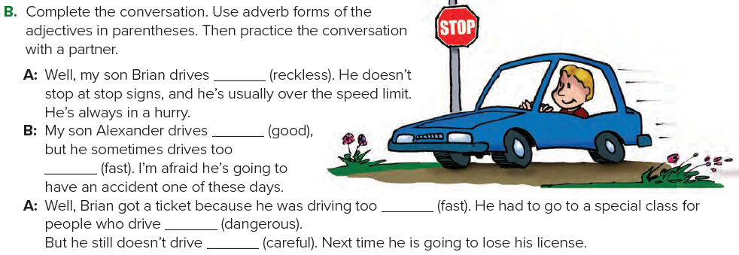
Page 80
recklessly
well
fast
fast
dangerously
carefully

Slide 11
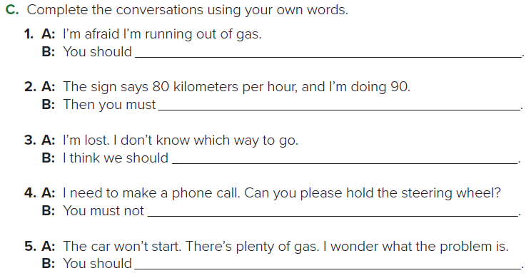
Page 81
stop at a gas station
slow down
stop and ask someone for directions
make a call when you’re driving
call a mechanic

Slide 12
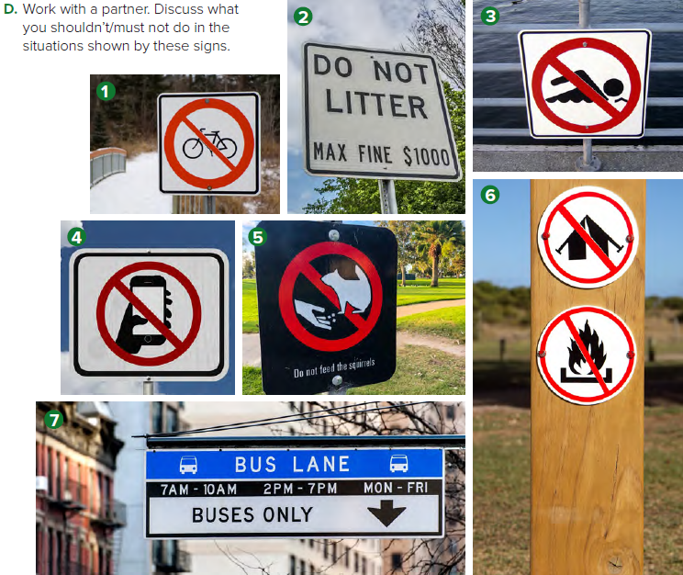
Page 81
1. You shouldn’t ride your bike here.
2. You must not litter.
3. You shouldn’t swim here.
4. You shouldn’t use your cell phone here.
5. You must not feed the squirrels and pigeons.
6. You should not camp or have a campfire here.
7. You must not park here.

Slide 13
Homework
Page 216

Slide 14
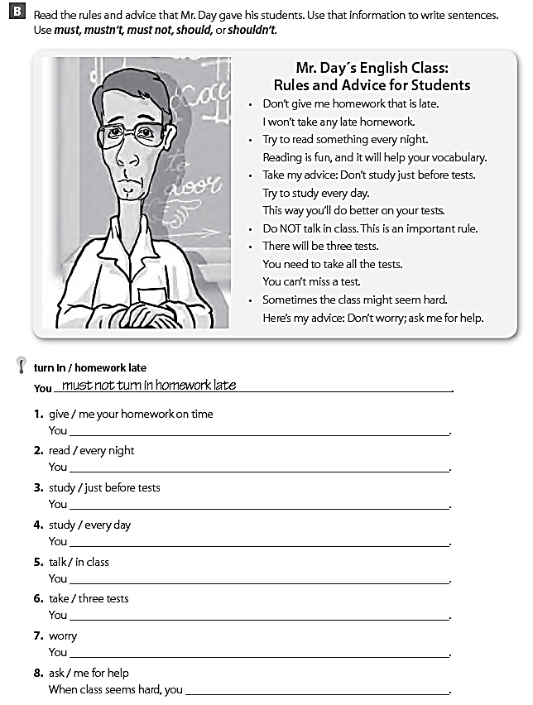
must give me your homework on time .
should read every night .
shouldn’t study just before tests .
should study every day .
mustn’t talk in class .
must take three tests .
shouldn’t be worry .
should ask me for help .

Slide 15
THANK YOU

