Slide 1

Drive Slowly
Unit 8
Reading

Slide 2
بسم الله الرحمن الرحيم
Day:
Date:

Slide 3


Identify the main idea of the passage
Identify specific information
Learning Objectives
answer questions about the passage
Write a list of driving tips and safety rules for new driving

Slide 4
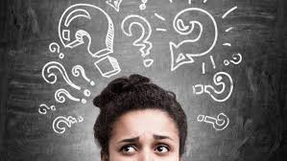
Vocabulary
Confusion

Slide 5
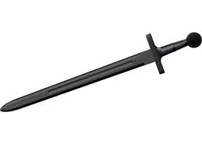
Vocabulary
sword

Slide 6
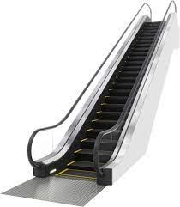
Vocabulary
escalator

Slide 7
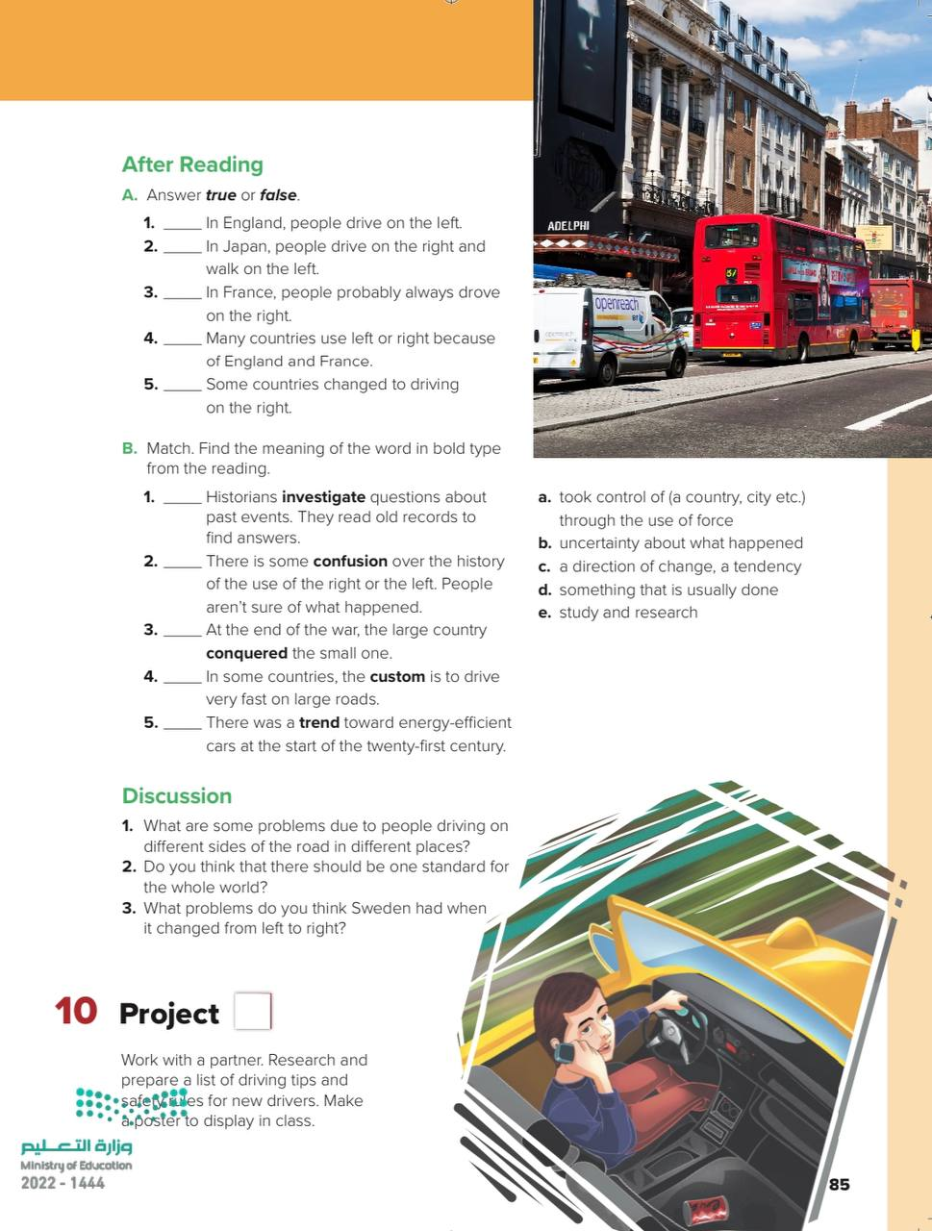
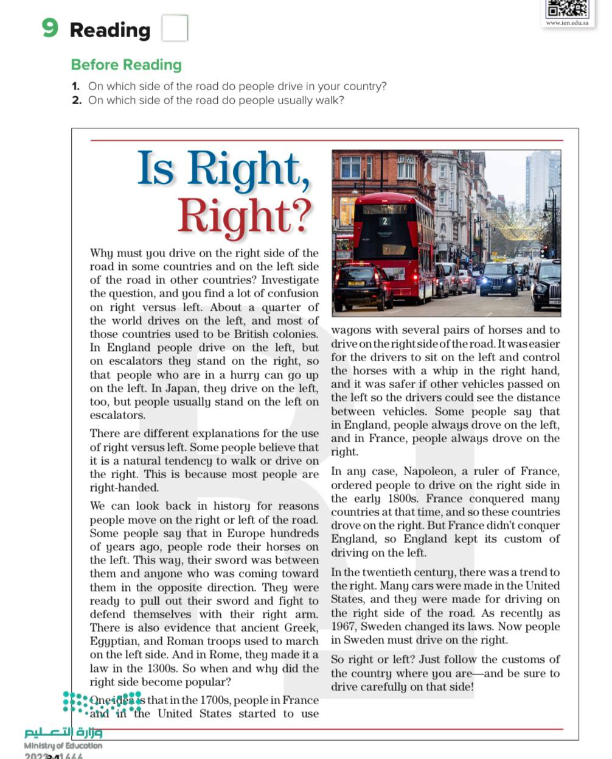
Before Reading

Slide 8
Before Reading
-What is the title?
-Scan: What is the passage talking about?
-Do we have subtitles?
-How many pictures are there? Paragraphs? Lines?
-Skim: Find the following in the passage: numbers, names of countries

Slide 9
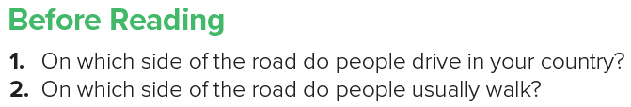
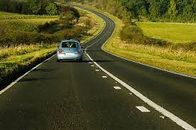
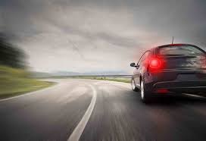

Slide 10
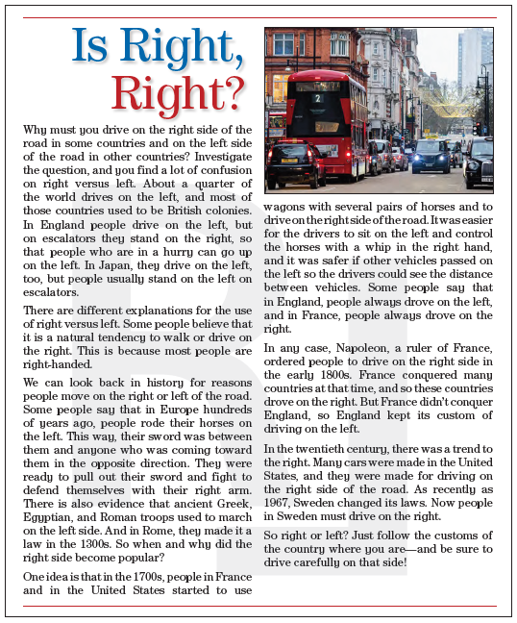

Page 84

Slide 11
Mind-map
Main Idea
Paragraph 1
Paragraph4
Paragraph 6
Paragraph 2
Paragraph 3
Paragraph 5

Slide 12
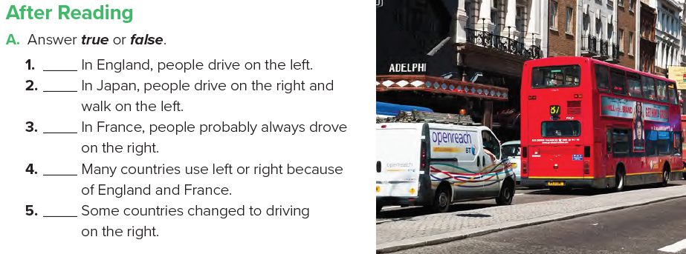
Page 85
T
F
T
T
T

Slide 13
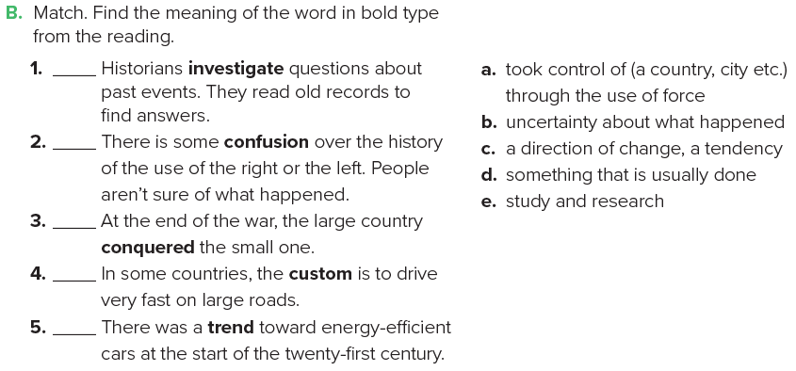
Page 85
e
b
a
d
c

Slide 14
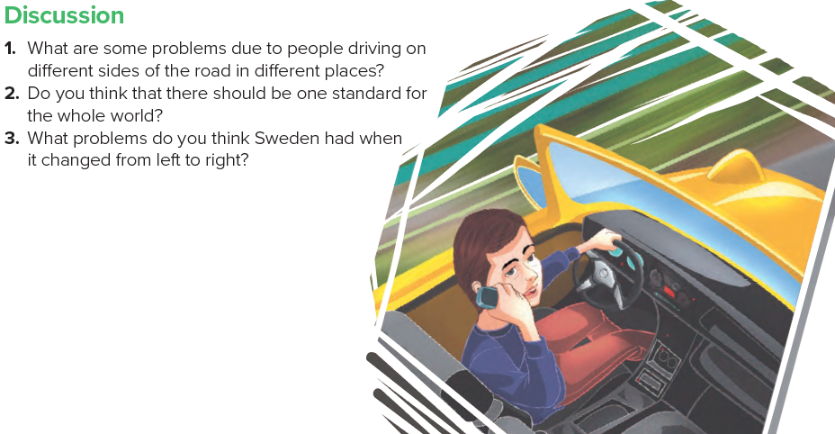
Page 85

Slide 15
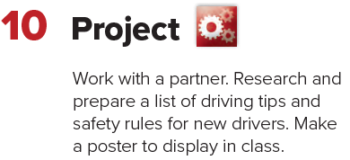
Page 85

Slide 16
Homework
Page 219

Slide 17
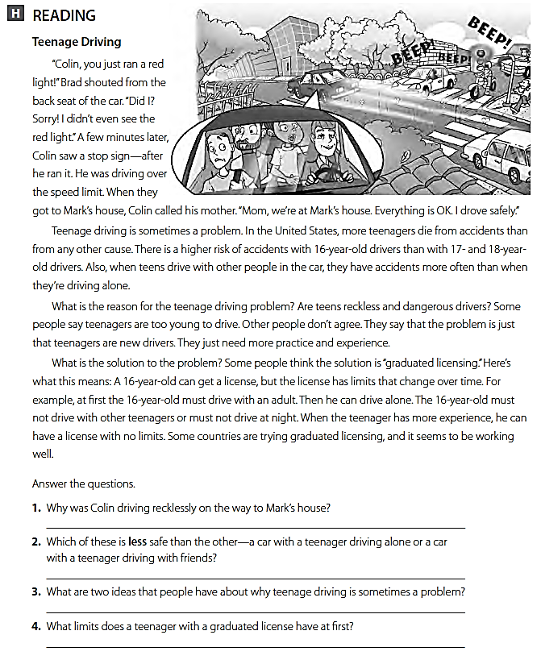
He ran a red light , and a stop sign
A car with a teenager driving with his friends .
Teenagers are too young to drive and they are new drivers .
He must drive with an adult .

Slide 18
THANK YOU

