Slide 1
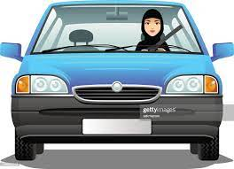
Drive Slowly!

Slide 2
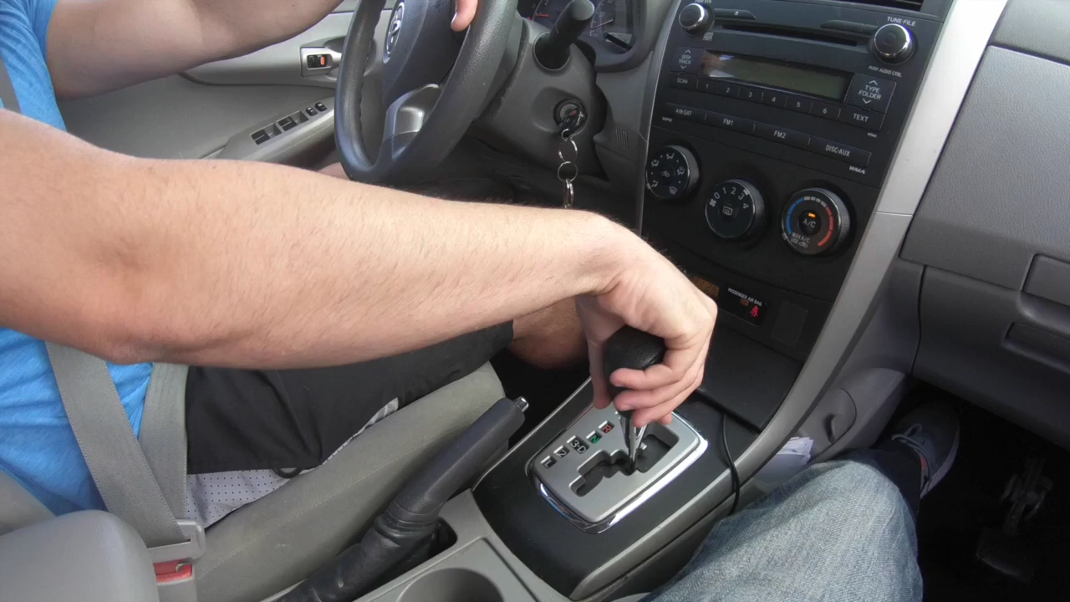

Slide 3
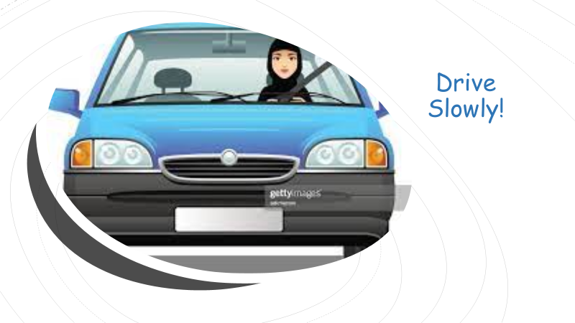
Drive Slowly!
1. Listen and discuss
Objectives:
List a number of car interior and exterior parts.
Tell the use of some cars part.
Use driving expressions properly.
recognize international traffic signs.
Answer the question in their book.

Slide 4
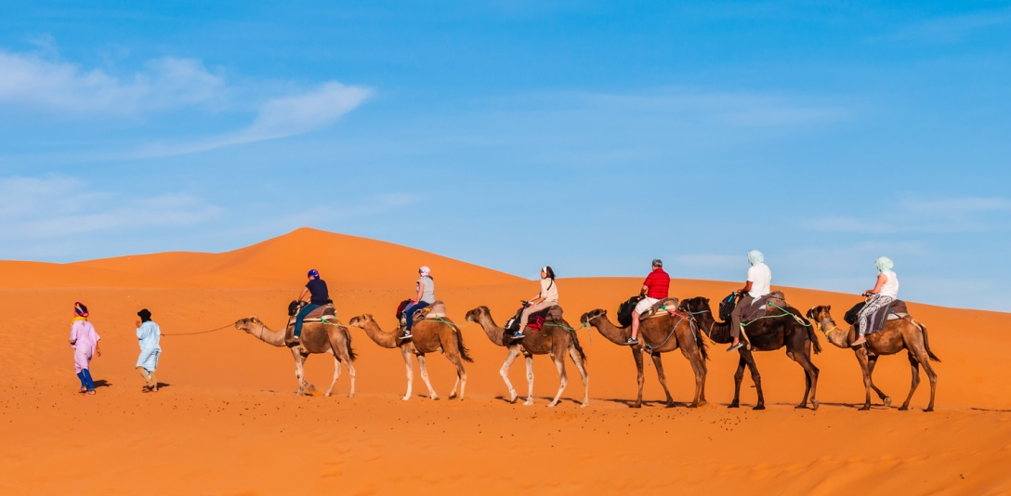
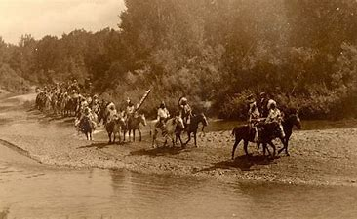

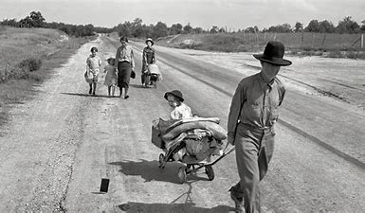
How did people travel in the past?

Slide 5
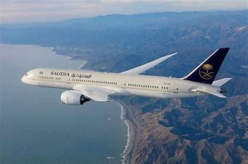
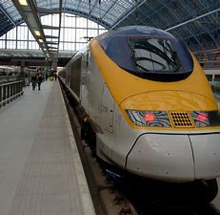
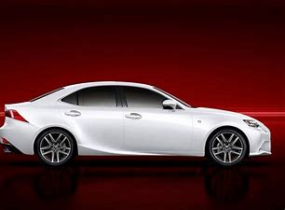
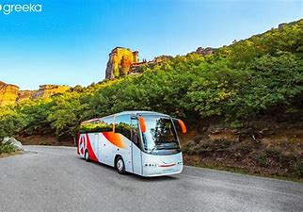
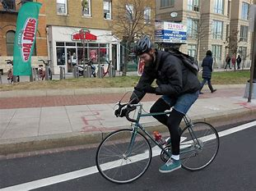
How do people travel nowadays?

Slide 6
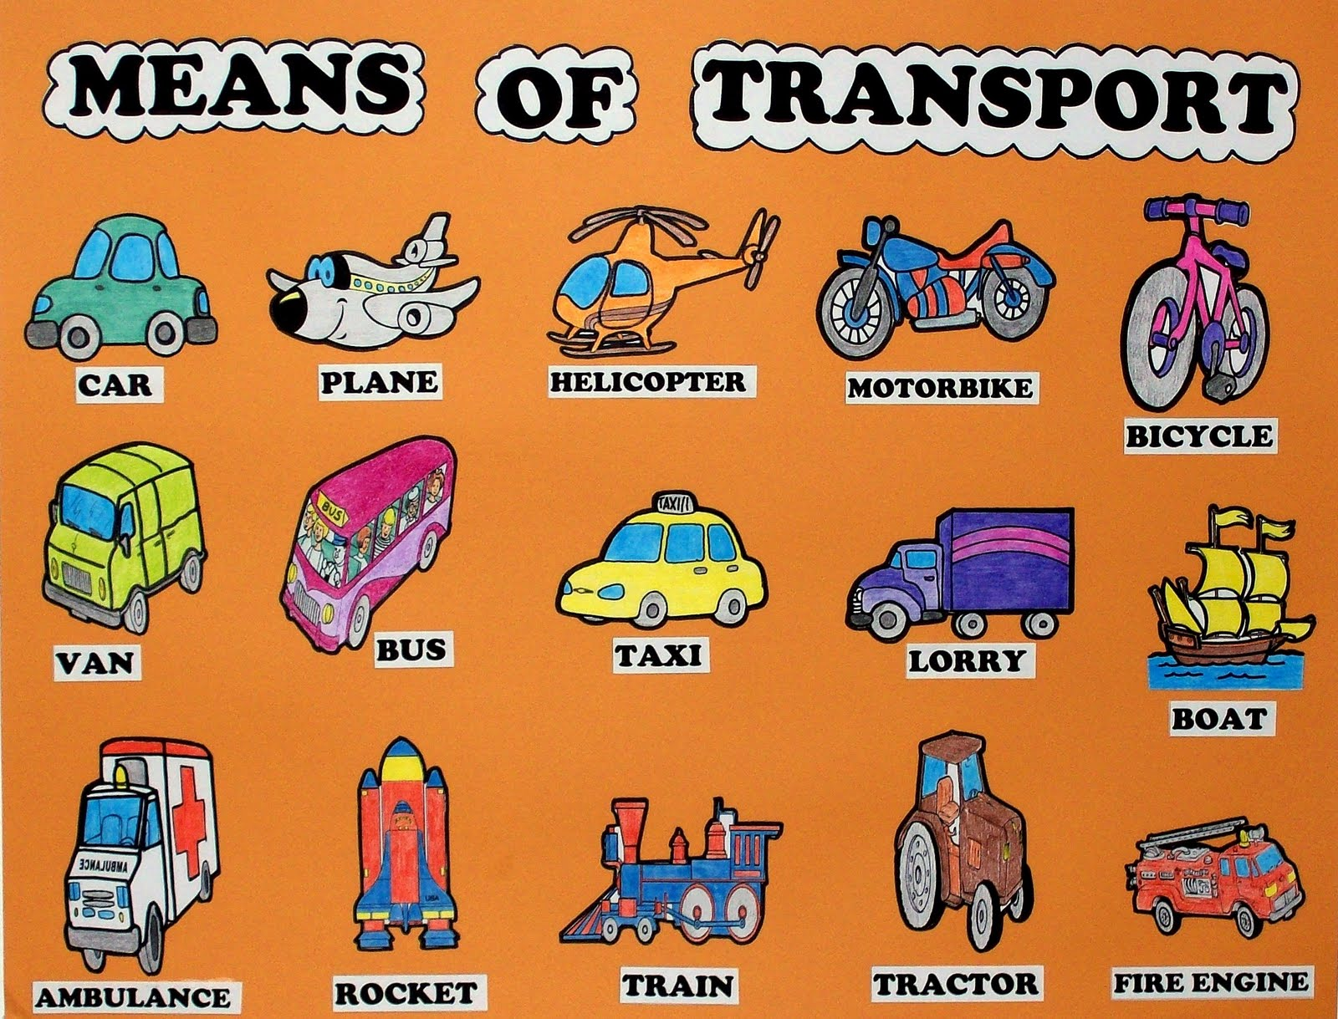
What is the most common means of transportation in Saudi Arabia?

Slide 7
What do you know about cars?
Were women always allowed to drive in Saudi Arabia?
When did women started diving?
10 – 10 -1439H
Do you know how to drive?
Would you like to learn?
In your opinion, what is the right age for driving?
If you get to buy your dream car, What will you buy?

Slide 8
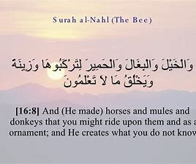

Slide 9
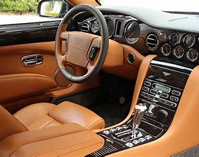
Look at the following picture.
Can you name any part?

Slide 10
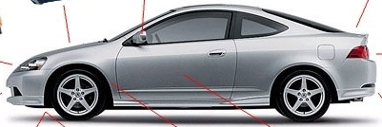
What about the exterior of the car?

Slide 11

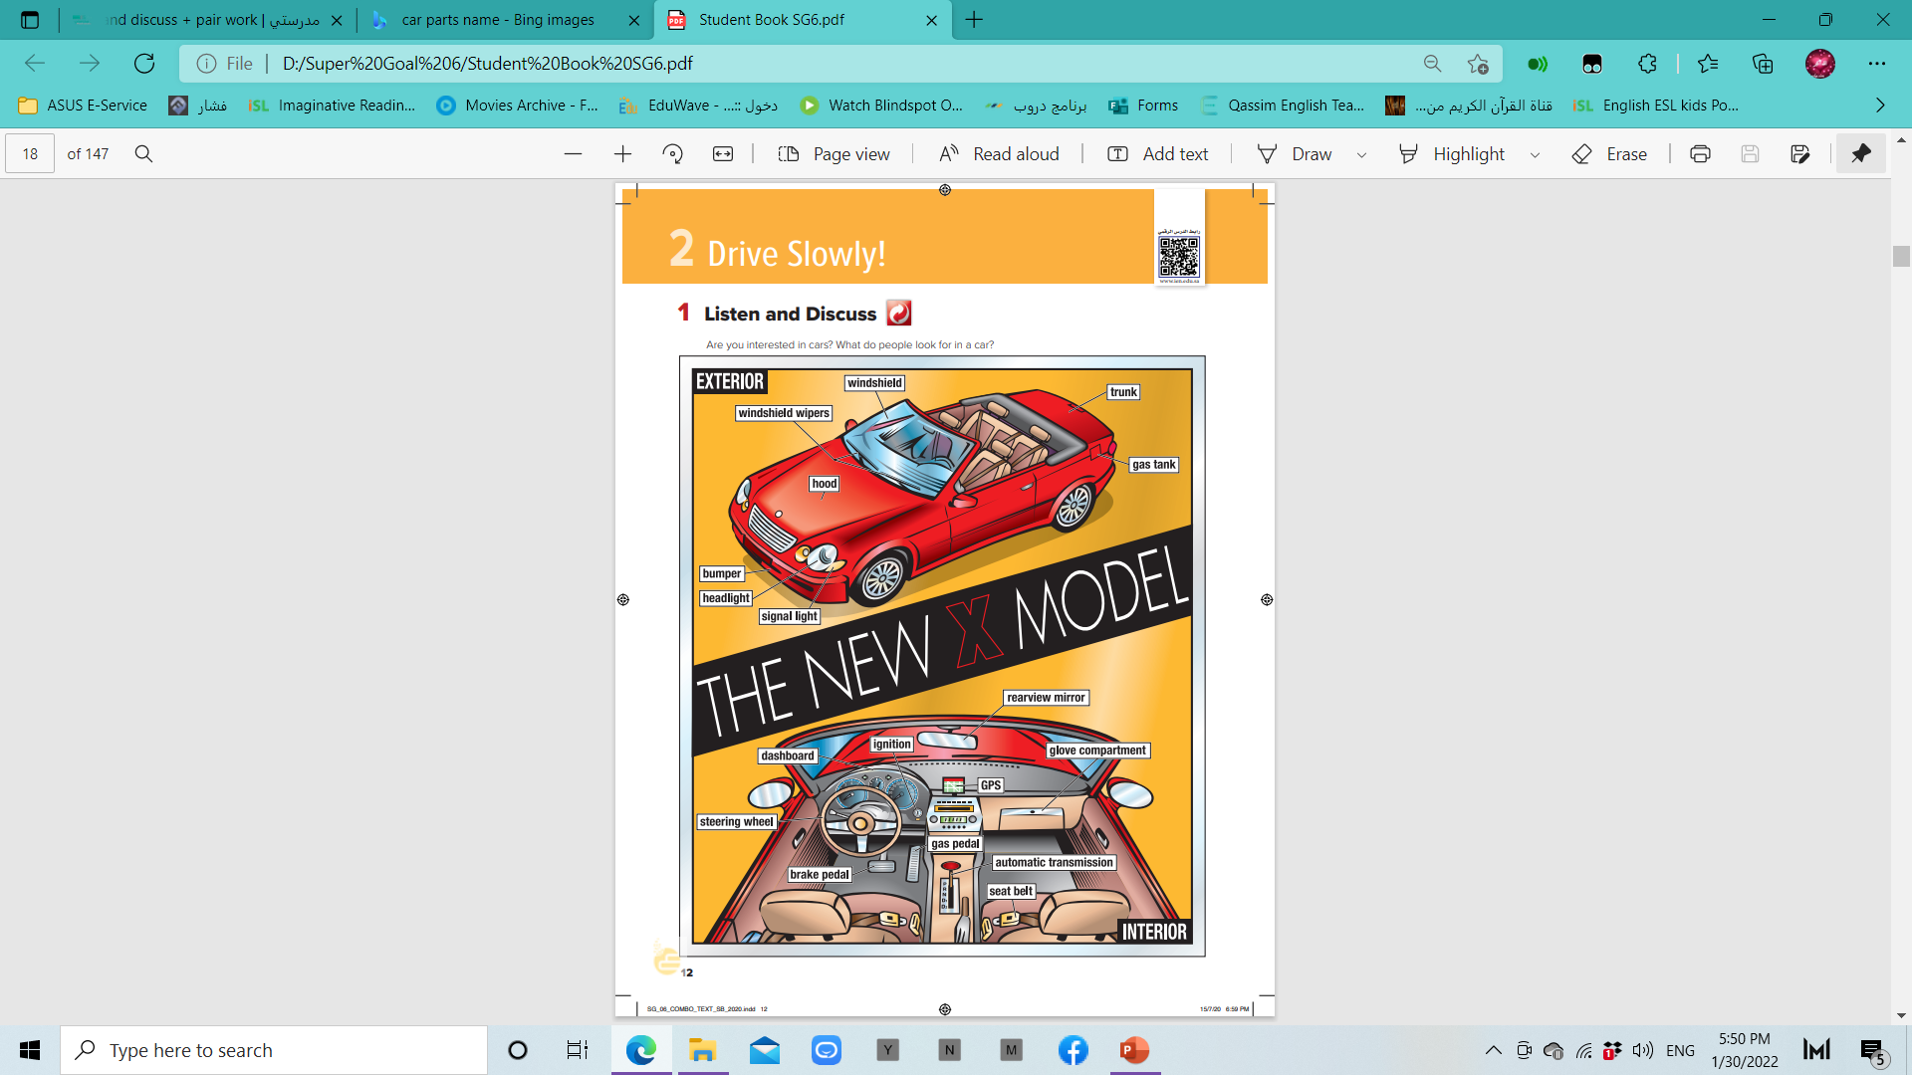
Exterior =
outside

Slide 12
interior =
inside

Slide 13


Slide 14
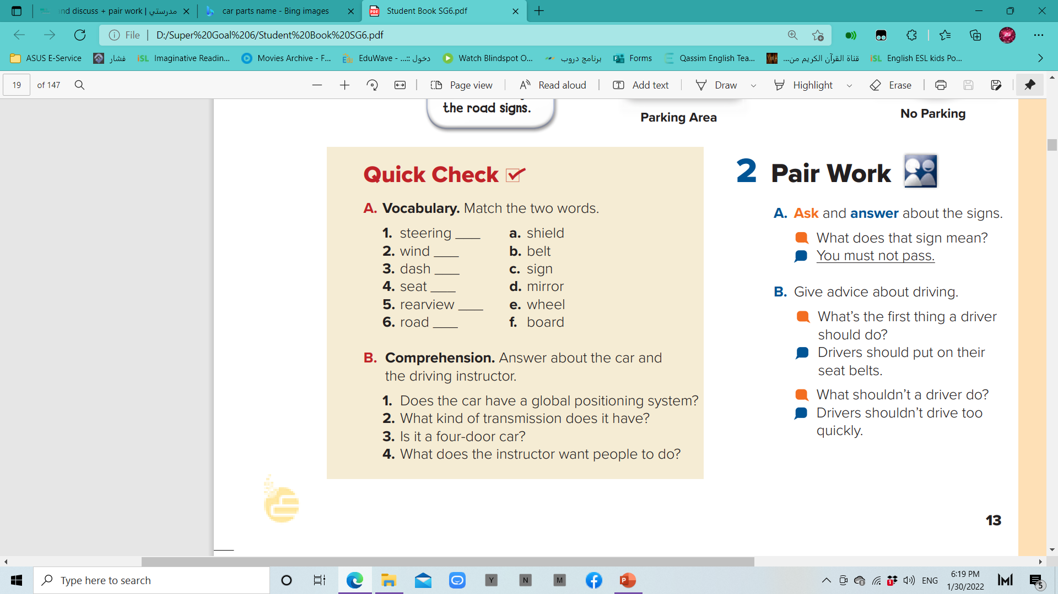

P. B. p.79. Ex: A
e
a
f
b
d
c

Slide 15
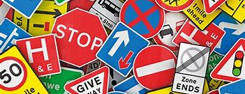
What are these?
Do you what they mean?

Slide 16
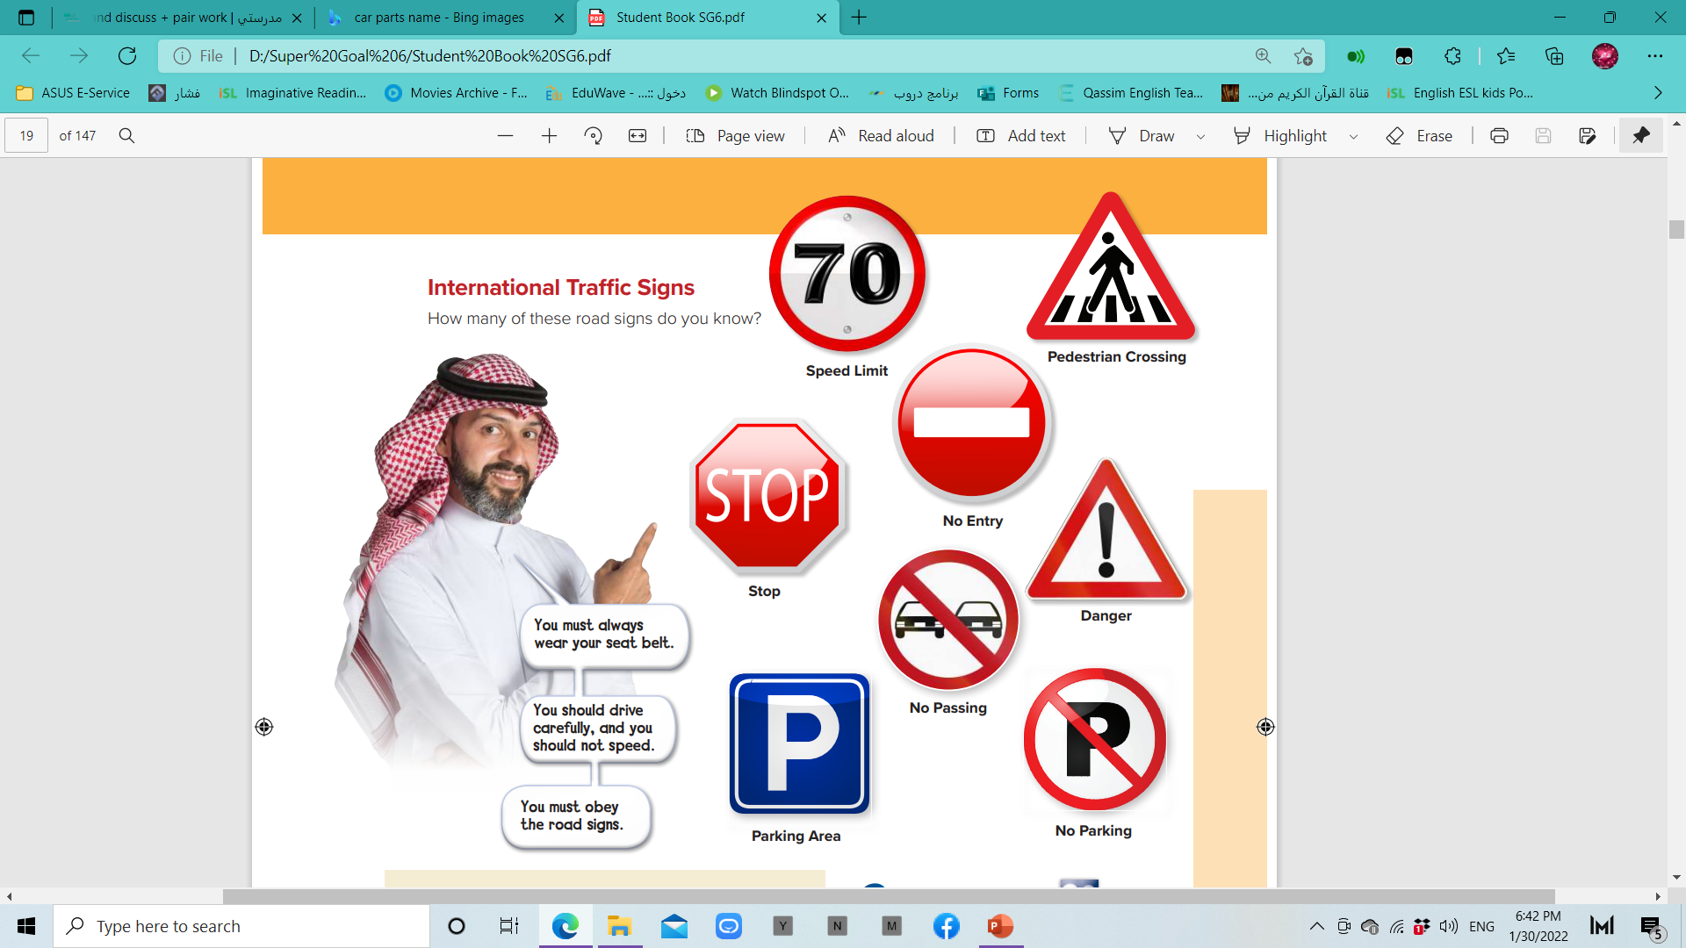
P. B. p.79. Ex: A

Slide 17

P. B. p.13. Ex: B
1. Yes, it does.
2. It has automatic transmission.
3. No, it isn’t.
4. He wants people to wear seat belts, to drive carefully, not to speed, and to obey road signs.

Slide 18
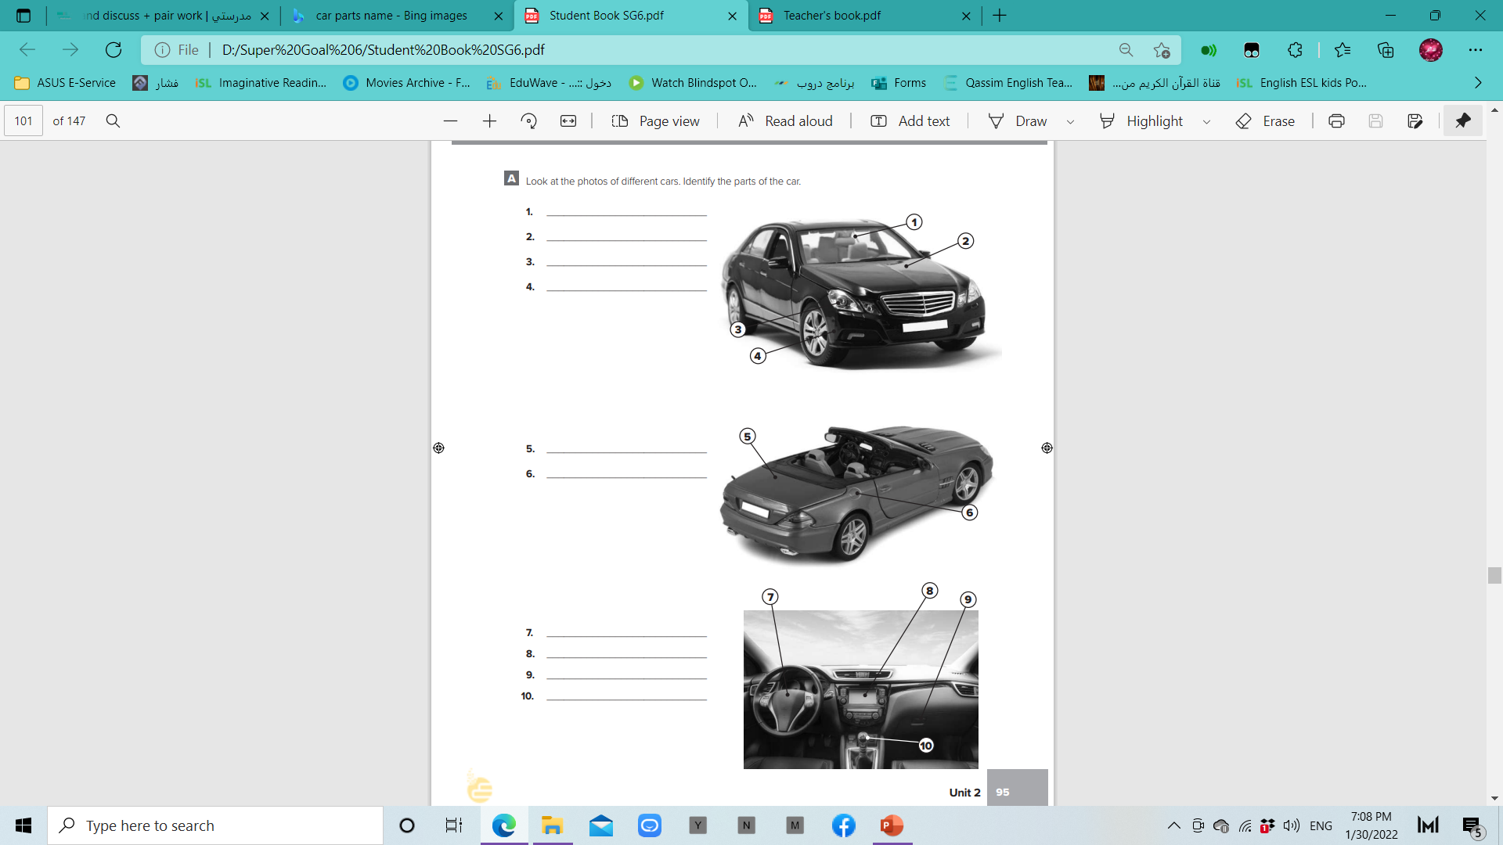

windshield
hood
headlight
bumper
W. B. p. 215
trunk
gas tank
Steering wheel
Dashboard
glove compartment
automatic transmission

Slide 19


