Slide 1

Super Goal 1
Where Do You Live ?
59

Slide 2

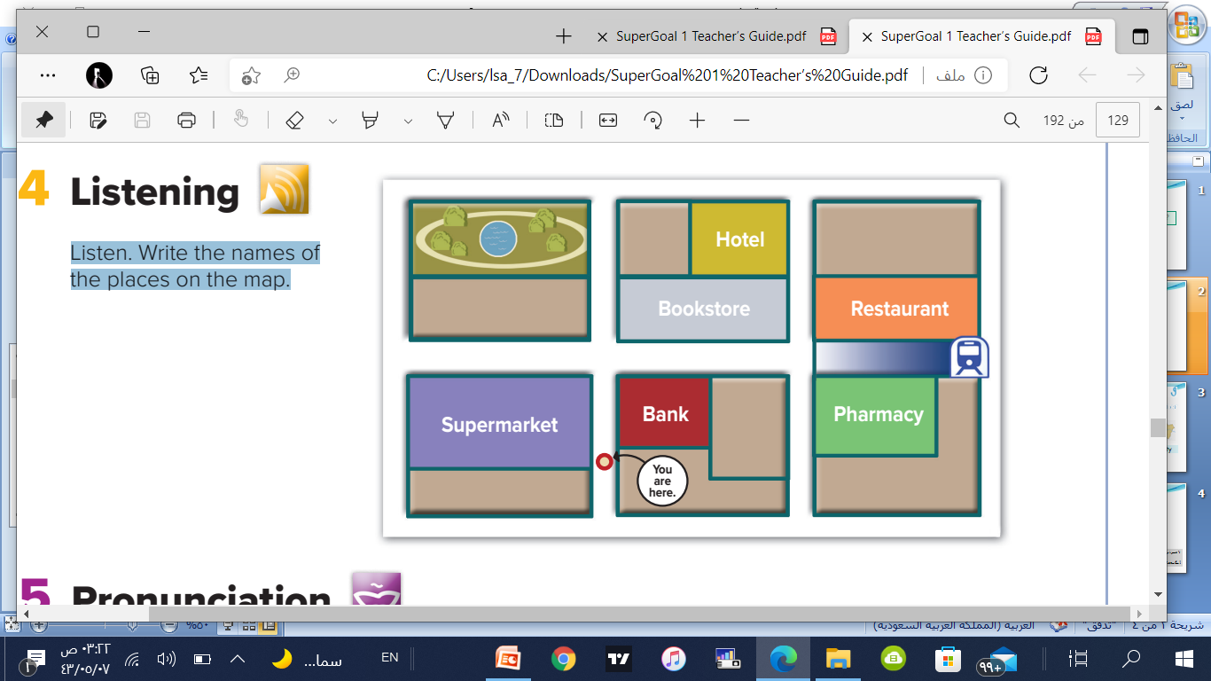
Write the names of the places on the map.
Cafe
Excuse me.
Where’s the English school?
Go straight. Turn left.
It’s across from
the supermarket.
English School
Is there a café near here ?
Yes, there is.
Go straight. It’s on the corner on your right. It’s next to the bookstore.
59

Slide 3
Write the names of the places on the map.
Cafe
Where is the subway stop?
Go straight. Turn right at the corner. Then walk a block. It’s between the pharmacy and the restaurant
English School
subway stop
Where is the convenience
store?
Convenience store
Go straight.
Turn right at the corner. It’s on your right. It’s next to the bank.
59

Slide 4








Give the directions !

Slide 5

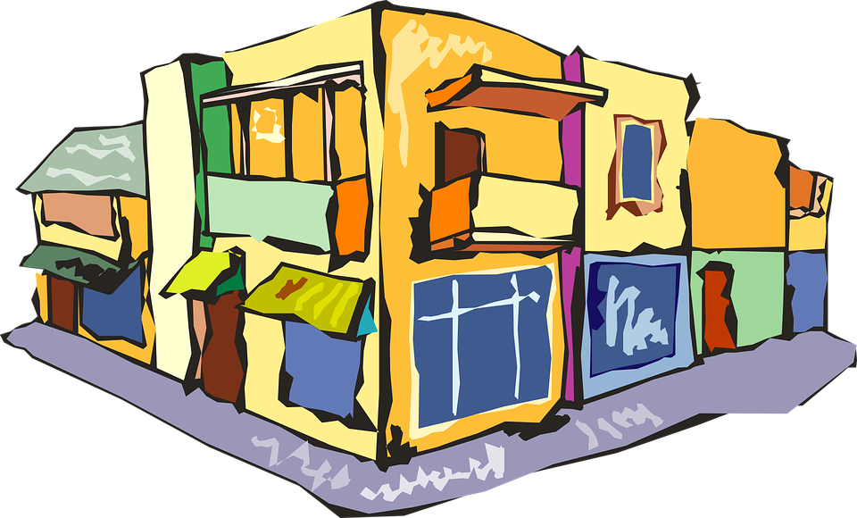
Fill in the missing litter
St_re
Bu_
_arket
Hote_
Store
Bus
Market
Hotel

Slide 6

Good Job Every One

Slide 7

The End
لا تنسونا من صالح دعائكم – رائد الحربي
@Rae_d_1

