Slide 1
Unit 7
Where do you live?
Writing

Slide 2
COVID 19
☺ Avoid gathering !
☺ wear a mask before going out
☺ Social distancing is not a choice, it is a must!
☺ Keep a distance of 2 meters to avoid accountability
☺ Wash hands constantly

Slide 3
بسم الله الرحمن الرحيم
Day:
Date:

Slide 4
Learning Objectives
1. Read a post card to a pen pal friend.
2. Write a post card to a pen pal friend.
3. use personal pronouns correctly.
4. design a brochure about neighborhood.

Slide 5
Writing
Page 62

Slide 6
Writing

Slide 7
Subject pronouns

Slide 8
Practice

Slide 9
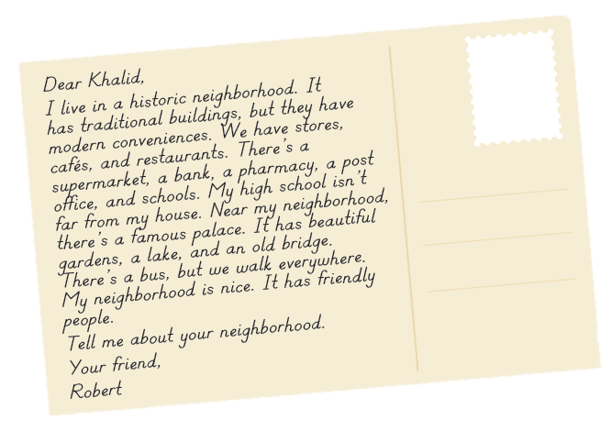
Writing

Slide 10
Writing

Slide 11
Writing

Slide 12
Homework
Page 118 (H)

Slide 13
