Slide 1
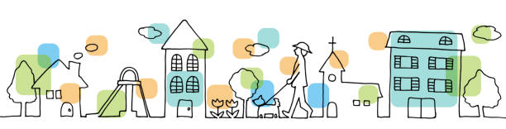
Super Goal 1
Unit 7 Lesson 1 page (56)
Listen and Discuss
T. Haya B.

Slide 2
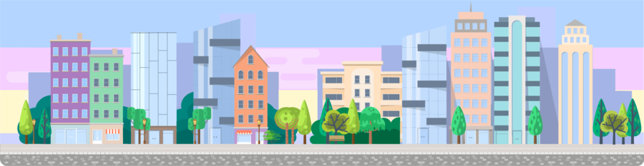
Where Do You Live?

Slide 3

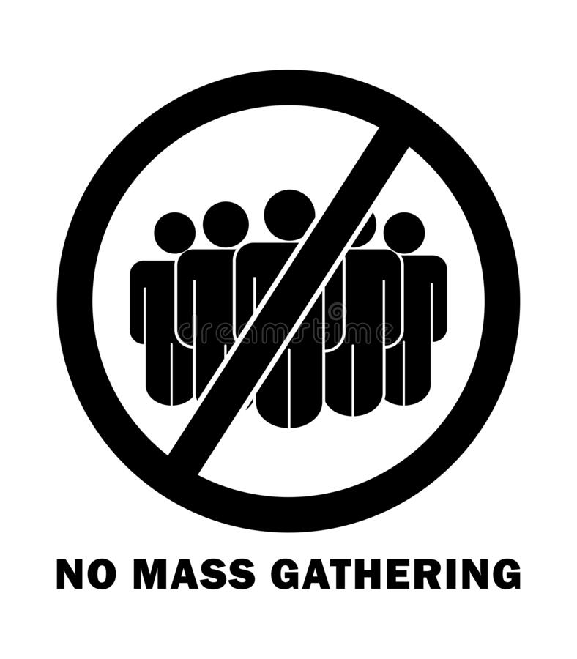

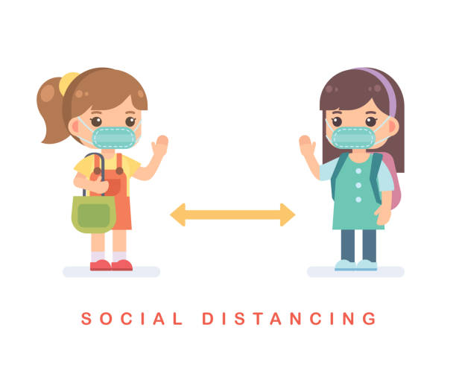
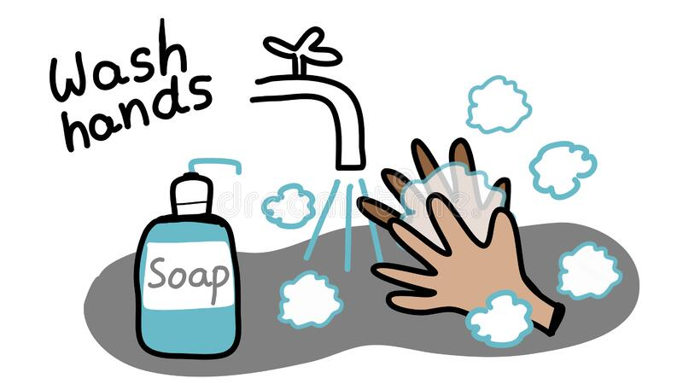

Rules of the classroom:-
1- avoid gathering.
2- we must wear mask.
3- social distancing is not a choice , it is a must.
4- Wash hands.
5- If you want to answer or ask, please, raise your hand

Slide 4

Check homework:-

Slide 5

Revision:-
Wheel spinning

Slide 6


Use and in a sentence
Use there is/ are in a sentence
SPIN
Use but in a sentence
describe your house
Use any preposition in a sentence
tekhnologic
Notes:
5 Segments

Slide 7
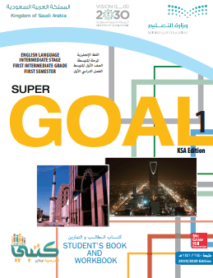
Objectives:
Open your book on page 56
1- read the paragraph.
2- learn new words.
3- name places in the city.
4- answer the question.

Slide 8
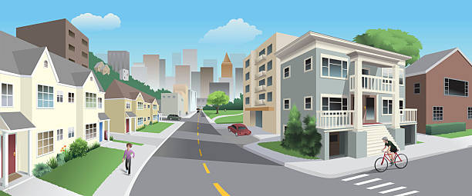
Warm up:
Open your book on page 56
Do you know this word (neighborhood) ?
It refers to specific area in a city or town.

Slide 9
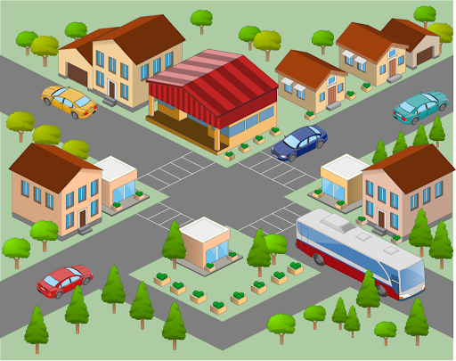
Warm up:
Open your book on page 56
School
Is there a park near the school?
restaurant
Is there a restaurant in the neighborhood?

Slide 10

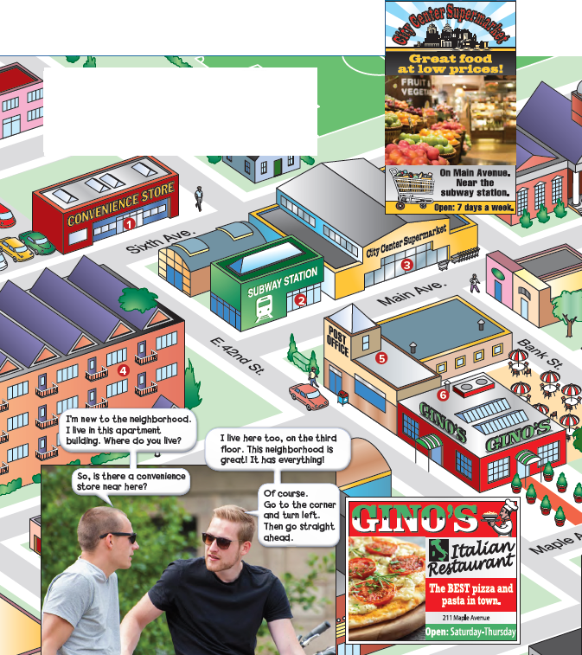
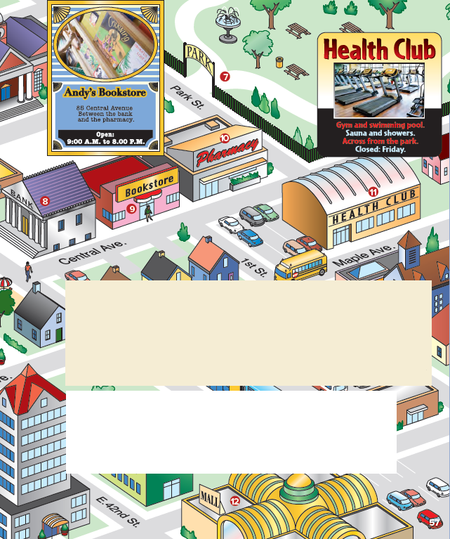
Listen and discuss:
Open your book on page 56

Slide 11

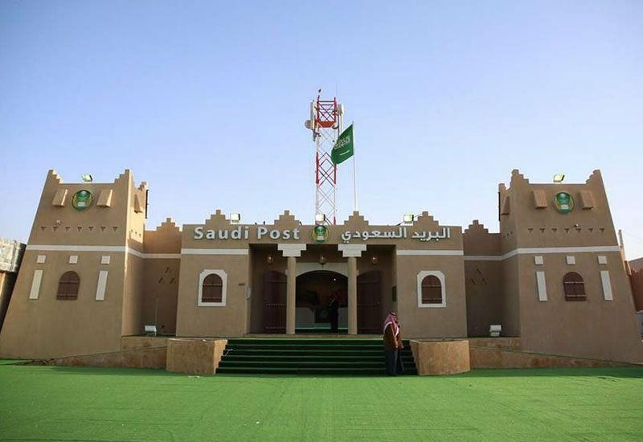
Name each picture by using who am I strategy
Listen and discuss:
a place where stamps are sold, and from where letters and packages are sent
Post Office

Slide 12
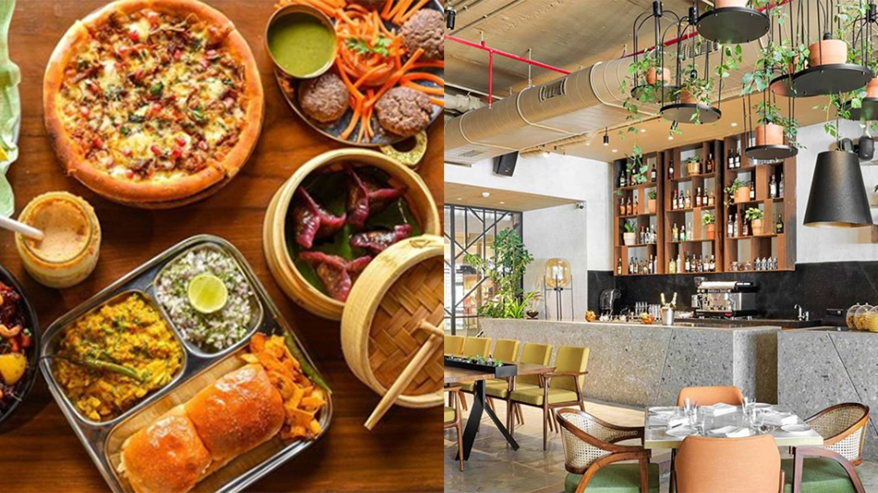
Name each picture by using who am I strategy
Listen and discuss:
a place where we order food
Restaurant

Slide 13
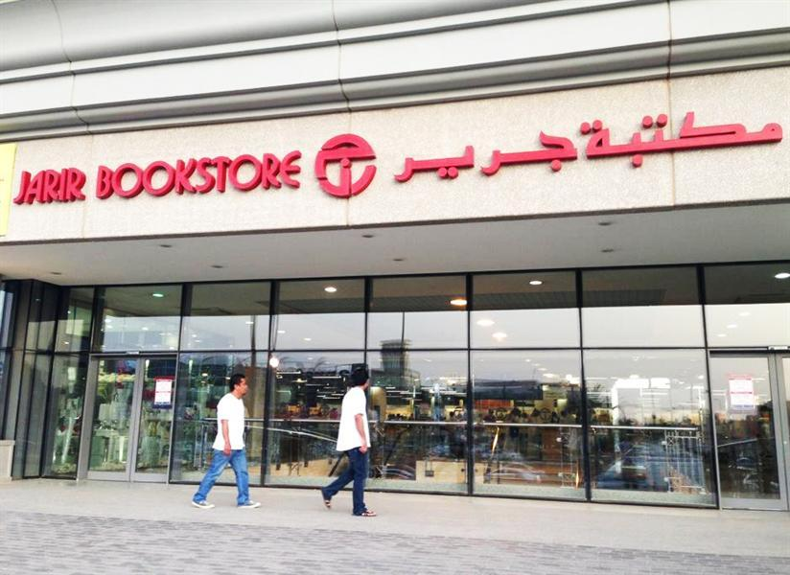
Name each picture by using who am I strategy
Listen and discuss:
a shop where books are sold.
Bookstore

Slide 14
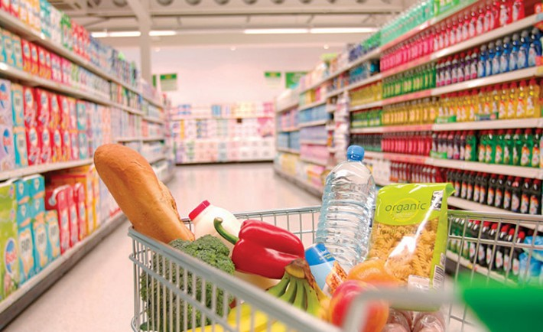
Name each picture by using who am I strategy
Listen and discuss:
a large self-service shop selling foods and household goods.
Supermarket

Slide 15
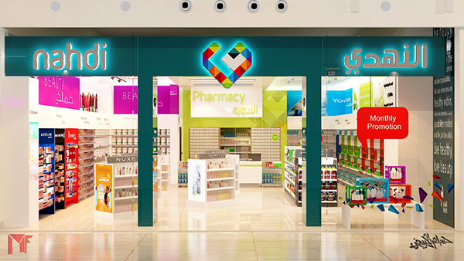
Name each picture by using who am I strategy
Listen and discuss:
A place where medicinal drugs are prepared or sold.
Pharmacy

Slide 16
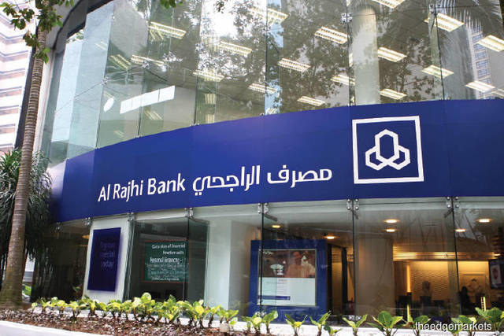
Name each picture by using who am I strategy
Listen and discuss:
A place where you save money
Bank

Slide 17
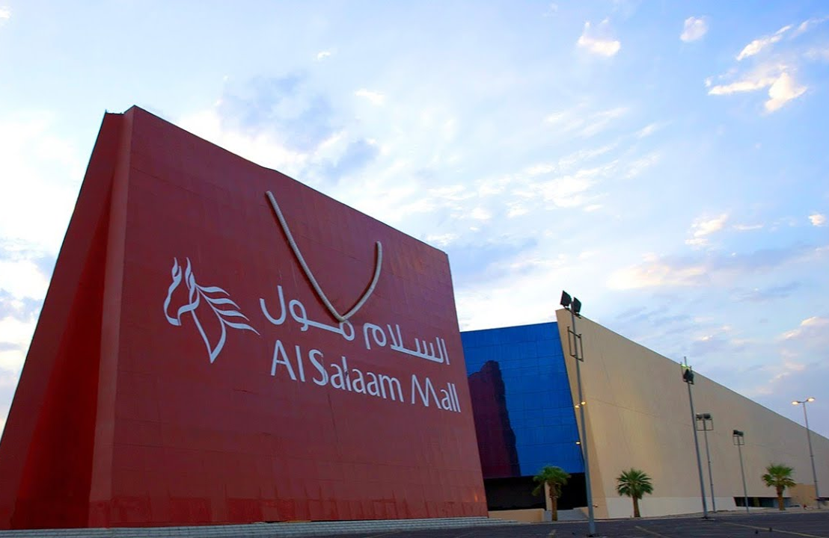
Name each picture by using who am I strategy
Listen and discuss:
a very large building or buildings containing a lot of stores , restaurant and café
Mall

Slide 18
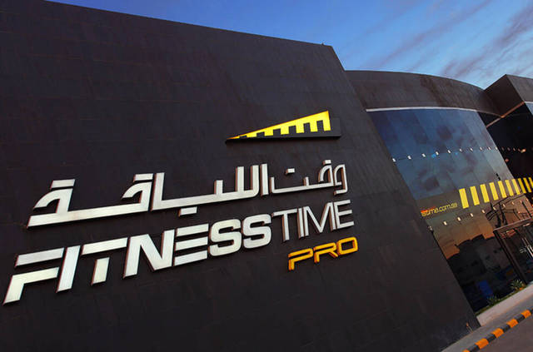
Name each picture by using who am I strategy
Listen and discuss:
is a place where you do exerices
Health
Club

Slide 19
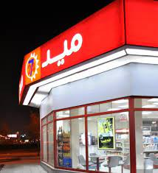
Name each picture by using who am I strategy
Listen and discuss:
small local store where you can buy food, newspapers, etc. and that is open until late at night or all the time
Convenience
Store

Slide 20
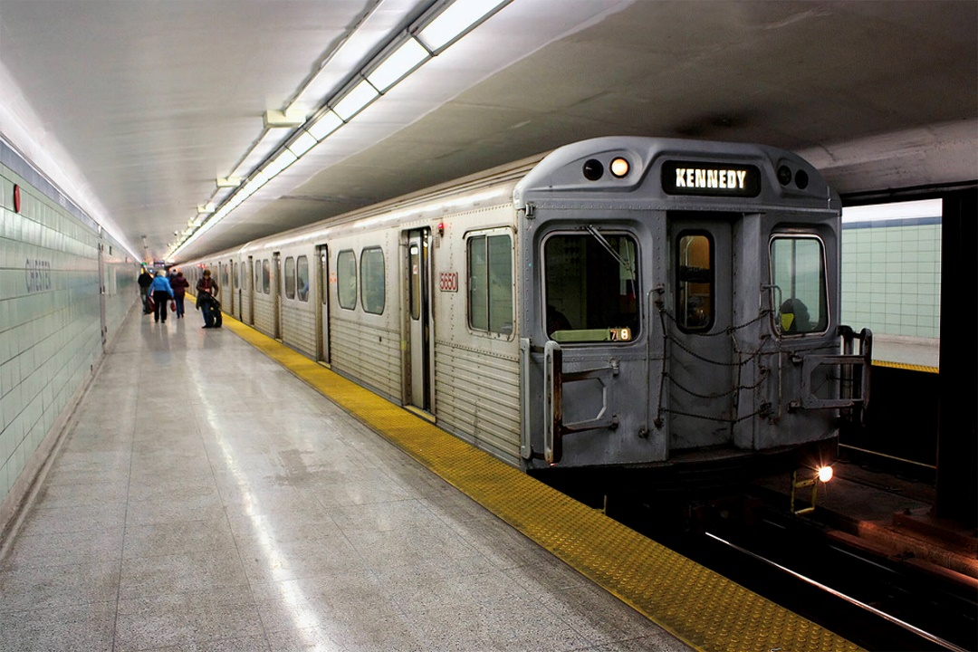
Name each picture by using who am I strategy
Listen and discuss:
A station is a building by a railway line where trains stop
Subway
Station

Slide 21
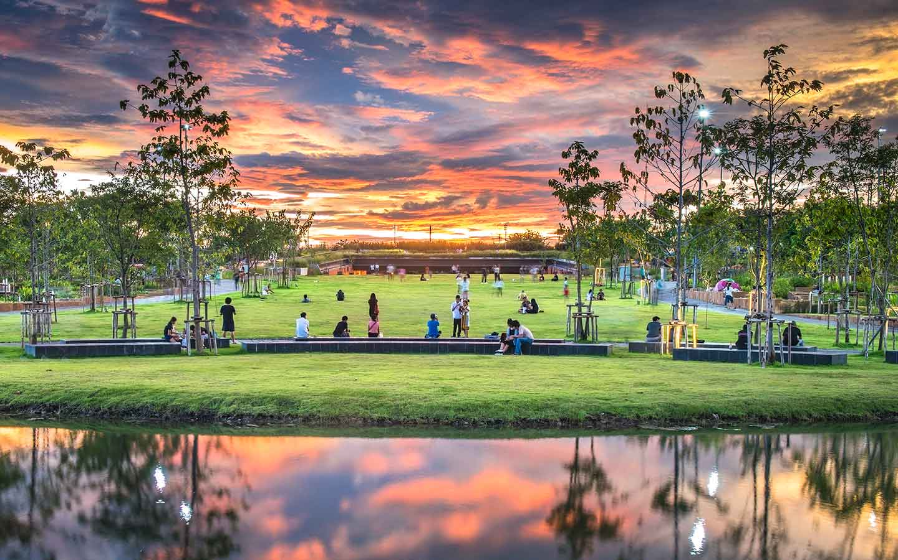
Name each picture by using who am I strategy
Listen and discuss:
a large public garden or area of land
Park

Slide 22
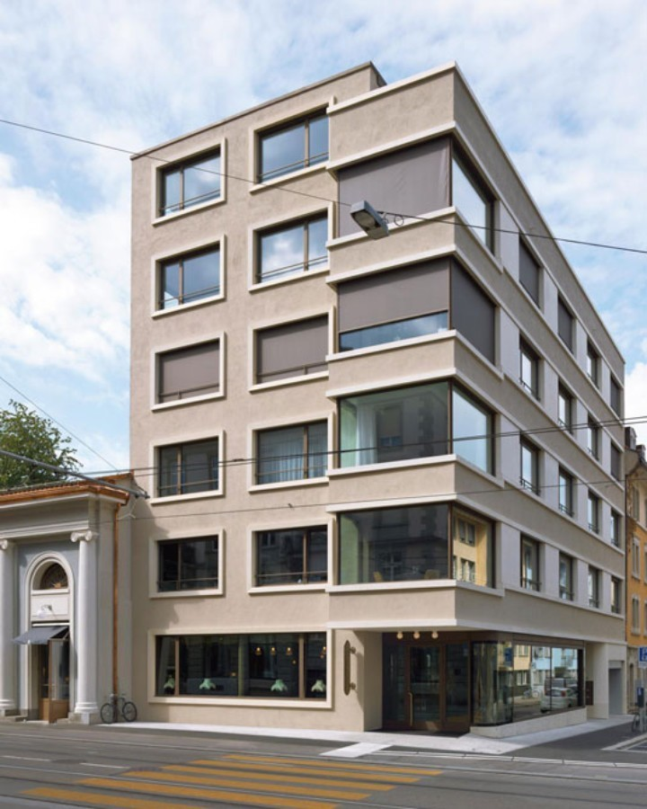
Name each picture by using who am I strategy
Listen and discuss:
a large building that is divided into apartments
Apartment
Building

Slide 23
Listen and discuss:
Discussion strategy
Do the young man live in the same apartment building ?
Yes.
Where does the new neighbor want to go?
To a convenience store.
Does the boy like the neighborhood?
Yes, he does. He says it is great

Slide 24

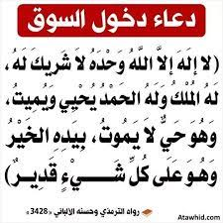

Slide 25


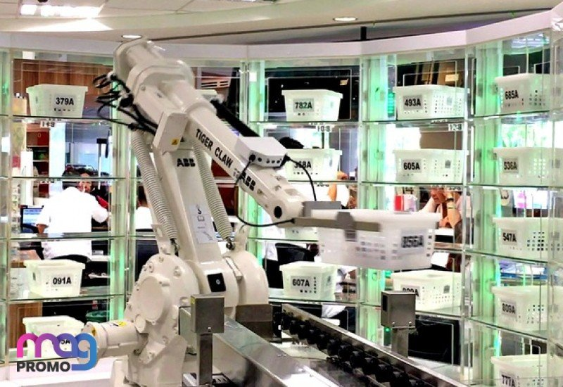
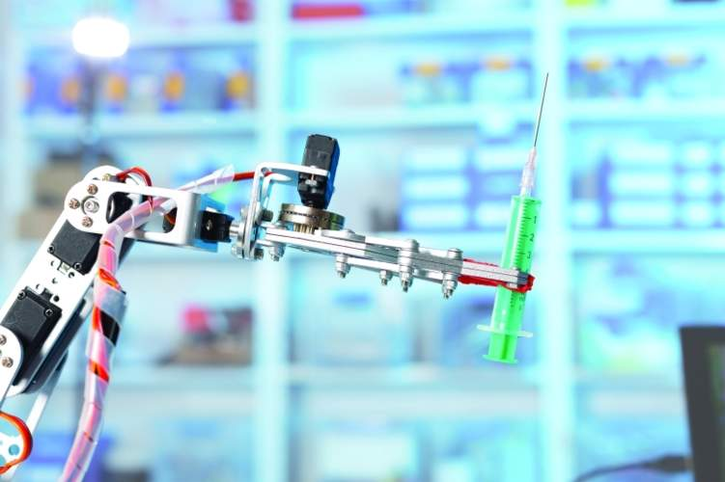
First smart pharmacy in Tabuk in King Fahad hospital

Slide 26
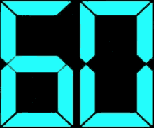
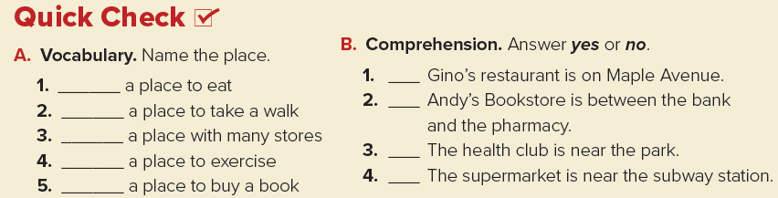
Listen and discuss:
Complete the question by using one minute strategy
resturant
The park
The mall
The health club
The bookstore

Slide 27
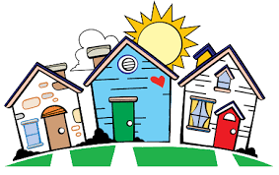
Task:
Draw your neighborhood

Slide 28
Homework:
Exercise A Page 115

Slide 29


