Slide 1
{وَاللَّهُ جَعَلَ لَكُمْ مِنْ بُيُوتِكُمْ سَكَنًا}

Slide 2
What’s your favorite room?
Where do you live?
SPIN
What places are there in your neighborhood?
How many bedrooms are there in your house?
What’s in your living room?
What’s in your bedroom?
tekhnologic
Notes:
6 Segments

Slide 3
Page 63

Slide 4
Objectives:
At the end of the lesson, students will be able to:
Use comparative and superlative adjectives correctly

Slide 5
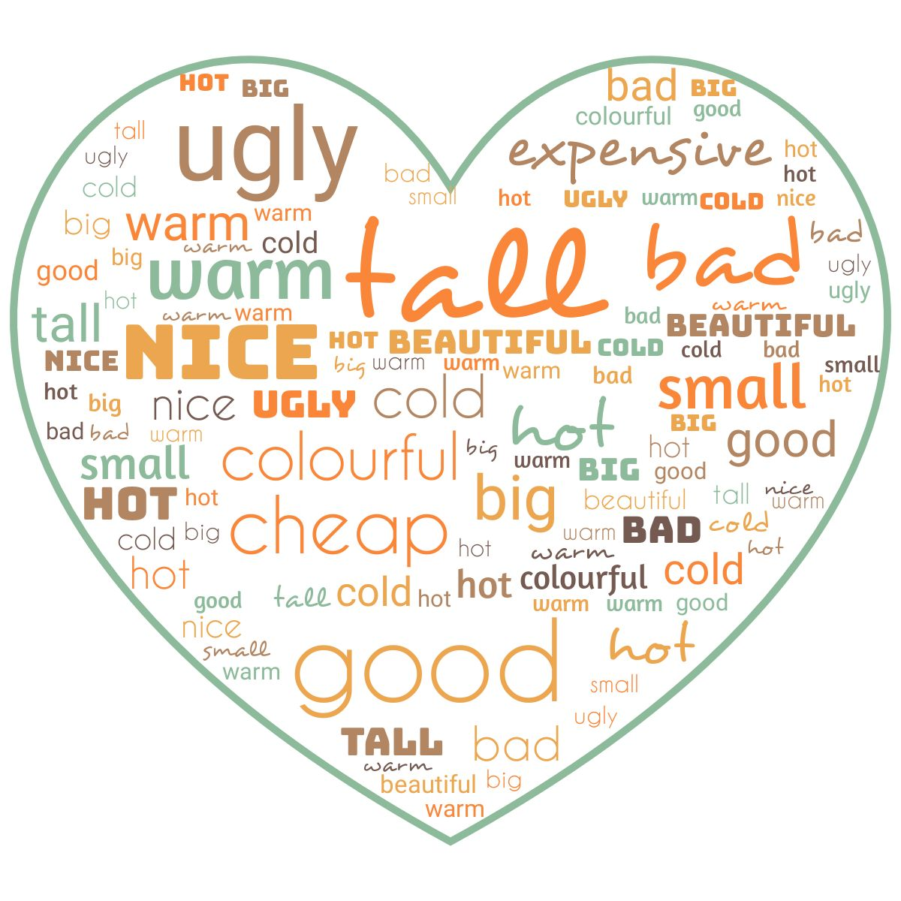
adjectives

Slide 6
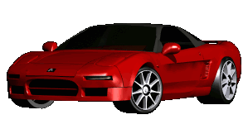
What is an adjective?
Adjective is a word which describes a noun
adjectives
noun
small
car
fast
expensive

Slide 7
Syllables – examples
(short)
fast
big
tall
long
im
por
tant
won
der
ful
(long)

Slide 8
Page 63
Comparative adjectives
Superlative adjectives

Slide 10
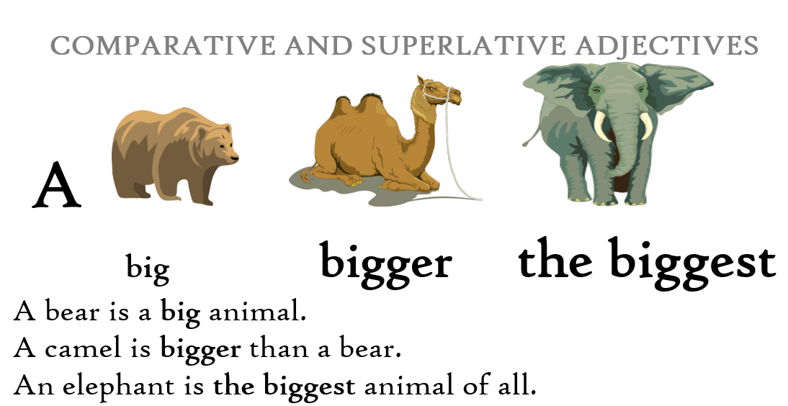

Slide 13
Summary comparison
comparative
superlative
long
er
long
est
the long
funny
funn
ier
the funn
iest
modern
more
modern
the most
modern
good
better
the best

Slide 14
Irregular comparatives
comparative
superlative
good
better
the best
bad
worse
the worst
far
further
the furthest
Many/ much
more
The most

Slide 15
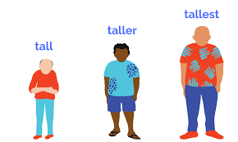
Compare:
Sami Ali Fahad

Slide 16
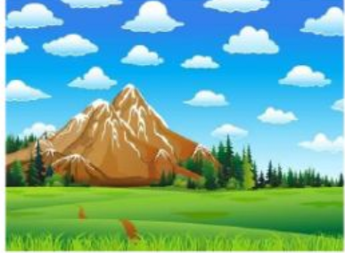
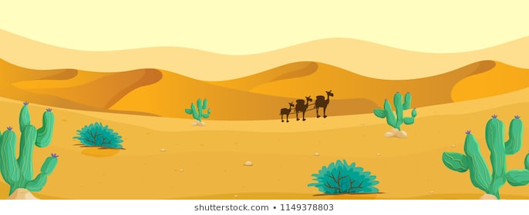
Compare: beautiful
mountains desert

Slide 17
Page 63

Slide 18
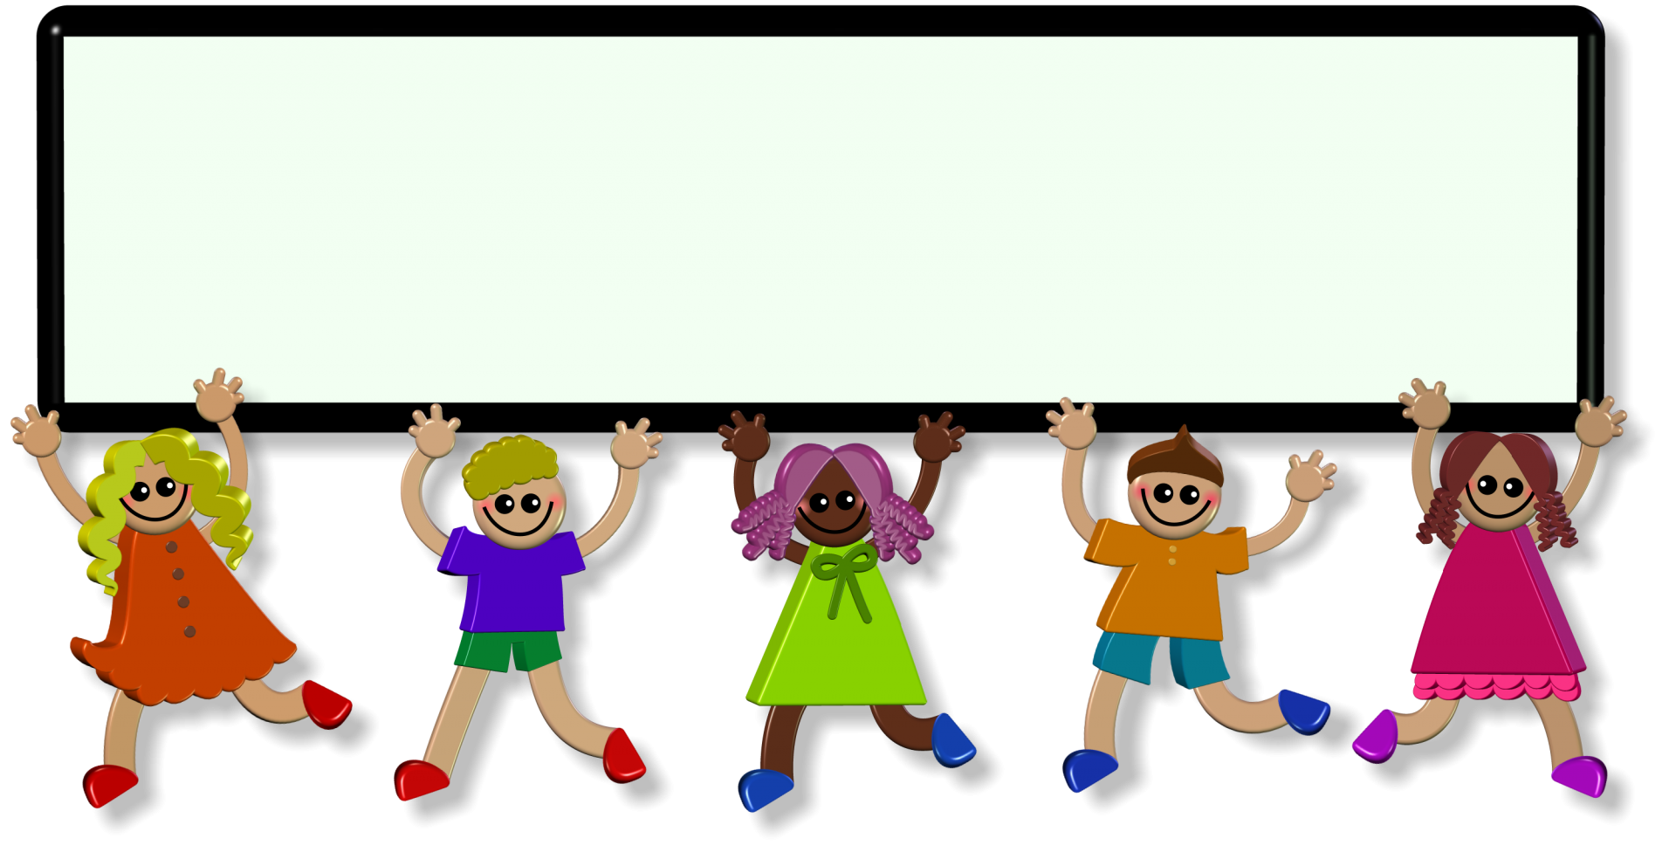
Evaluation
https://quizizz.com/admin/quiz/5fbac8e58f5a90001bbe2141

Slide 19
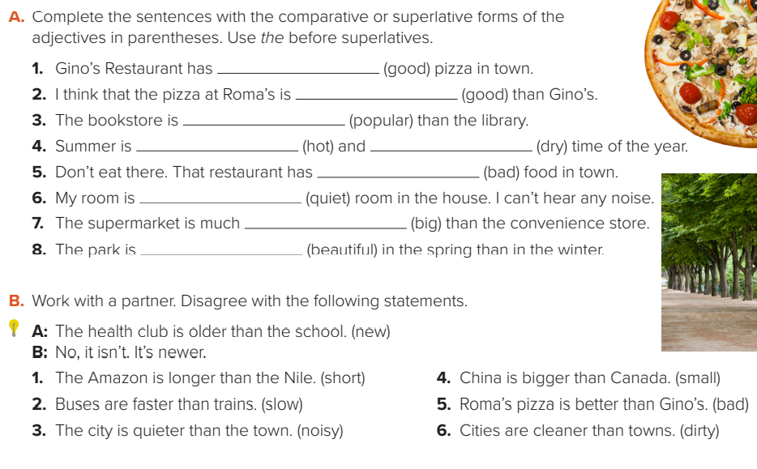
Page 63
the best
better
more popular
the hottest
the driest
the worst
the quietest
bigger
more beautiful

Slide 20
Page 63
1-No, it isn’t. it’s shorter.
4-No, it isn’t. It’s smaller.
2-No, they aren’t. They’re slower.
5-No, it isn’t. It’s worse.
3-No, it isn’t. It’s noisier.
6-No, they aren’t. They’re dirtier.

Slide 21
Homework:

