Slide 1

Unit 8
What Are You Doing?
part 1

Slide 2
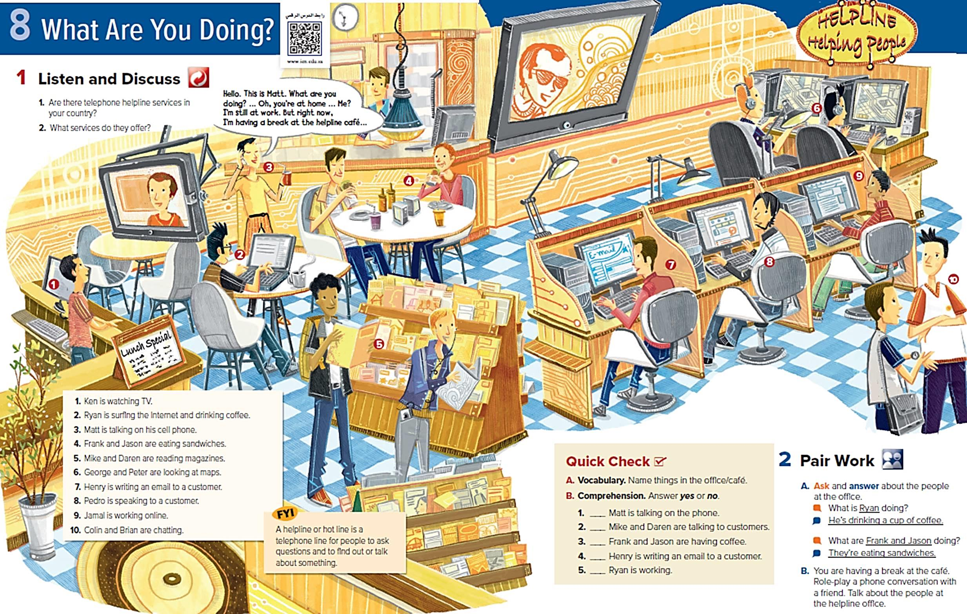


Slide 3
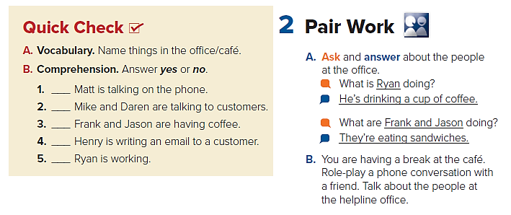
Yes
No
No
Yes
No

Slide 4
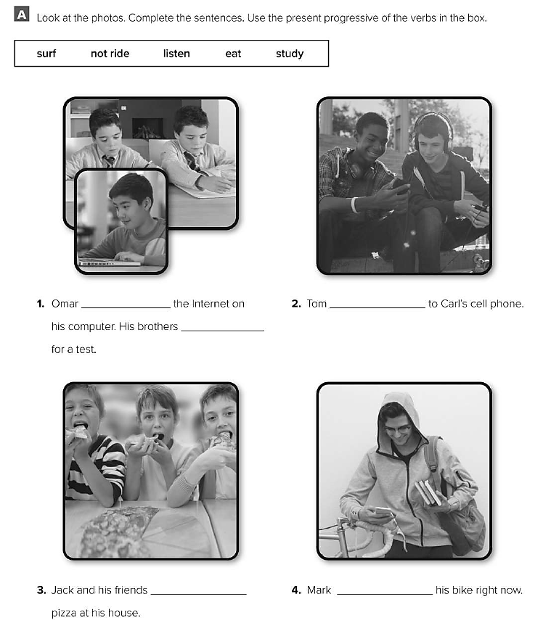
is surfing
is studying
listening
are eating
isn’t riding

