Slide 1
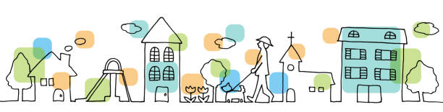
Super Goal 1
Unit 7 Lesson 3 page (58 + 59)
Grammar
T. Haya B.

Slide 2
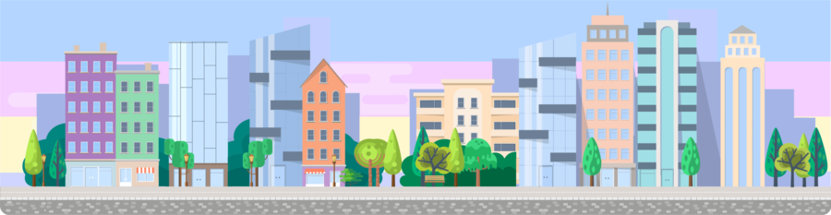
Where Do You Live?

Slide 3

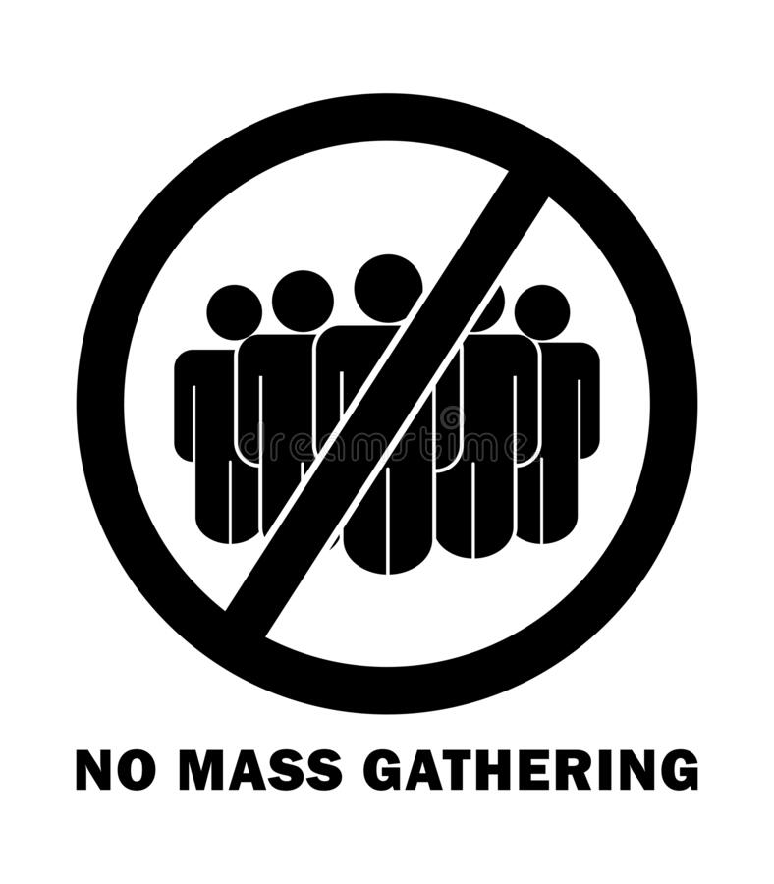

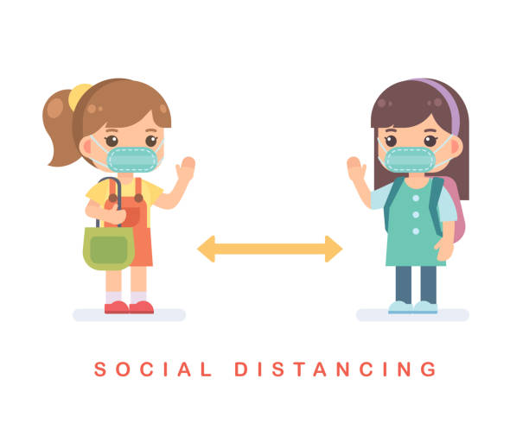
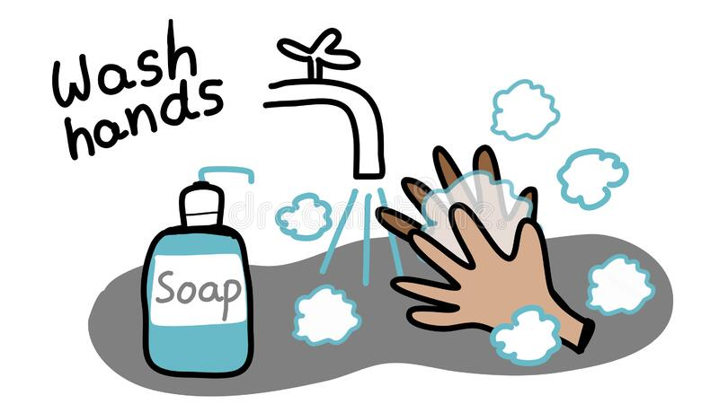

Rules of the classroom:-
1- avoid gathering.
2- we must wear mask.
3- social distancing is not a choice , it is a must.
4- Wash hands.
5- If you want to answer or ask, please, raise your hand

Slide 4

Check homework:-

Slide 5
Revision:-
Where do you live ?
I live in ………… neighborhood
Name the places
I order food

Slide 6
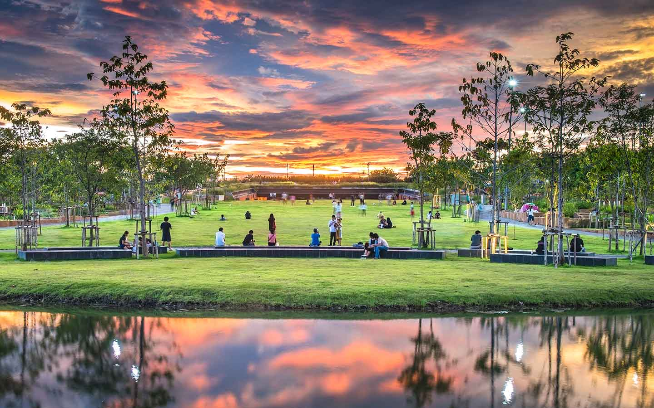

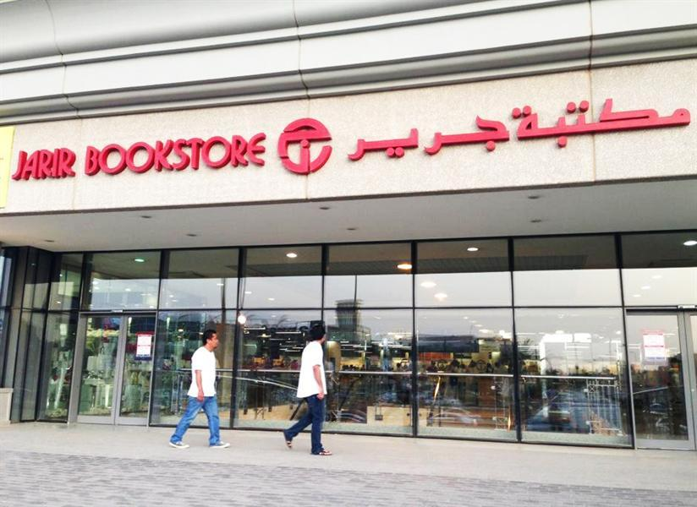
Revision:-
Name these places
……………………
……………………
……………………

Slide 7
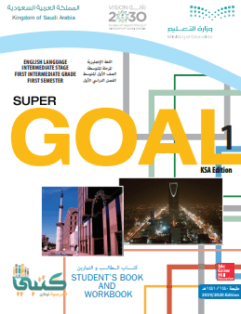
Objectives:
Open your book on page 56
Use " live " with prepositions in meaningful sentence.
2. Use prepositions correctly.
3. Give directions correctly.
4. Answer the question.

Slide 8
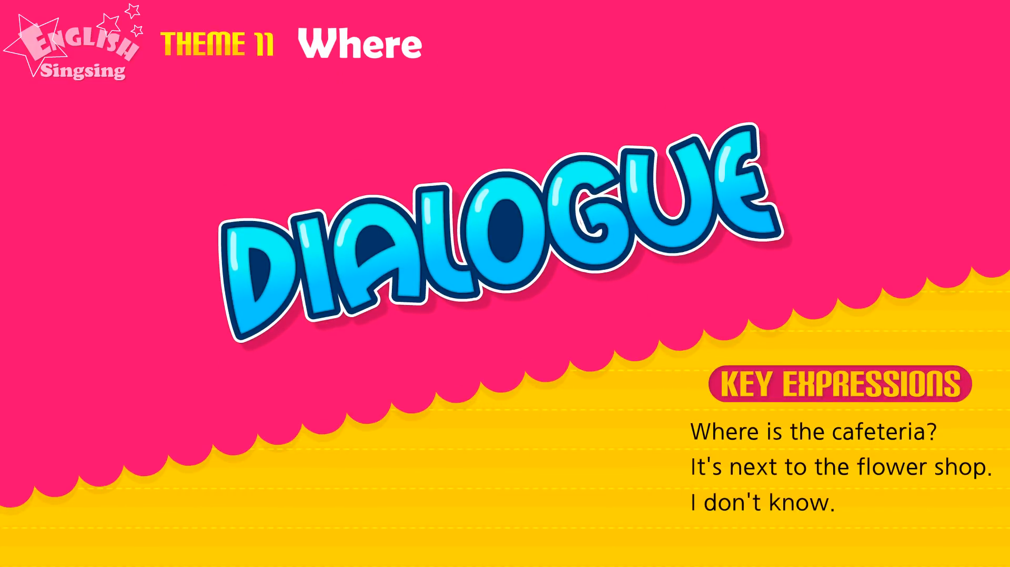
Warm up:
Observation strategy

Slide 9
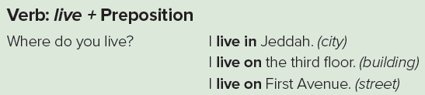
Grammar:
Open your book on page 58

Slide 10
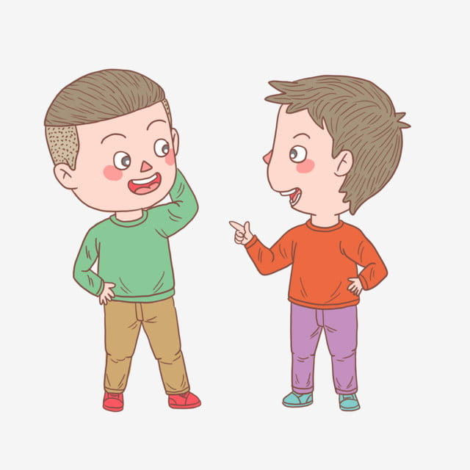
Grammar:
Open your book on page 58
I live in Riyadh
Where you do you live?

Slide 11
Grammar:
Open your book on page 58
I live on the third floor
Where you do you live?

Slide 12
Grammar:
Open your book on page 58
I live on the king Fahd street
Where you do you live?

Slide 13

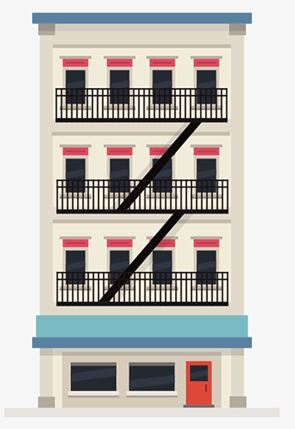

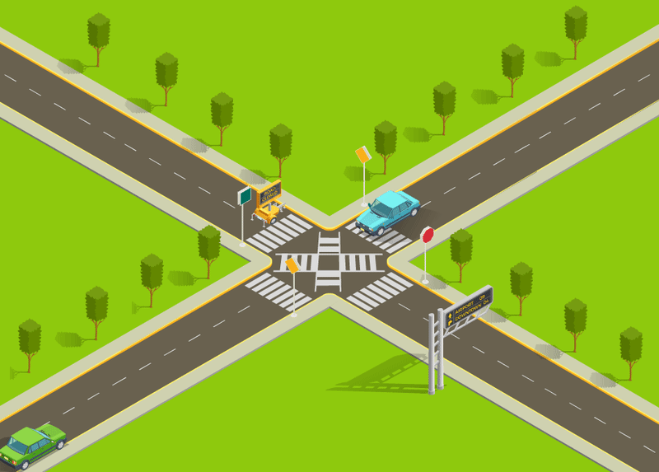
Grammar:
Open your book on page 58
Live + in + city
Live + on + street
Live + on + floor number

Slide 14
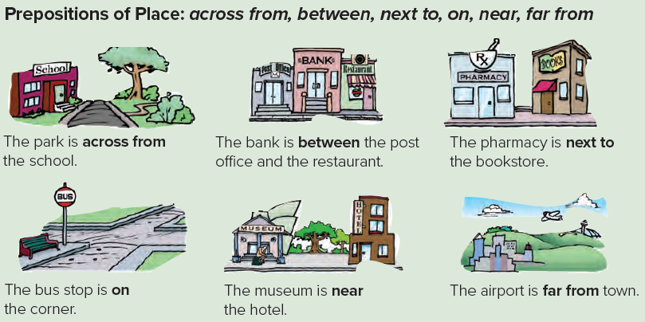
Grammar:
Prepositions of place: across from, between, next to ,on ,near, far from

Slide 15


Grammar:
Let’s play
https://wordwall.net/resource/4235878/prepositions-of-place

Slide 16
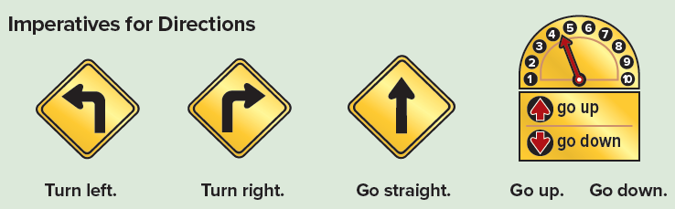
Grammar:
Imperatives for directions

Slide 17
Grammar:
Let’s play
https://wordwall.net/resource/233257/directions

Slide 18

Where did our prophet Mohammad live?
He lived ………. Makkah.

Slide 19


Where do king Salman live?
He lived ………. Riyadh.

Slide 20
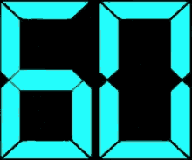
Exerise (58):
Complete the question by using one minute strategy

Slide 21
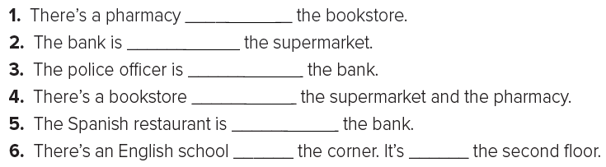
Exerise (58):
Complete the question by using one minute strategy
next to
across from
near
between
next to
on
on

Slide 22

Task:
Draw your neighborhood

Slide 23
Homework:
Exercise C Page 116

Slide 24


