Slide 1
Super Goal 1

Slide 2
Unit 8

Slide 3

The objectives of the lesson :
At the end of this session, the students will be able to :
Read about teen's favorite place

Slide 4
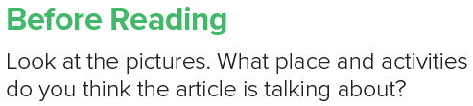

Slide 5
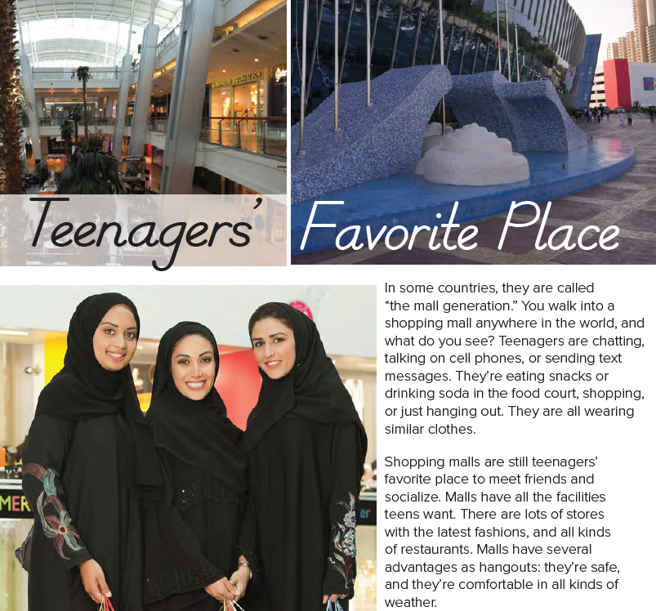


Slide 6
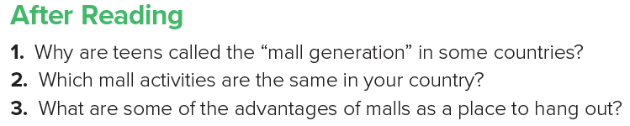
1. Because teenagers’ favorite place to meet friends and socialize is the mall.
2. Answers will vary.
3. Malls are safe, and they’re comfortable in all kinds of weather.

