Slide 1
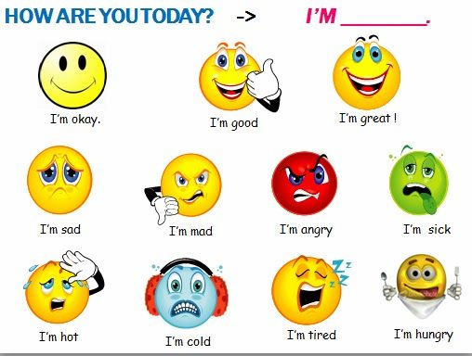

Slide 2
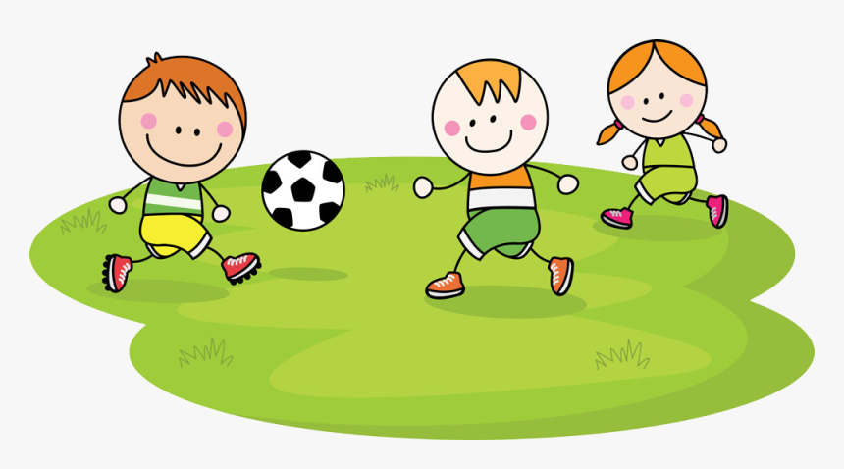
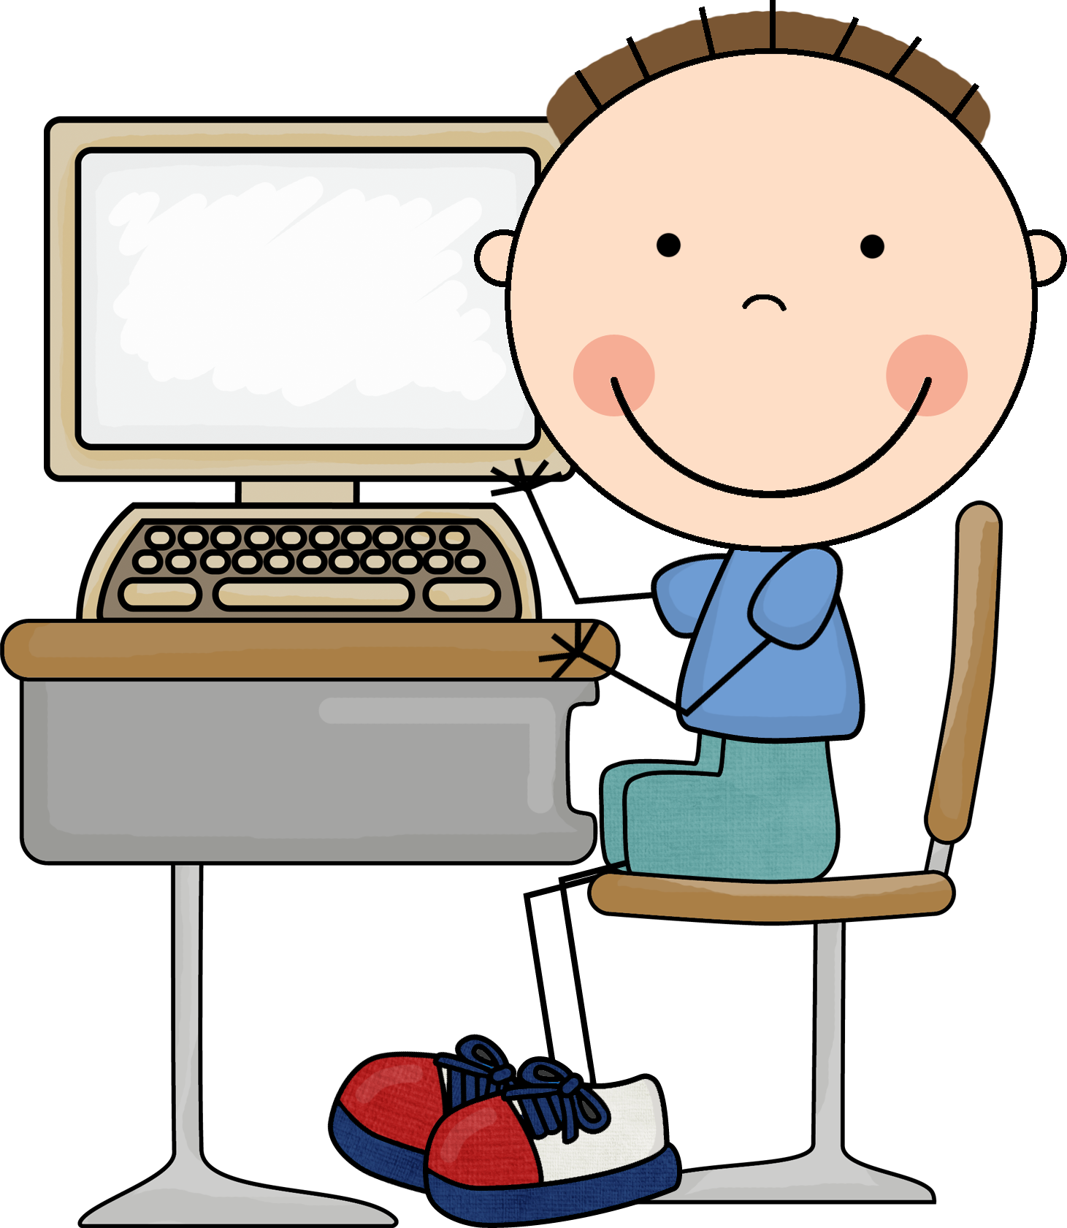
Revision
What are they doing?
What is Mona doing?
What is the boy doing?

Slide 3
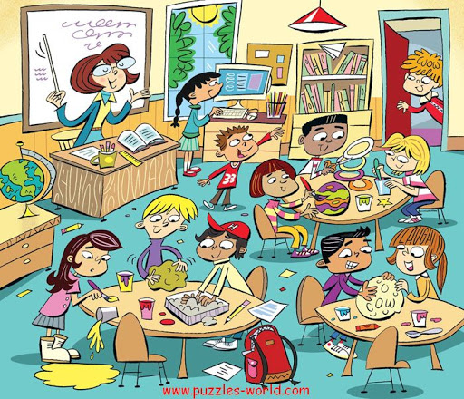
Warm up
Memory game
Warm up
Memory game

Slide 4
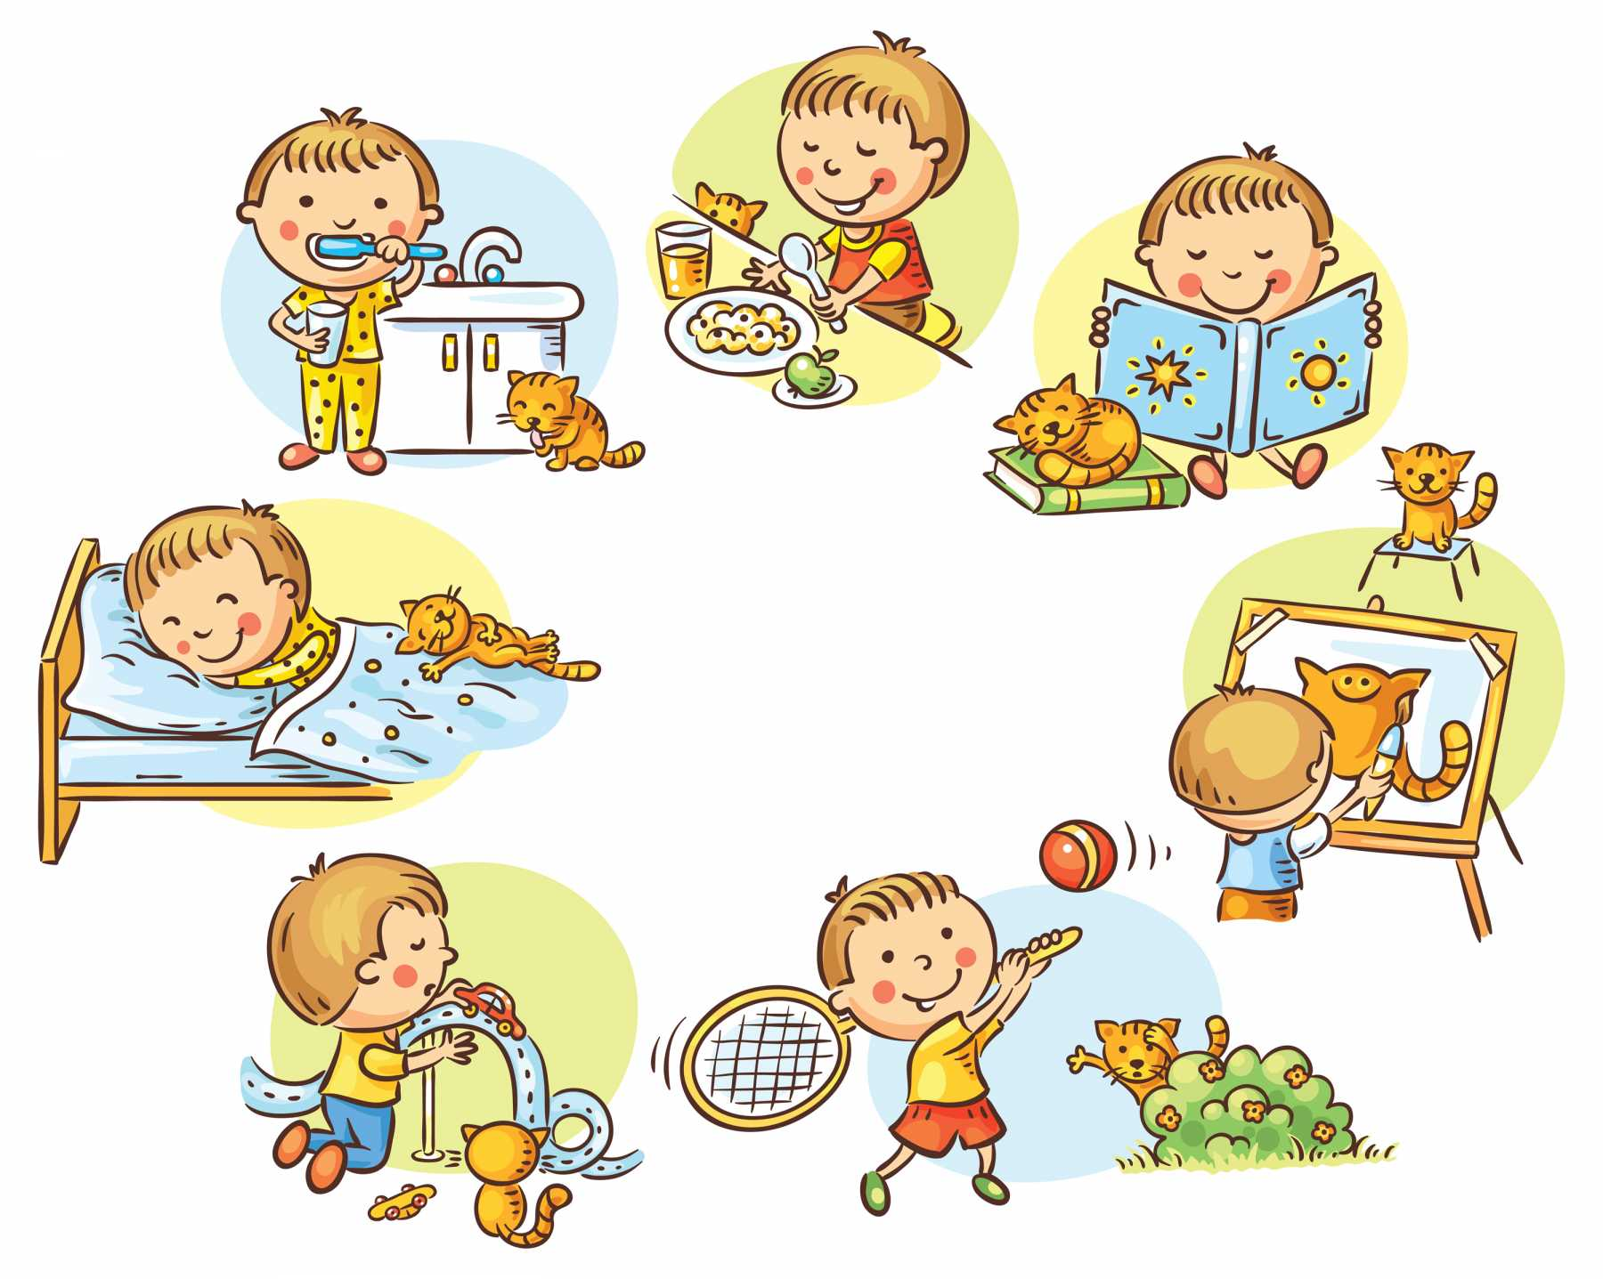
قال :(نِعمَتانِ مغبونٌ فيهما كثيرٌ من الناسِ: الصَّحَّةُ والفَّراغُ)

Slide 5
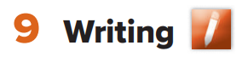
Page 70

Slide 6
Objectives:
At the end of the lesson, students will be able to:
Compose sentences from scrambled words.

Slide 7
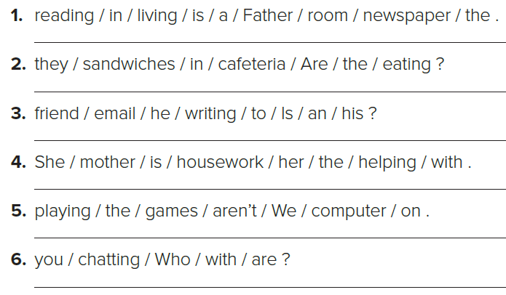
Page 70
Father is reading a newspaper in the living room.
Are they eating sandwiches in the cafeteria?
Is he writing an email to his friend?
She is helping her mother with the housework.
We aren’t playing games on the computer.
Who are you chatting with?

Slide 8
Page 70
Who are the family members?
A: Where are her parents?
A: What’s he doing?
A: Where is her baby brother?
B:They’re at the supermarket.
B: He’s drinking coffee and reading a newspaper.
B: He’s in the kitchen.
A: What are they doing?
A: Where is Ali (her brother)?
A: What’s he doing?
B: They’re shopping.
B: (She thinks) He’s in the park.
B: He’s playing with his toys.
A: What’s she doing?
A: Where is her grandfather?
A: What’s he doing?
A: Where is her grandmother?
B: He’s in the backyard.
B: He’s riding his bike, or he’s running.
B: She’s cooking.
B: She’s in the kitchen.

Slide 9
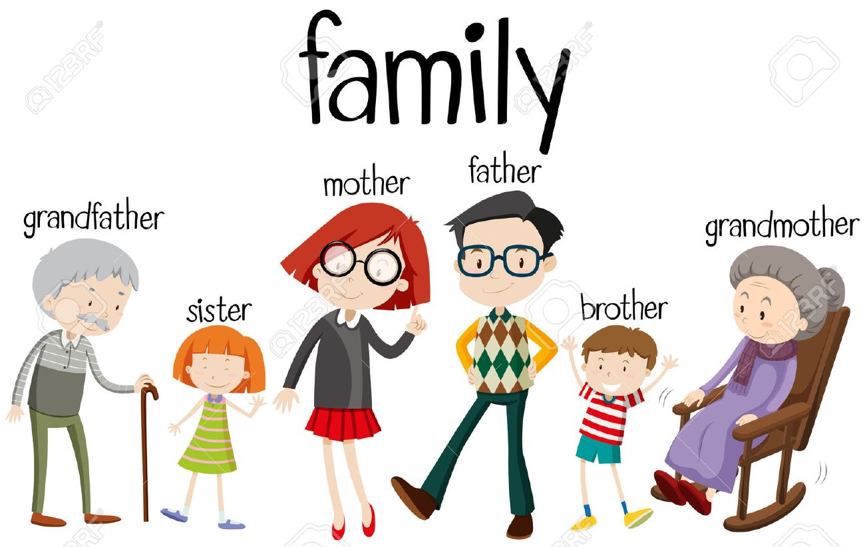
Page 70
I’m watching Tv in the living room. My mom is cooking the dinner. My father is listening to the radio. My sister is surfing the net. My brother is playing football with his friend in the yard. My friend is playing video games.

Slide 13
Page 70

Slide 14
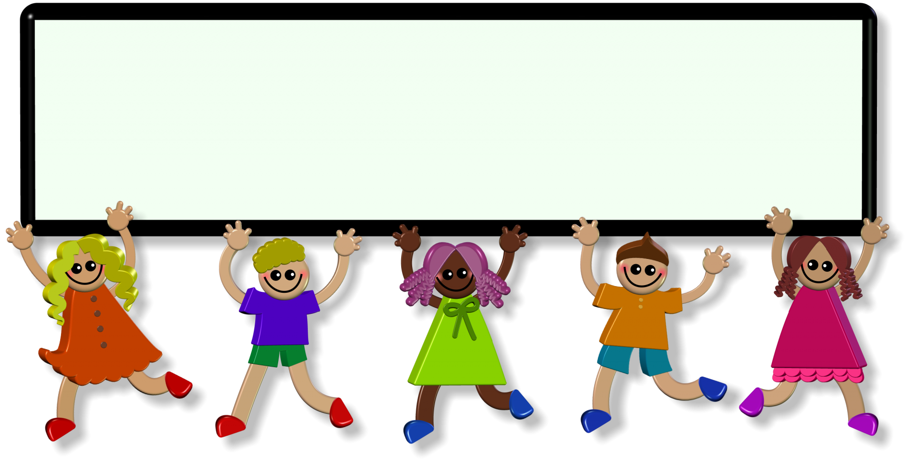
Evaluation
https://wordwall.net/ar/resource/26987940/pronoun
https://wordwall.net/ar/resource/9026713/pronouns-subject

Slide 15
Thank you!

Slide 16
Homework:
\

