Slide 1


Slide 2


Slide 3

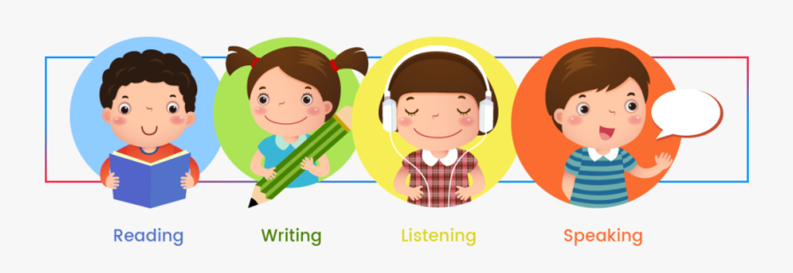

Slide 4
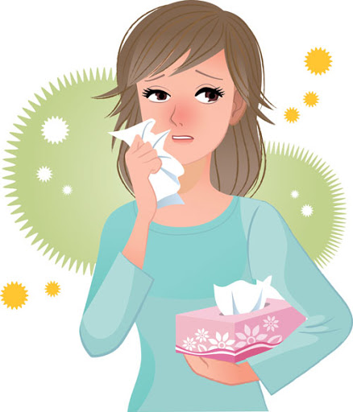
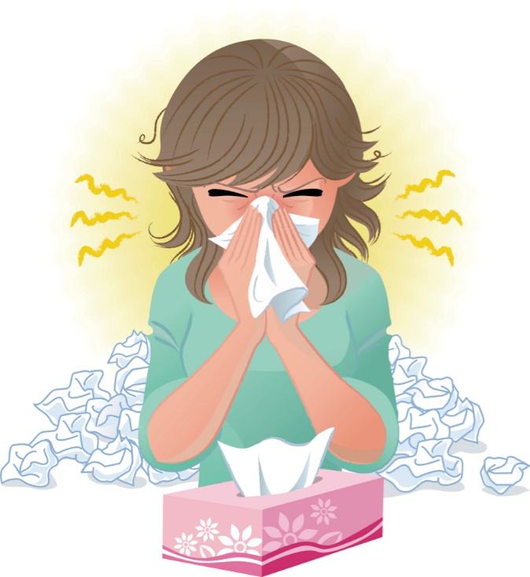
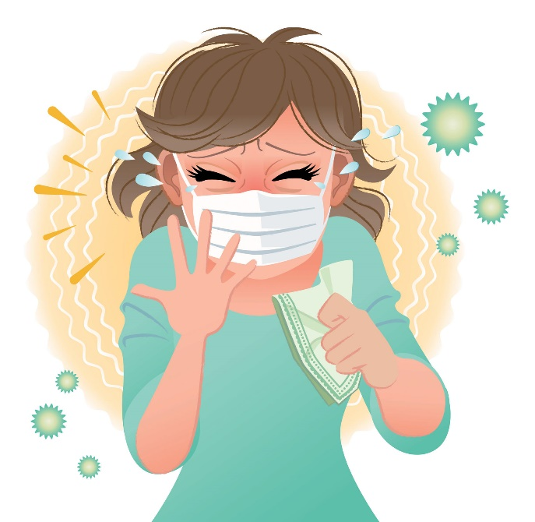
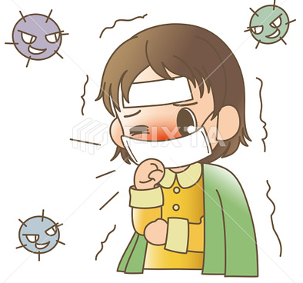
Covid 19
☺Avoid gathering !
☺We must wear a mask before
going out.
☺Social distancing is not a
choice, it is a must!
☺Keep a distance of 2 meters
to avoid accountability
☺wash hands constantly.

Slide 5


Slide 6


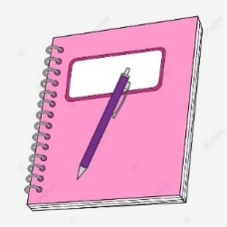
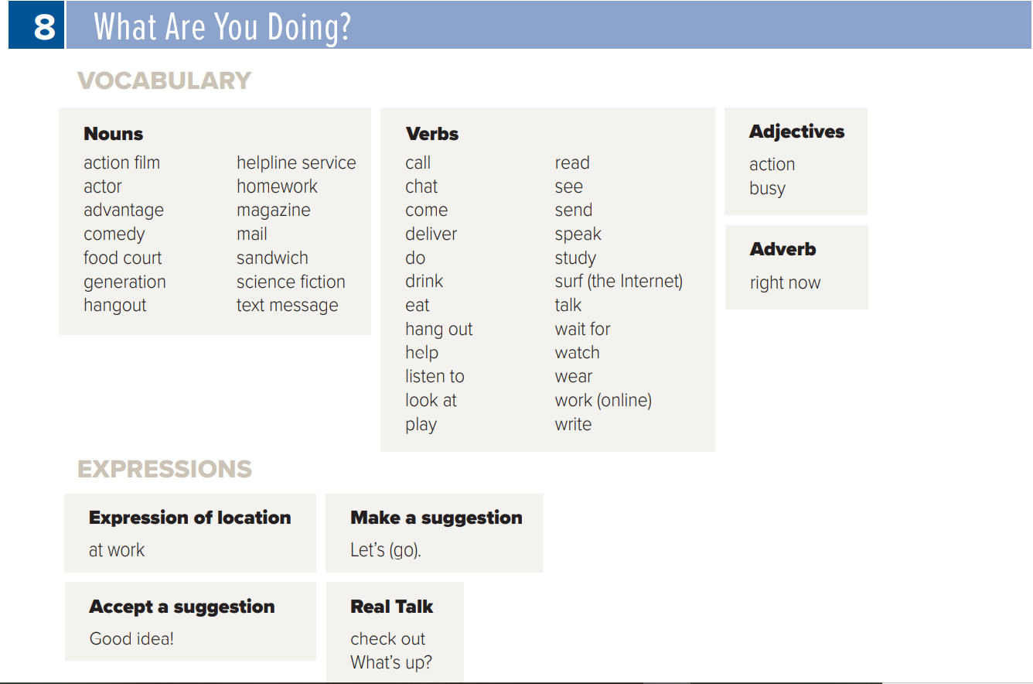
SG1 U8
Page 82

Slide 7









Page 69 and 70
Today: Wednesday
Date:
25 -5-1443 H
December 29th \ 2021
everyone,
How is everything going?

Slide 8






Slide 9




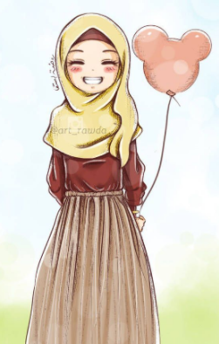
ارجو الالتزام بعدم كتابة أي تعليقات غير لائقة بالأدب العام. علماً بأنه أي محادثة نصية او كتابية مسجلة تحت اسمك ورقم هويتك
وعلية سيتم معاقبة من لم تلتزم بالذوق العام والسلوك الحسن خلال تواجدك في المنصة او الفصول الافتراضية.
وذلك برفع شكوى وبلاغ رسمي ضدك بما تم كتابته او قولة والتواصل مع ولي الأمر والمسؤولين لاتخاذ الاجراء اللازم مع المخالفة.
ونتمنى وضع صوره في ملفك التعريفي لائقة بالمنصة التعليمية

Slide 10
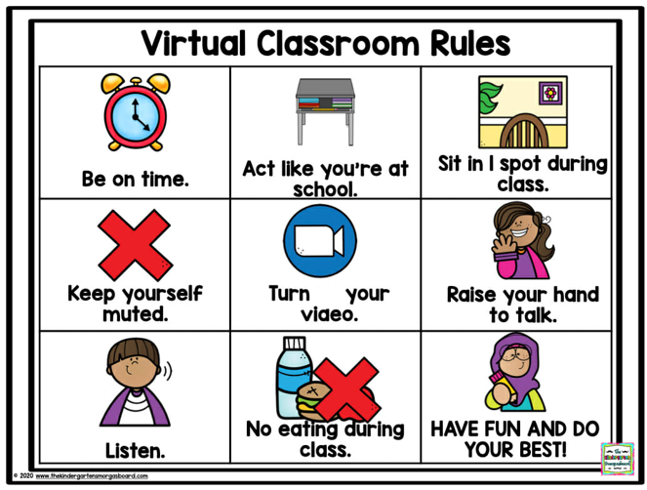
off

Slide 11



☺
Page 69 and 70
♥
Read the text about Teenagers’ Favorite Place
create a report about a popular teen hangout
Answer some questions

Slide 12




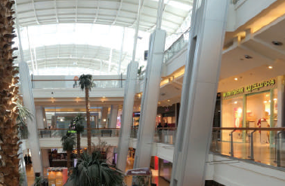
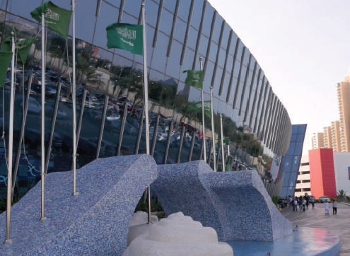

Page 69
shopping, buying, talking, walking, looking, hanging out.
Where do you think the people are? (at a shopping mall)

Slide 13





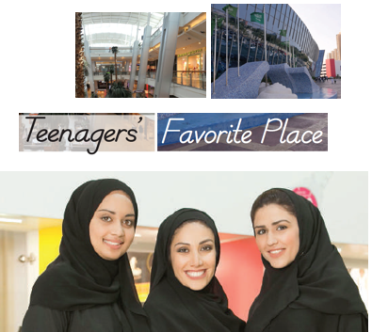

Unit:8
Wednesday 18\5\1443H
22nd of December \2021
Reading What Are You Doing? SG1 page 69
Anticipation guide
Reading
Before Reading |  | Statement | After Reading
Agree | Disagree |  | Agree | Disagree
 |  | Teenagers are all wearing the same clothes
 |  | Malls are dangerous for teenagers.
 |  | Malls have all the facilities teens want.
 |  | Museums are the best places for teenagers.
https://www.liveworksheets.com/1-lv2238480vn
T. Noureyah Alghamdi

Slide 14
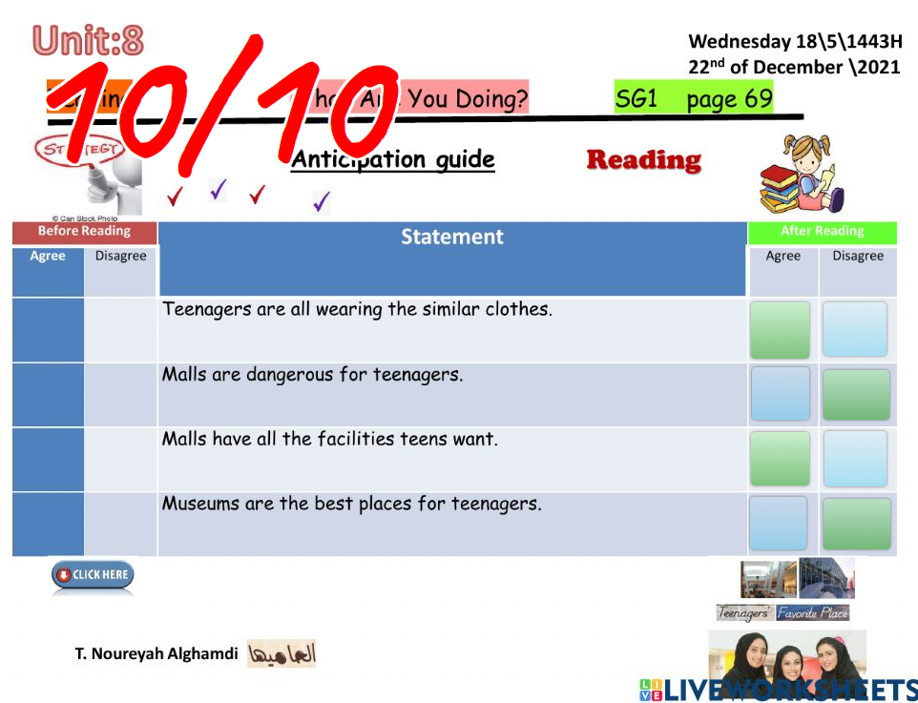
https://www.liveworksheets.com/1-lv2238480vn

Slide 15



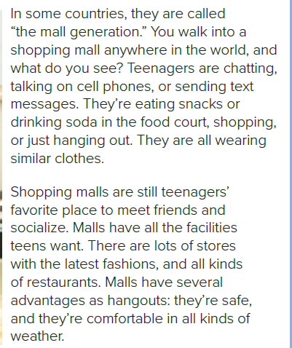
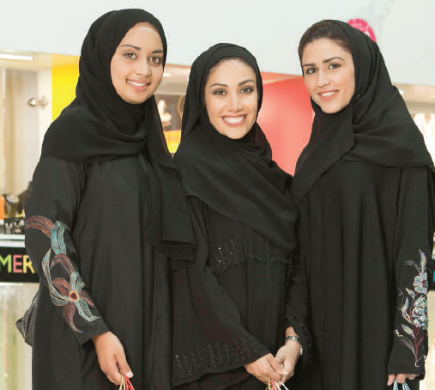
Page 69

Slide 16
Page 69
What do the teenagers in the reading do in malls?
eat, drink, talk, shop, chat, hang out, socialize, etc.)
Do you usually “hang out” at malls? Why or why not?

Slide 17


Page 69
1. Because teenagers’ favorite place to meet friends and socialize
is the mall.
2. Red Sea Mall
3. Malls are safe, and they’re comfortable in all kinds of weather.

Slide 18

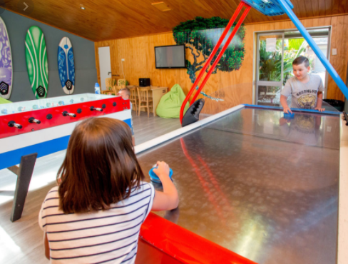
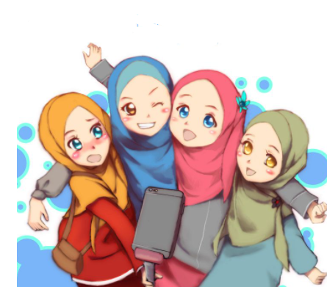
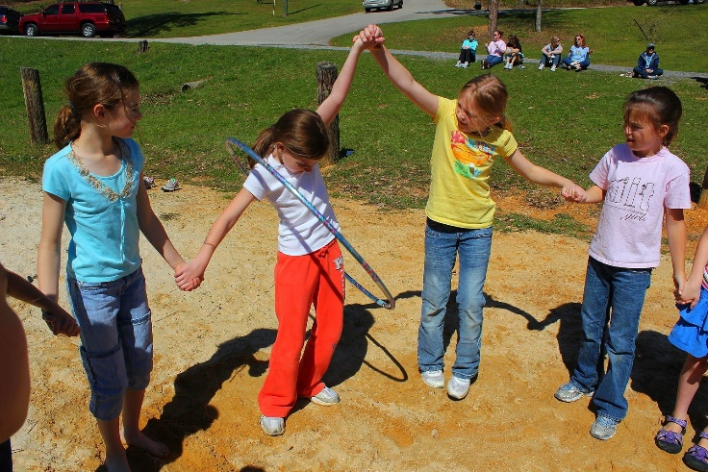
Page 70
Choose a place where teenagers like to hang out in your town. You can take photos or draw pictures of the place and the
activities people do there.

Slide 19




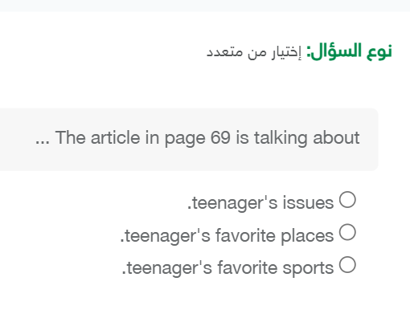

platform
من واجب المنصة
للتذكير

Slide 20
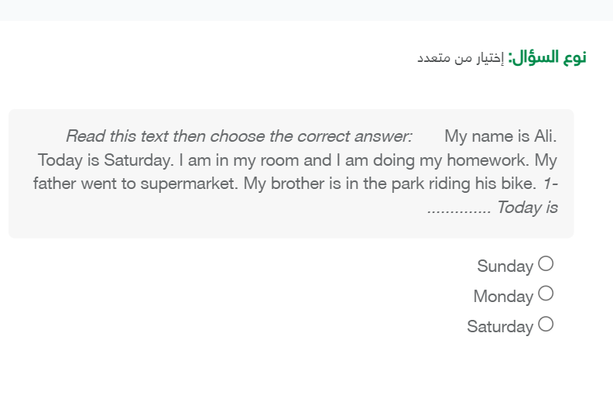

Slide 21
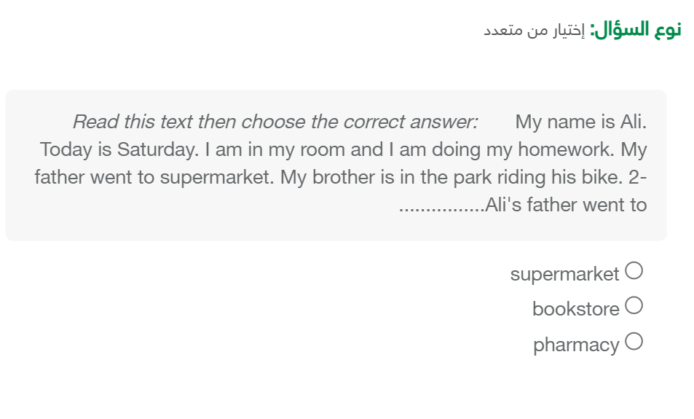

Slide 22

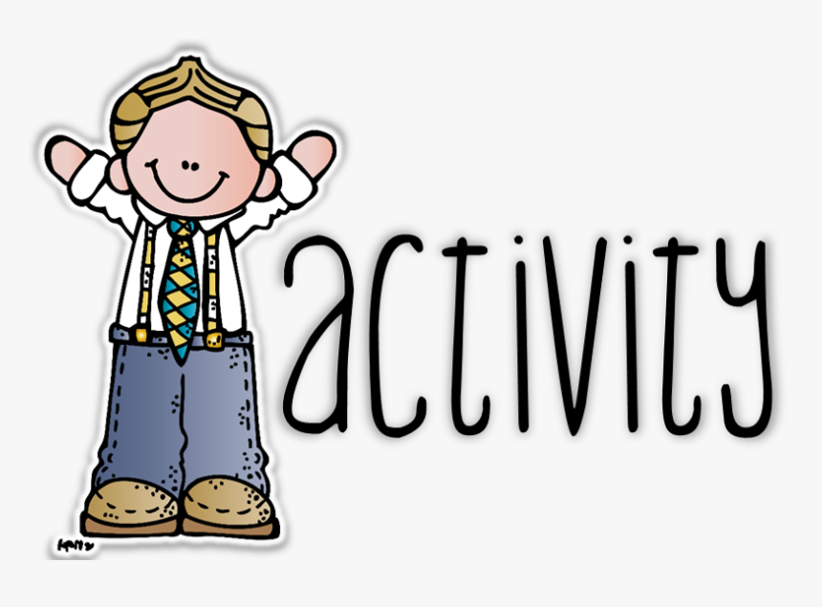

بعد حل الواجب
يتم ارسال صورة لذلك
في قسم الأنشطة
على المنصة
Page 122
EX E
يكتفى بصورة واحدة لتمرين واحد فقط☺

Slide 23
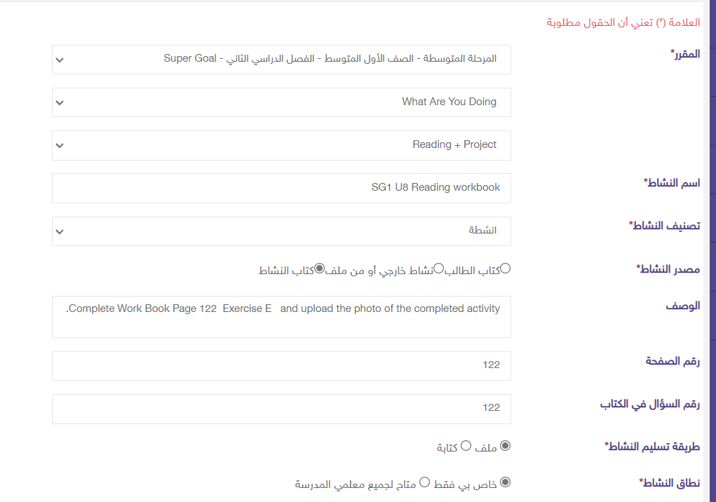

Slide 24






Assign page 122 for practice read and draw.
Ex E

Slide 25




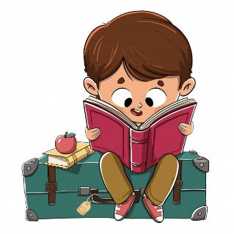
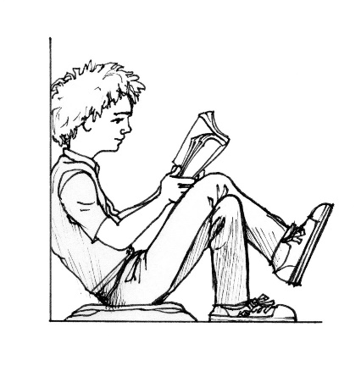
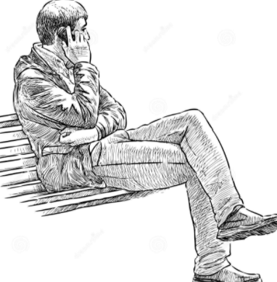
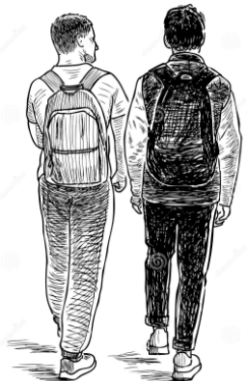
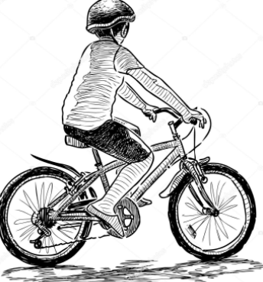
Page 122

Slide 26


أتمنى الاهتمام بمتابعة الدروس في قتوات عين الرسمية من وزارة التعليم
T.Noureyah Alghamdi
The end

Slide 27

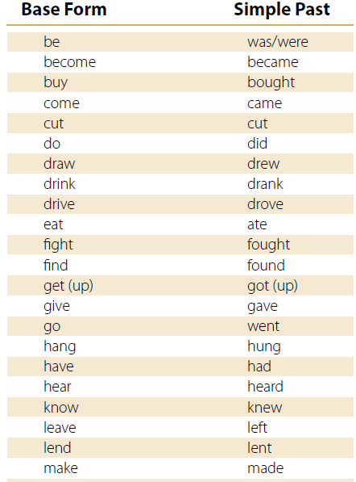
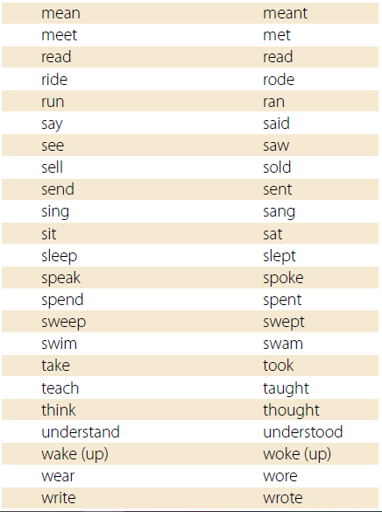

Slide 28
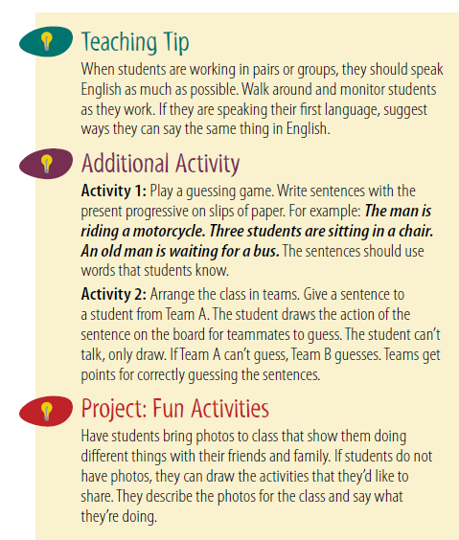

Slide 29
