Slide 1
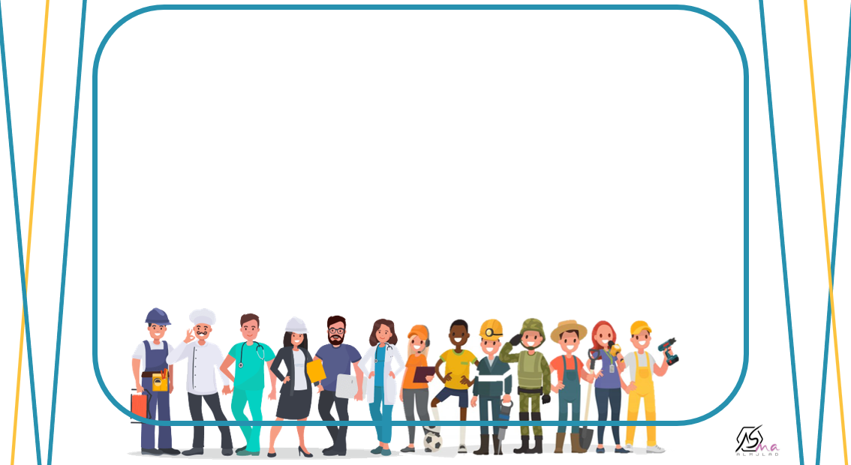

What Do You Do?
listen and discuss

Slide 2
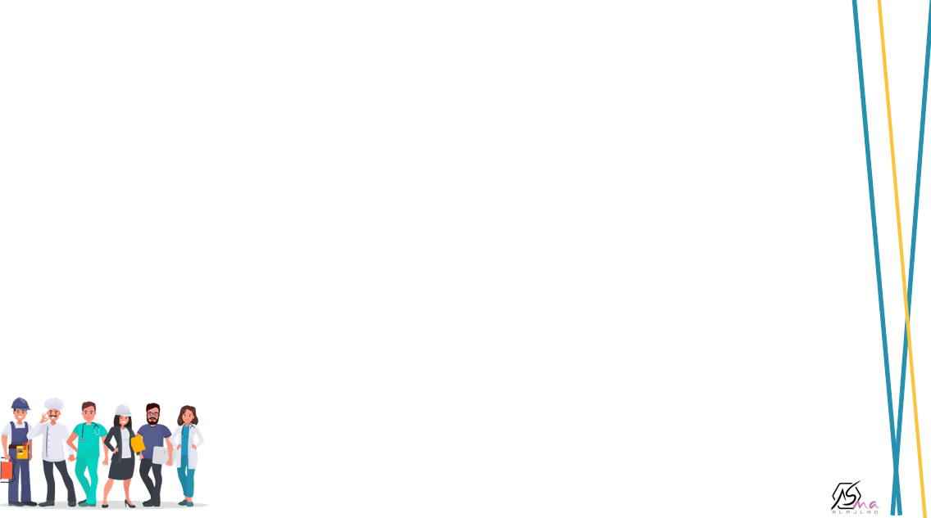
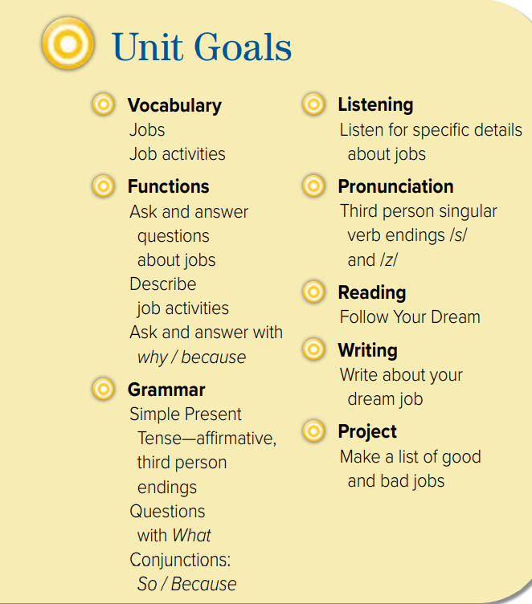

Slide 3
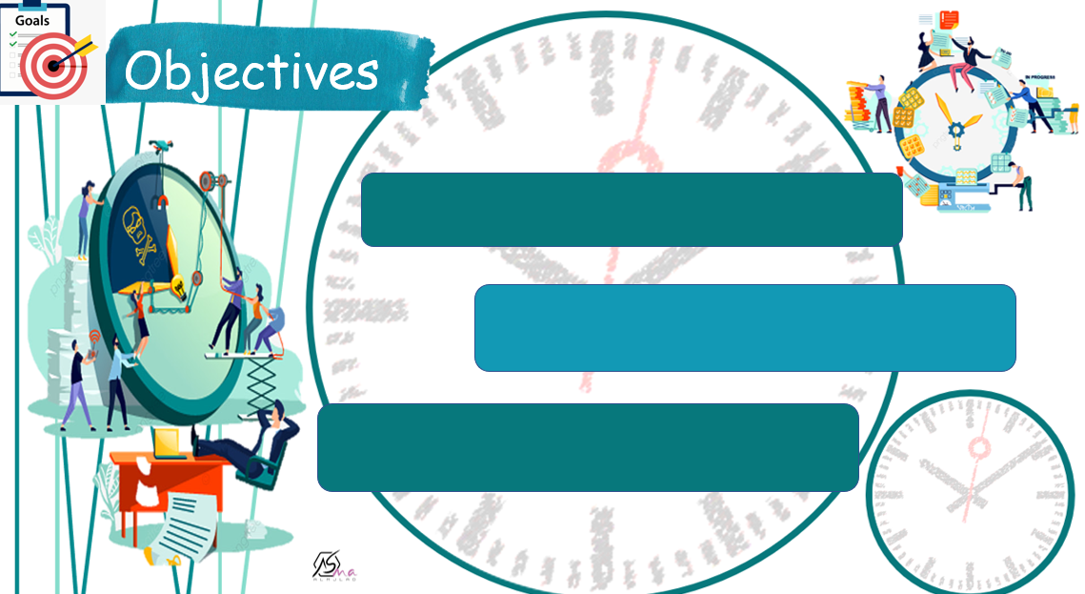
List a number of jobs
Describe job activity
Discuss future jobs using (want )

Slide 4
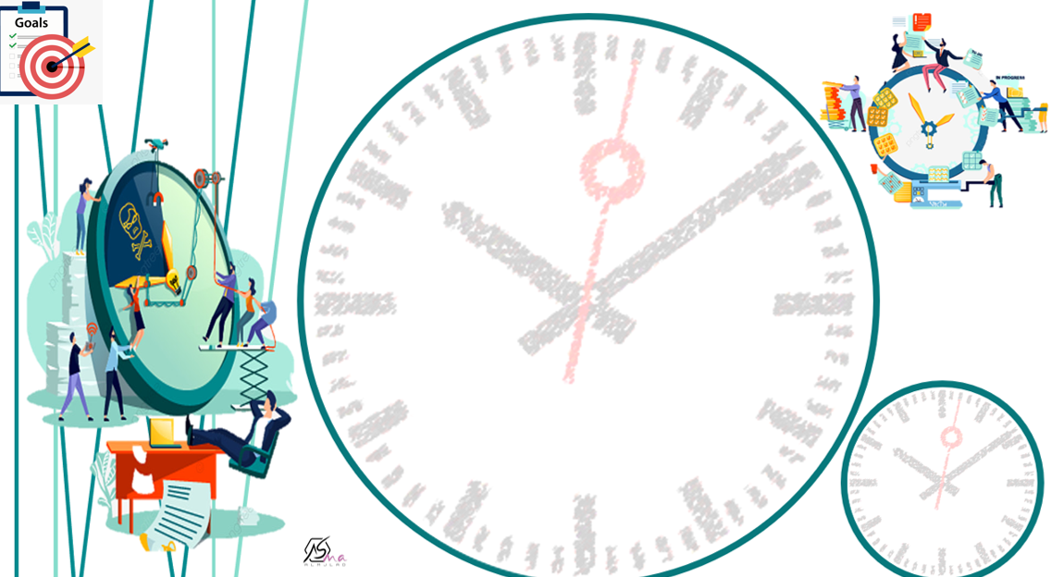


Slide 5
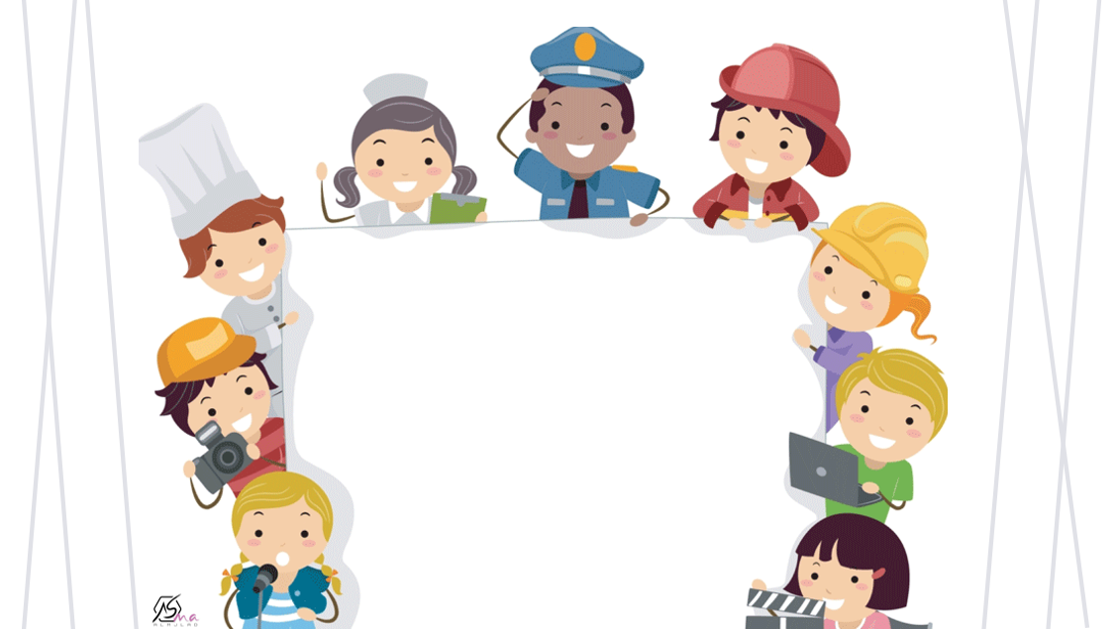

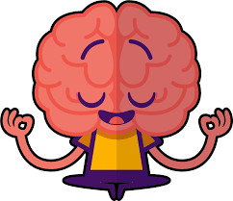

Slide 6
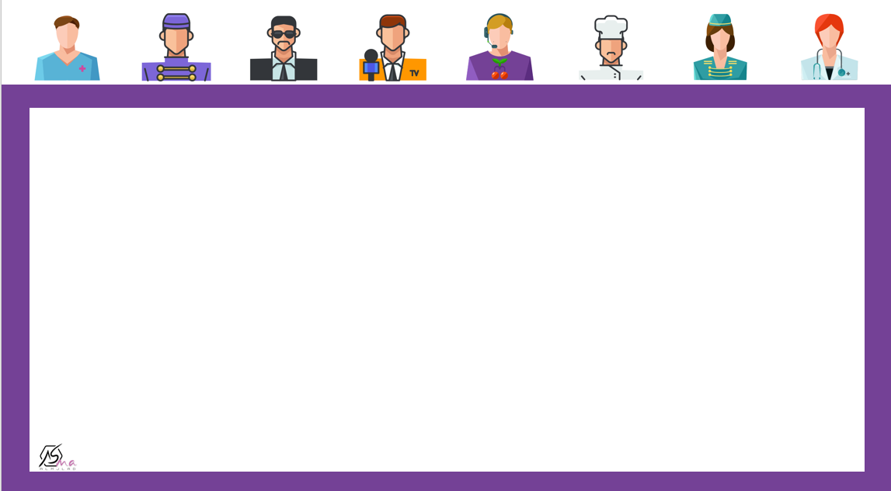
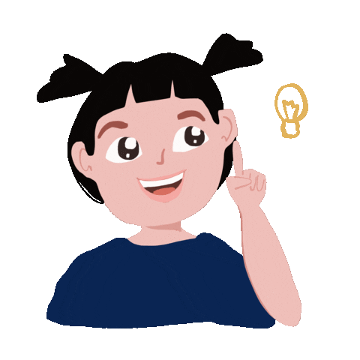

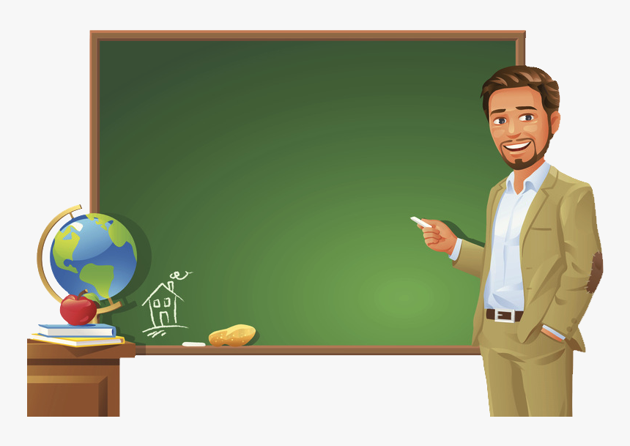
Guess
I work in SCHOOL
I help people learn new things
A teacher

Slide 7
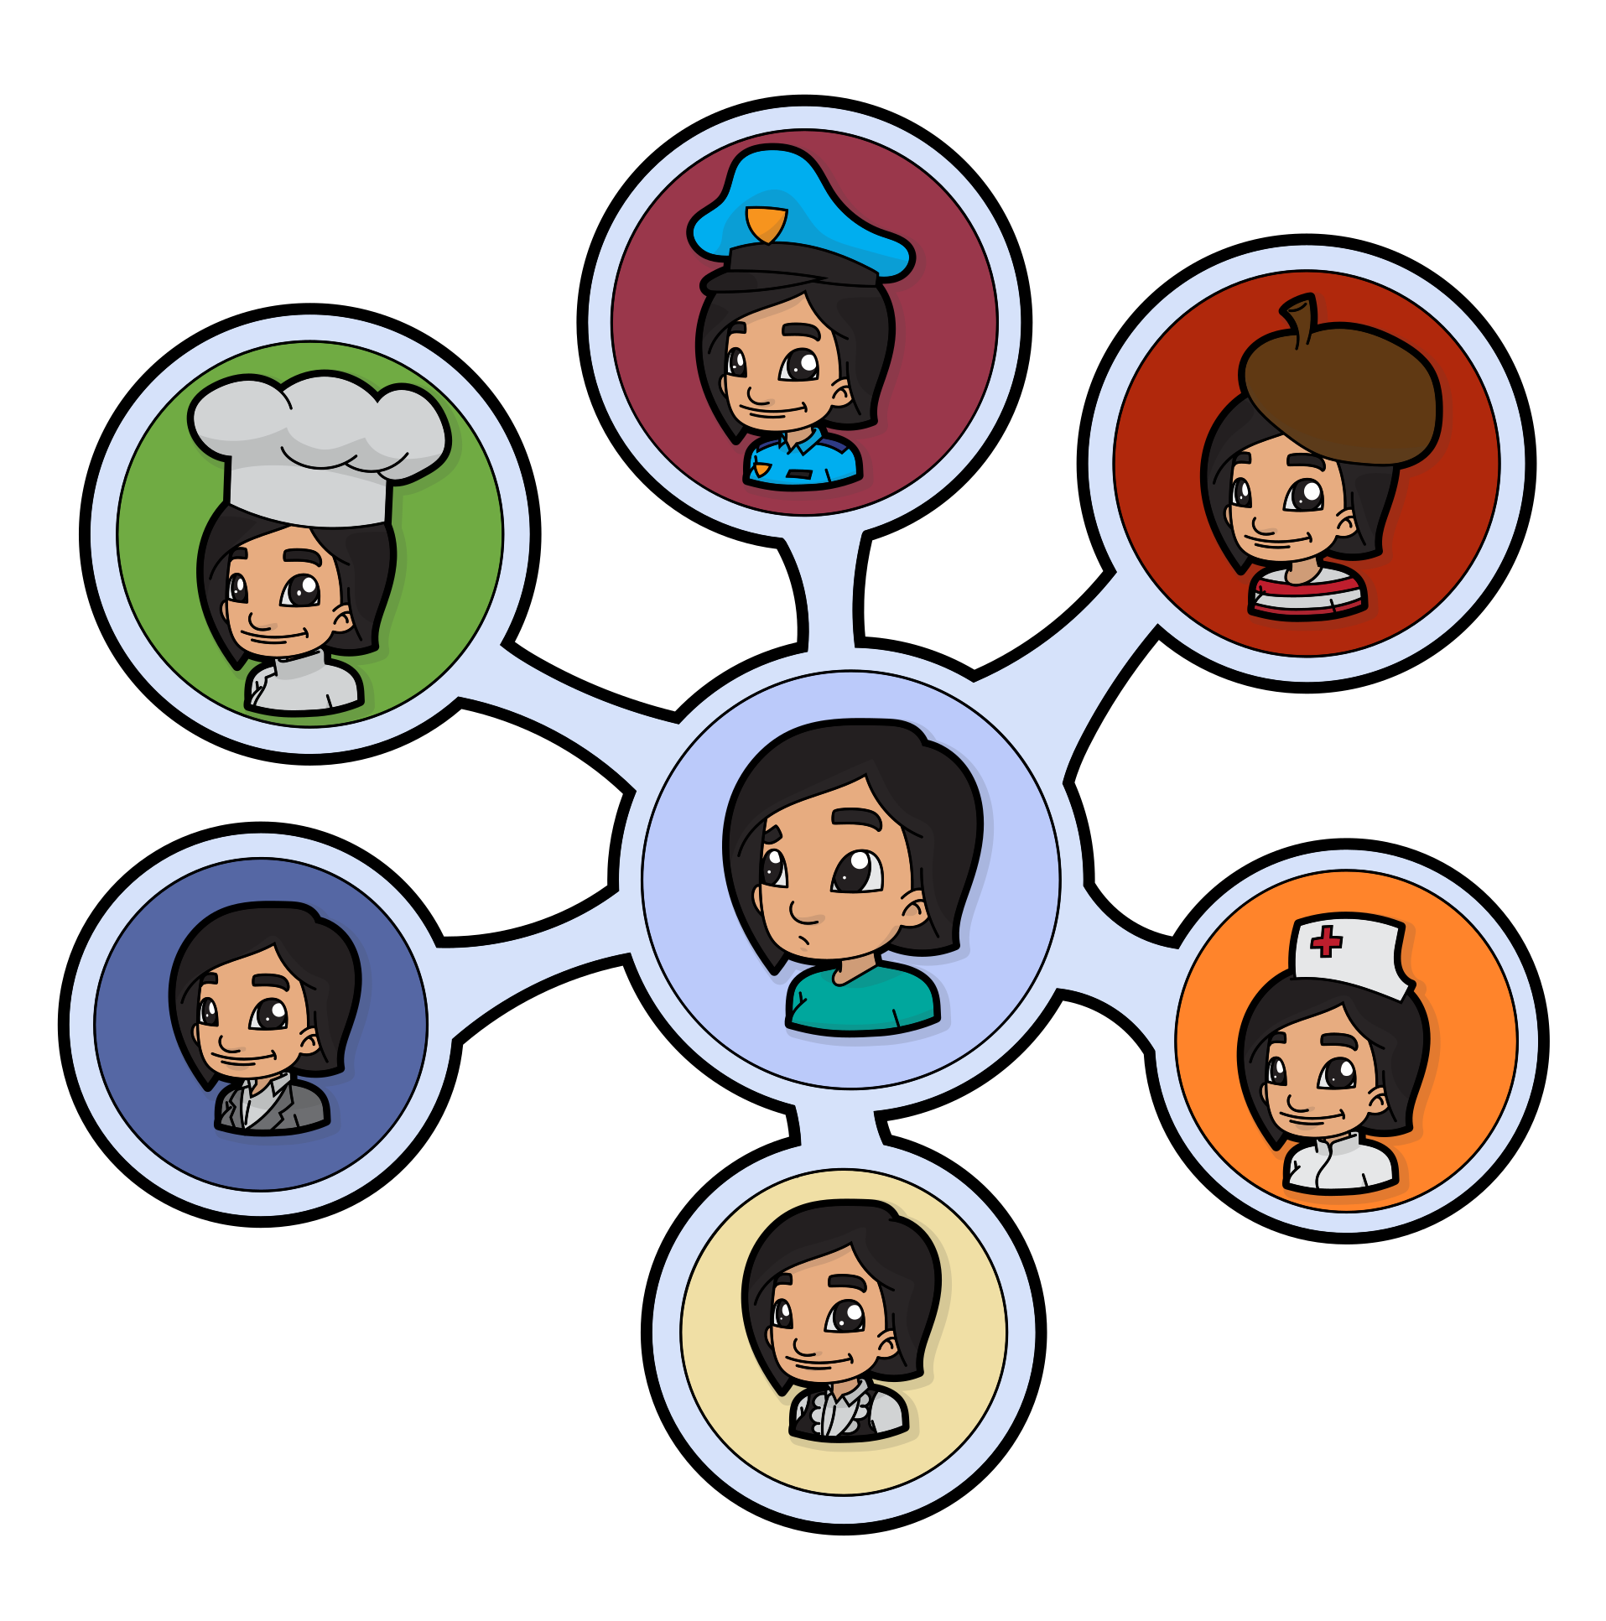
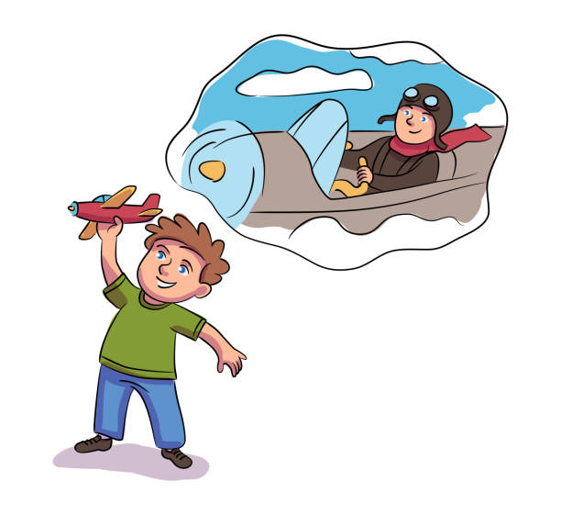
What is your dream job ?

Slide 8
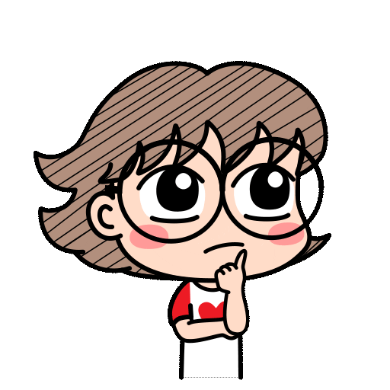

What do I do?
What do you think I like about my job?
Do I work in a school?

Slide 9

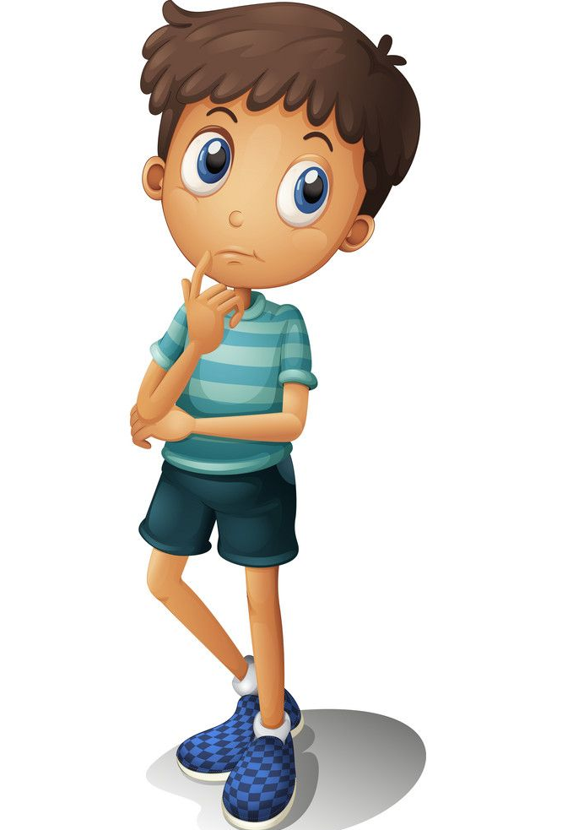
What do you do
What do you want to be in future ?
What are things that you like about this job?

Slide 10
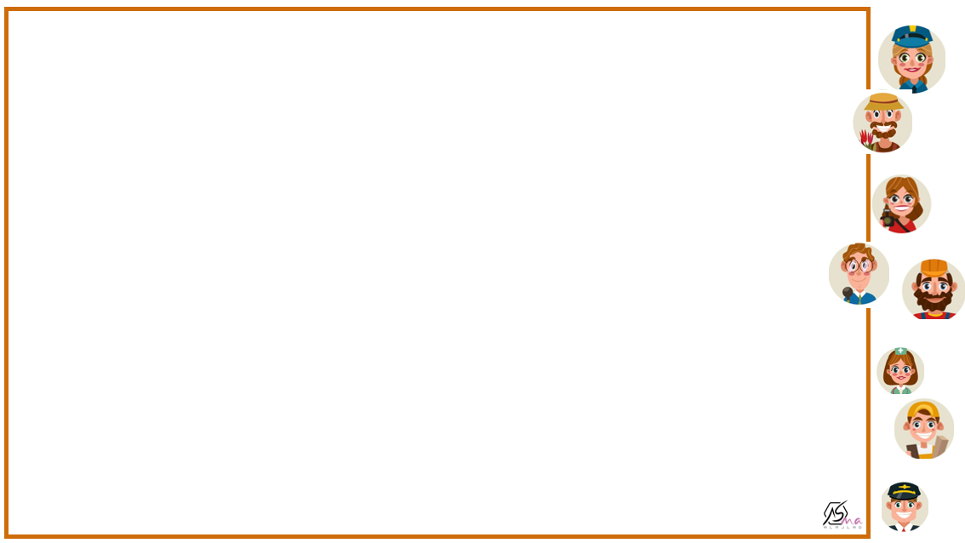
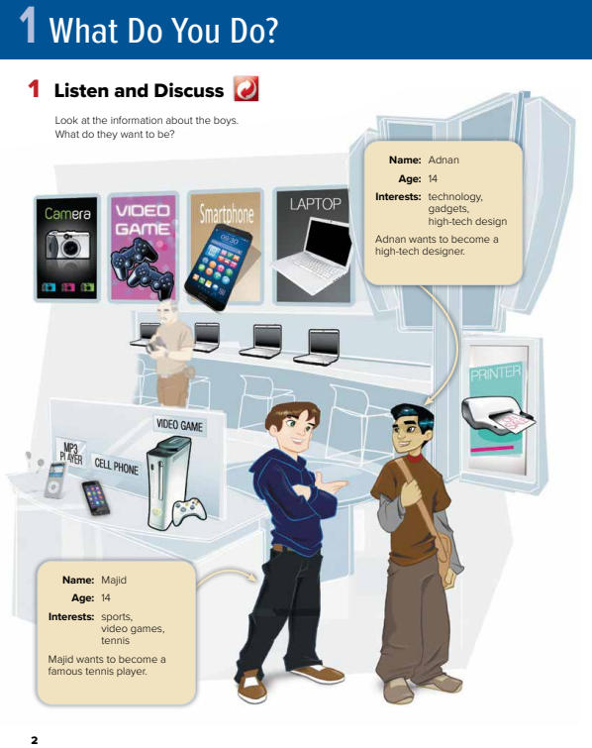
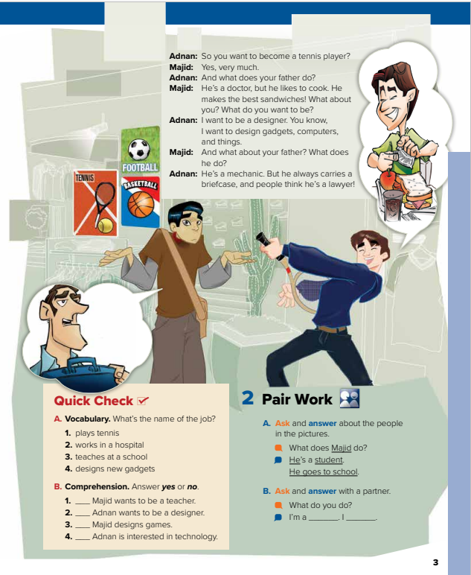


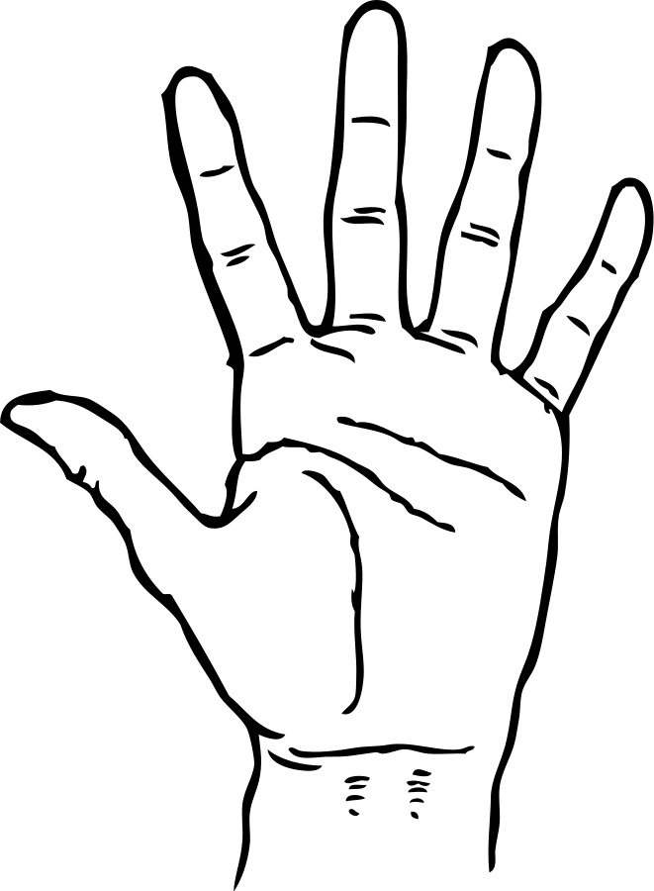

where are the two boys ?
@ page 2+3
electronic gadgets
Name some gadgets that you can see.
suggest jobs that such gadgets are used.

Slide 11
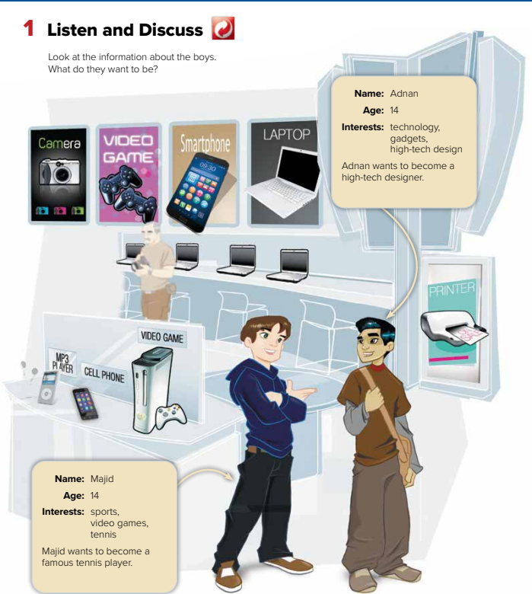



What do they want to be?

Slide 12
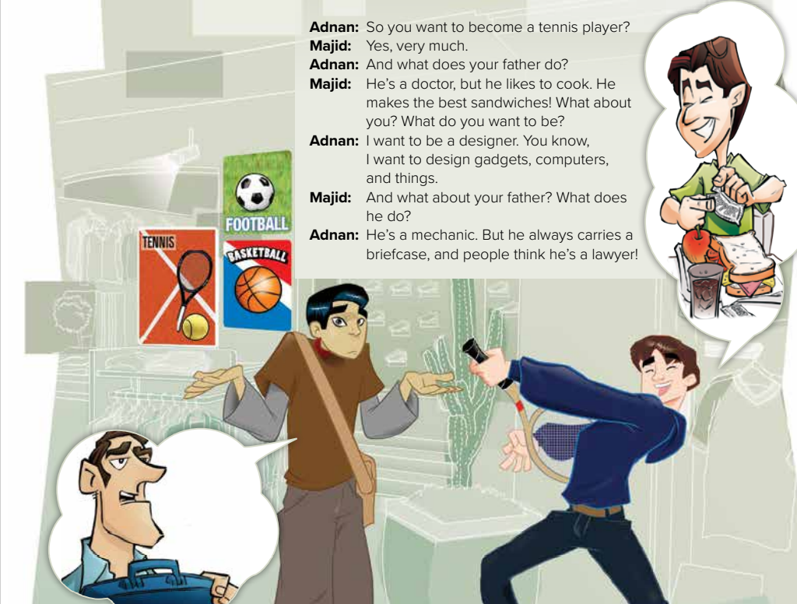

Is Majid’s father a cook?
What is Majid’s father do ?
Is Adnan’s father a lawyer?
What is Adnan ‘s father do?
Why do people think he's a lawyer?

Slide 13
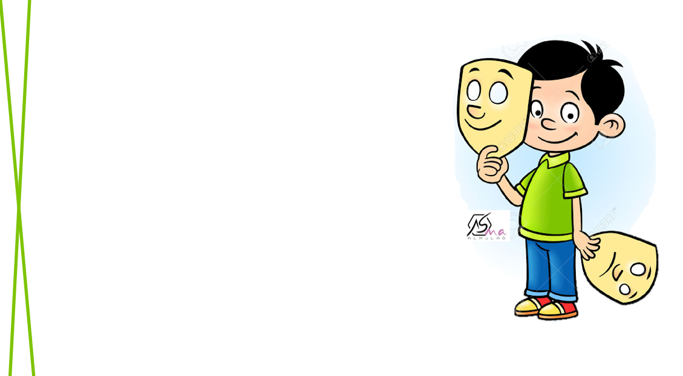
Who I am ?
Play tennis

Slide 14
Who I am ?
Works in a hospital

Slide 15
Who I am ?
Teaches at a school

Slide 16
Who I am ?
Designs new gadgets

Slide 17
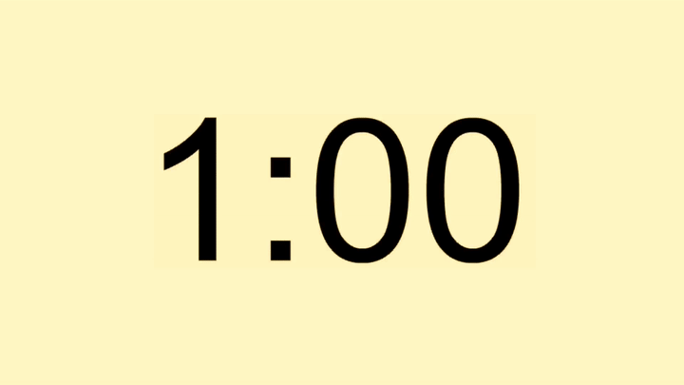
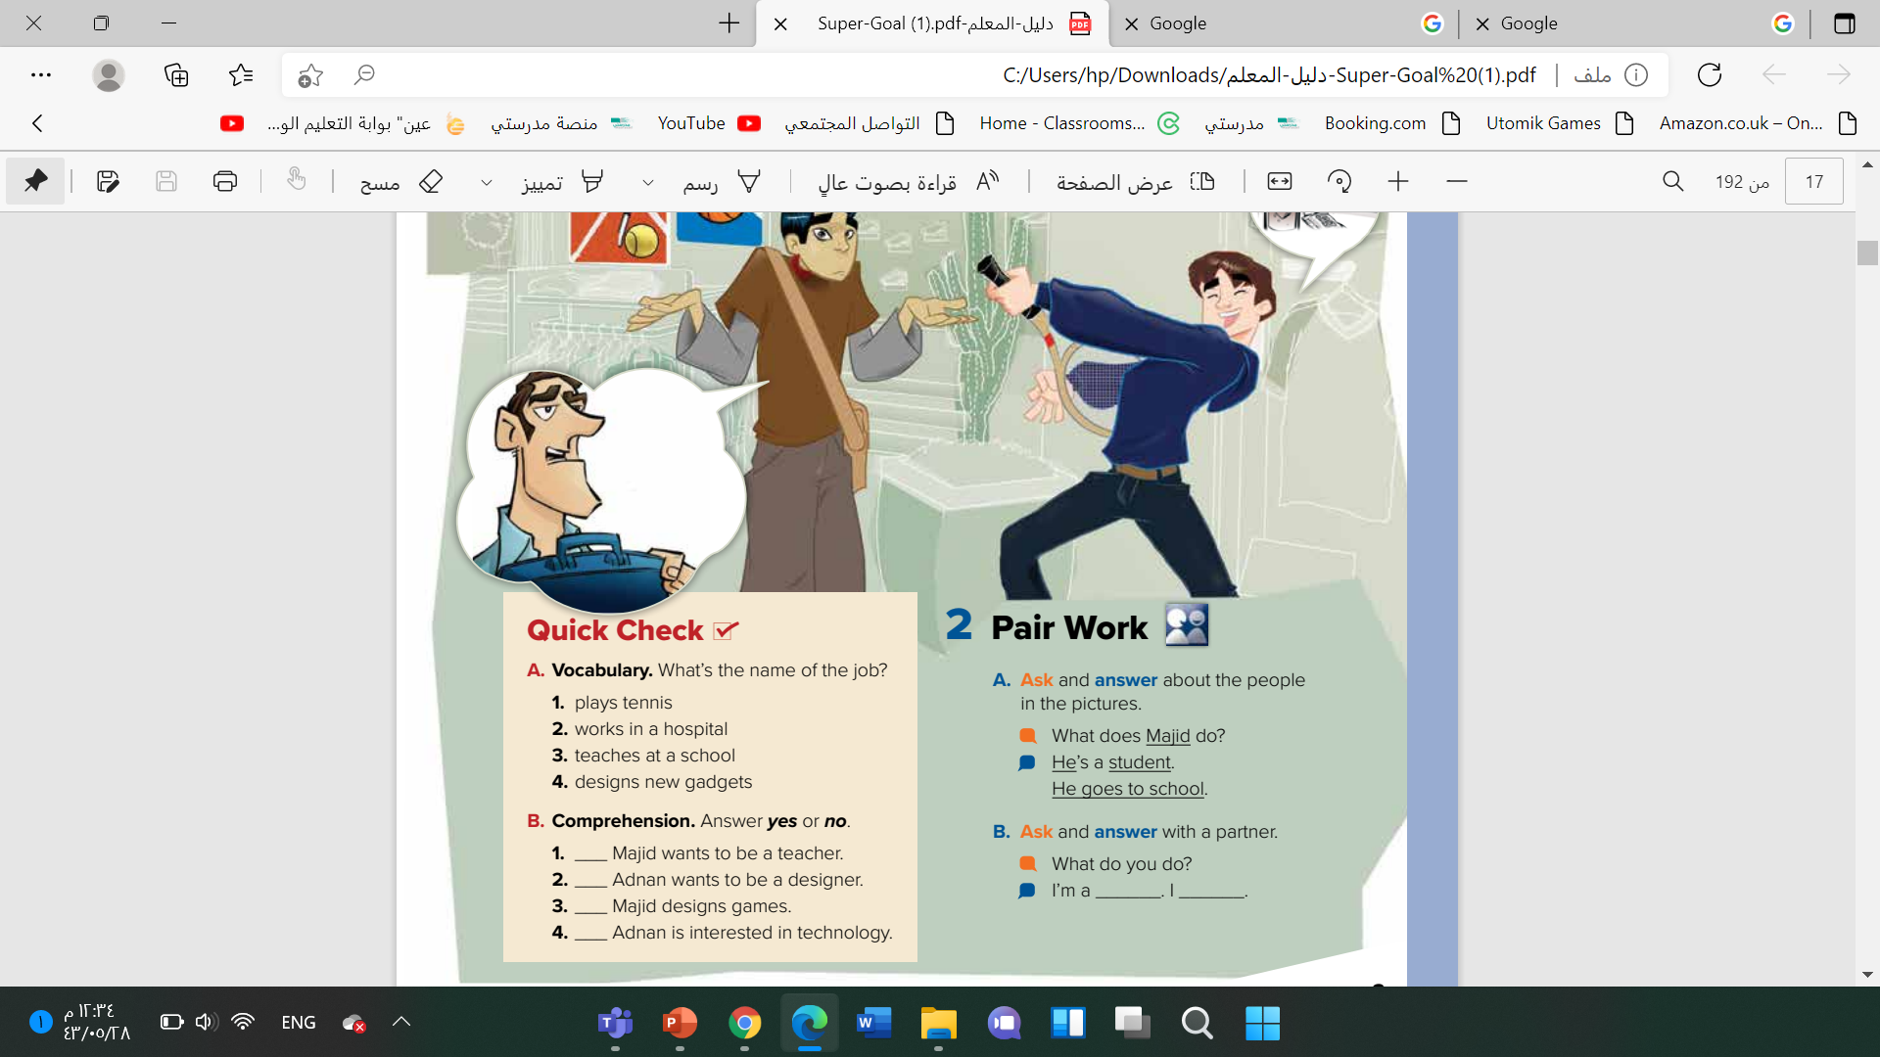
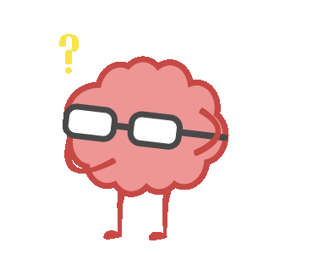
Tennis player
Doctor\ nurse
teacher
high-tech designer

Slide 18
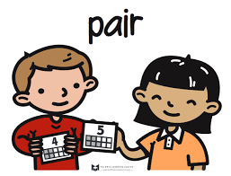


no
yes
no
yes

Slide 19



Slide 20
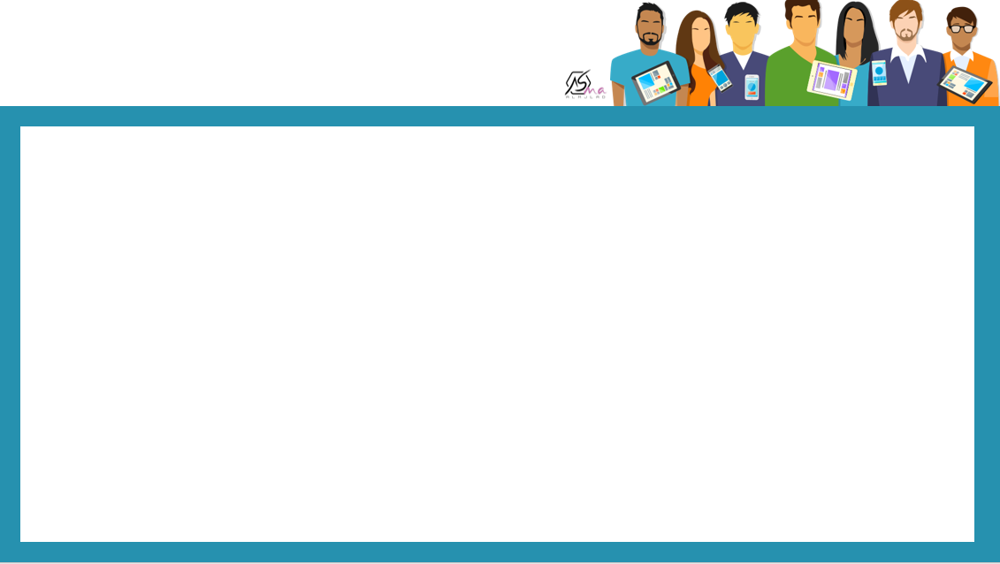


Slide 21


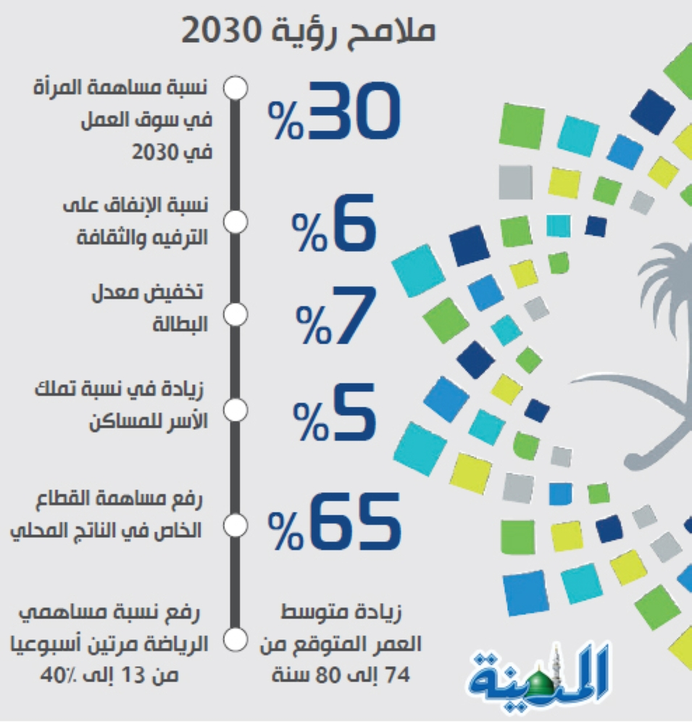


Slide 22
Work book

Slide 23
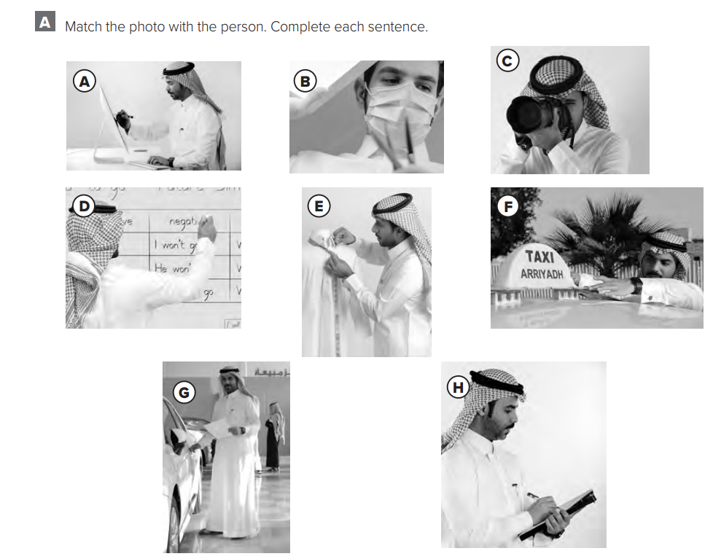
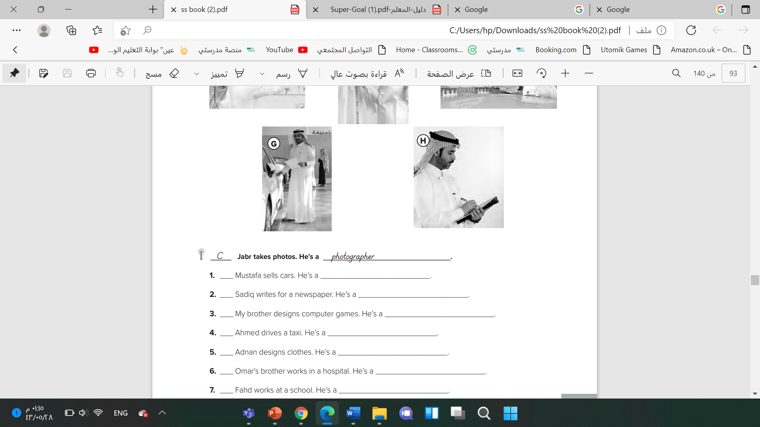
G
salesperson
H
reporter
A
high-tech designer
F
taxi driver
E
fashion designer
B
nurse OR doctor
D
teacher

Slide 24




Slide 25
