Slide 1


U 2
What’s school like?
Grammar

Slide 2

Use present simple in affirmative and negative form and questions.
Use adjectives with noun and verb to be correctly.
Listen for specific details about people.
Pronounce the third person singular verb ending -es.

Slide 3



Slide 4
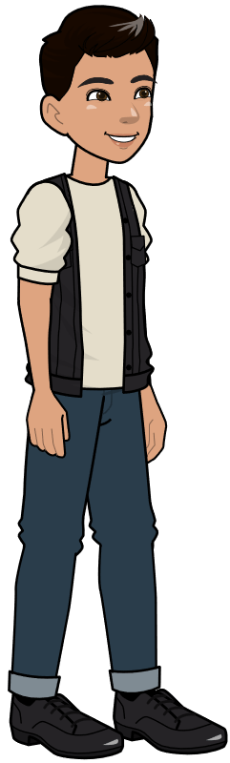
What do usually do in the evening?
I make dinner
She does her homework
I study / drink water

Slide 5


I speak English
I don’t speak English

Slide 6
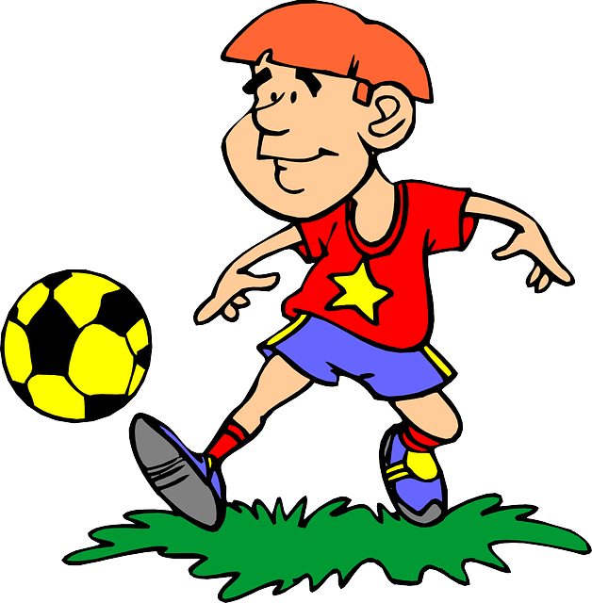
He plays football
He doesn’t play football

Slide 7
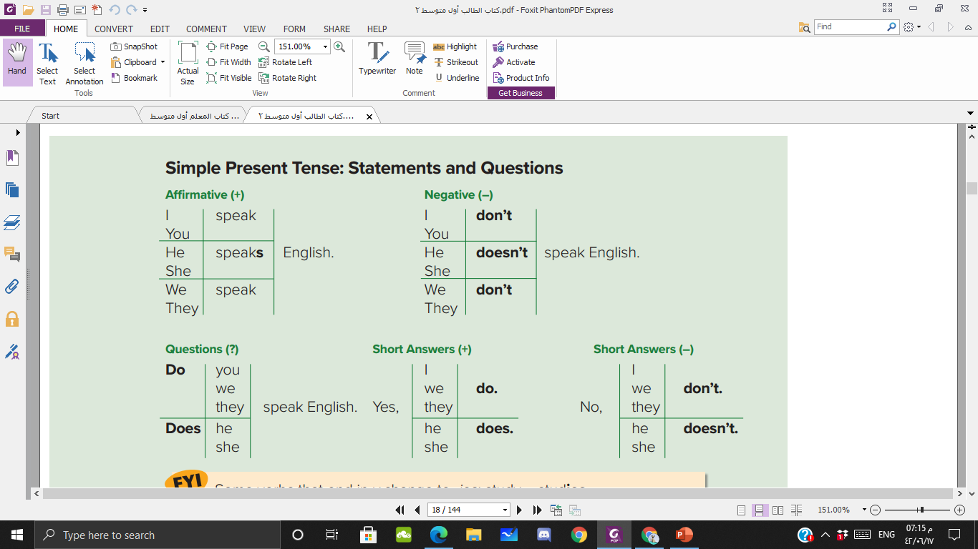

Slide 8
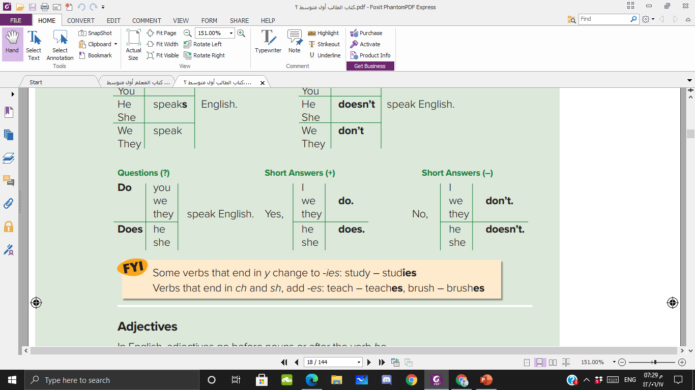
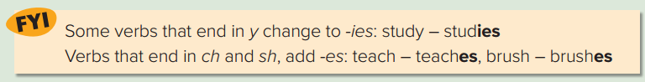

Slide 9
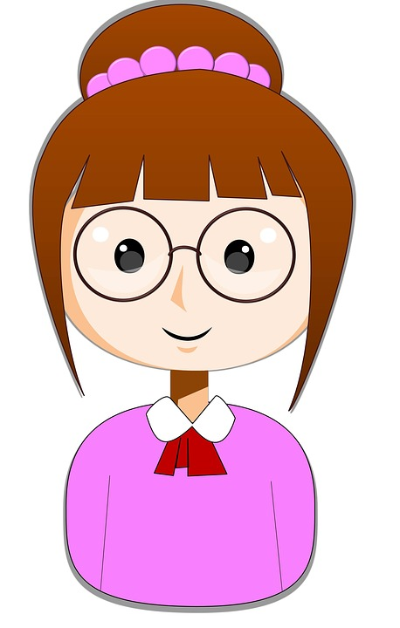

Do you …………………….?
Yes/No

Slide 10
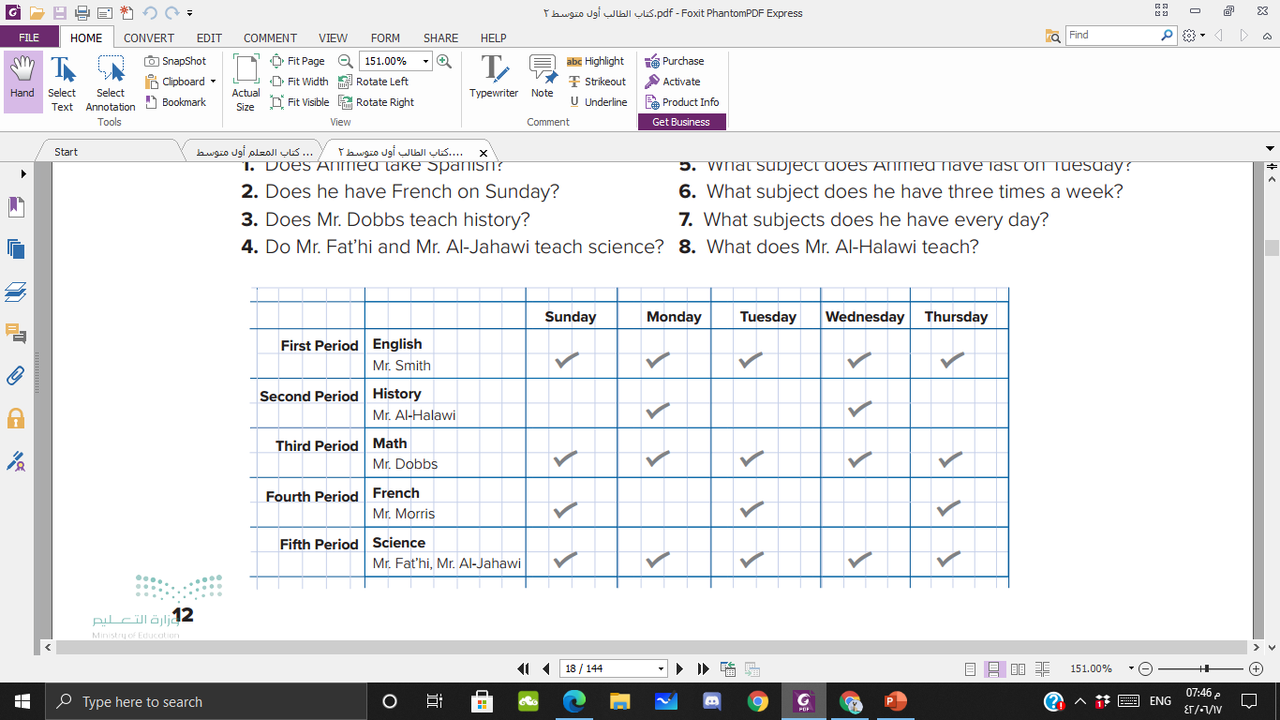

Ahmed’s schedule

Slide 11
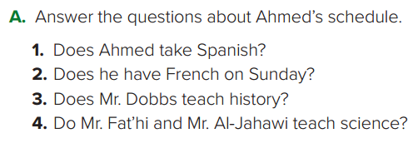
No, he doesn’t
Yes, he does
No, he doesn’t
Yes, he does

Slide 12
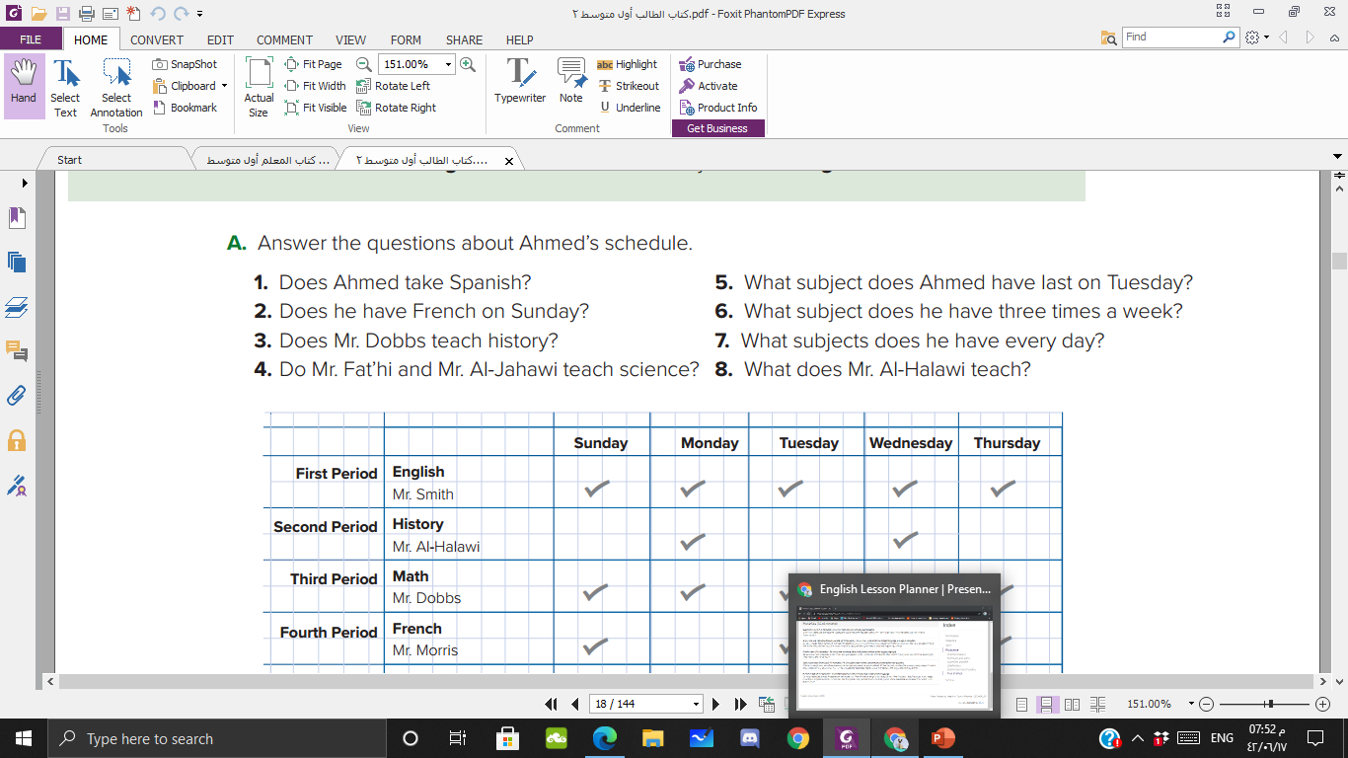

He has science last on Tuesday.
He has French three times a week.
He has English, math and science everyday.
He teaches history.

Slide 13

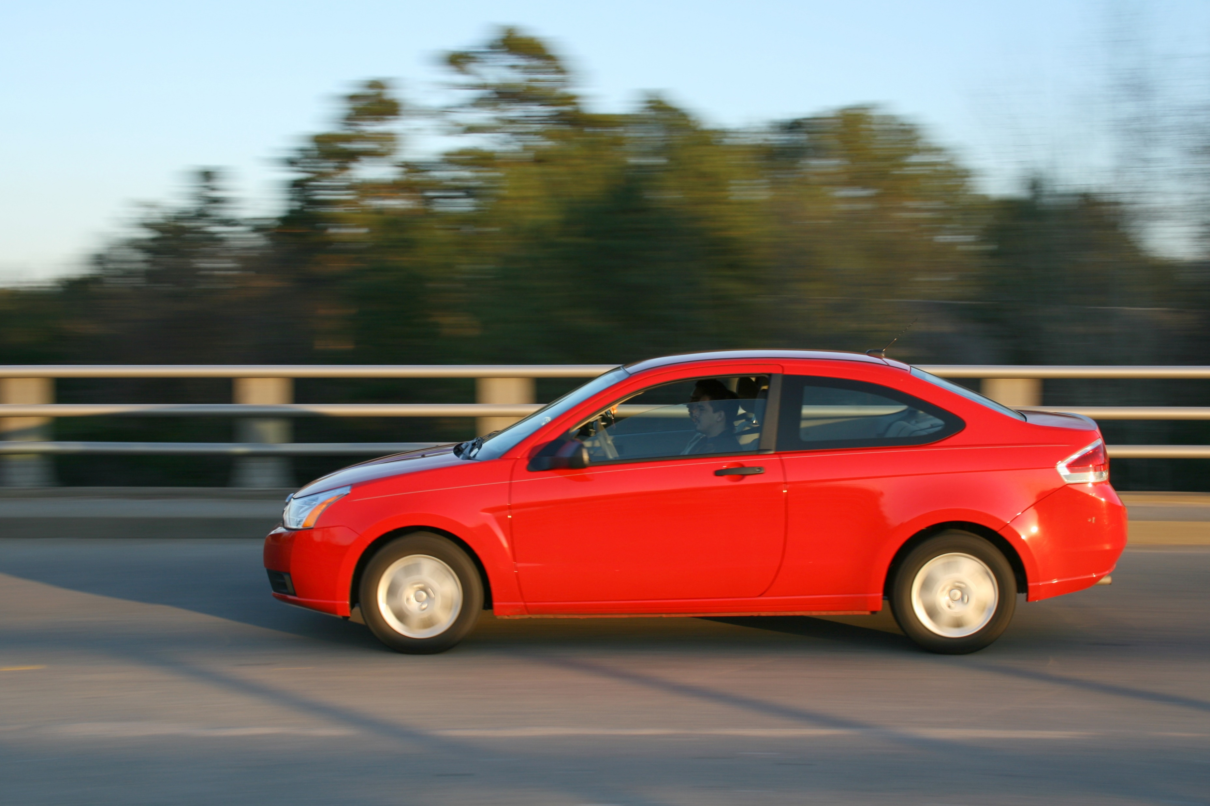
This is a red car
This car is red

Slide 14
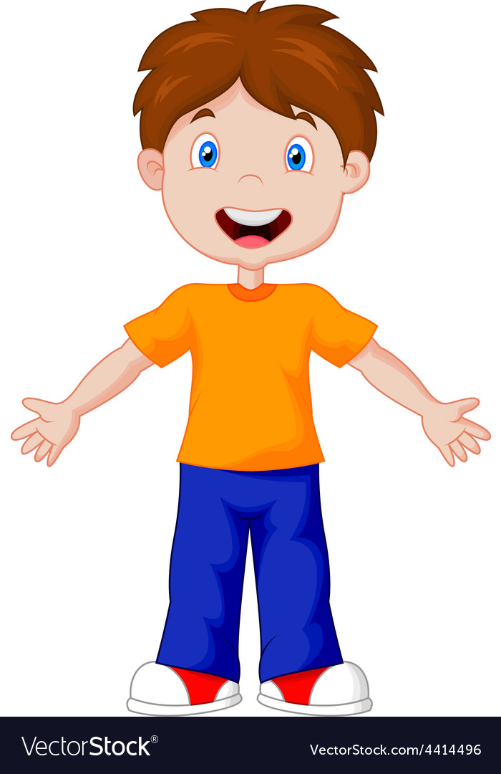
He has a short hair
His hair is short

Slide 15
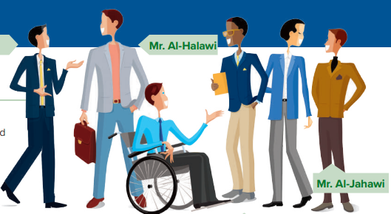

Slide 16
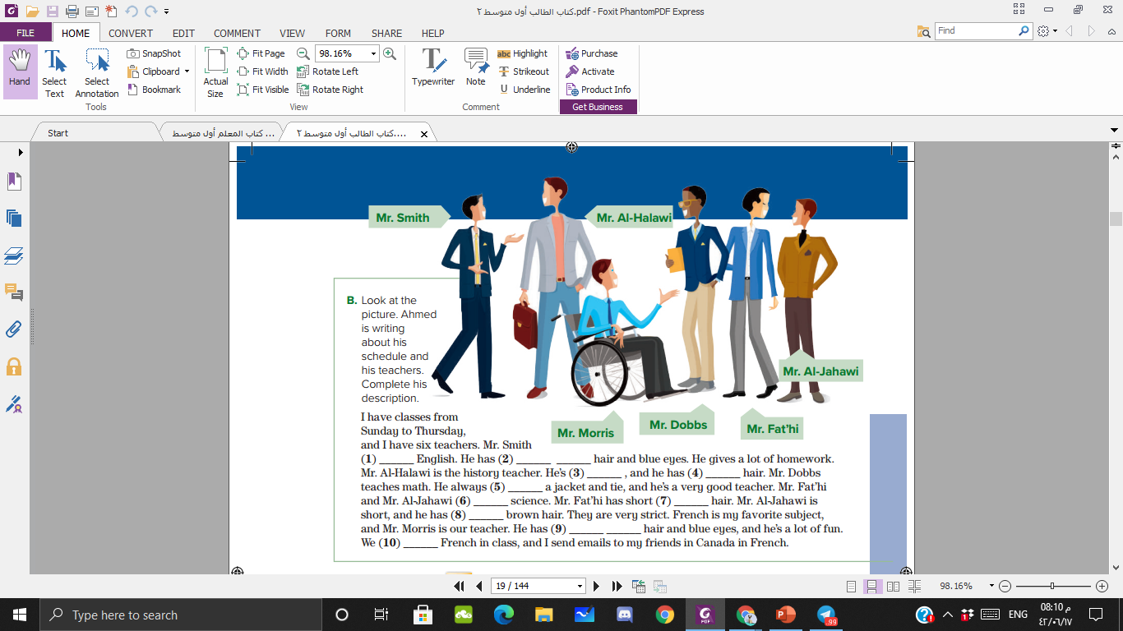
teaches
Short black
tall
brown
wears
teach
black
Short
Short brown
speak

Slide 17
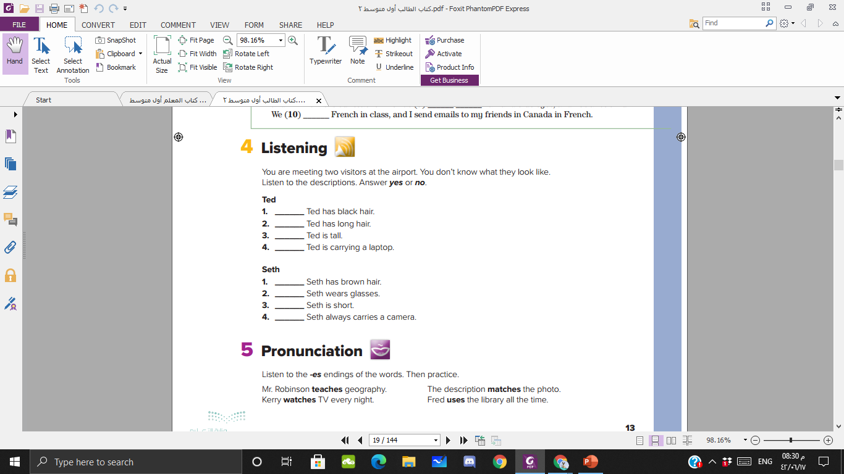

no
no
yes
yes
no
yes
no
yes

Slide 18
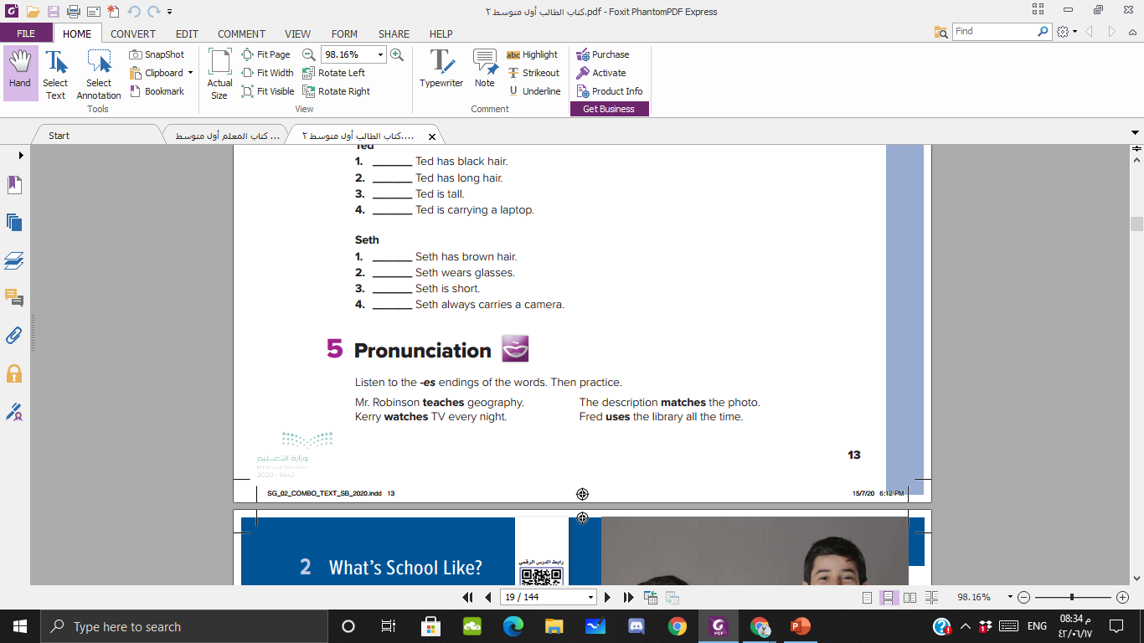

Slide 19

P 94

