Slide 1



Slide 2

Who teaches English in your school ?
Teacher Latifah has short black hair.
She has gray eyes.
Who has short hair and wears glasses?

Slide 3

1-list a number of school subjects.
2-describe subjects.
3-describe people.

Slide 4
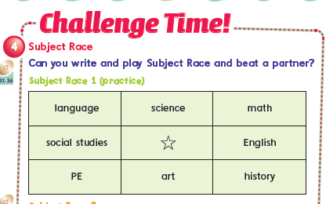
6th Grade – We Can 6

Slide 5

What is this subject?
It is English.
Do you like English ?
Yes, I do.
English is great.

Slide 6

What is this subject?
It is Arabic .
Do you like Arabic ?
Yes, I do.
Arabic is easy.

Slide 7

What is this subject?
It is Math.
Do you like Math?
No, I don`t.
Math is difficult.

Slide 8

What is this subject?
It is Art.
Do you like Art?
Yes, I do.
Art is fun.

Slide 9

What is this subject?
It is Science.
Do you like Science?
No, I don`t.
Science is boring.

Slide 10

What is this subject?
It is Computer Science.
Do you like it?
Yes, I do.
Computer science is challenging.

Slide 11

What is this subject?
It is Physical Education.
Do you like it?
Yes, I do.
PE is interesting.

Slide 12
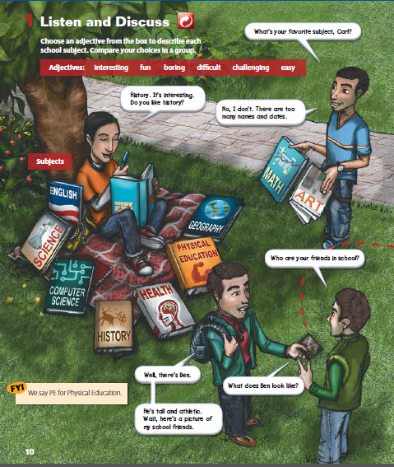
Who
What
Where
Action

Slide 13
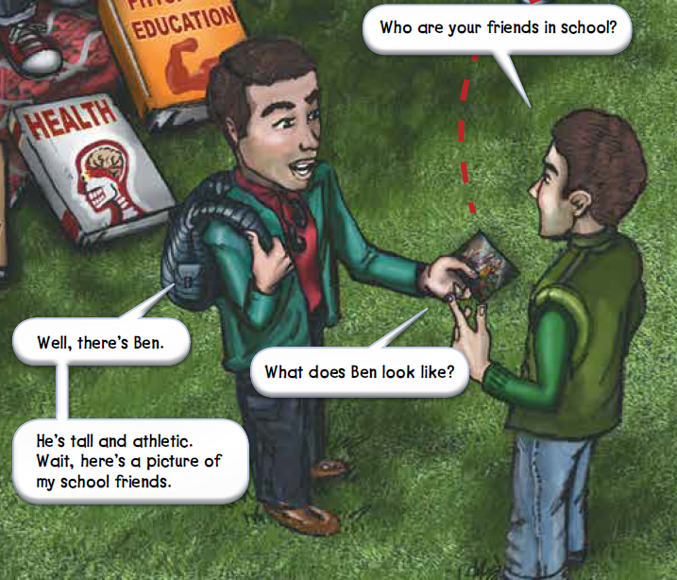
What does Ben look like?

Slide 14
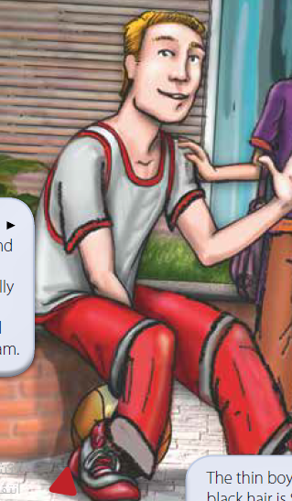
What does he look like?
He is tall.
He has blond hair and blue eyes.
He is athletic.
He is active.

Slide 15
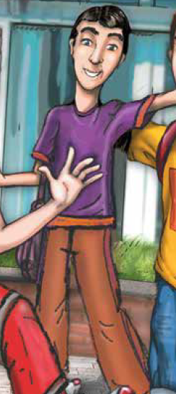
What does he look like?
He is thin .
He has black hair .

Slide 16
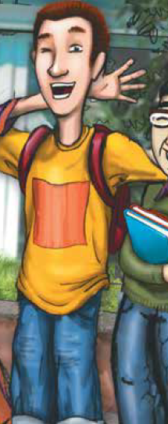
What does he look like?
He`s lots of fun.
He has brown hair.

Slide 17
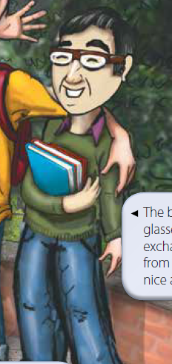
What does he look like?
He wears glasses.
He is an exchange student.
He is very nice.
He is very smart.

Slide 18
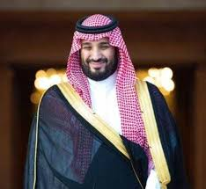
What does he look like?

Slide 19
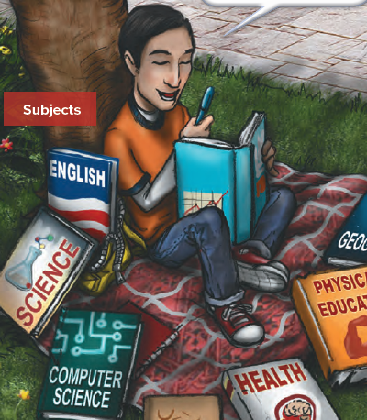
What is Carl doing?

Slide 20
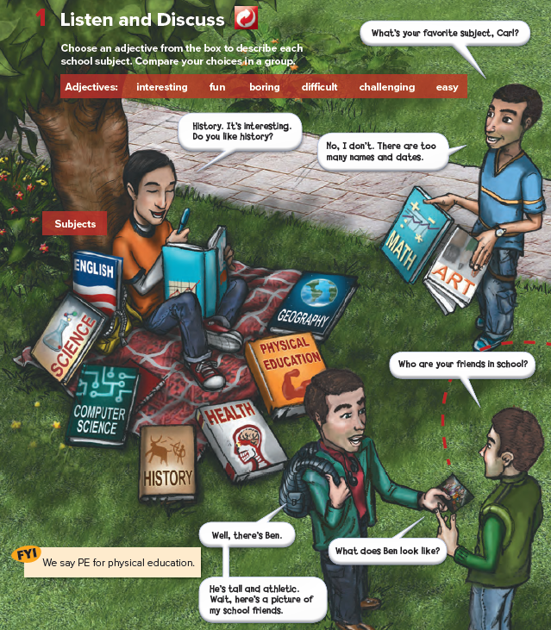
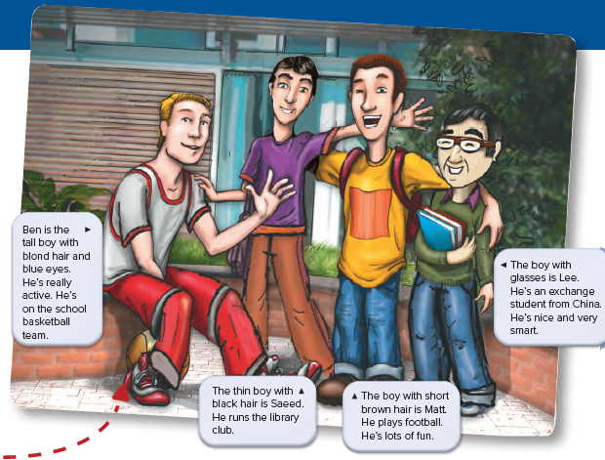


Slide 21
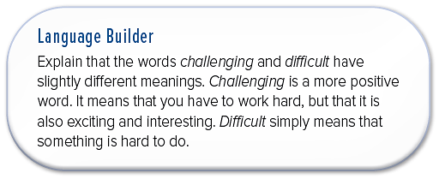

Slide 22
Who has blond hair?
Who wears glasses?
Who has brown hair?

Slide 23
Can you describe your friend ?
Mark has short brown hair.
He has brown eyes.

Slide 24
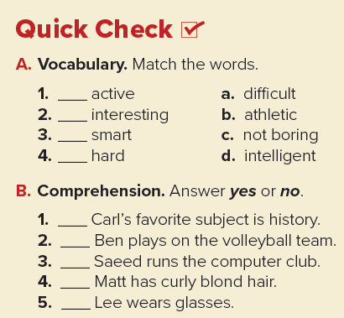
b
c
d
a
yes
no
no
no
yes

Slide 25
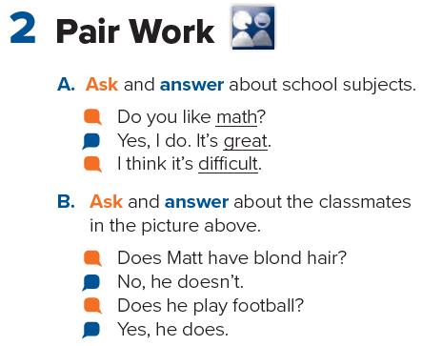

Slide 26
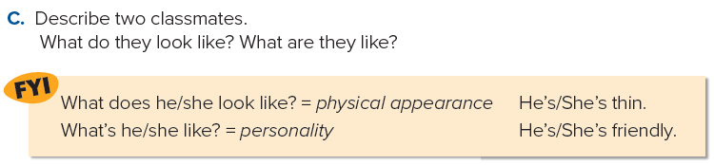

Slide 27

Page 93

Slide 28
Teacher : Anfal Al-Ghamdi
@englishanfal
ملاحظة : التسع الشرائح الأخيرة مقتبسة من عرض أ-بدر الشهري فجزاه الله خير الجزاء

