Slide 1

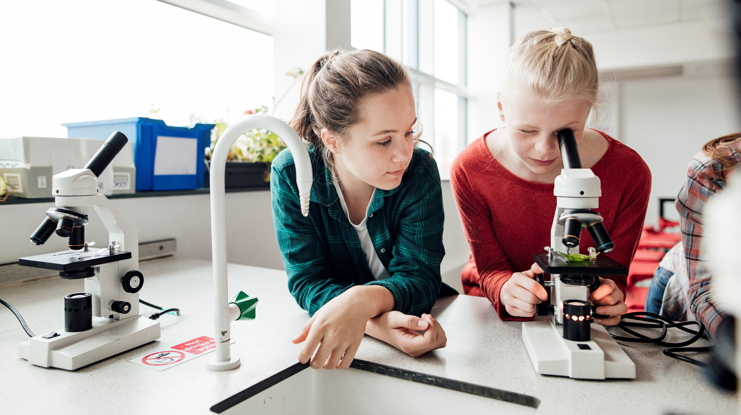
2-What’s school like?
6 Conversation
P.14

Slide 2
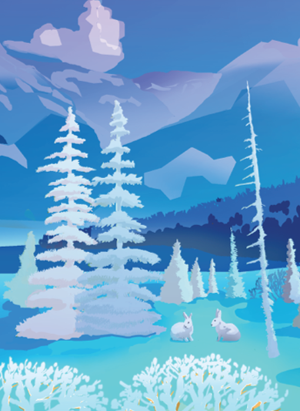
WINTER 2021
S | M | T | W | T | F | S
 |  |  |  |  | 1 | 2
3 | 4 | 5 | 6 | 7 | 8 | 9
10 | 11 | 12 | 13 | 14 | 15 | 16
17 | 18 | 19 | 20 | 21 | 22 | 23
24 | 25 | 26 | 27 | 28 | 29 | 30
31
What’s the day
and the date today?
JANUARY
S | M | T | W | T | F | S
 | 1 | 2 | 3 | 4 | 5 | 6
7 | 8 | 9 | 10 | 11 | 12 | 13
14 | 15 | 16 | 17 | 18 | 19 | 20
21 | 22 | 23 | 24 | 25 | 26 | 27
28
FEBRUARY
S | M | T | W | T | F | S
 | 1 | 2 | 3 | 4 | 5 | 6
7 | 8 | 9 | 10 | 11 | 12 | 13
14 | 15 | 16 | 17 | 18 | 19 | 20
21 | 22 | 23 | 24 | 25 | 26 | 27
28 | 29 | 30 | 31
MARCH

Slide 3
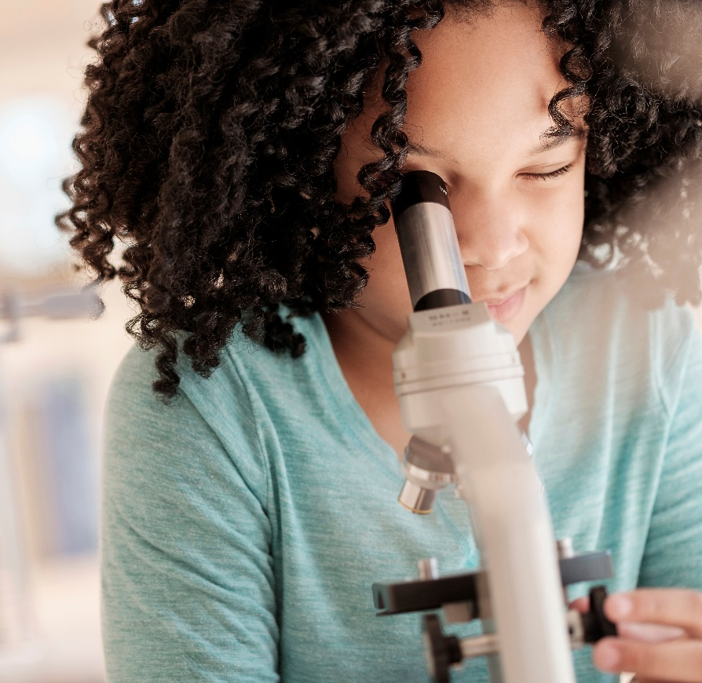
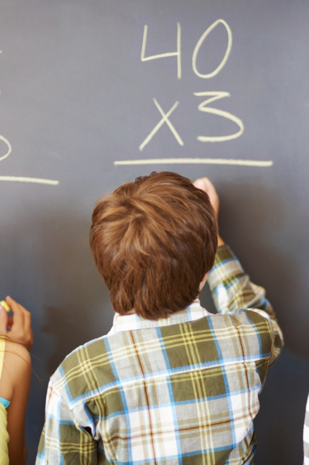
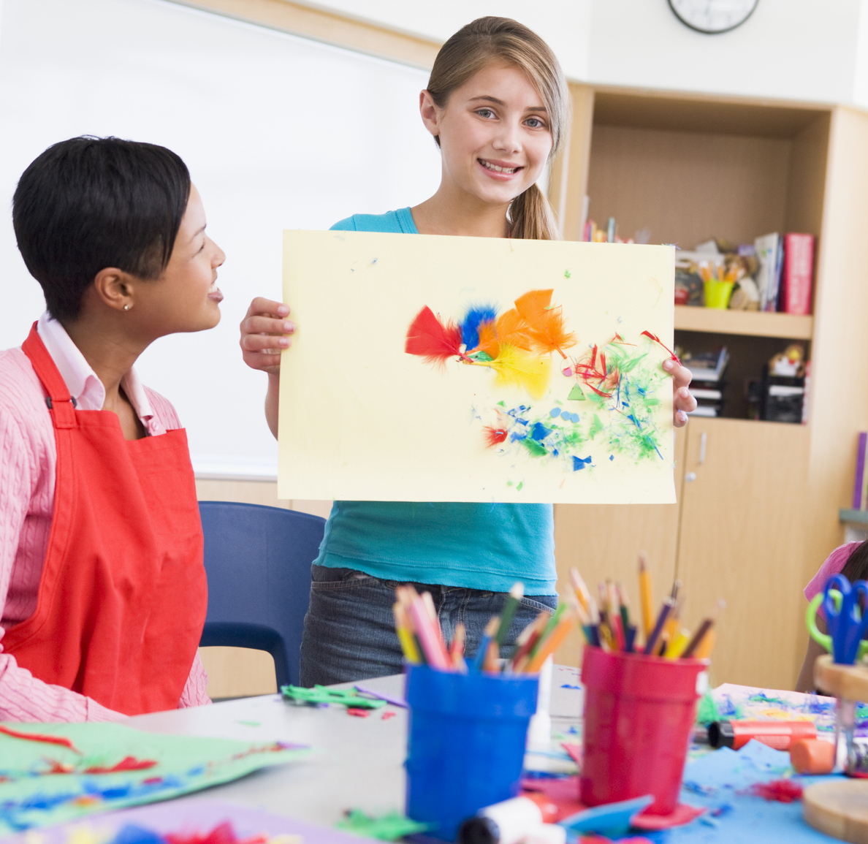
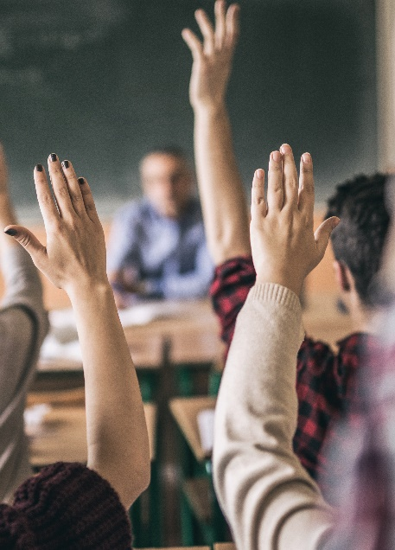
Warm up
What’s your favorite subject?
Do you like Computer science ? Why?
Who is your favorite teacher?Why?
P.14

Slide 4
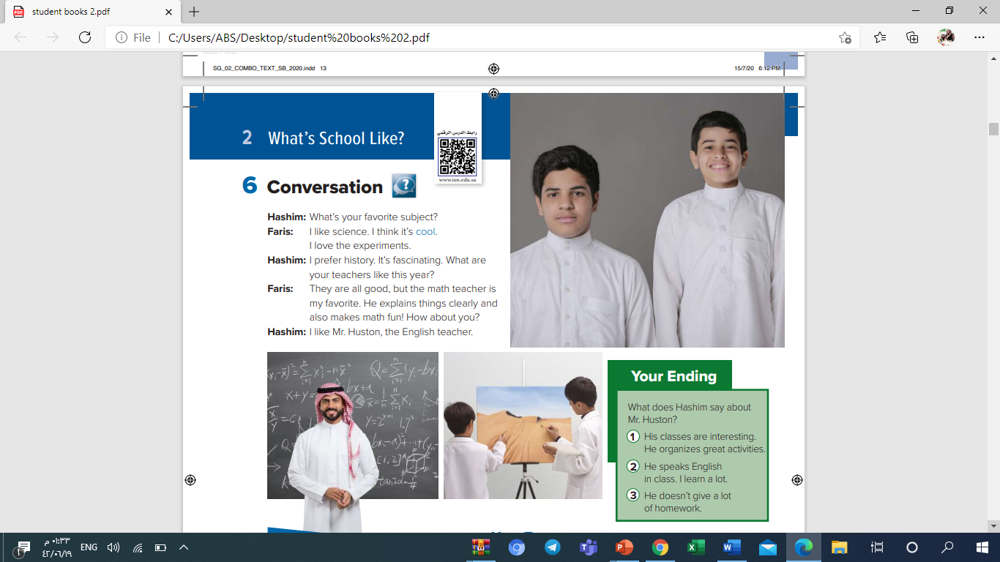
1-Read the title
2-Describe the pictures.
3-What are the
boys’ names?
P.14

Slide 5

Positive adjectives
P.14
1-Underline
the adjectives.
2- What are the
synonyms for:
great
cool≈
fascinating ≈
interesting
3-What are the
opposites of
boring
Fun≠
good ≠
bad

Slide 6


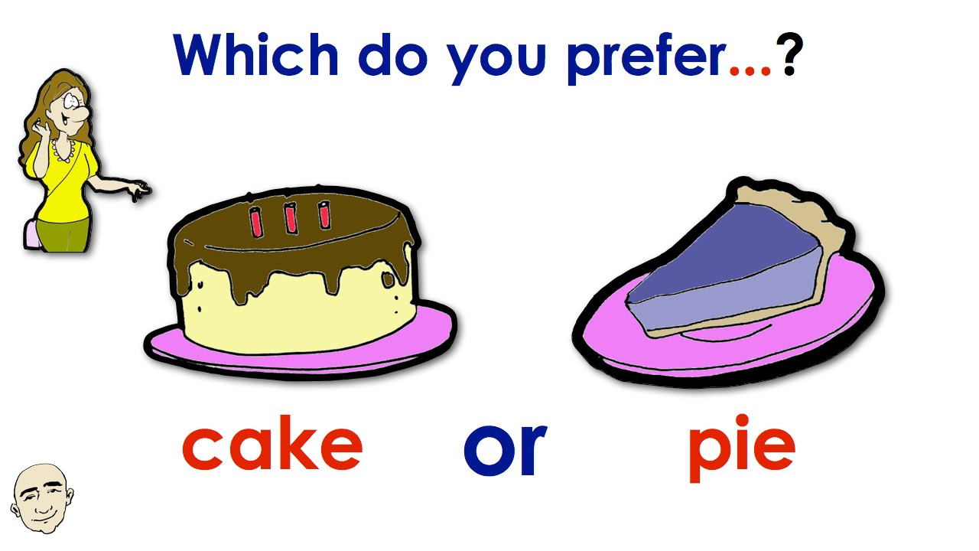
P.14
Emotional verbs

Slide 7

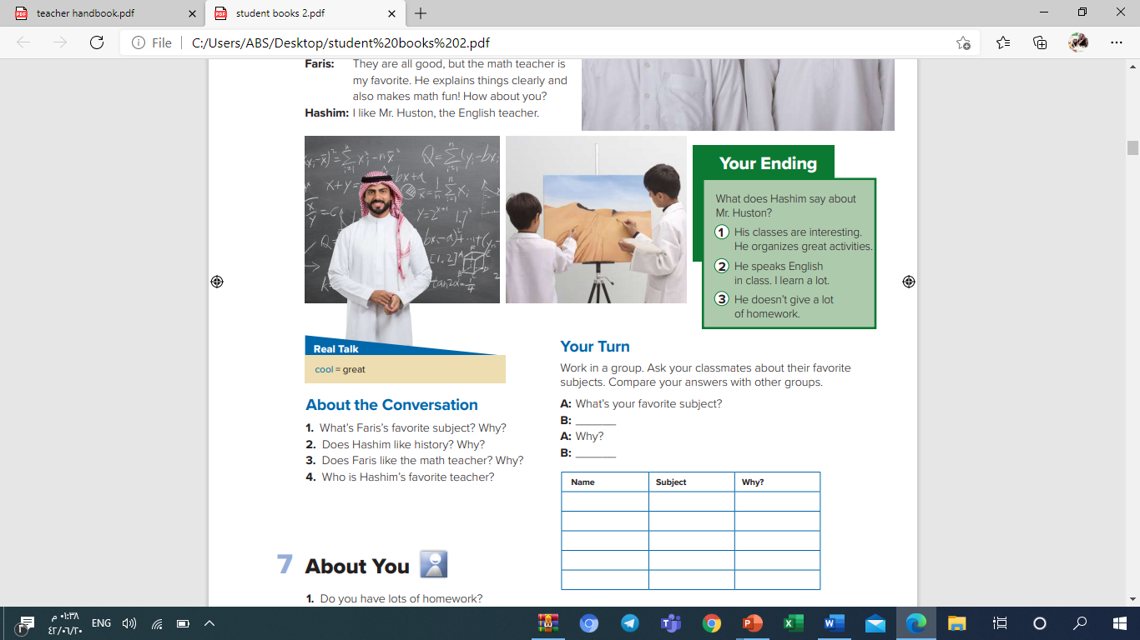
P.14
Listen to the
Conversation ,then
choose the ending
you like the most.

Slide 8
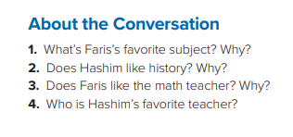
-Read the conversation
then answer the questions
1-it’s science. Because he
thinks it’s cool, and he loves experiments.
2-Yes, he does. Because it’s fascinating.
3-Yes,he does. Because he explains
things clearly and also makes math fun!
P.14
4-Mr. Huston, the English teacher.

Slide 9
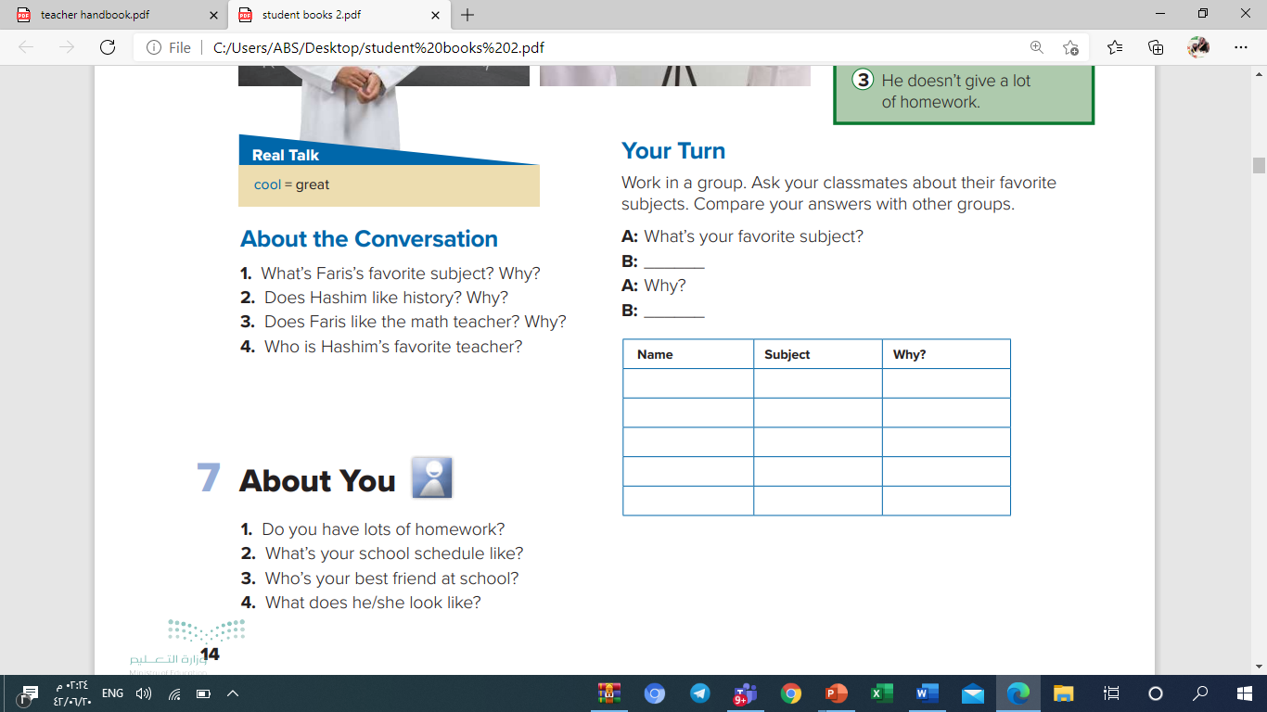
Task1: move to the group rooms then fill the chart (5min)
Task 2: come back to the main room and
compare your answers with other groups
P.14

Slide 10
P.14

Slide 11
Thank
You
T. Bushra al swailem

