Slide 1

Super Goal 2
Unit 1 Lesson 9
Page (17)
10- Grammar
Done by: T. Haya
B.

Slide 2
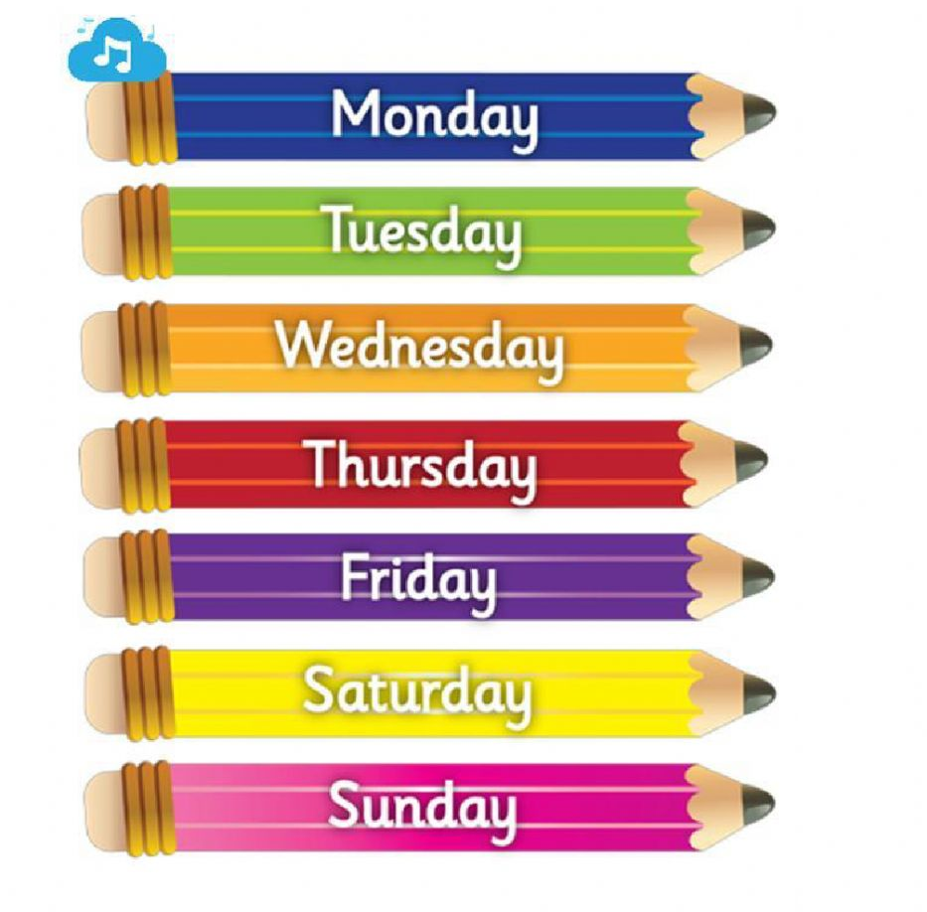
What’s day today?
What is the date?

Slide 3

Objectives:
- use adverbs.
- use adjectives with -ed.
- Distinguish between adjectives with ed and adjectives with ing

Slide 4

Rules of the classroom:
1- mute your mic.
2- don’t interrupt your teacher or friend
3- listen to your teacher
4- speak English during the lesson.
5- raise your hand .

Slide 5
Revision
speaking time
Describe your self or your friend?

Slide 6

Warm up
https://youtu.be/HqvOs3ILy7w

Slide 7

:
intensifiers
Adverbs : words that make adjectives stronger
Adverbs:
Quite / extremely /pretty /really / Very

Slide 8
:
examples
Reem a is tall
Reem is quite tall
To make the adjective stronger , we’ll add adverb

Slide 9
:
examples
1-English is quite interesting
It is ……………….
2-The test is a very difficult
It is ……………….
3-The boy is quite intelligent.
He is …………………………..

Slide 10
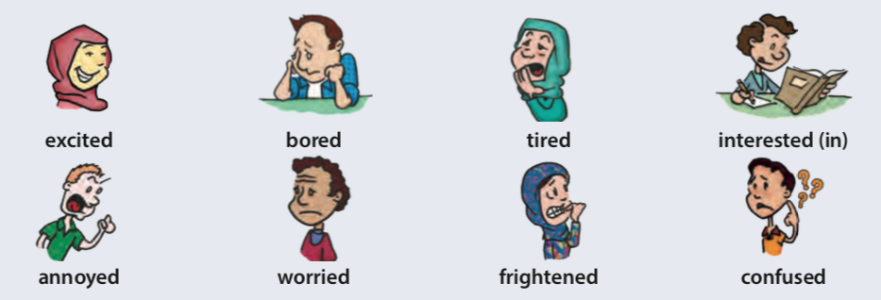
:
Adjectives with ed
Describe how a person feel or react

Slide 11
:
Adjectives with ed
Describe how a person feel or react
I am excited
She is interested in Math.
They are frightened

Slide 12



:
Adjectives with ing
the person or the thing that makes us feel
This book is interesting
The spider is frightening
The museum is exciting

Slide 13
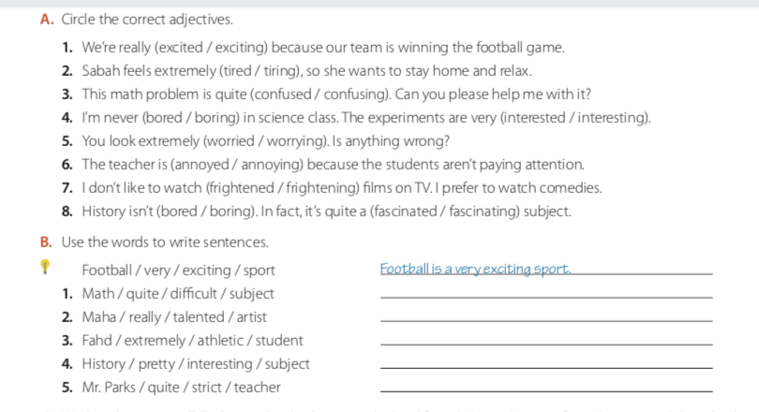
:
Open your book (17)

Slide 14

:
Lets play
https://wordwall.net/ar/resource/1745084

Slide 15
:
Homework

Slide 16

:

