Slide 1

Unit 1
What Do You Do ?
part 4

Slide 2
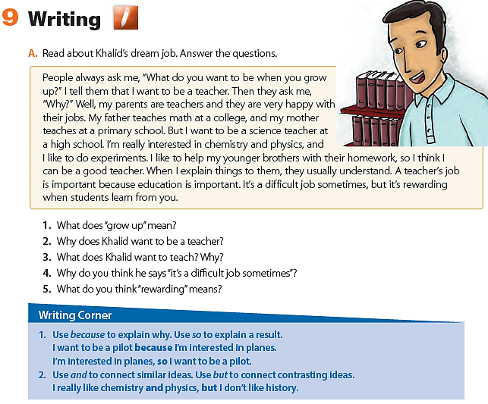
become an adult
His parents are teachers and they are happy with their jobs.
He wants to teach science because he’s interested in chemistry and physics
satisfying; pleasing

Slide 3
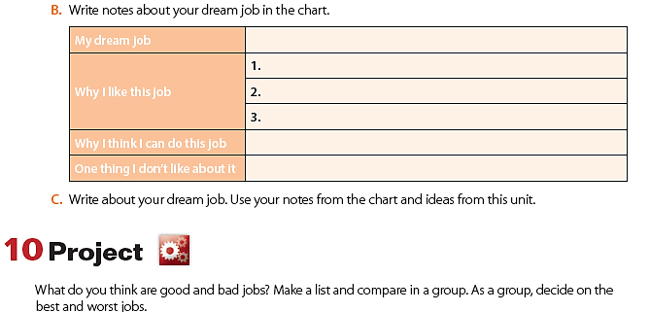
I want to be a doctor
I can save lives
The salary is satisfying
People respect doctors
I study hard to get into the medical college
It can be stressful job

Slide 4
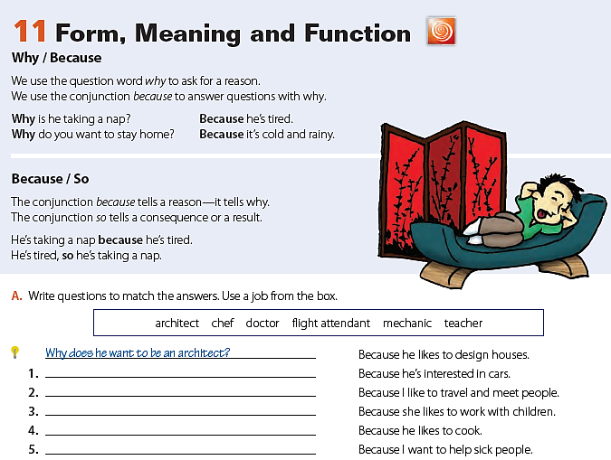
Why does he want to be a mechanic?
Why do you want to be a flight attendant?
Why does she want to be a teacher?
Why does he want to be a chef?
Why do you want to be a doctor?

Slide 5
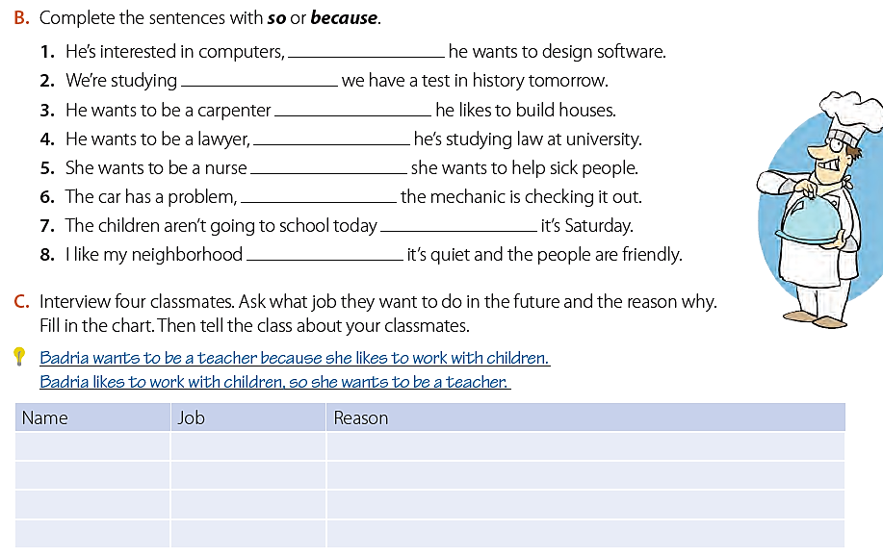
so
because
because
so
because
so
because
because
Sample answers
Sarah
Chief
I like cooking / I’m good in preparing Saudi dishes

Slide 6
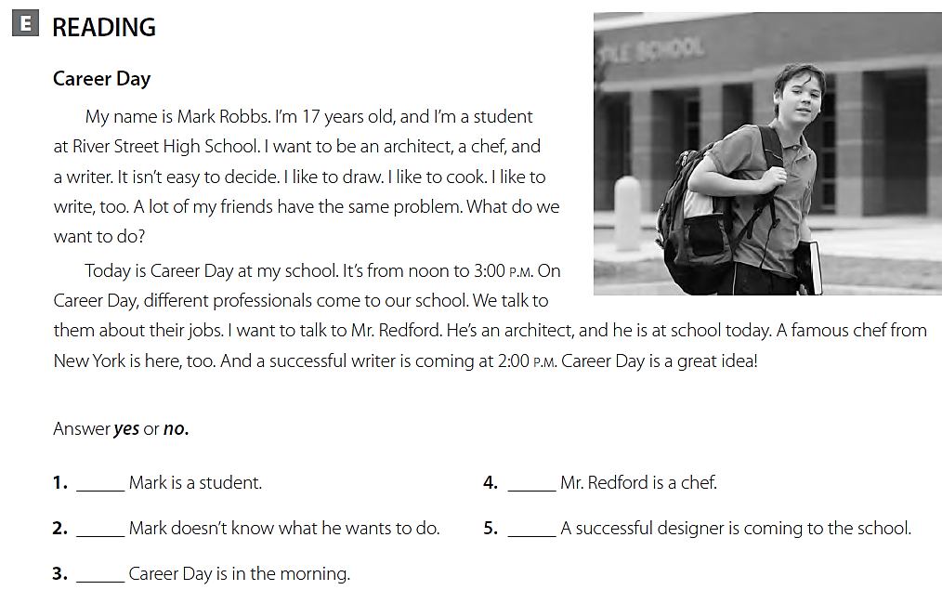

yes
no
yes
no
no

Slide 7
