Slide 1

Unit 1
What Do You Do ?
part 3

Slide 2
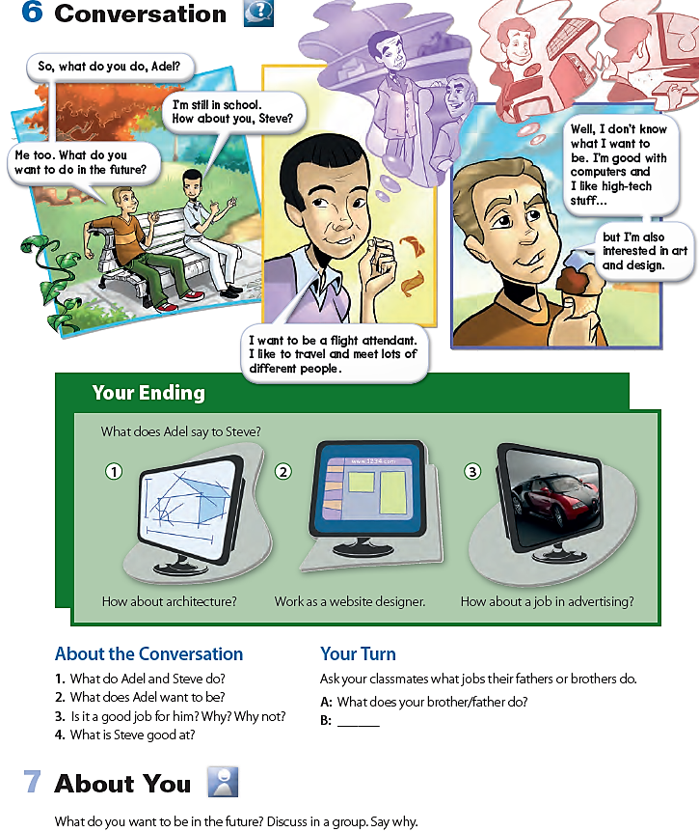

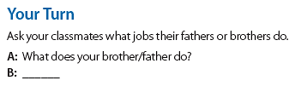
Adel and Steve are students.
He wants to be a flight attendant.
Yes, it is. He likes to travel and meet lots of different people.
Steve is good with computers.

Slide 3
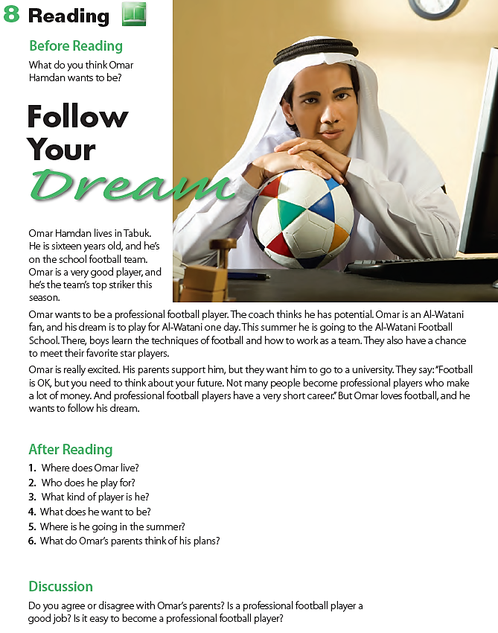
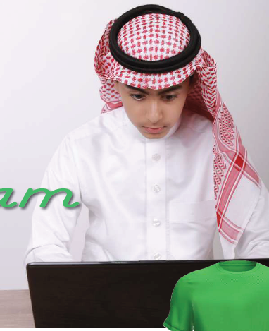
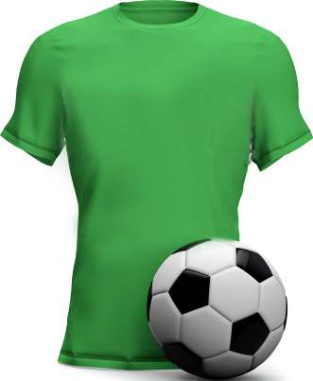
Omar lives in Tabuk, Saudi Arabia.
He plays football for his school.
He’s a good player. / He’s a striker.
He wants to be a professional football player.
He is going to a football school.
His parents support him, but they want him to go to a university

Slide 4
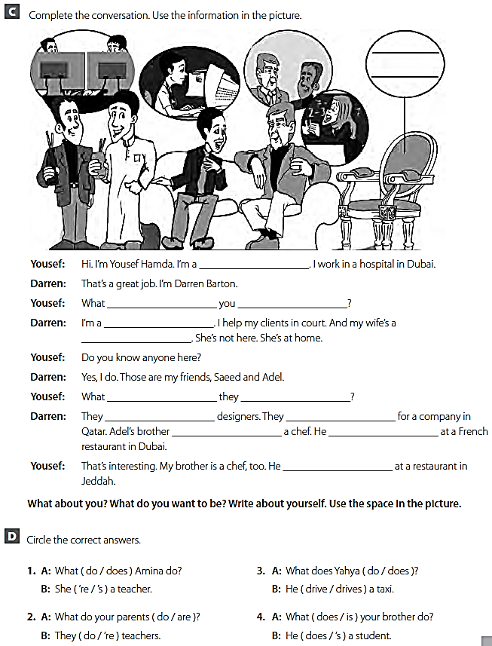
doctor
do
do
lawyer
teacher
do
do
are
work
is
works
works

