Slide 1
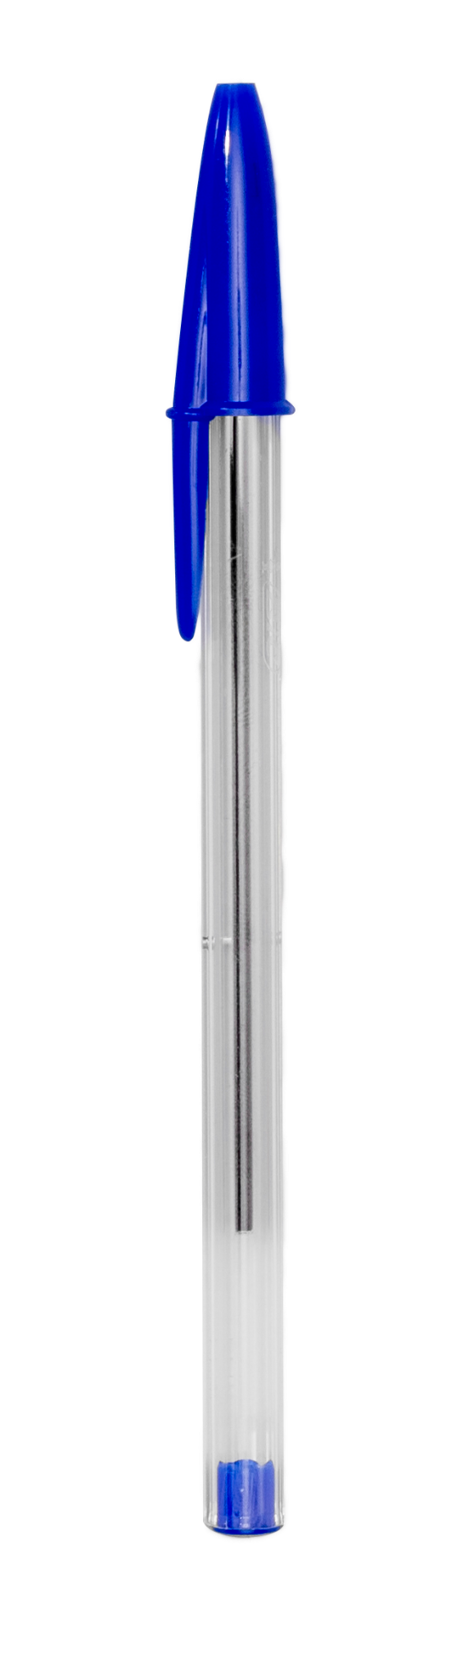
Unit 2
Whats school like?
Listen & Discuss

Slide 2
Classroom rules

Slide 3
What's the date and day of today?

Slide 4
Warm up!
What do you want to be ?
Notes:
Big text and subtitle. You can add graphic resources to the composition (photo or vector)

Slide 5
TABLE OF CONTENTS
01
02
03
list a number of school subjects.
describe subjects.
describe people.

Slide 6


Slide 7









Slide 8
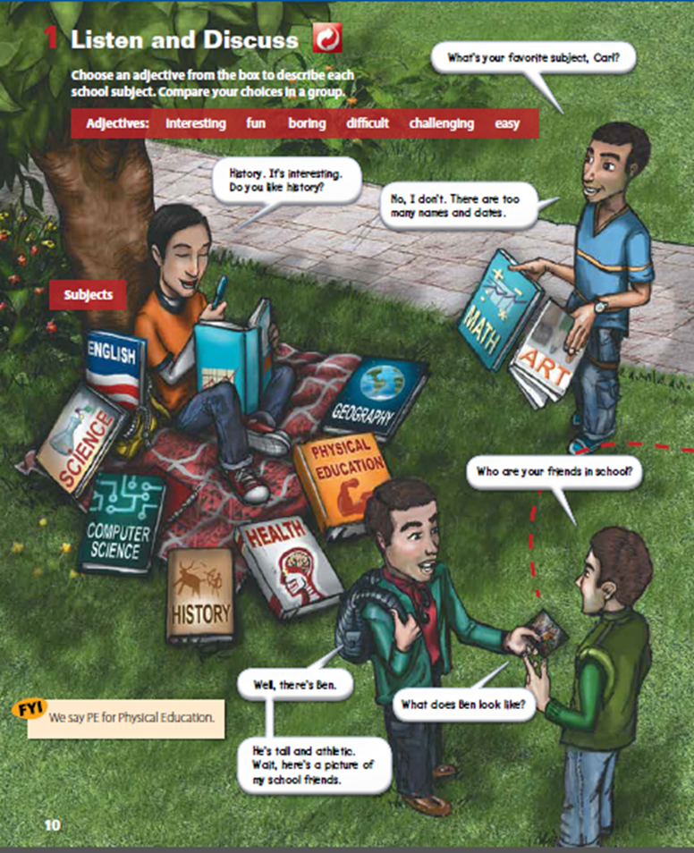
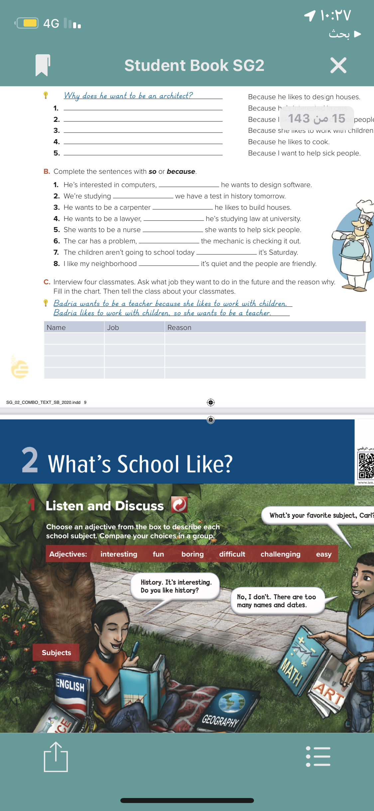
80

Slide 9

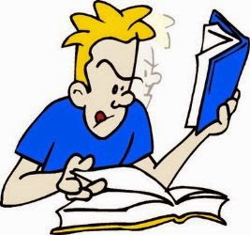
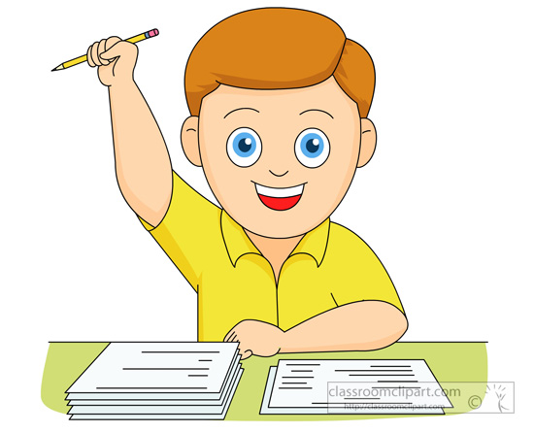
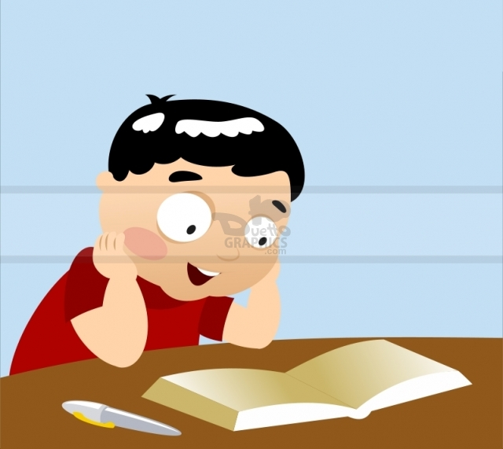
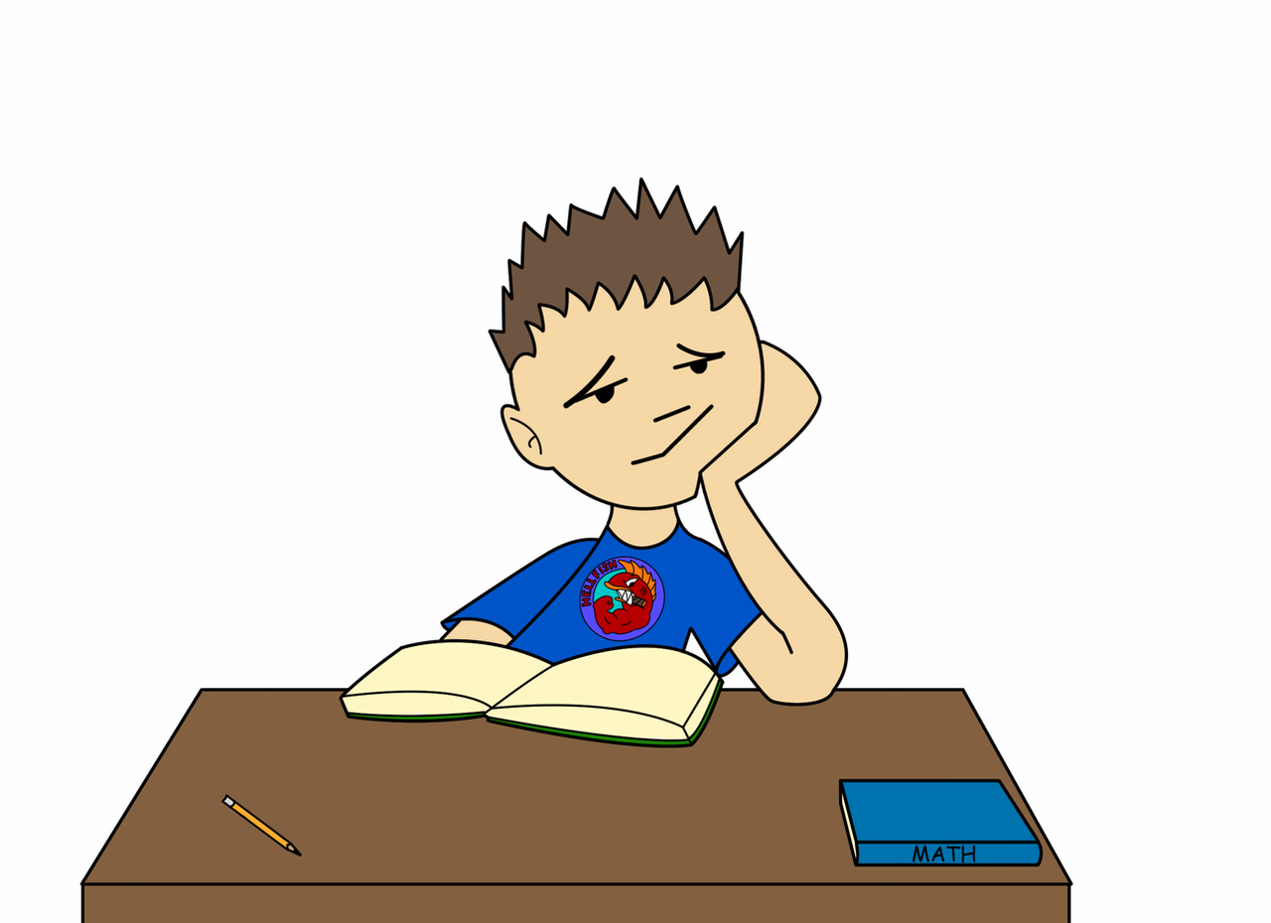
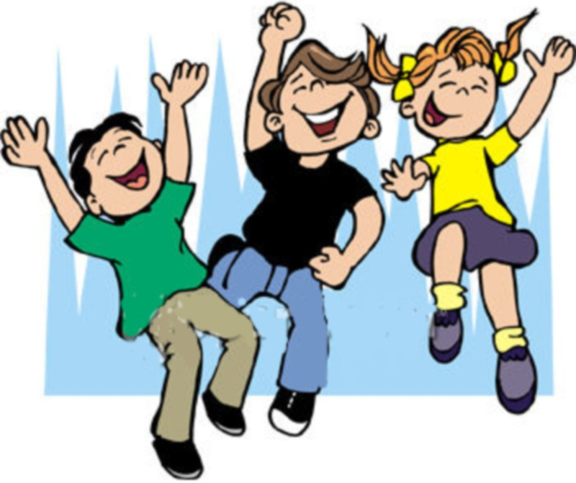

Listen then describe each school subject using the following adjectives.
English-Science- Computer Science – History -Health-
Physical education (PE) –Geography –Math -Art
difficult
easy
interesting
boring
fun
challenging

Slide 10
What is this subject?
It is English.

Slide 11
What is this subject?
It is Arabic .

Slide 12
What is this subject?
It is Math .

Slide 13
What is this subject?
It is Science.

Slide 14
What is this subject?
It is Art.

Slide 15
What is this subject?
It is Computer Science.

Slide 16
What is this subject?
It is Physical Education.
PE

Slide 17


Slide 18
What is your favorite subject?
80

Slide 19
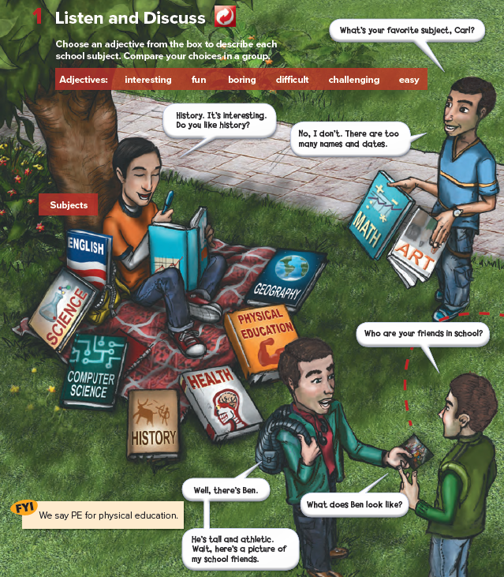
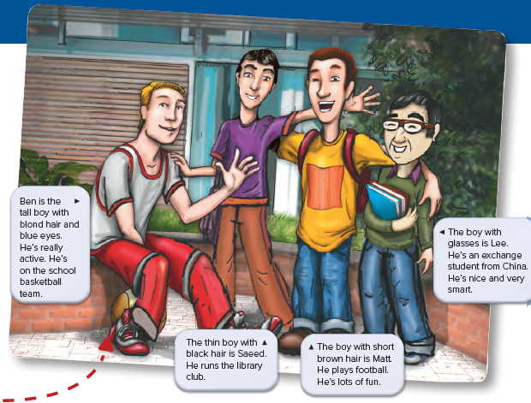
What is Carl doing?

Slide 20
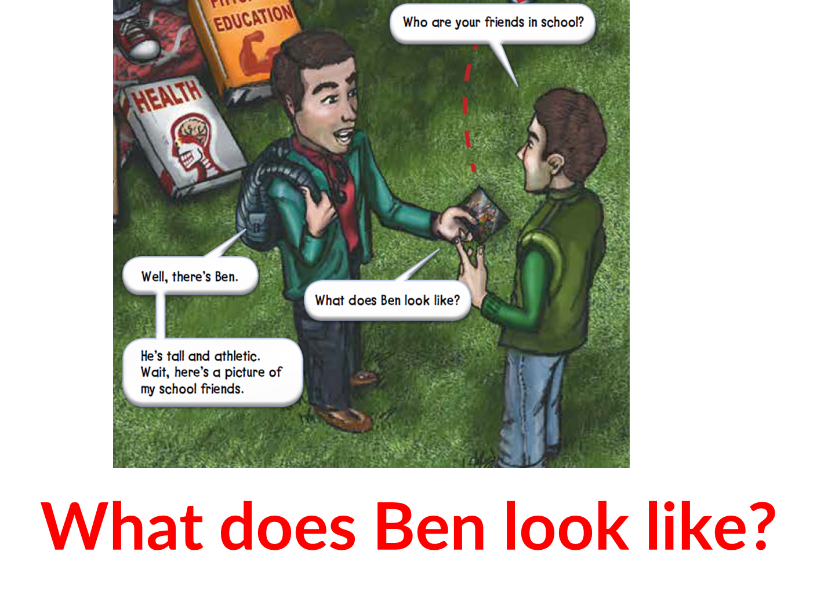
2022 SCHEDULE

Slide 21
2022 SCHEDULE

Slide 22
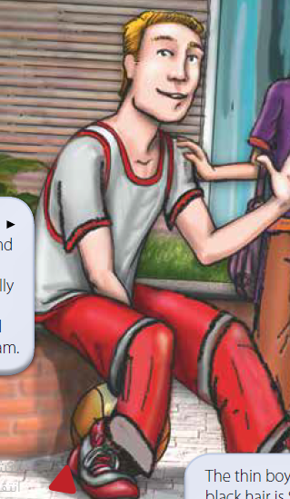
What does he look like?
He is tall.
He has blond hair and blue eyes.
What does he like?
He is active and athletic

Slide 23
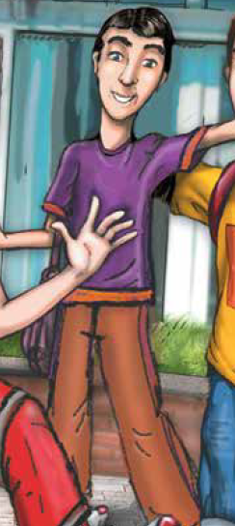
What does he look like?
He is thin .
He has black hair .

Slide 24
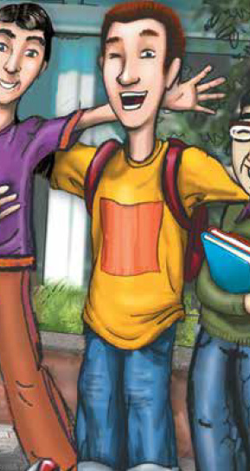
What does he look like?
He has brown hair.
What does he like?
He Is fun .

Slide 25
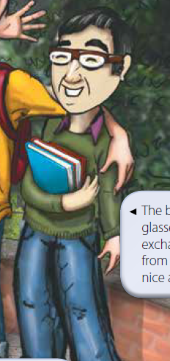
What does he look like?
He wears glasses.
What does he like?
He is an exchange student.

Slide 26
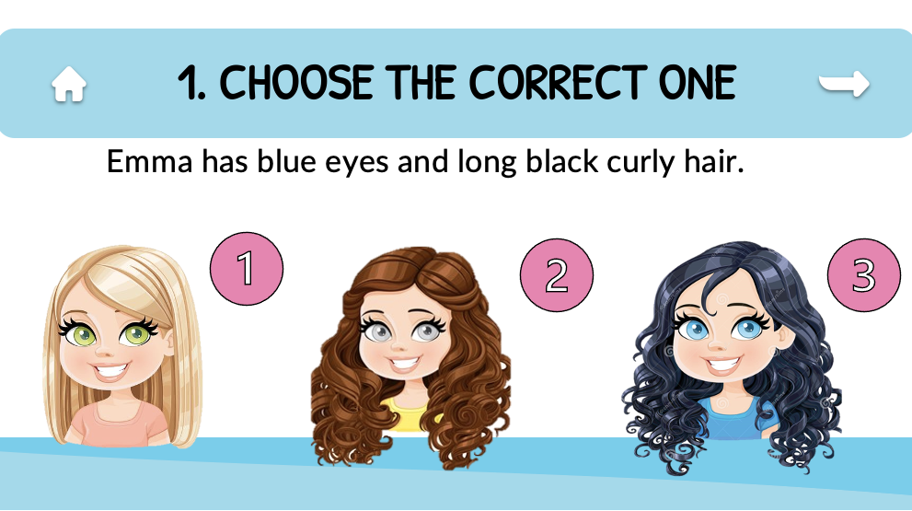

Slide 27
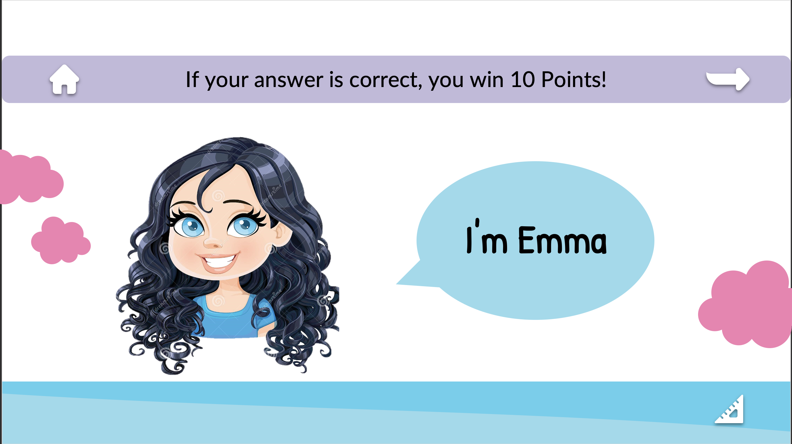

Slide 28
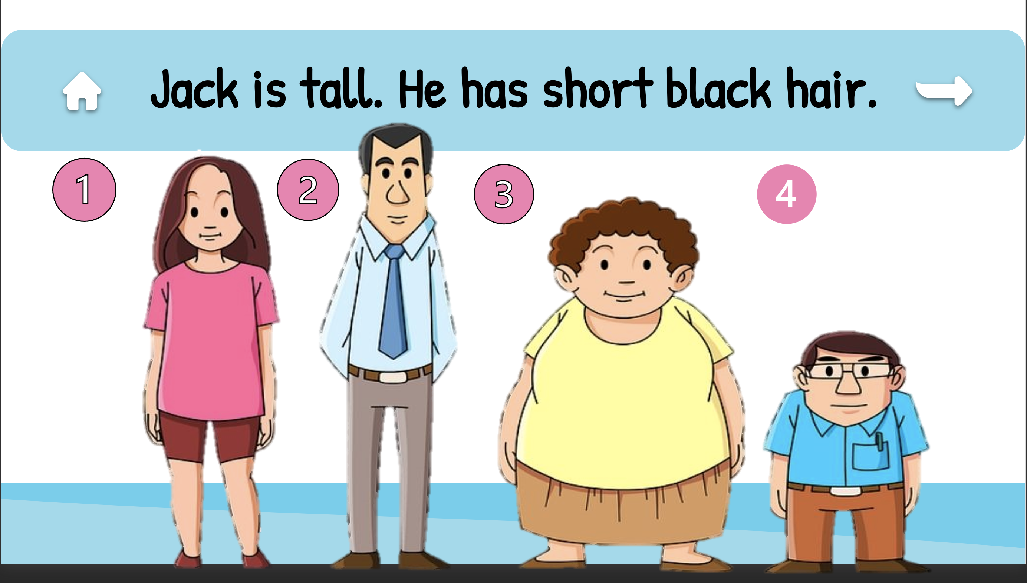

Slide 29
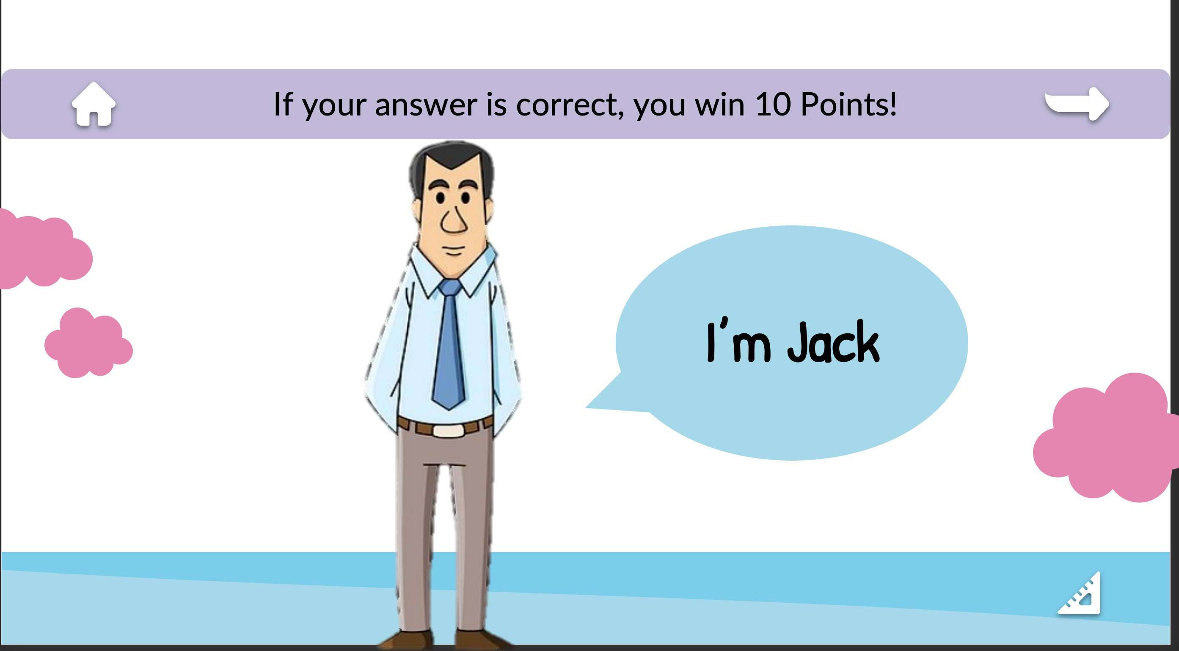

Slide 30



Madrasati web site is one of Saudi achievement in learning during the time of covid 19

Slide 31


Slide 32
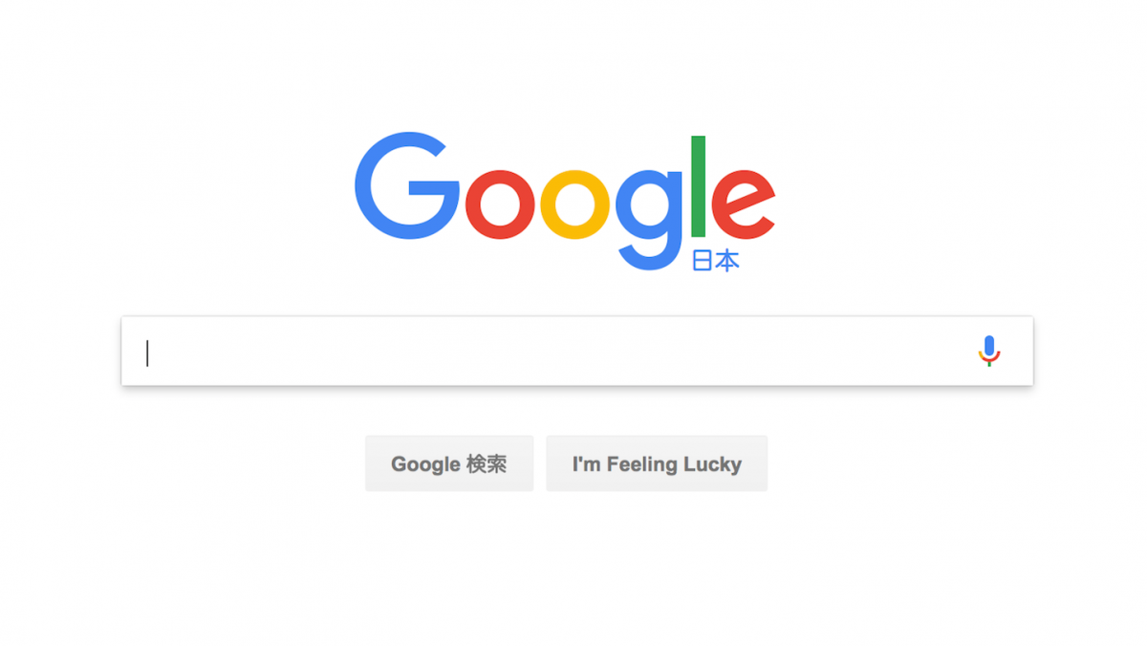
What’s the name of the first school in Saudi Arabia?
Task

Slide 33
Can you describe your friend ?
What does She look like?
What does She like?
She has ( black – brown- blond ) hair.
She has ( black – brown- blond ) eyes.
She is tall
She is short
She has ( short – long ) hair
She has ( curly - straight) hair
Smart .
Active.
Intelligent.
Fun.
Shy.
Selfish.

Slide 34
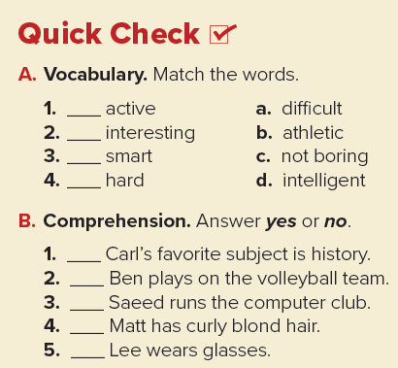
b
c
d
a
yes
no
no
no
yes

Slide 35
Home work
Page ; 93
Notes:
Title and subtitle

Slide 36
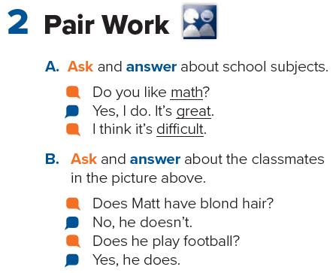

Slide 37
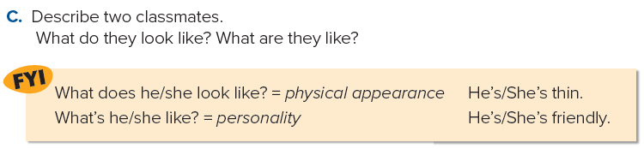

Slide 38
Unit 2
Whats school like?
Grammar

Slide 39
اللهم بك أصبحنا وبك أمسينا وبك نحيا وبك نموت وإليك النشور

Slide 40
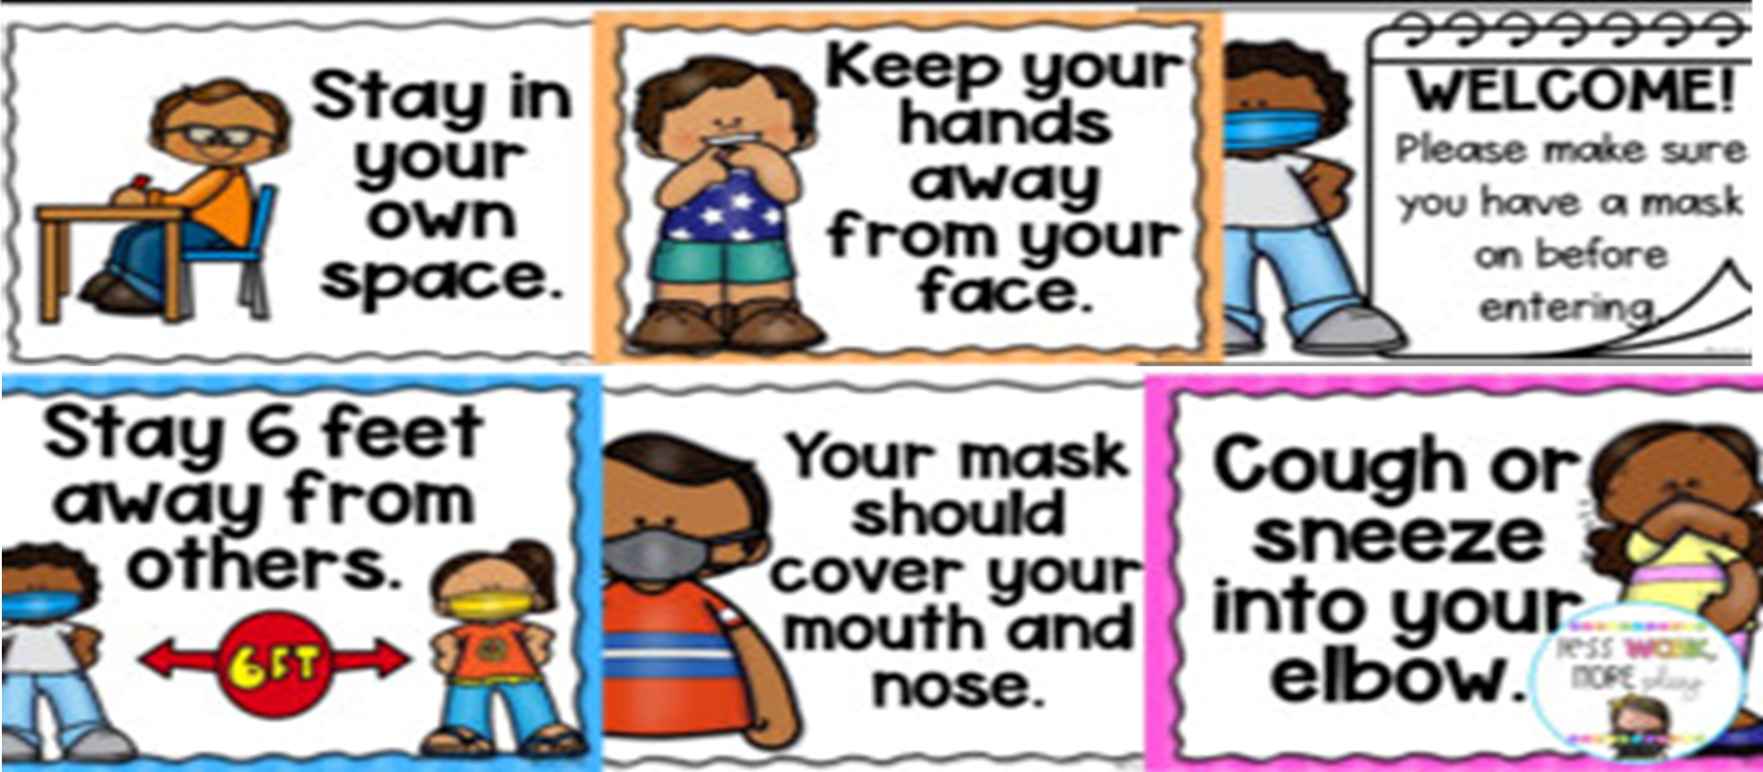
Classroom rules

Slide 41


Slide 42
What's the date and day of today?

Slide 43
Worm up!
What did we took yesterday ?
Notes:
Big text and subtitle. You can add graphic resources to the composition (photo or vector)

Slide 44
TABLE OF CONTENTS
01
02
03
Use present simple in affirmative and negative form and questions.
Use adjectives with noun and verb to be correctly.
Listen for specific details about people.

Slide 45
What do usually do in the evening?
I make dinner
She does her homework
I study / drink water
Notes:
Title and bullet point text

Slide 46


I speak English
I don’t speak English
Notes:
Title and bullet point text

Slide 47
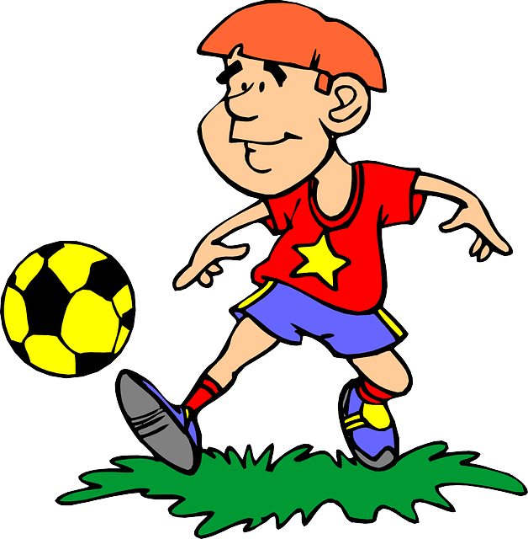
He plays football
He doesn’t play football
Notes:
Title and bullet point text

Slide 48
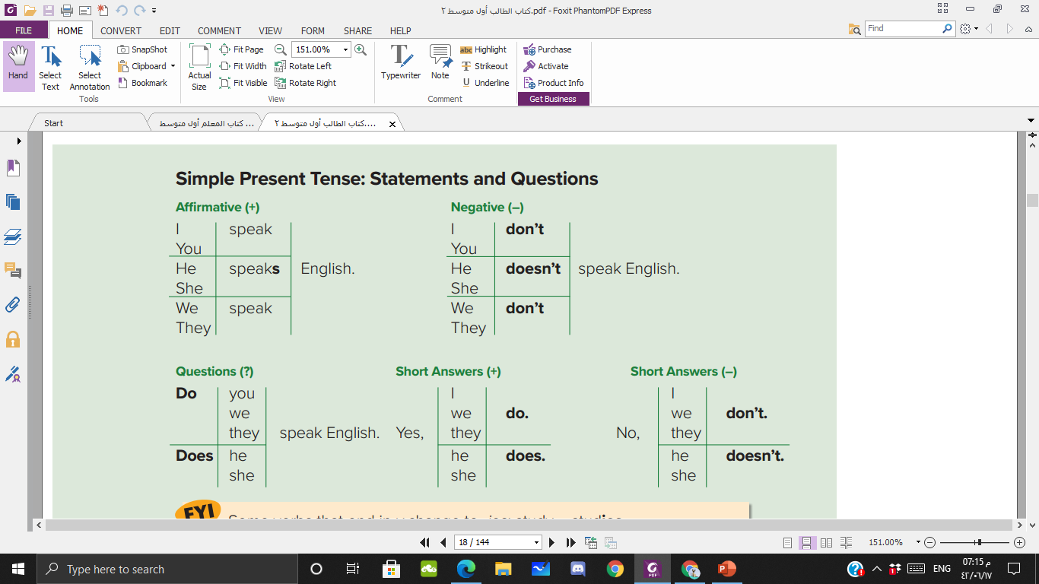
Notes:
Title and bullet point text

Slide 49
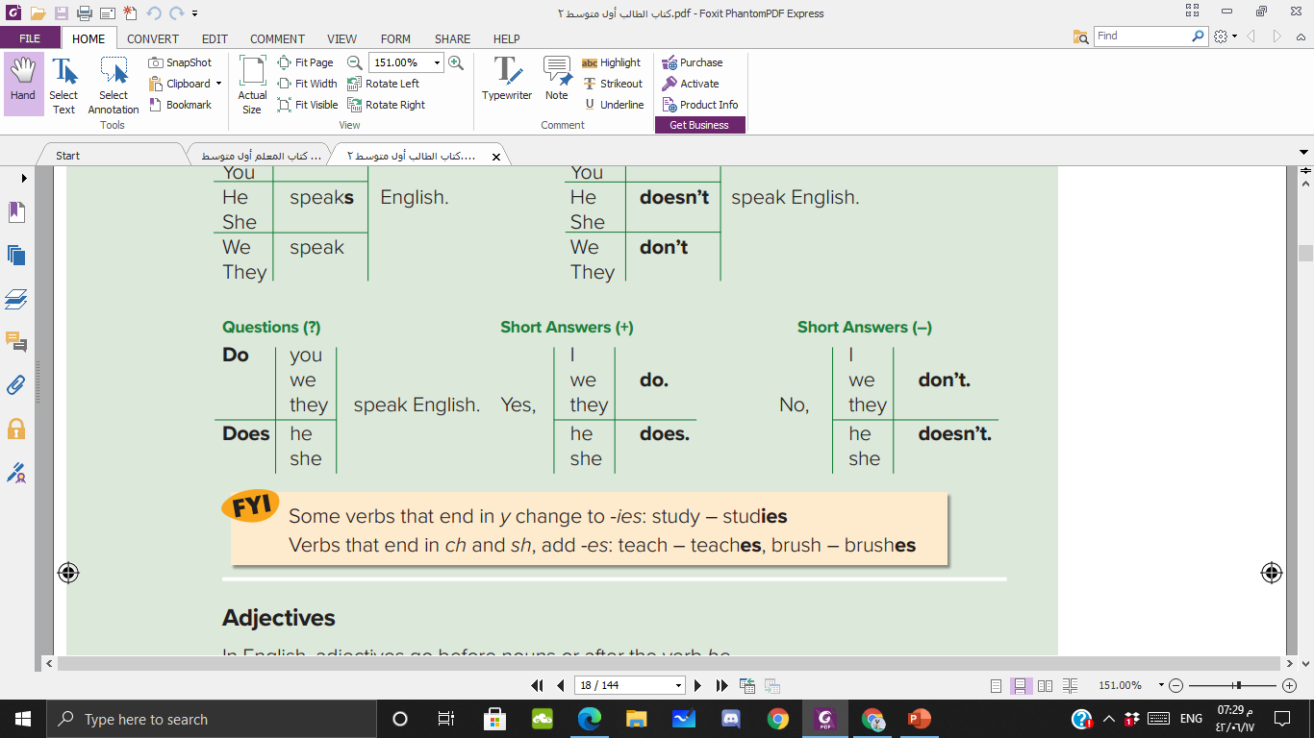
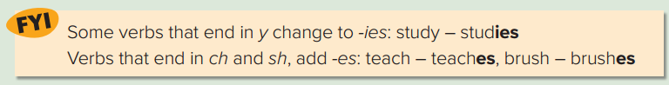
Notes:
Title and bullet point text

Slide 50
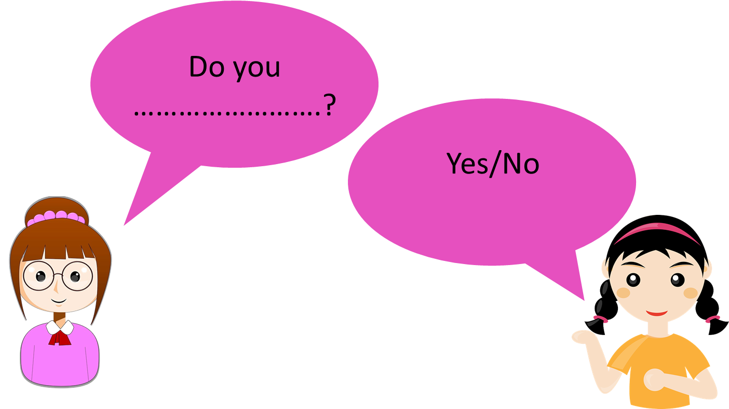
Notes:
Title and bullet point text

Slide 51
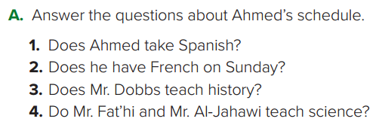
No, he doesn’t.
Yes, he does.
No, he doesn’t.
Yes, they do.
Notes:
Title and bullet point text

Slide 52
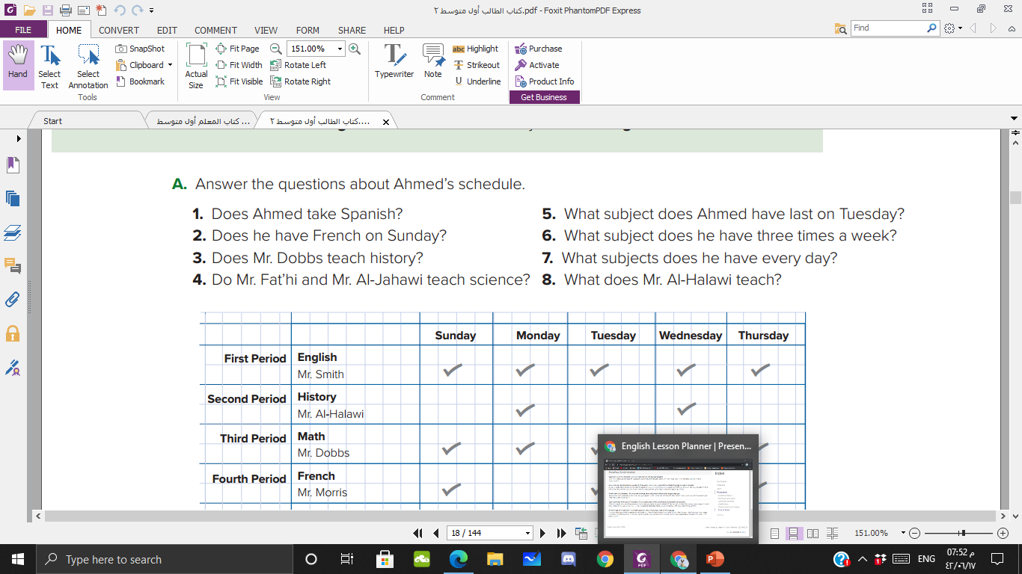

He has science last on Tuesday.
He has French three times a week.
He has English, math and science everyday.
He teaches history.
Notes:
Title and bullet point text

Slide 53

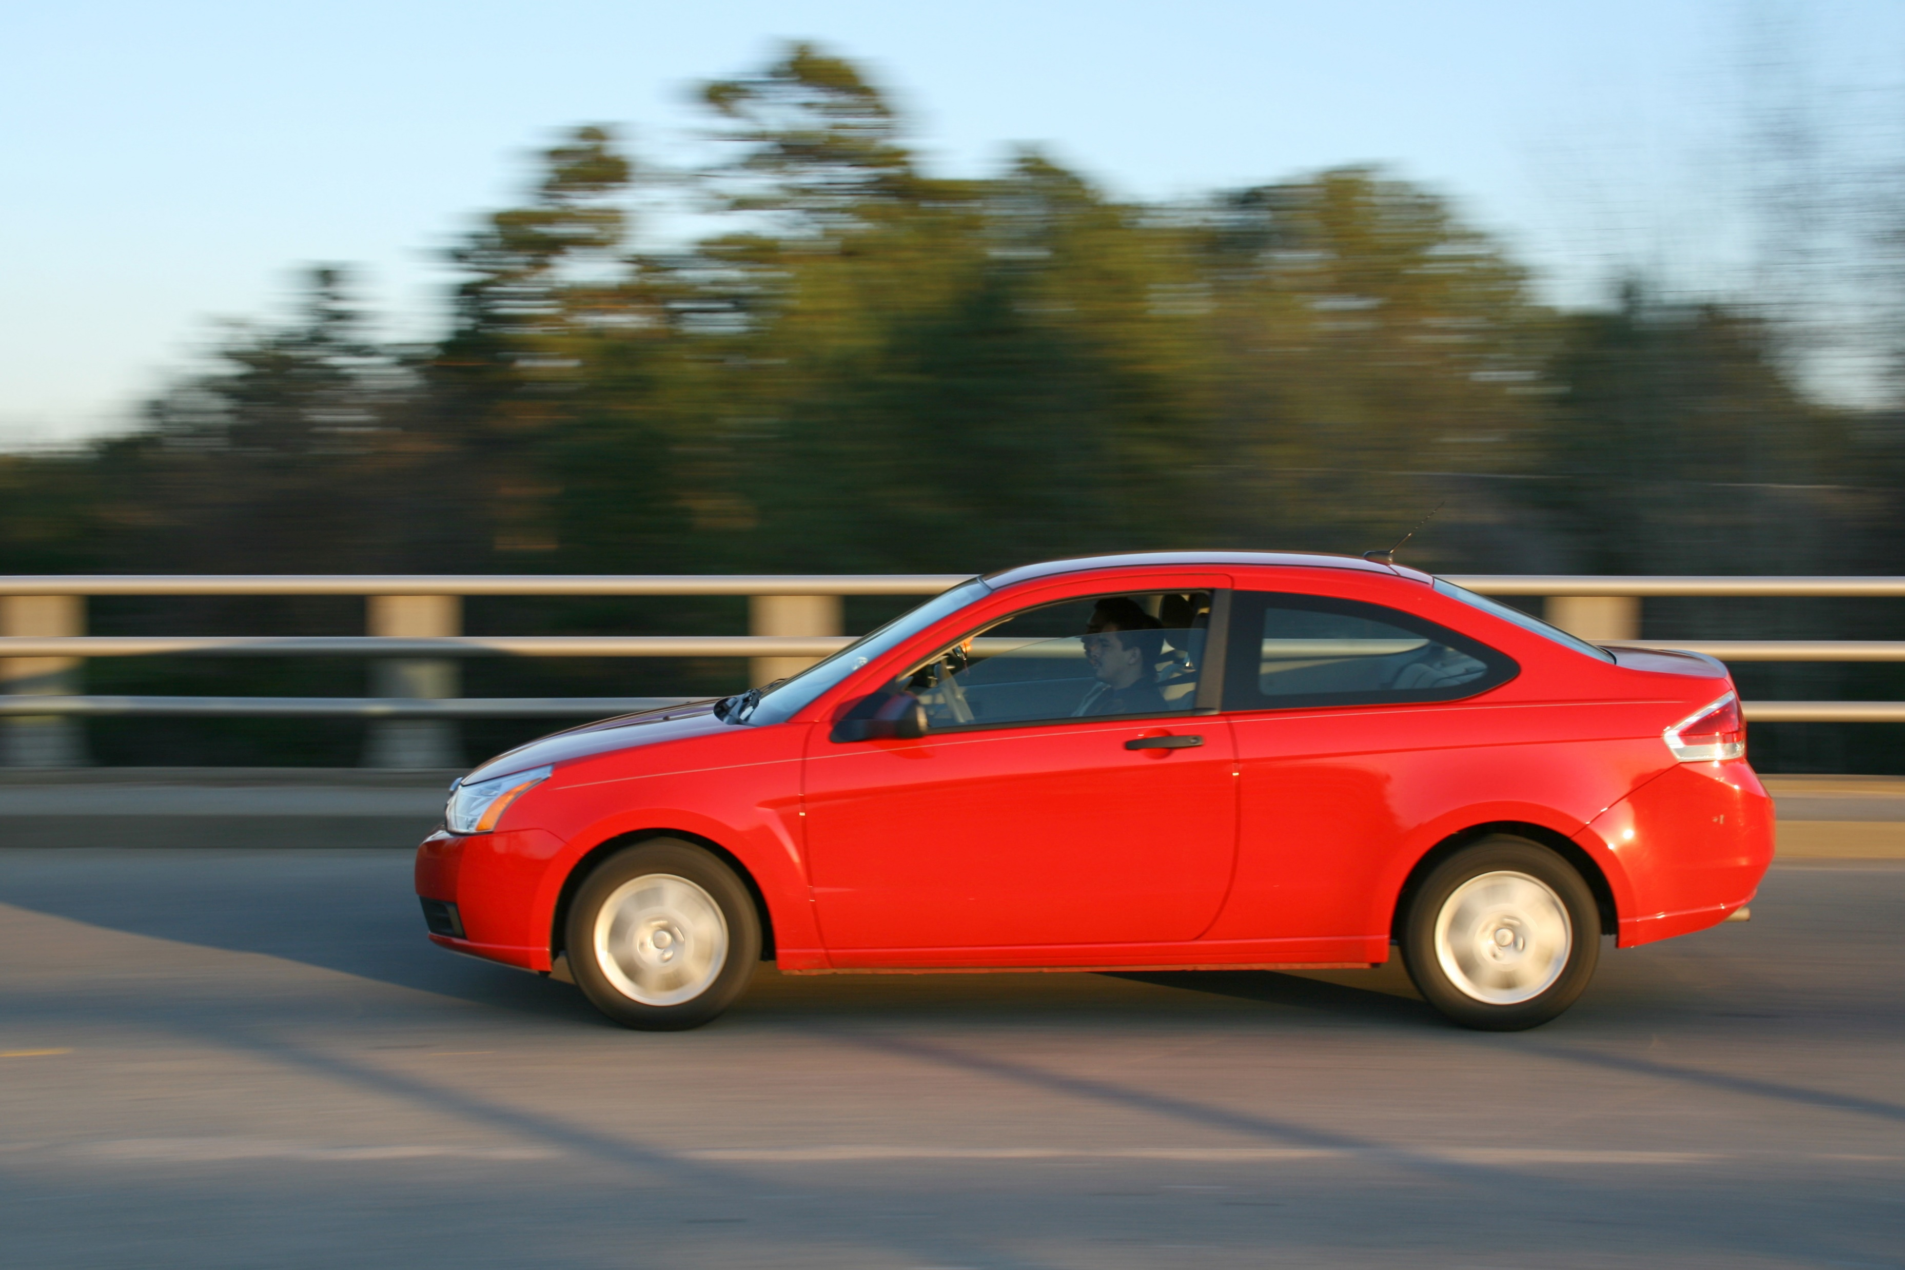
This is a red car
This car is red
Notes:
Title and bullet point text

Slide 54
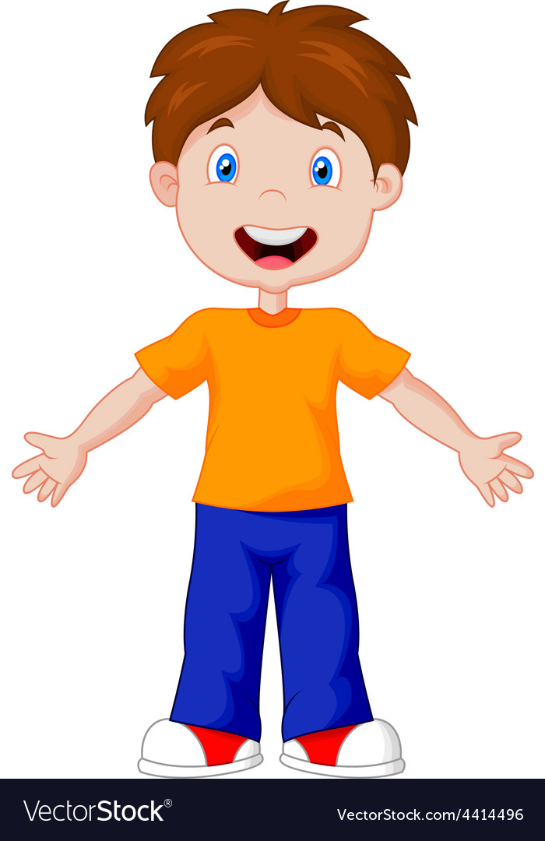
He has a short hair
His hair is short
Notes:
Title and bullet point text

Slide 55
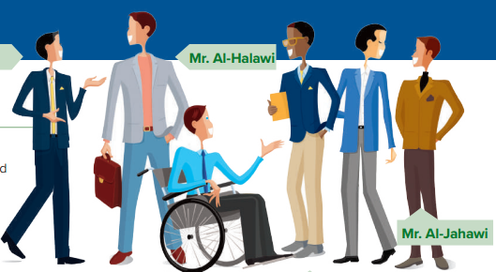
Notes:
Title and bullet point text

Slide 56
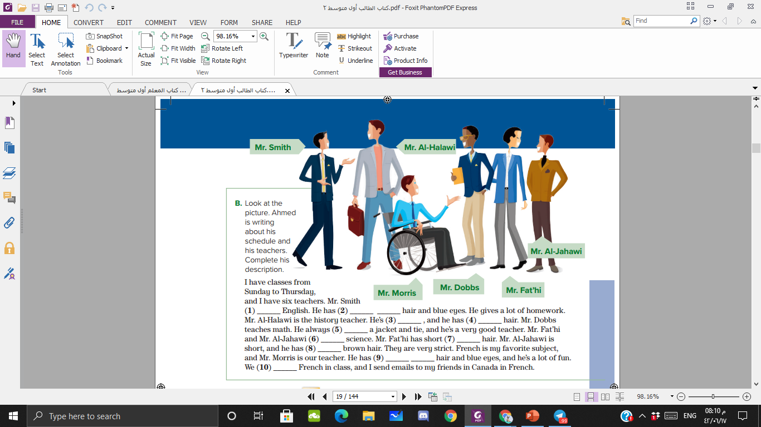
teaches
Short black
tall
brown
wears
teach
black
Short
Short brown
speak
Notes:
Title and bullet point text

Slide 57
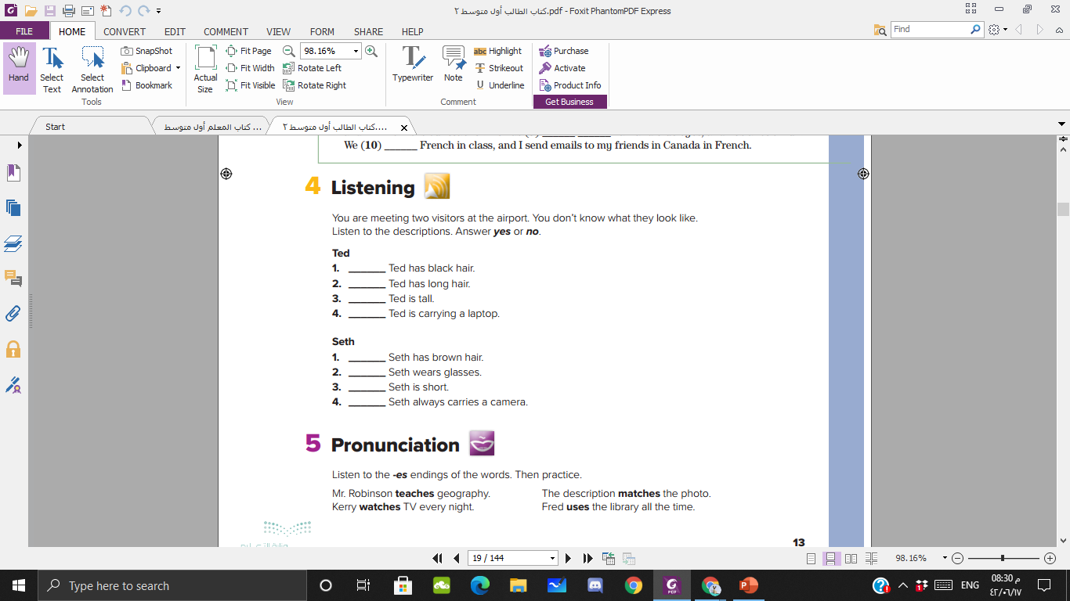

no
no
yes
yes
no
yes
no
yes
Notes:
Title and bullet point text

Slide 58
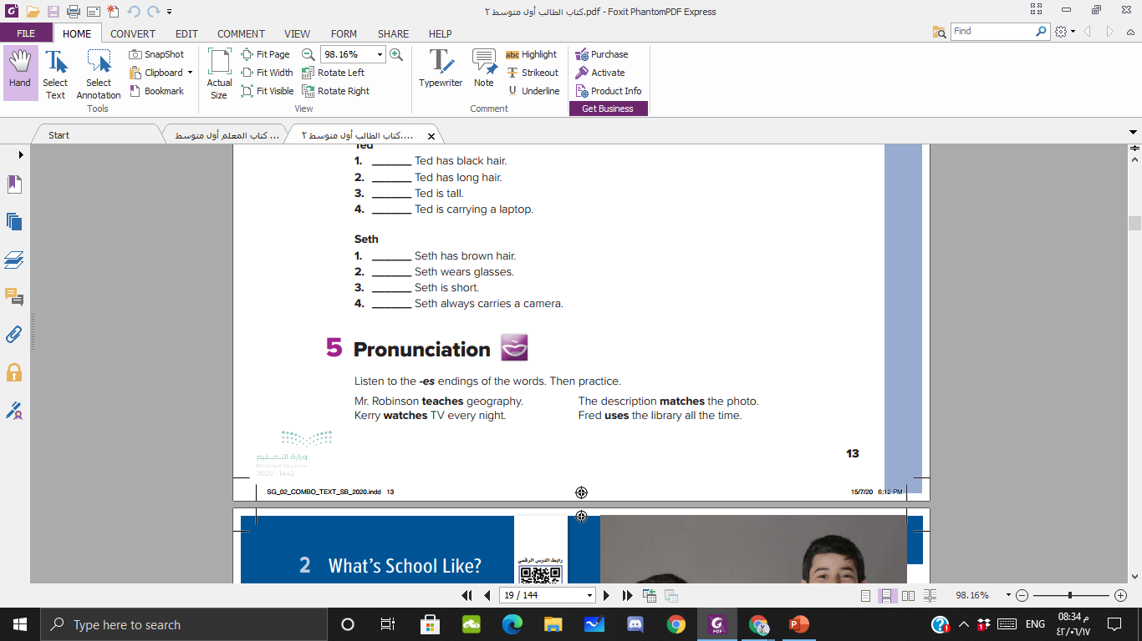
Notes:
Title and bullet point text

Slide 59
Home work
Page ; 94
Notes:
Title and subtitle

Slide 60
Unit 2
Whats school like?
Conversation & Reading

Slide 61
اللهم بك أصبحنا وبك أمسينا وبك نحيا وبك نموت وإليك النشور

Slide 62
Classroom rules

Slide 64
What's the date and day of today?

Slide 65
Worm up!
What is your favorite subject and why?
Notes:
Big text and subtitle. You can add graphic resources to the composition (photo or vector)

Slide 66
TABLE OF CONTENTS
01
02
03
Read a conversation correctly.
Identify the main idea of reading
Answer questions after reading about it

Slide 67

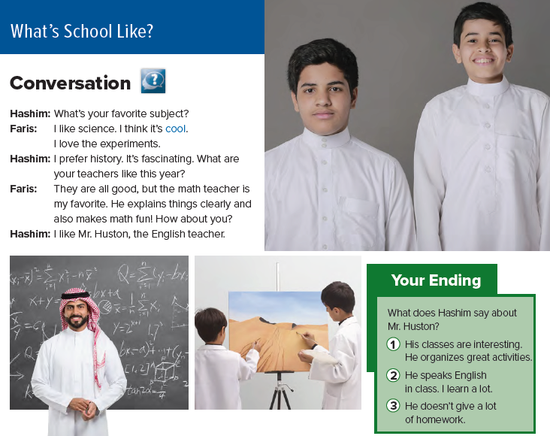

Slide 68
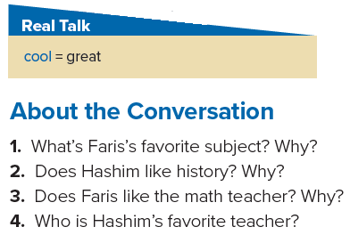
1. Faris’s favorite subject is science. Faris loves the experiments.
2. Yes, he does. He thinks it’s fascinating.
3. Yes, he does. The teacher explains things clearly and also makes math fun.
4. His favorite teacher is Mr. Huston, the English teacher.

Slide 69
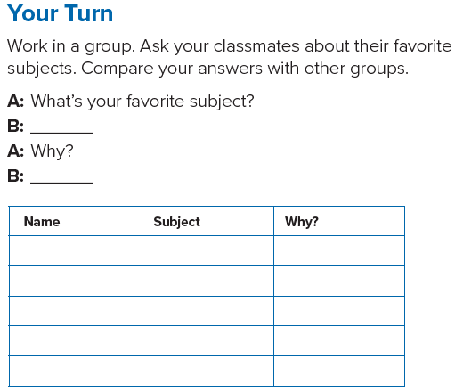

Slide 70
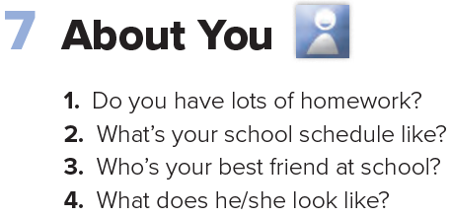

Slide 71



Slide 72
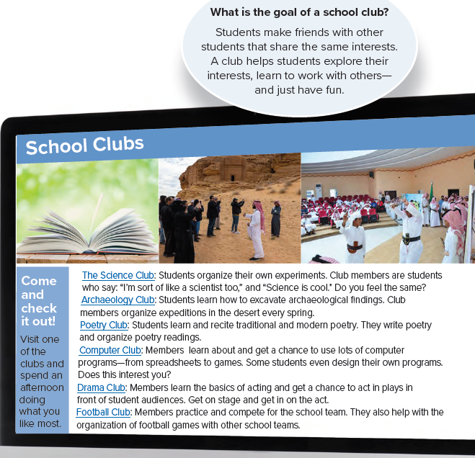

Slide 73
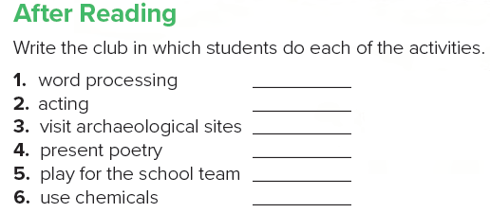
Computer club
Drama club
Archaeology club
Poetry club
Football club
Science club

Slide 74
Home work
Page ; 95
Notes:
Title and subtitle

Slide 75
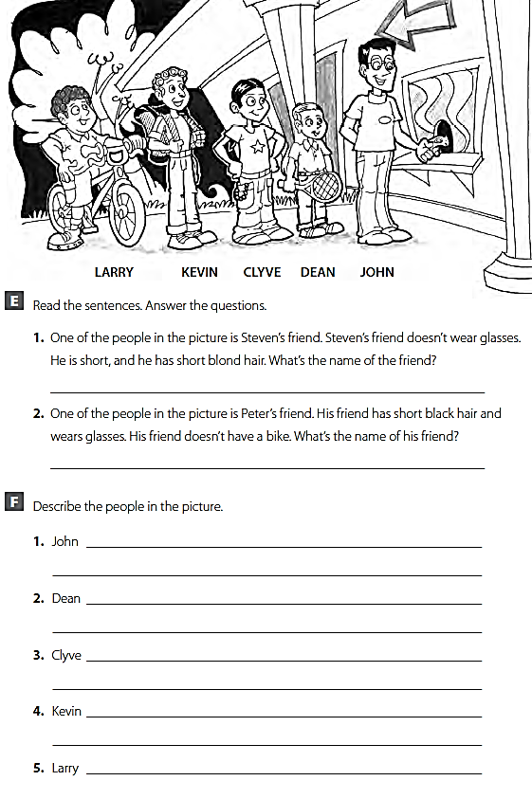
Dean
John

Slide 76
is tall. He wears glasses. He has short black hair.
is short. He has short blond hair. He plays tennis.
is short. He has short black hair.
is tall. He has curly hair. He has a backpack.
has short curly hair. He has a bike.

Slide 77
Unit 2
Whats school like?
Writing

Slide 78
اللهم بك أصبحنا وبك أمسينا وبك نحيا وبك نموت وإليك النشور

Slide 79
Classroom rules

Slide 81
What's the date and day of today?

Slide 82
Worm up!
Can you describe one of your classmates ?
Notes:
Big text and subtitle. You can add graphic resources to the composition (photo or vector)

Slide 83
TABLE OF CONTENTS
01
02
03
Complete a chart about physical appearance
Match questions with answers
Rewrite personal information

Slide 84
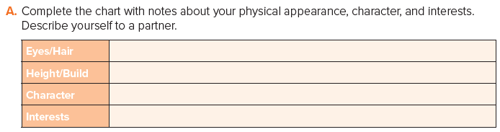
I have brown eyes.
I am 158 cm.
I am quite and friendly.
I am interested in Reading

Slide 85
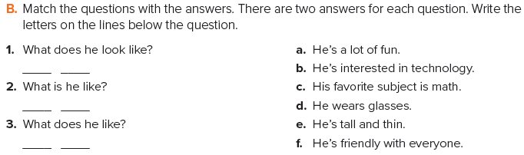
d e
a f
b c

Slide 86
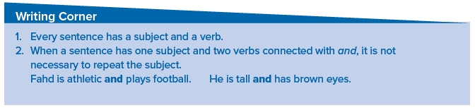

Slide 87
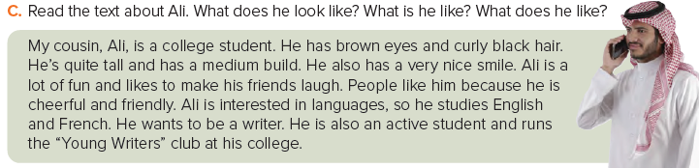
Appearance:
brown eyes; curly black hair; quite tall; medium build; nice smile
Character:
a lot of fun; makes his friends laugh; cheerful and friendly; active student
Interests:
languages: English, French; writing; runs the “Young Writers” club

Slide 88



Slide 89
Home work
Page ; 96 (G)
Notes:
Title and subtitle

Slide 90
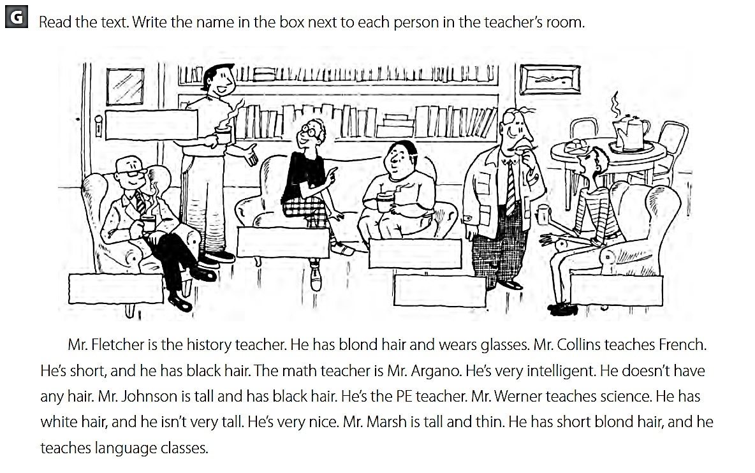
Mr. Johnson
Mr. Fletcher
Mr. Collins
Mr.Argano
Mr. Werner
Mr. Marsh

Slide 91
Unit 2
Whats school like?
Form, meaning & Functions

Slide 92
اللهم بك أصبحنا وبك أمسينا وبك نحيا وبك نموت وإليك النشور

Slide 93
Classroom rules

Slide 95
What's the date and day of today?

Slide 96
Worm up!
How do you feel?
Notes:
Big text and subtitle. You can add graphic resources to the composition (photo or vector)

Slide 97
TABLE OF CONTENTS
01
02
03
Differentiate between adjectives according to their endings
Use the correct adjective
Form meaningful sentences correctly

Slide 98
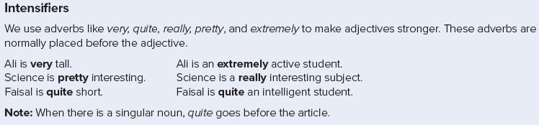

Slide 100


Slide 101


Slide 102

Math is quite a difficult subject.
Maha is a really talented artist.
Fahd is an extremely athletic student.
History is a pretty interesting subject.
Mr. Parks is quite a strict teacher.

Slide 103
For example :
math is an extremely difficult subject.
Ahmed is a really intelligent student.
It is very delicious meal.

Slide 104
Home work
Page ; 96 (H)
Notes:
Title and subtitle

Slide 105

Hi Sam, School is fun. I’m taking
Hi Sam, I study a lot of subjects in my school , like
math, English, history, computer science, physical
education, and art. My favorite subject is art . My
teachers are Mr. Omar, Mr. Ali, Mr. Fahad, Mr. Sami,
Mr. Hassan, and Mr. Nasser. I’m the team captain in my
school football team . It’s great ! I’m also in the Science Club .

