Slide 1
Super Goal 2

Slide 2
Unit 1

Slide 3
The objectives of the lesson :
At the end of this session, the students will be able to :
- complete a chart from listening material
- Answer questions from a conversation
- Hold a classroom discussion about what one wants to be in the future

Slide 4
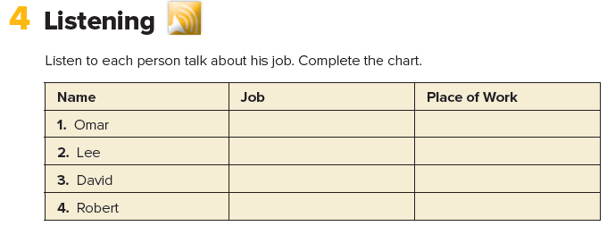
chef restaurant
salesperson store
teacher school
doctor hospital

Slide 5
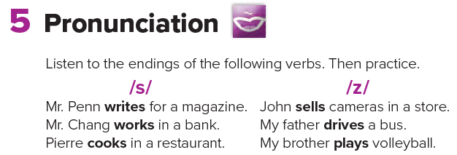

Slide 6
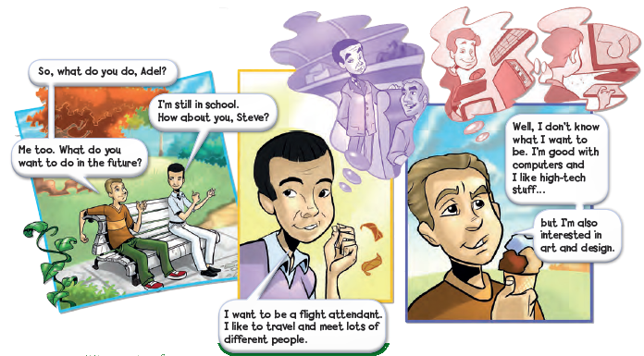
Where are the people?
What are their names?

Slide 8
Where does a flight attendant work?
What does a flight attendant do ?

Slide 9
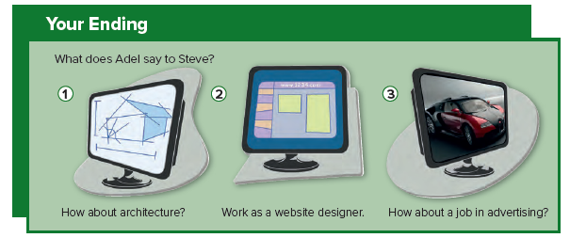
Who likes ending number 1 ?
Who likes ending number 2?
Who likes ending number 3?
Remember there is no right or wrong answer to this.

Slide 10
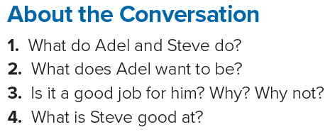
1. Adel and Steve are students.
2. He wants to be a flight attendant.
3. Yes, it is. He likes to travel and meet lots of different people.
4. Steve is good with computers.

