Slide 1
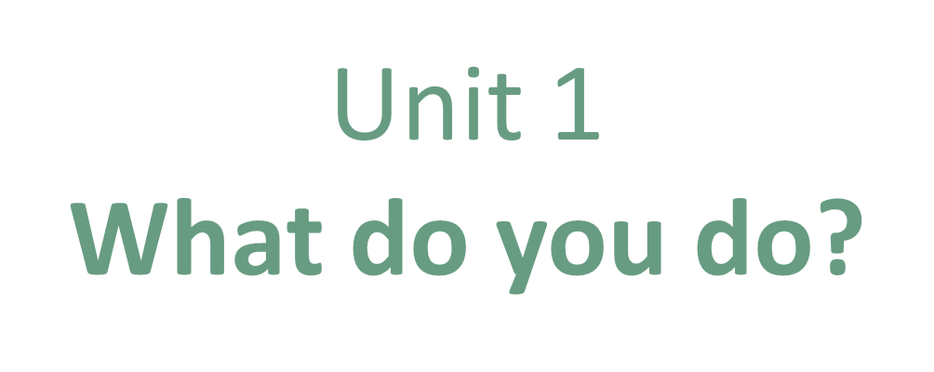
Form, ,Meaning & Function

Slide 2
COVID 19
☺ Avoid gathering !
☺ wear a mask before going out
☺ Social distancing is not a choice, it is a must!
☺ Keep a distance of 2 meters to avoid accountability
☺ Wash hands constantly

Slide 3
Day
بسم الله الرحمن الرحيم
Date

Slide 4
LEARNING OBECTIVES
01 Ask about reasons correctly
02 use conjunctions correctly.
03 match questions with answers correctly
04 interview classmates correctly

Slide 6
Practice

Slide 8
Practice

Slide 9
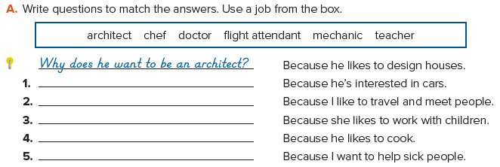
Why does he want to be a mechanic?
Why do you want to be a flight attendant?
Why does she want to be a teacher?
Why does he want to be a chef?
Why do you want to be a doctor?

Slide 10
so
because
because
so
because
so
because
because

Slide 11
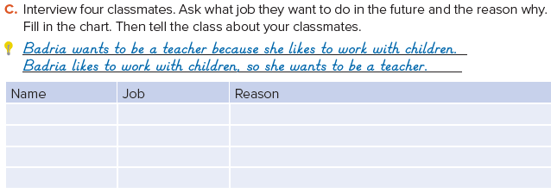

Slide 12
Homework
Page 92 F

Slide 13
