Slide 2
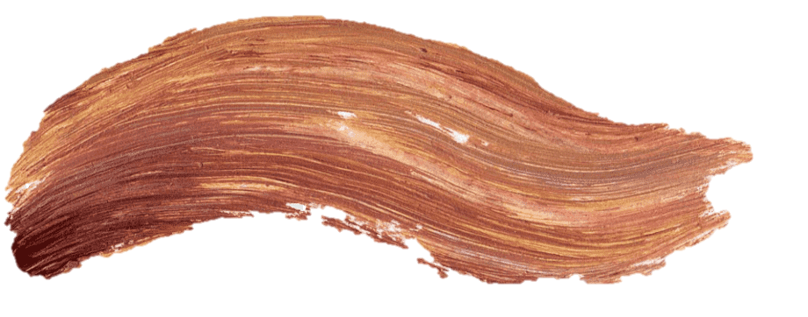
U10 : What’s School Like?
Conversation
Page: 84

Slide 3
Lesson Objectives:
1
Read the conversation correctly
2
Use the "real talk" phrases in new sentences

Slide 4
What’s your favorite subject?

Slide 6
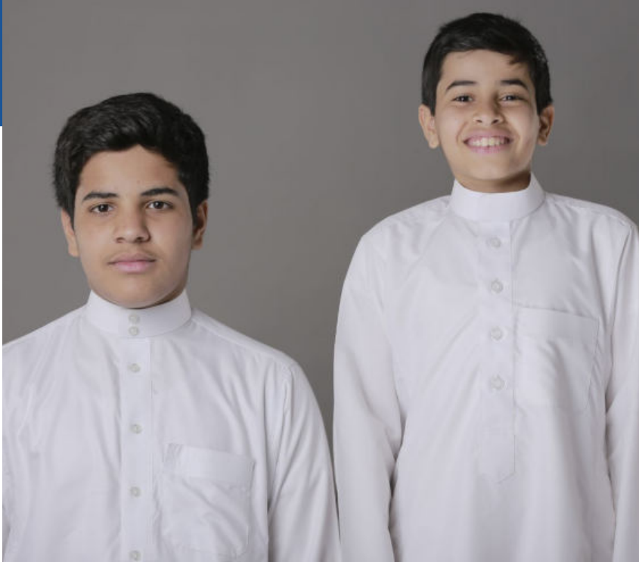

Slide 7
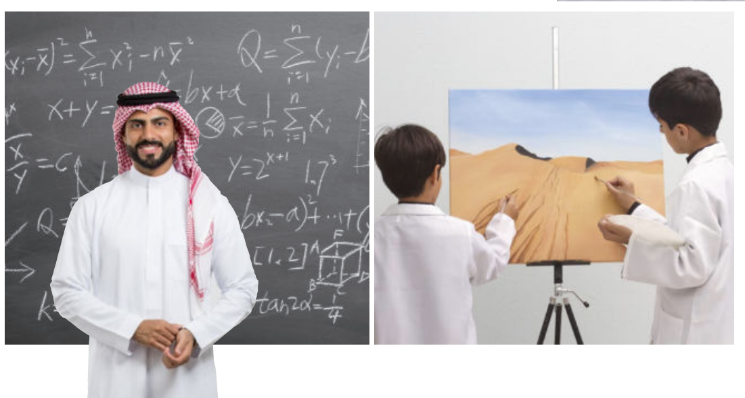

Slide 8
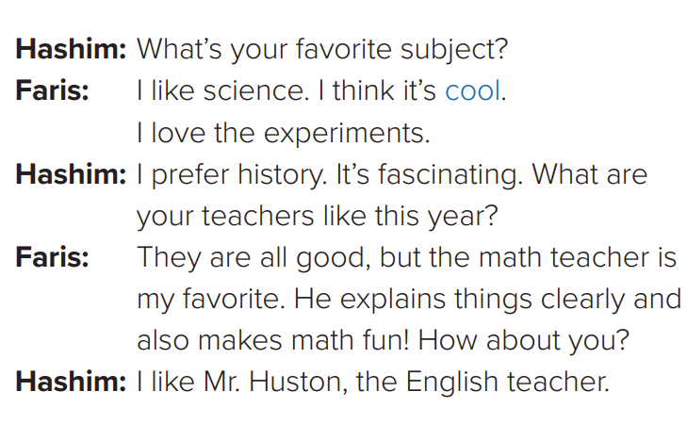

Slide 9
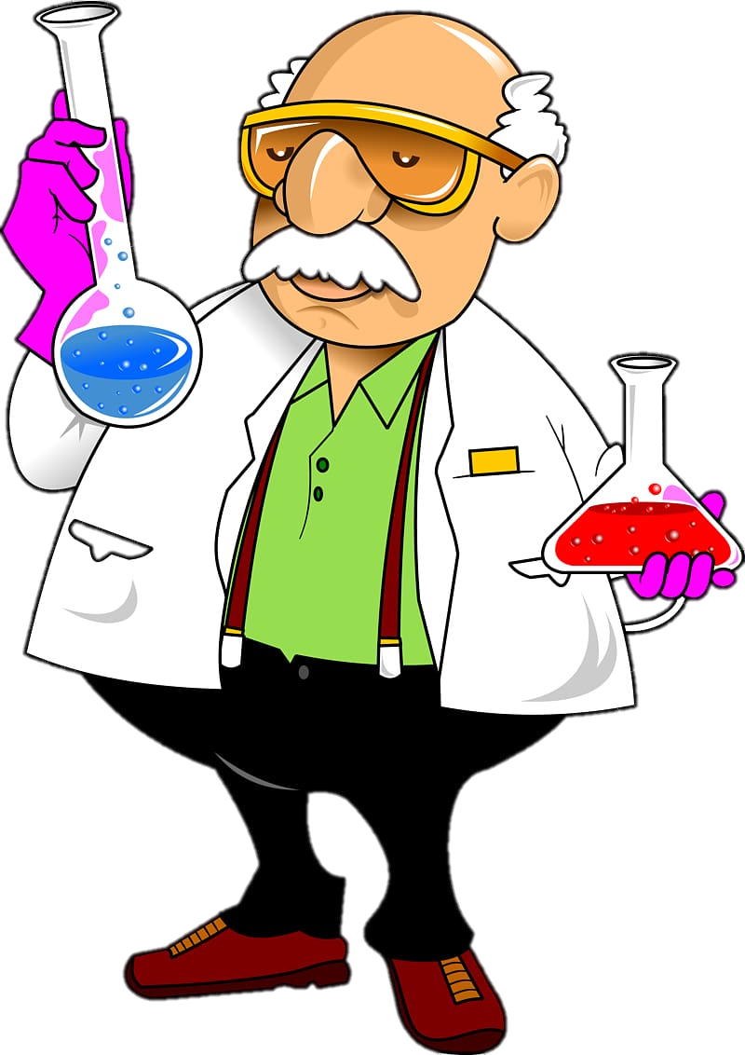
experiments

Slide 10
What does Hashim say about Mr. Huston

Slide 11
cool = great

Slide 12
About the Conversation:
What’s Faris’s favorite subject? Why?
Does Hashim like history? Why?
Faris’s favorite subject is science.
Faris loves the experiments.
Yes, he does. He thinks it’s fascinating

Slide 13
About the Conversation:
Does Faris like the math teacher? Why?
Who is Hashim’s favorite teacher?
No, he doesn’t.
His favorite teacher is Mr. Huston, the English teacher

Slide 14
WorkBook 227

Slide 15
عبير العنزي

