Slide 1


Slide 2
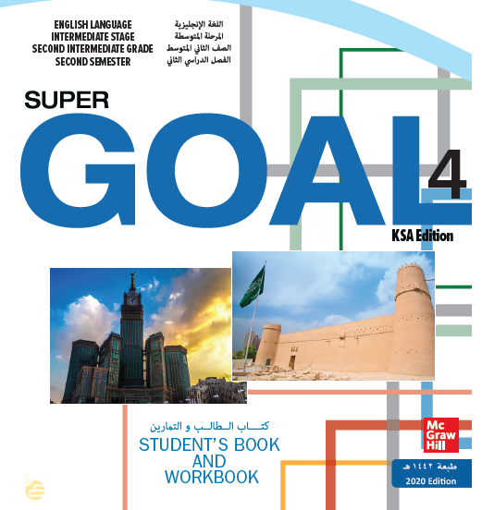

Slide 3


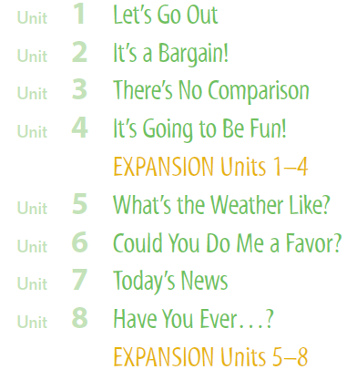

Slide 4

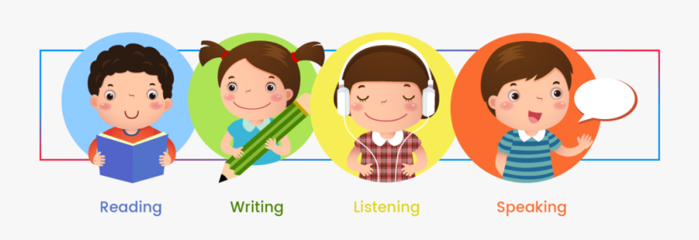

Slide 5
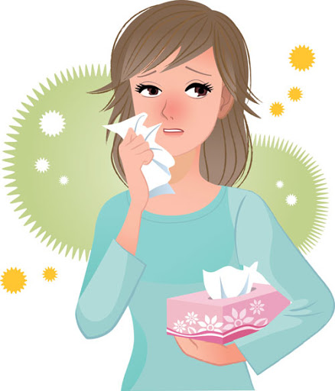
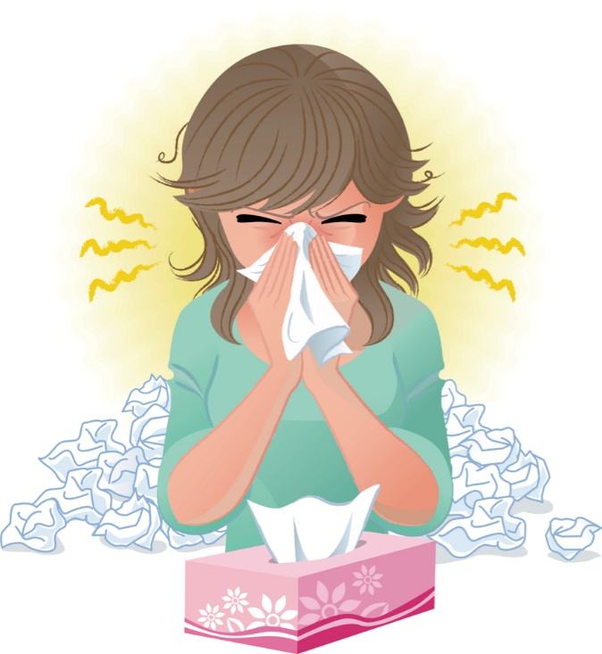

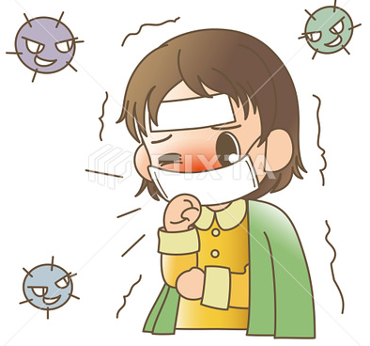
Covid 19
☺Avoid gathering !
☺We must wear a mask before
going out.
☺Social distancing is not a
choice, it is a must!
☺Keep a distance of 2 meters
to avoid accountability
☺wash hands constantly.

Slide 6


Slide 7
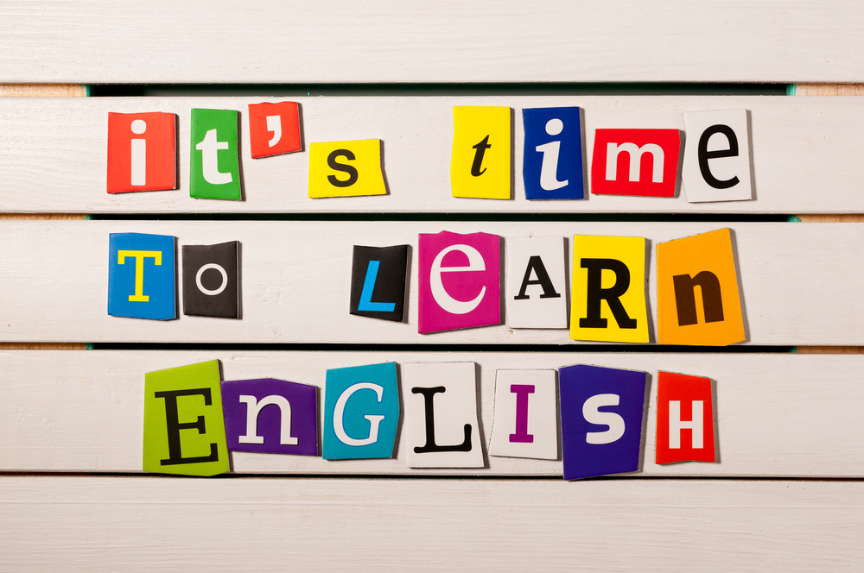

Slide 8
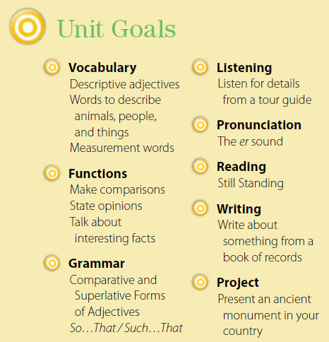

Slide 9





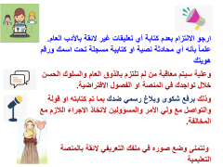
Today: Tuesday
Date:
9-4-1442 H
November 24th \ 2020
everyone,
How is everything going?

Slide 10




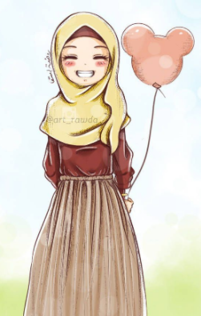
ارجو الالتزام بعدم كتابة أي تعليقات غير لائقة بالأدب العام. علماً بأنه أي محادثة نصية او كتابية مسجلة تحت اسمك ورقم هويتك
وعلية سيتم معاقبة من لم تلتزم بالذوق العام والسلوك الحسن خلال تواجدك في المنصة او الفصول الافتراضية.
وذلك برفع شكوى وبلاغ رسمي ضدك بما تم كتابته او قولة والتواصل مع ولي الأمر والمسؤولين لاتخاذ الاجراء اللازم مع المخالفة.
ونتمنى وضع صوره في ملفك التعريفي لائقة بالمنصة التعليمية

Slide 11
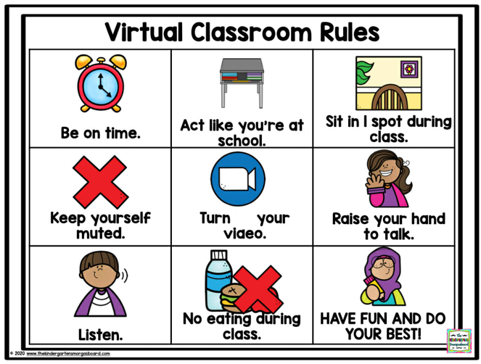
off

Slide 12




☺
♥
Give amazing facts around the world
Judge the given information
..

Slide 13

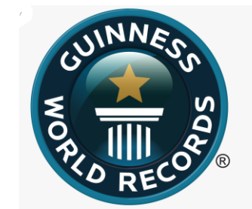

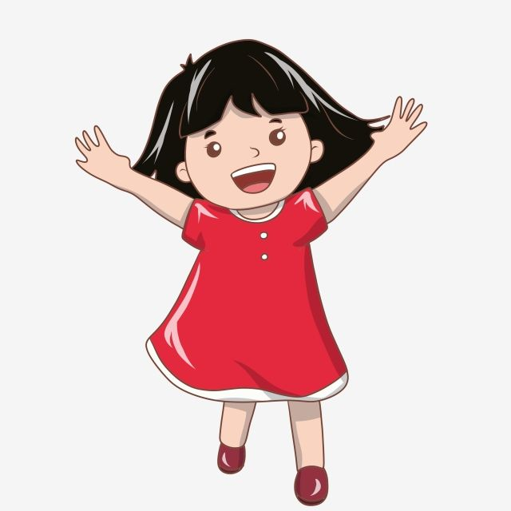

The names of a variety of record holders from the natural world and from the human world
Mount Everest,
the Nile,
Russia,
Burj Khalifa,
Usain Bolt
(They are all world record holders.)

Slide 14
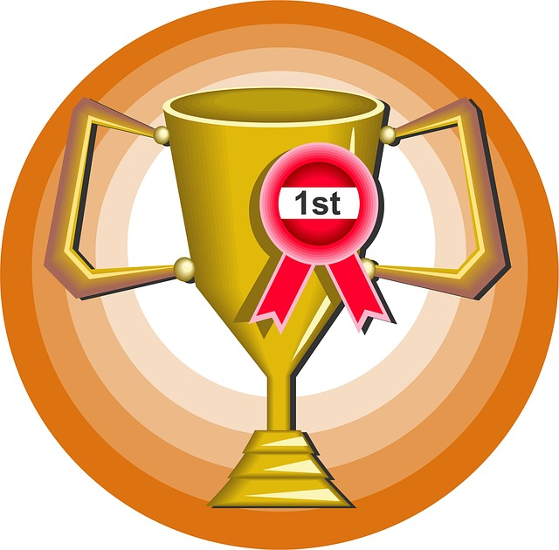
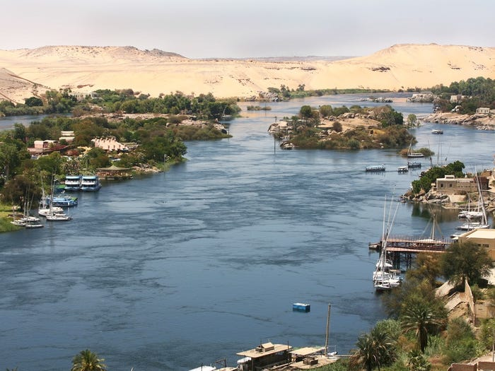

The Nile River is 4,160 miles long,
earning it the title of the world's longest river.

Slide 15
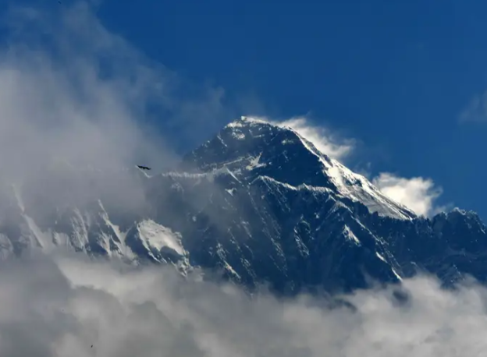
Asia is also home to the highest mountain in the world, Mount Everest.

Slide 16
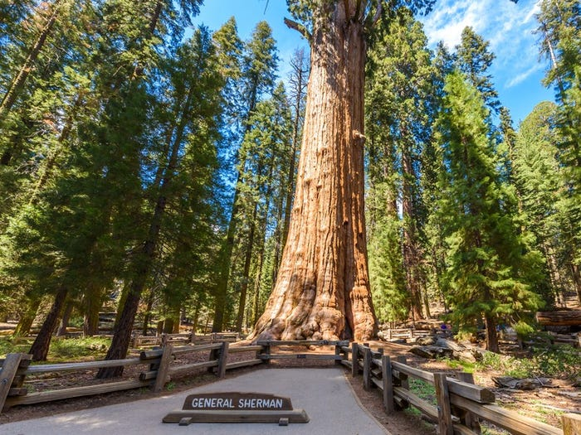
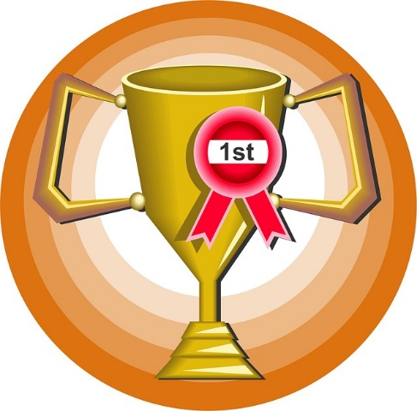
The General Sherman Tree, found in Sequoia National Park, holds the record for the world's largest tree.

Slide 17
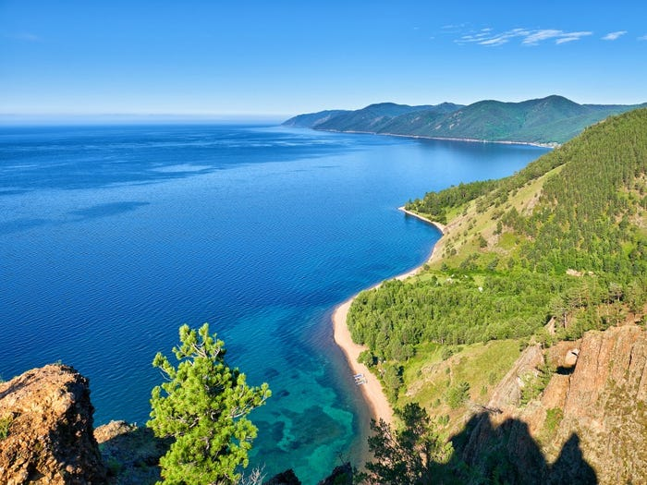

Another enormous, record-holding body of water is Lake Baikal in Russia,
which is the world's largest and deepest lake.

Slide 18
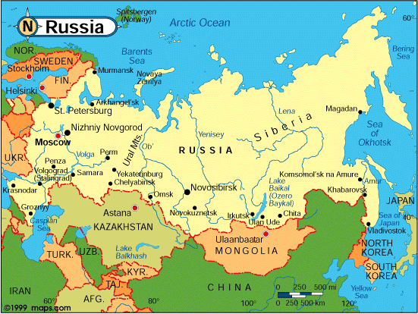
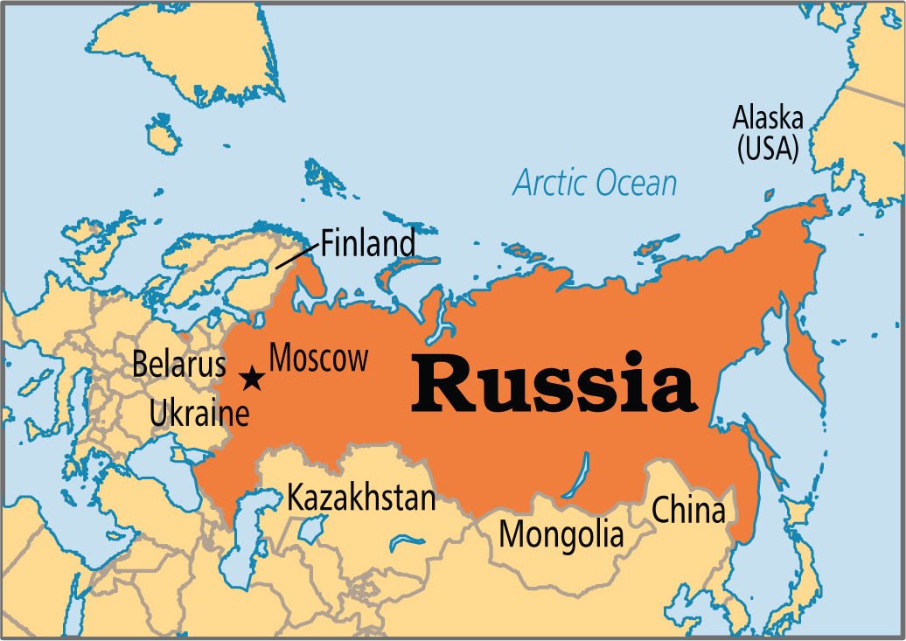
Russia is the largest country in the world.

Slide 19
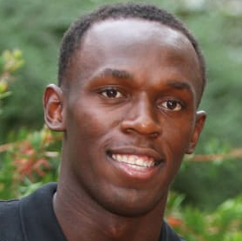
Usain Bolt
Jamaica's Usain Bolt is an Olympic legend
who has been called "the fastest man alive"
for smashing world records and winning multiple
gold medals at the 2008, 2012 and 2016
Summer Games.

Slide 20
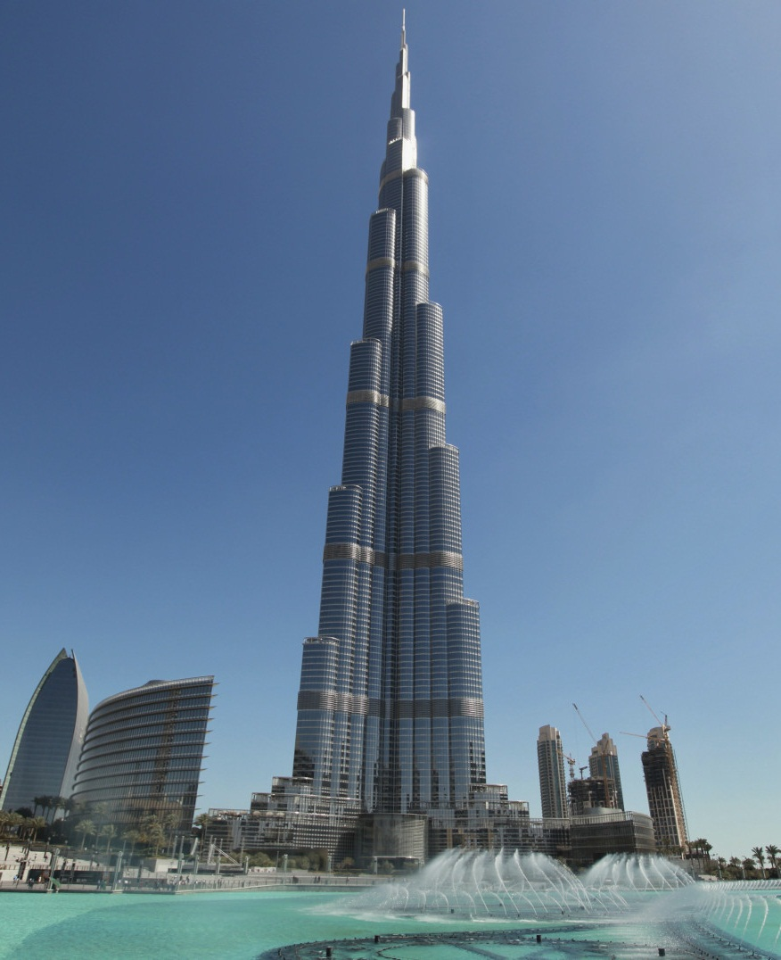
Burj Khalifa the World's Top 10 Tallest Buildings.

Slide 21





Leader Name: __________ Group No. (___)
Anticipation guide
Read
Before Reading |  | Statement | After Reading
Agree | Disagree |  | Agree | Disagree
 |  | The Burj Al Arab Hotel in Oman.
 |  | Football is the most popular international team sport.
 |  | The Arabian Oryx can dive.
 |  | Sharks can smell a tiny drop of blood from miles away.

Slide 22

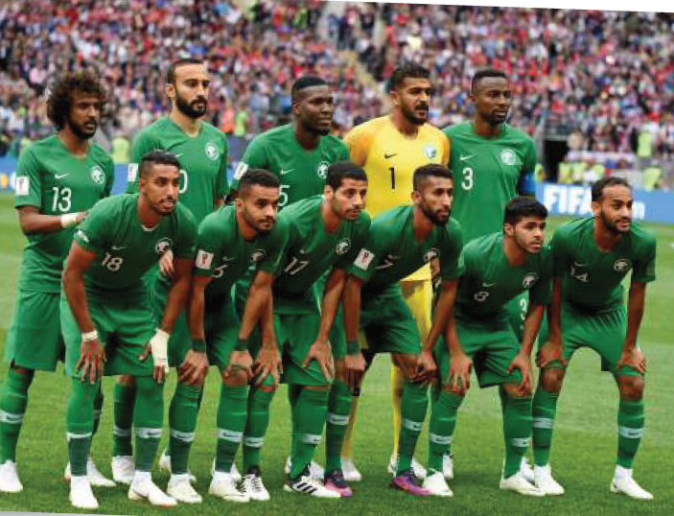
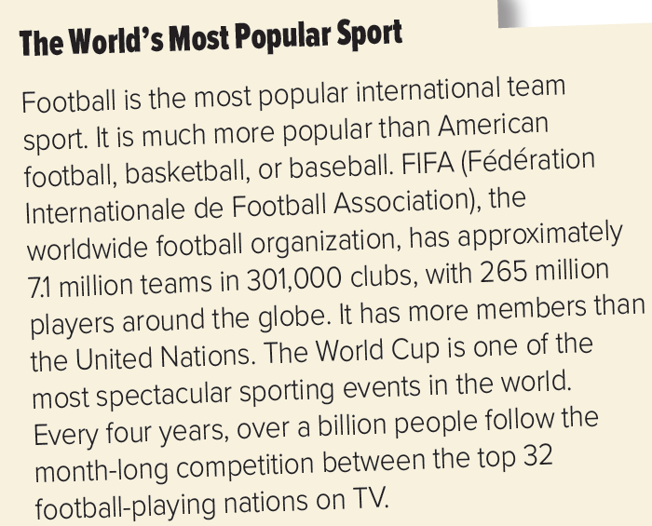


Page 18
1.What makes football different from all other sports?
2.How many teams are there around the world?
3.How many clubs are there?
4.How many players are there?
5.How many teams play in the World Cup?
6.How many people watch the World Cup around the globe?
1. It is the most popular international team sport.
7.1 million teams
301,000 clubs.
265 million players around the globe.
There are 32 national teams in the world cup.
Over a billion viewers.

Slide 23
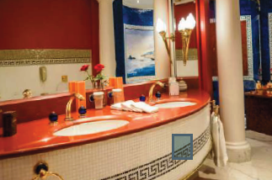

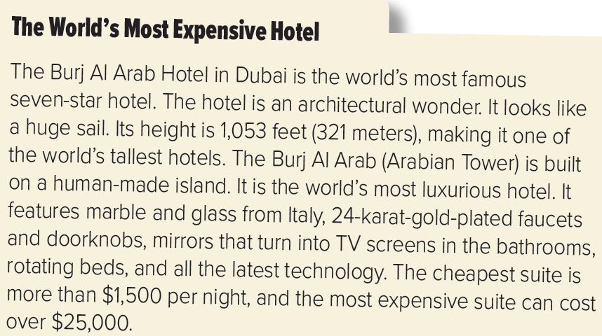
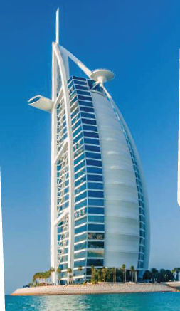
Page 18
The world’s most famous 7 star hotel.
1.What makes the hotel special?
2.Where is it located?
3.How tall is it? What makes the hotel rooms special?
4.How much does it cost to stay there for a night?
In Dubai.
In Dubai.
In Dubai.

Slide 24
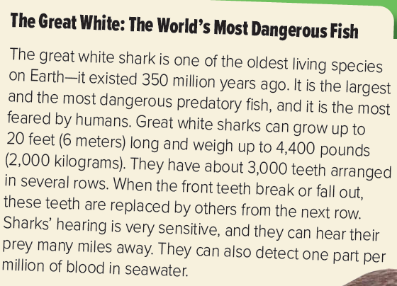


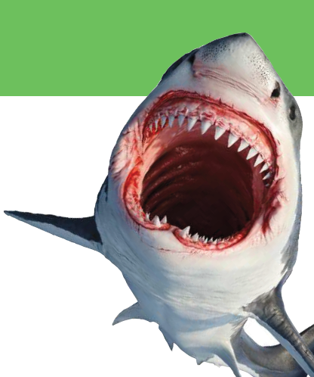
Page 19
1.What do you think makes the great white shark so special?
2.How long do you think great white sharks are?
3.How much do you think they weigh?
4.How many teeth do you think they have?
5.Do you think they have good or bad hearing?
6.Do you think they have a good or bad sense of smell?
The oldest living species on Earth.
6 meters long.
weigh up to 4,400 pounds.
About 3000 teeth
Good hearing
Good sense of smell
A predatory animal
kills and eats other animals

Slide 25
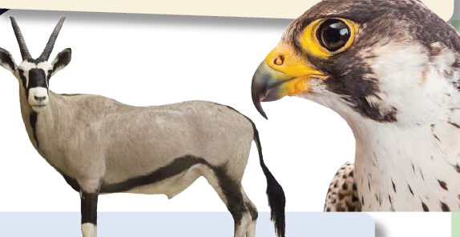
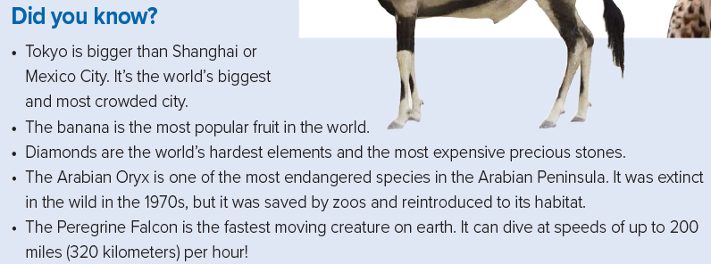
Page 19
1.What are the two animals called?
2.Where does each animal live?
3.What adjectives do you think best describe each animal? 4.What is special about these animals?
The Arabian Oryx and Peregrine Falcon.
In the Arabian Peninsula and the falcon live on all continents
except Antarctica.
Endangered and fastest
One was saved and the other it can dive.

Slide 26




Slide 27

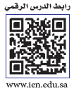


Page 18

Slide 28
Page 19
1.The most dangerous fish in
the world is _____.
2.Tokyo is _____.

Slide 29




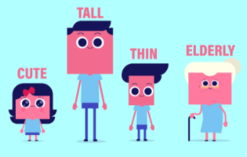
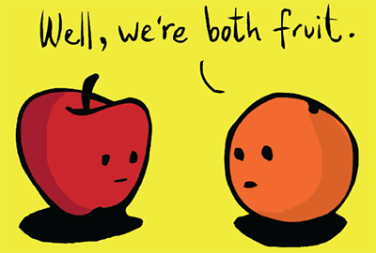
Page 19
most dangerous more popular.
most spectacular
most famous
most luxurious
most expensive
the most feared
most crowded
the tallest
the latest
the cheapest
the oldest
the largest
The biggest

Slide 30
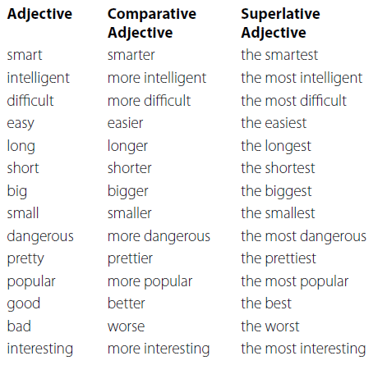
…er than…
..the…..…est
..more………than
..the most ………….

Slide 31

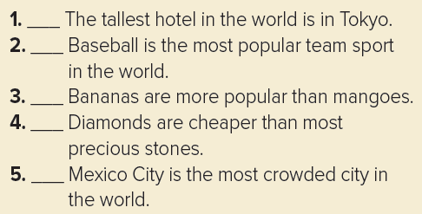
Page 19
no
no
yes
no
no
the adjectives in 1, 2, and 5 (superlative with the most and -est)
are different from the adjectives in 3 and 4
(comparative with more and -er).

Slide 32



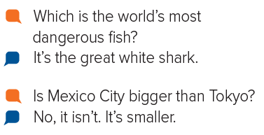
Page 19
Which is the most popular fruit in the world? (the banana)

Slide 33








Assign page 97 for practice Vocabulary
Exercise A

Slide 34
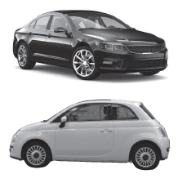
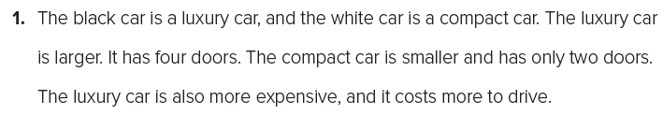
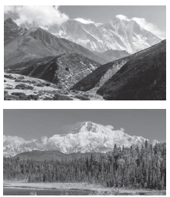
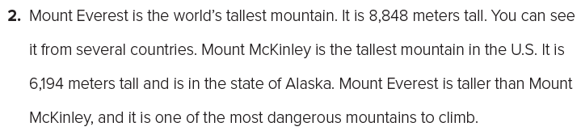
Page 97
1. larger, smaller, more expensive
2. the…tallest, the tallest, taller, the most dangerous

Slide 35
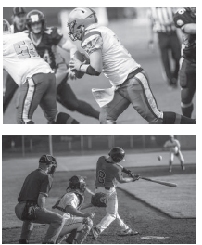
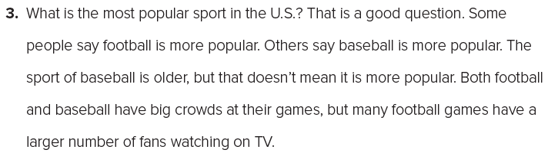
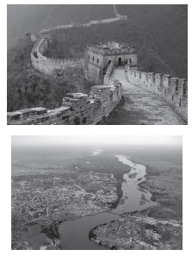
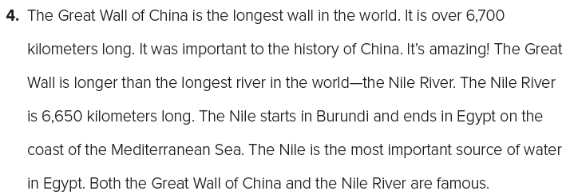
Page 97
3. the most popular, more popular, more popular, older, more popular, larger
4. the longest, longer, the longest, the most important

Slide 36


أتمنى الاهتمام بمتابعة الدروس في قتوات عين الرسمية من وزارة التعليم
T.Noureyah Alghamdi
The end

Slide 37
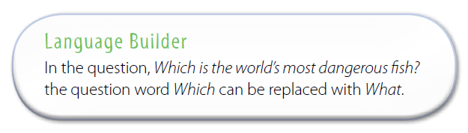

Slide 38
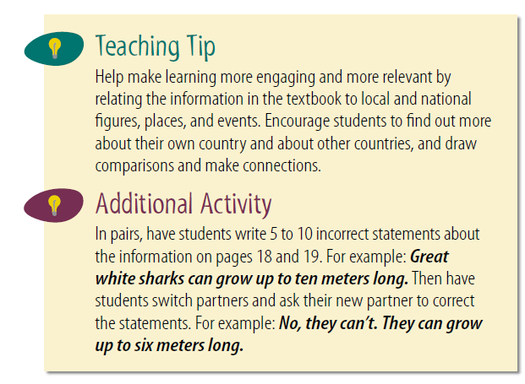

Slide 39
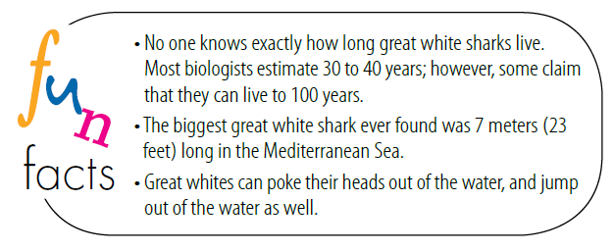

Slide 40

