Slide 1
U10 what`s school like ? conversation
Safa Salman AlHerz

Slide 2
What day is today ?
Today is Sunday
What data is today ?
14 \7 \1444 H

Slide 3
Warm up

Slide 5
Objectives:
6\conversation
1-

Slide 7
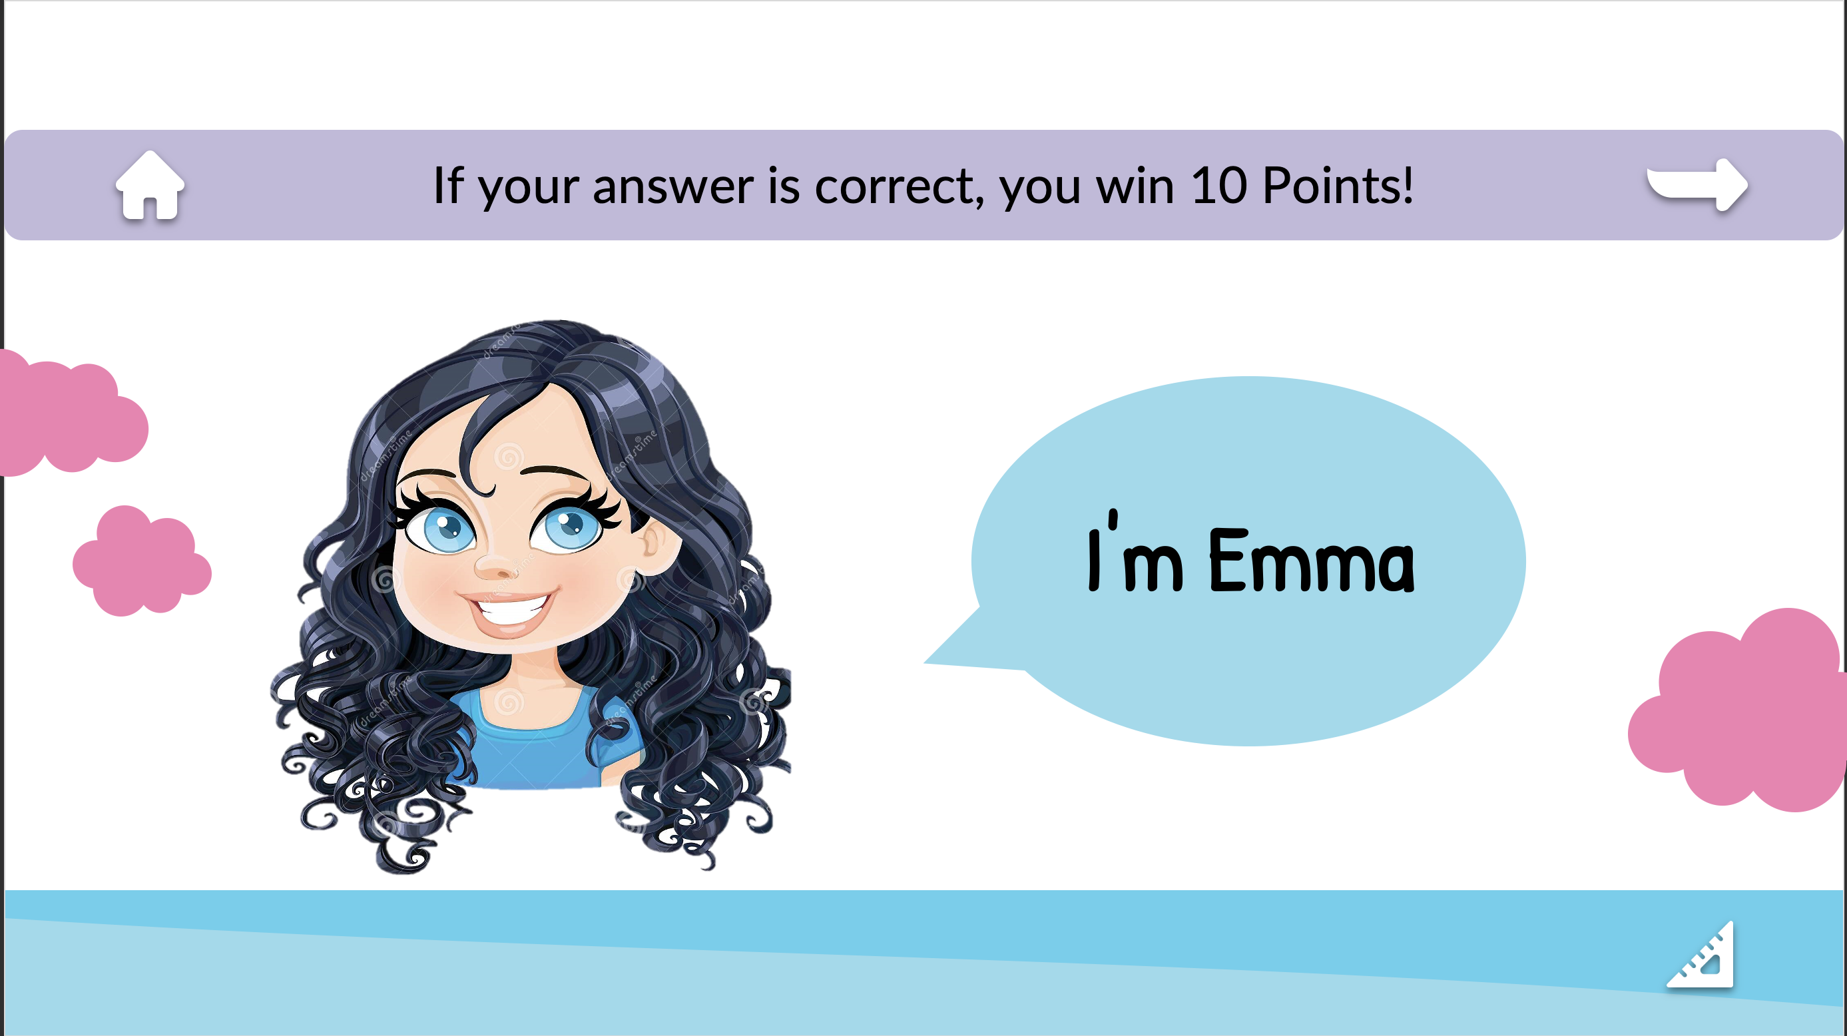

Slide 8
Objectives
conversation
1\Read a conversation correctly
2\ Answer questions after reading
3\ Identify some adjectives

Slide 11
What subject do you like ? Why ?

Slide 12
How many character there in the conversation ?
What are their names?
Flora Berggren
Rajesh Santoshi
Chief Operations Officer
VP Marketing

Slide 13
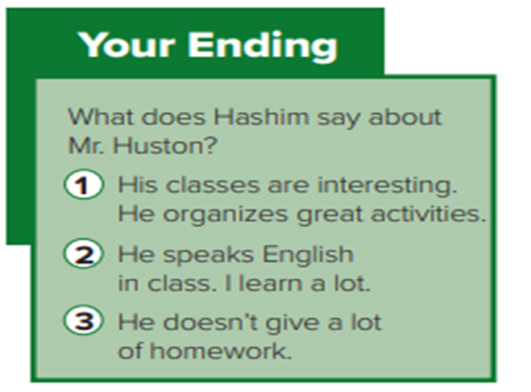
Listen then choose the ending you like the most.

Slide 14
1-Underline
the adjectives.
2- What are the
synonyms for:
great
Cool ≈
fascinating ≈
interesting
3-What are the
opposites of
Fun ≠
good ≠
boring
bad

Slide 15
Read the conversation then answer the questions

Slide 16
One minute strategy

Slide 18
answer the questions
1-it’s science. Because he thinks it’s cool.
2-Yes, he does. Because it’s fascinating.
3-Yes,he does. Because he explains
things clearly and also makes math fun!
4-Mr. Huston, the English teacher.

Slide 19
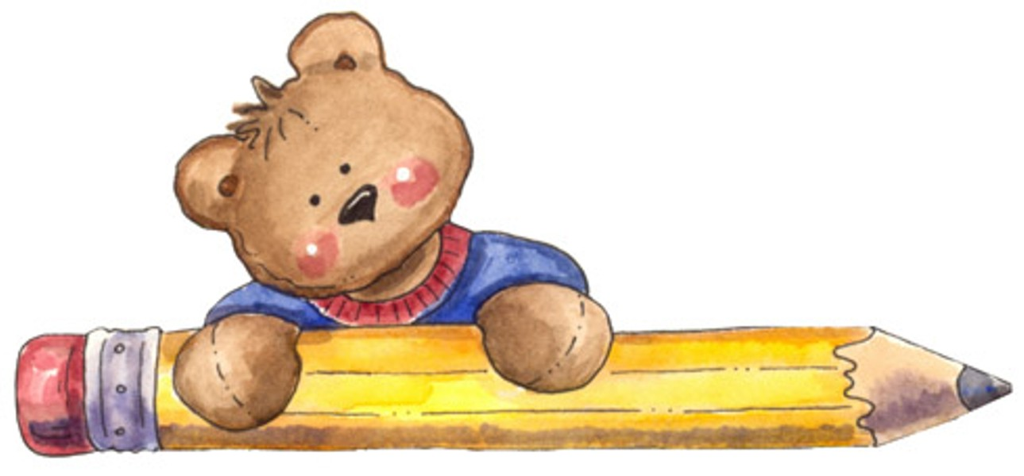
Let's practice

Slide 20
Task: move to the groups then fill the chart (4min)

Slide 21
HOMEWORK
Open page 226
Answer C \ D

Slide 22
Thank You
Don’t forget your homework at
Madrasati platform
Have a nice day
Your teacher \ Safa Salman AlHerz

