Slide 1

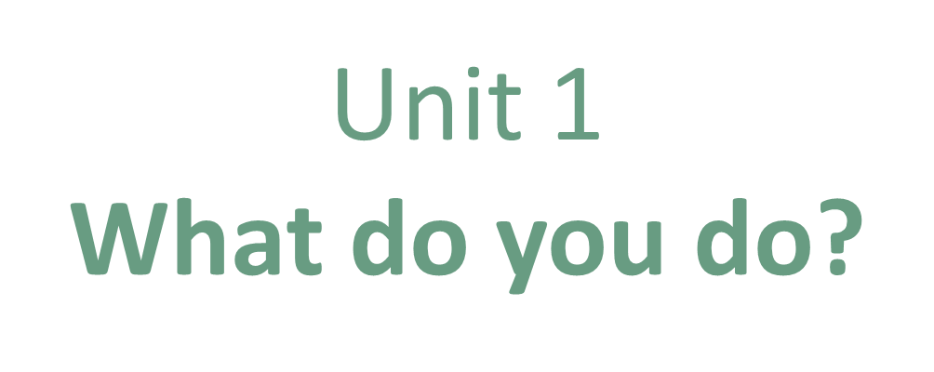
Conversation & Reading

Slide 2
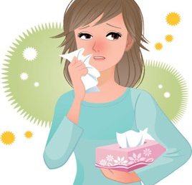
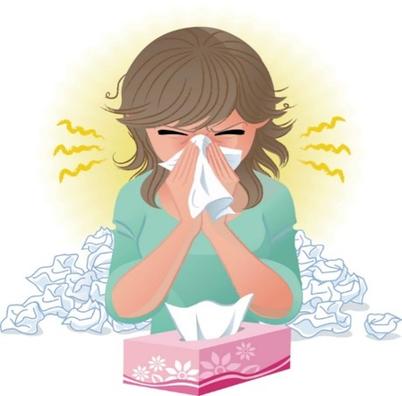
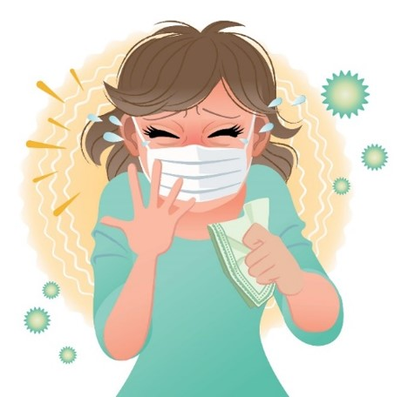
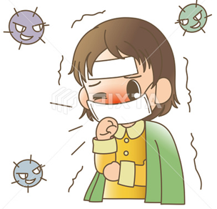

COVID 19
☺ Avoid gathering !
☺ wear a mask before going out
☺ Social distancing is not a choice, it is a must!
☺ Keep a distance of 2 meters to avoid accountability
☺ Wash hands constantly

Slide 3
Day
بسم الله الرحمن الرحيم
Date

Slide 4

LEARNING OBECTIVES
01 read a conversation correctly
02 practice making a conversation correctly
03 Identify the main idea of reading
04 answer questions after reading about it
05 talk about their future job

Slide 5
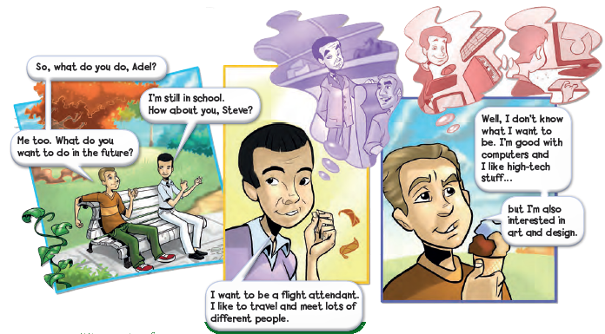
Where are the people?
What are their names?

Slide 6
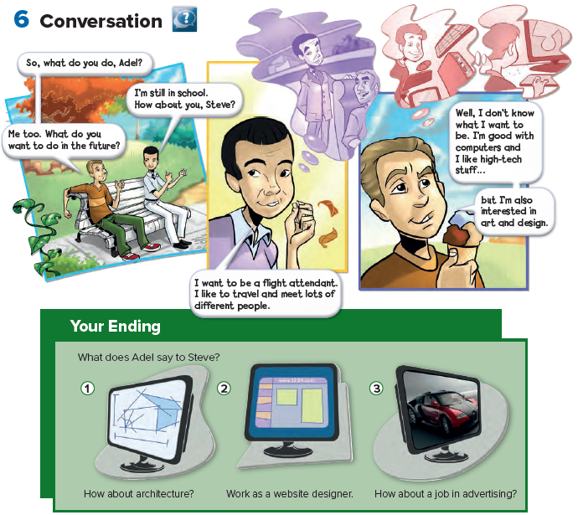


Slide 7
Where does a flight attendant work?
What does a flight attendant do ?

Slide 8
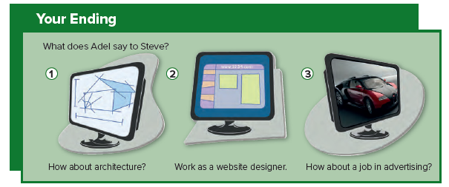
Who likes ending number 1 ?
Who likes ending number 2?
Who likes ending number 3?
Remember there is no right or wrong answer to this.

Slide 9
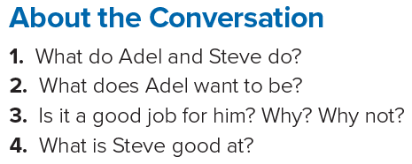
1. Adel and Steve are students.
2. He wants to be a flight attendant.
3. Yes, it is. He likes to travel and meet lots of different people.
4. Steve is good with computers.
Answers

Slide 10
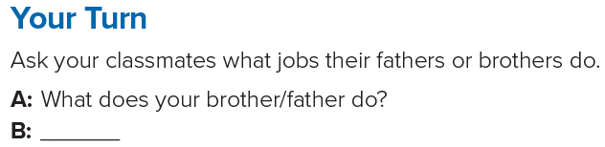
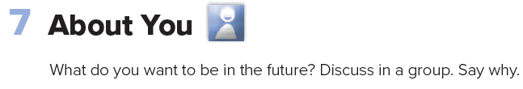

Slide 11
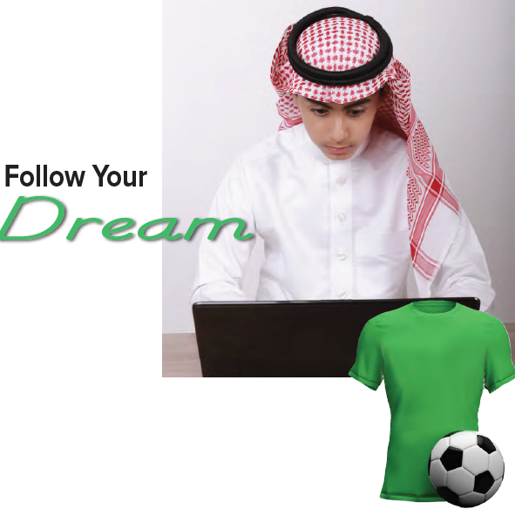


Slide 12
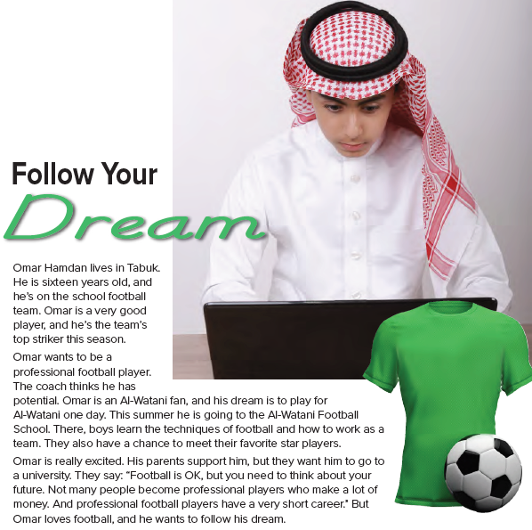

Slide 13
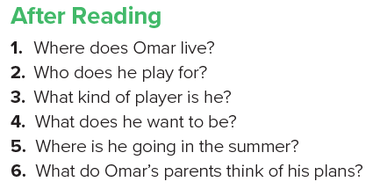
1. Omar lives in Tabuk, Saudi Arabia.
2. He plays football for his school.
3. He’s a good player./He’s a striker.
4. He wants to be a professional football player.
5. He is going to a football school.
6. His parents support him, but they want him to go to a university.
Answers

Slide 14
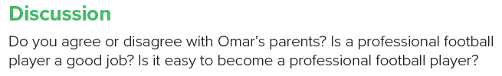

Slide 15
Homework
Page 91

Slide 16
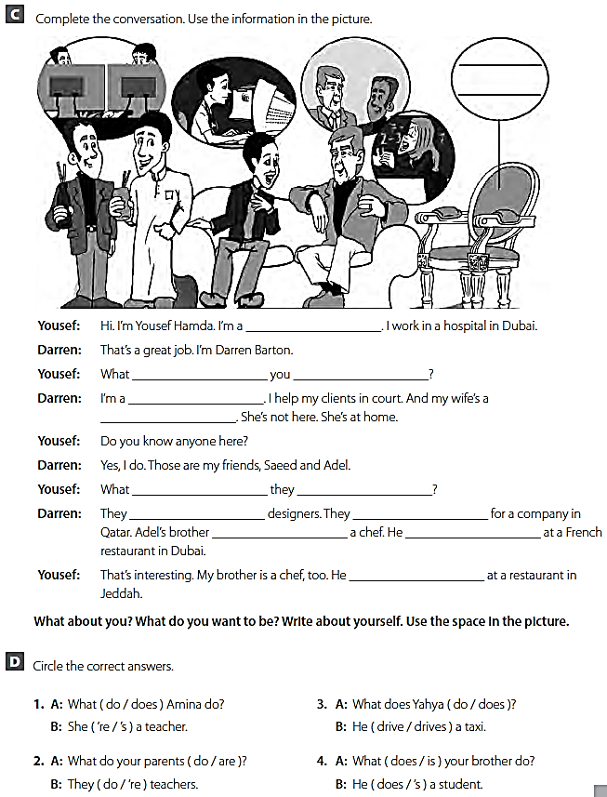
doctor
do
do
lawyer
teacher
do
do
are
work
is
works
works

