Slide 1

1
Super Goal 2
Unit 3 Lesson 1
Form, meaning and function
Page 25
What Time Do You Get Up?
v
Done by: T. Haya B.

Slide 2
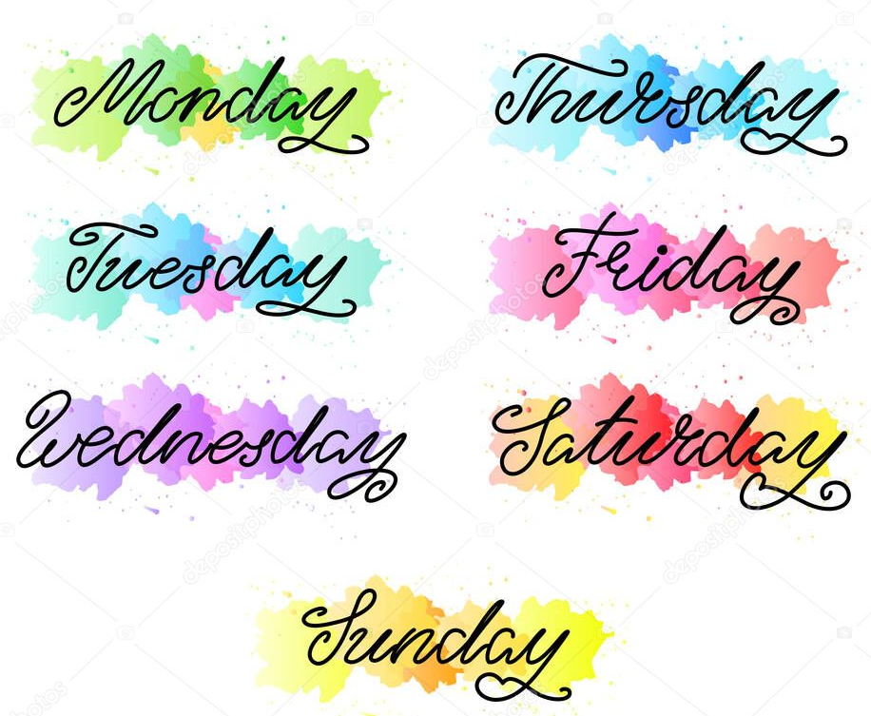

What is the day today?
What is the date today?

Slide 3

Rules of the virtual classroom:
Don’t interrupt your teacher / friend
Raise your hand
Don’t open your mic
Listen to your teacher
Speak English

Slide 4

Objectives ( open your book page 23 and extract the objectives ):-
Use present progressive
Answer the questions
Compare between present simple and progressive
Use present simple

Slide 5

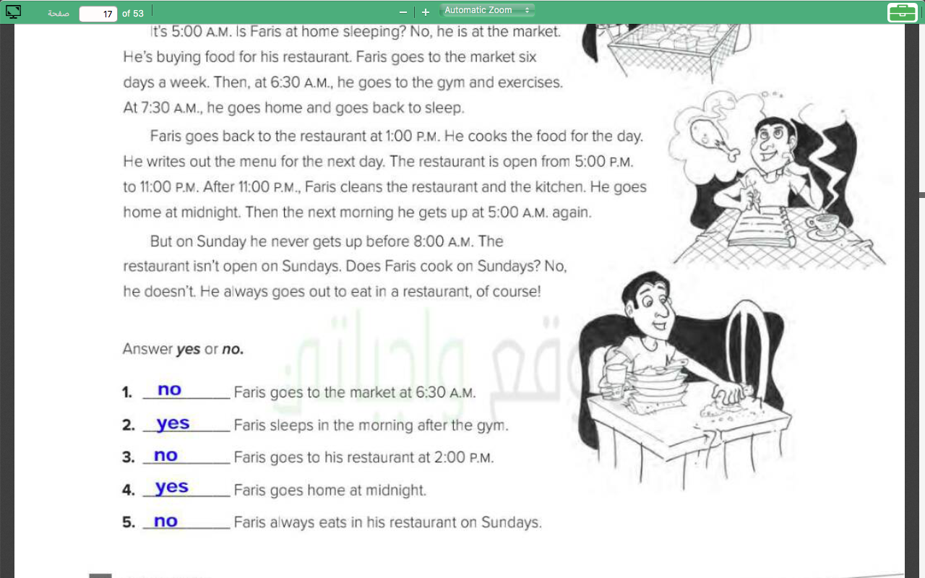
Home work:
Lets check your homework page 100 (F)

Slide 6

Revision:-
What time do you get up?
What do you usually do after class?
What do usually do in the evening?

Slide 7

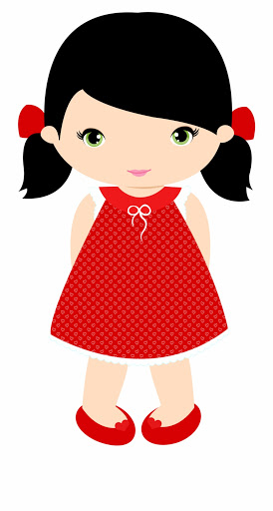

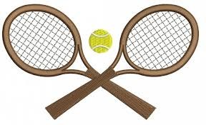
Warm up :-
My name is Noura. I am 13 years old. I live in Dammam, but I am studying in Abha this year. I usually play tennis. It is my favorite sport . So, I am going to the sport club now.
Underline the present simple and circle present progressive

Slide 8


Present simple
Present progressive

Slide 9




Present simple
Verb+s
Verb s
Always –usually-sometimes- never
It
He sometimes reads book.
We usually study Math
They
she
I
He
We
you

Slide 10

Present simple
Does/doesn’t
Do/don’t
?
not
?
not
examples
she
It
They
I
He
We
you

Slide 11

(Question)
It drinks milk.
……………………………………..
Does it drink milk?
(Negative)
I clean the room.
……………………………………..
I don’t clean the room.

Slide 12
Present progressive
Is +Verb + ing
Look- listen – now –at the moment
are +Verb + ing
It
He is reading now.
We are studying Math at the moment
They
she
I
He
We
you

Slide 13
Present progressive
Is + isn’t
Are + aren’t
?
not
?
not
examples
she
It
They
I
He
We
you

Slide 14
(Question)
He is drinking water now
……………………………………..
Is he drinking water now?
(Negative)
I am cleaning the room at the moment.
I am not cleaning the room at the moment.

Slide 15

present simple
1- General truths
The moon goes around the earth
1-things happening now
The moon goes around the earth
1- habit/routine
He usually walks to school
1- temporary actions
He lives in Riyadh, but he is studying in Jeddah
1- permanent actions
I live in Riyadh
present progressive

Slide 16
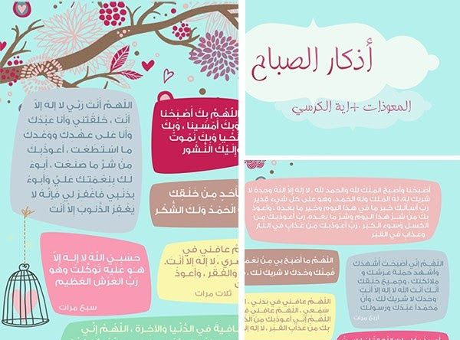
اذكار الصباح والمساء
I always read Alathakar

Slide 17
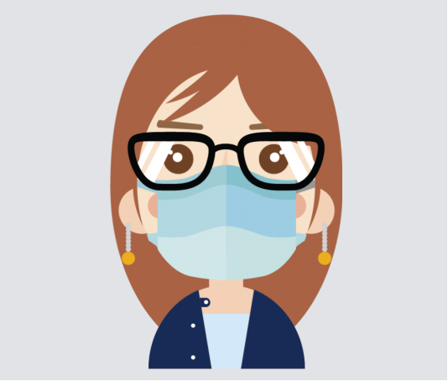

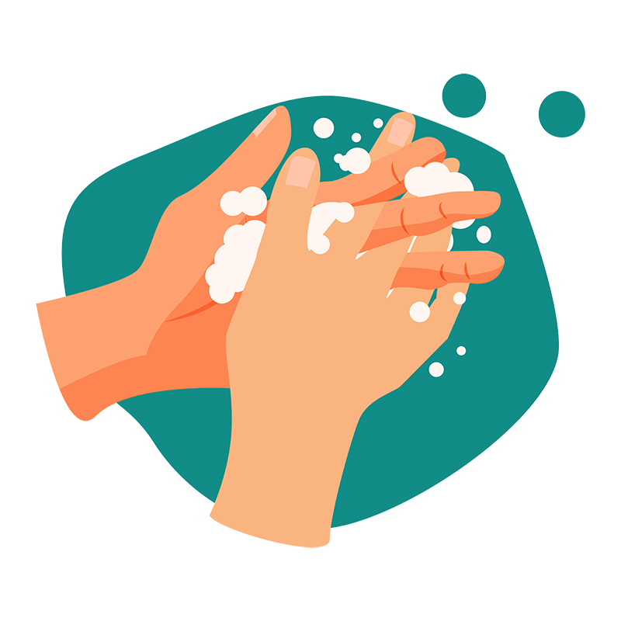
She always wears mask when she go out
I always wash my hands at least 40 seconds
Look at the picture and write sentences in present simple

Slide 18
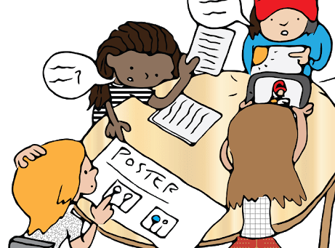
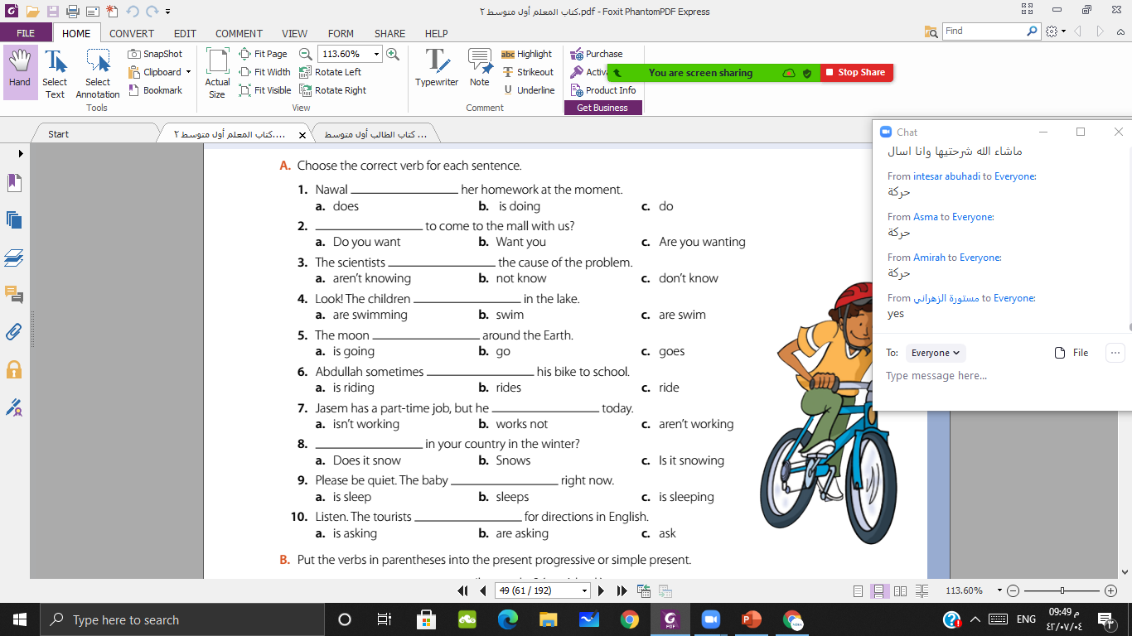

A:-
By using cooperative learning strategy, answer the question

Slide 19
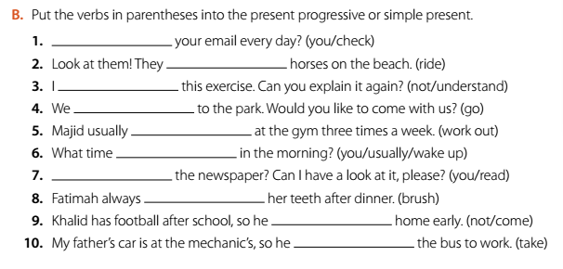
B:-
By using one minute strategy, answer the question.

Slide 20



