Slide 1

Super Goal 2
Unit 3 Lesson3
Grammar
Page 20 & 21
What Time Do You Get Up?
v
Done by: T. Haya B.

Slide 2
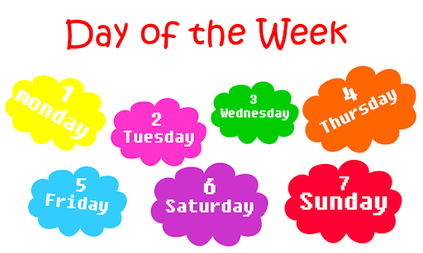
What is the day today?
What is the date today?

Slide 3

Home work (Last lesson):
Ex A and B Page 97+98
Let’s check your homework

Slide 4

Rules of the virtual classroom:
Don’t interrupt your teacher / friend
Raise your hand
Don’t open your mic
Listen to your teacher
Speak english

Slide 5
Revision:
What time do you get up?
What do you usually after dinner?
What time do you study?

Slide 6

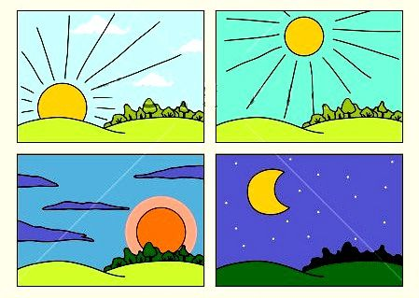

Revision :-
morning
afternoon
am ______ morning
pm --------- afternoon/evening/ night
evening
night

Slide 7

Objectives :-
Differentiate between after/before/then
Answer the question
Use adverbs of frequency
Use prepositions

Slide 8
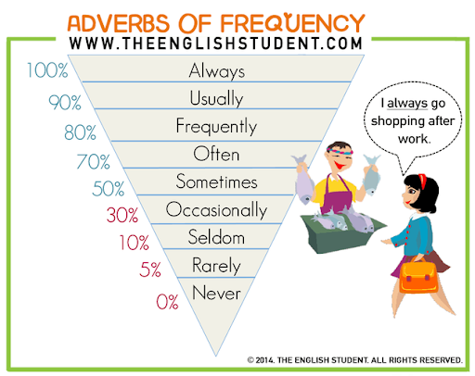

Slide 9


Adverb of frequency
I always read Quran.
Always (100%)
I usually go to café
usually (90%)
I sometimes clean my room.
sometimes (50%)
I never play football.
never (0%)

Slide 10

Adverb of frequency
I always brush my teeth.
I sometimes do homework at 9:00 o’clock
Adverb of frequency generally go before the verb
Adverb of frequency go after the verb if there is verb be
He is usually late for school.
The adverb sometimes can also at the beginning of the sentence
Sometimes I get up at 5:30 A.M.

Slide 11

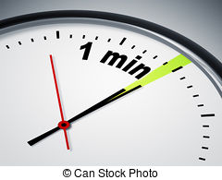
evaluation
A- By using one minute strategy( what do you do after schoo) ,make sentence using adverb of frequency
B-Use adverb of frequency:-.
1-I wash my hands. ( use adverb always)
…………………………………………………………
2-He is active . ( use adverb usually)
…………………………………………………………
3-He gets up late. ( use adverb never)
…………………………………………………………

Slide 12
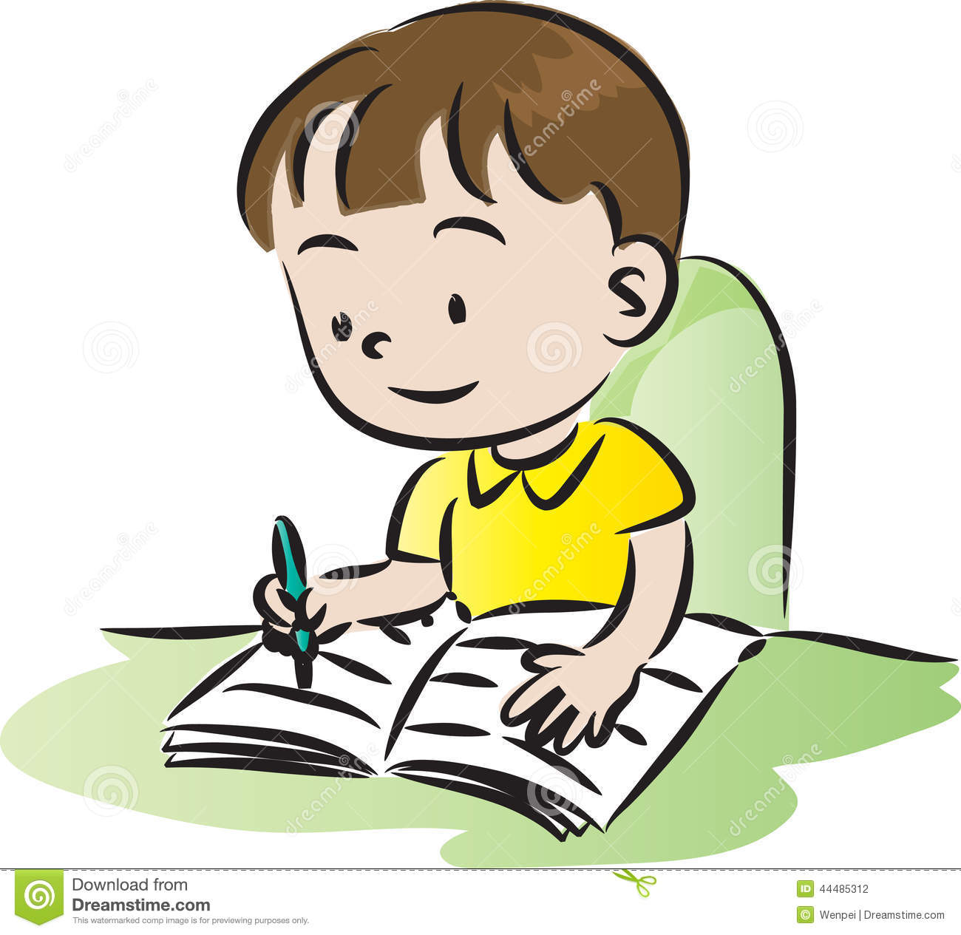
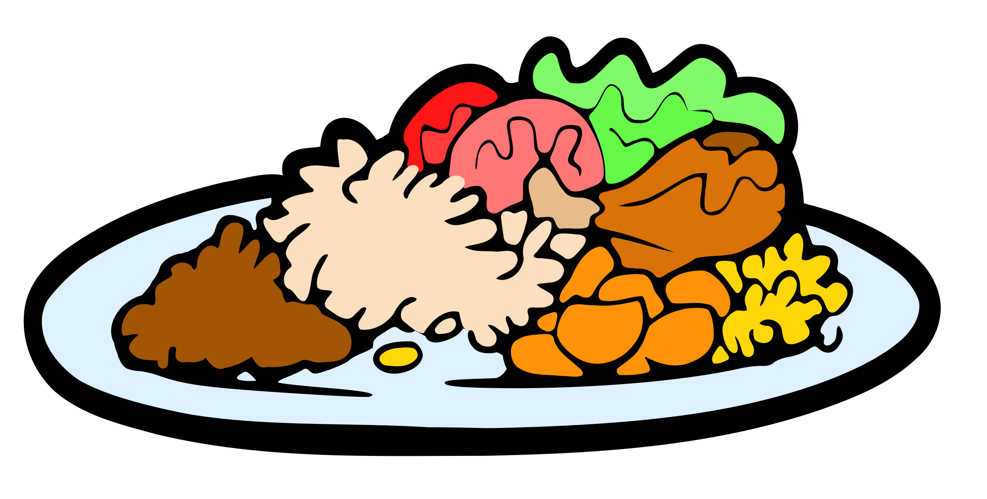
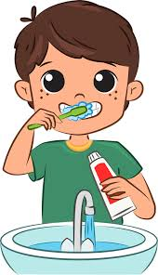
Time expressions: before/ after then /everyday
He is usually does his homework before dinner.
2
1
He always brushes his teeth after dinner.
2
1

Slide 13
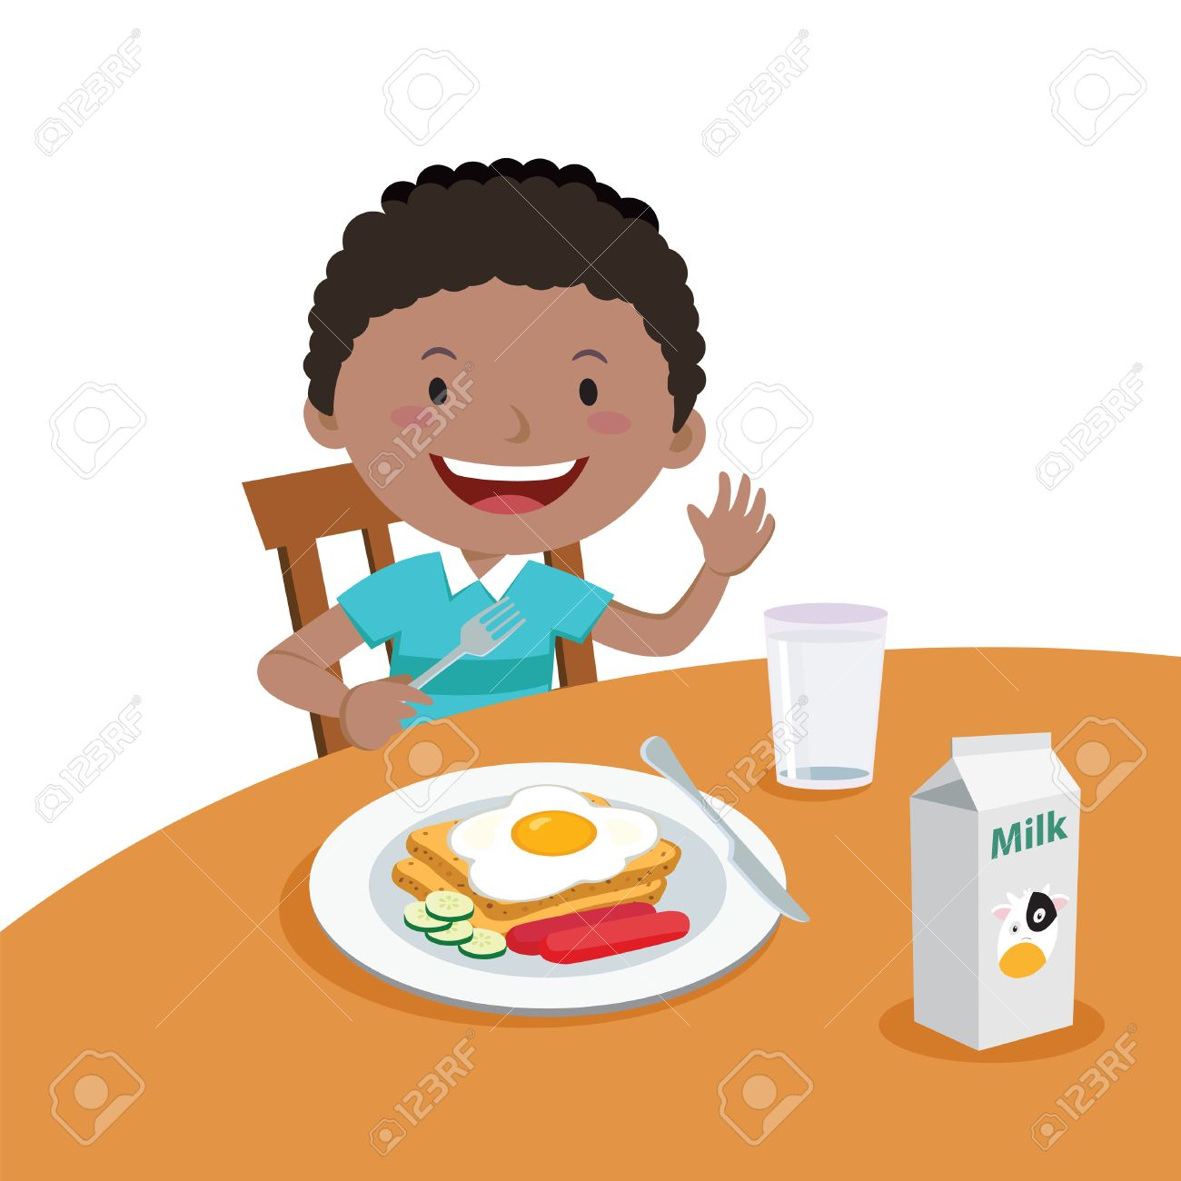

Time expressions: before/ after then /everyday
What do you usually do after this class?.
First………………………………………….. Then ………………………………

Slide 14

Preposition :at/in/on Time expression
Choose the correct preposition (on/in):-
I go to supermarket …………..Sunday.
School starts ………………..September.
On with days of the week + dates
In with months

Slide 15
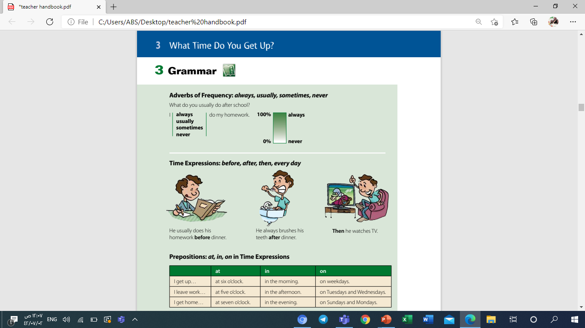
Preposition :at/in/on Time expression

Slide 16
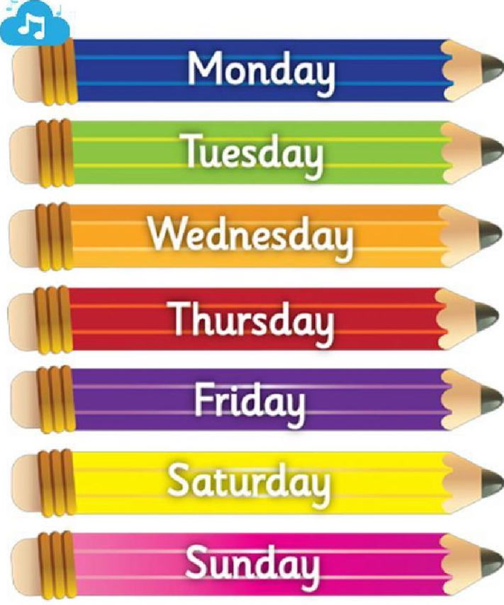
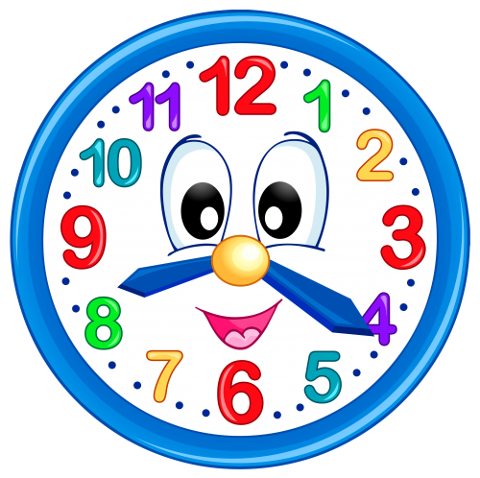


Preposition :at/in/on Time expression
at
in
on
At 3:00 o’clock
At night Not at the night
In the morning
In the afternoon
In the evening
On weekends
On sunday
Ahmed always studies at 5:00 o'clock in the evening.
I sometimes go to garden on weekends.

Slide 17

يقول النبي ﷺ: ((نعمتان مغبون فيهما كثير من الناس: الصحة، والفراغ))

Slide 18
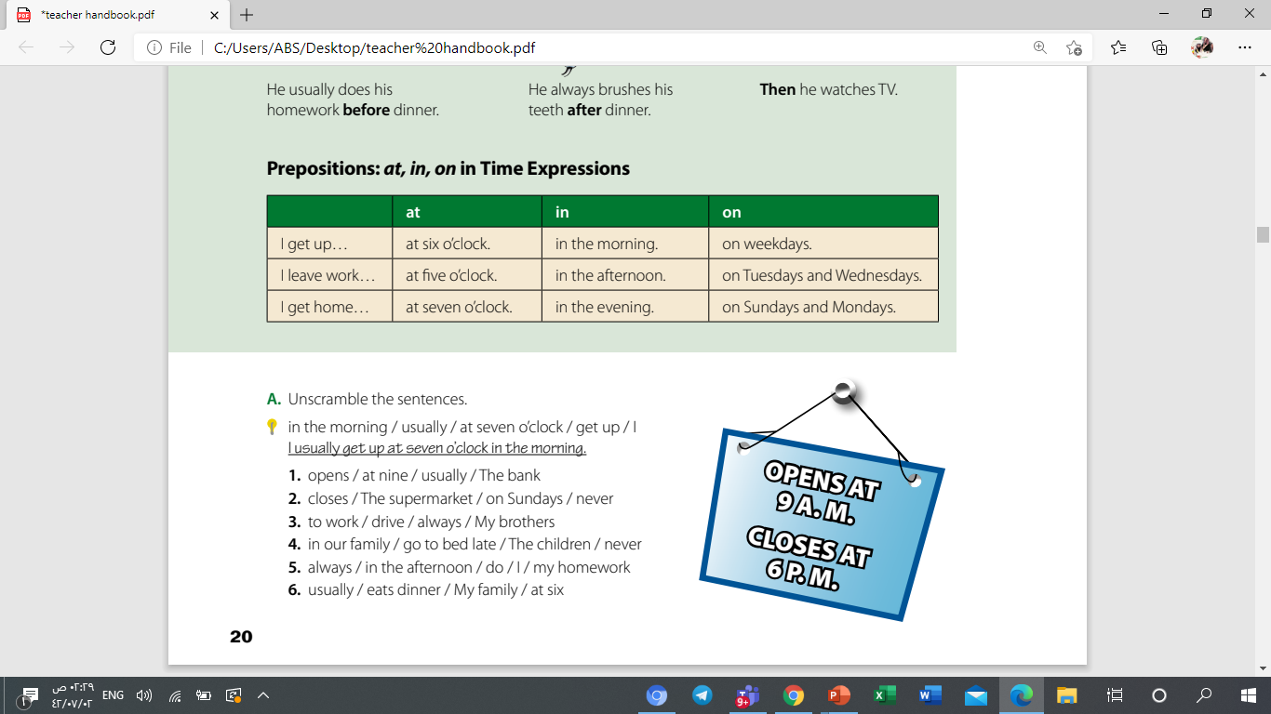
Open your book on page 20
By using one minute strategy, answer the following exerise

Slide 19
Homework :
Exercise C page 98 ( work book)

Slide 20


